Slide 1
A Generic Power Plant and Grid
John C. Bean
Outline
Most power plants = Heat source + boiling water kettle + propeller + generator
Including coal, nuclear, biomass/biofuel, and one type of natural gas (CCGT)
Hydro and wind plants omit the heat source & kettle
But photovoltaic power plants (alone) are completely different
Our demand for their power is very cyclic = Base Power + Dispatchable Power
Massive steam plants cannot efficiently meet this cycle (only hydropower can)
And only one type of natural gas plant (OCGT) can deal well with its 2-3 hour peak
Combining many power plants into a grid requires scrupulous synchronization
And even that falls apart if one tries to transmit AC power over long distances
Where the peaks in current and peaks in voltage cease to track one another
Which, accelerated by green energy, is pushing us toward high voltage DC power transmission
As enabled by transformers + diodes + capacitors
(Written / Revised: July 2019)

Slide 2
A Generic Power Plant and Grid
Our natural tendency is to focus on only certain types of power plants
Those we revile OR
Those we see as technological saviors OR
Those closest to our personal experience and/or expertise
But power plants are just pieces in the huge puzzle of an Energy System
And, of course, puzzle pieces are USELESS IF THEY DO NOT FIT into a puzzle
Yes, in the future we hope to assemble very different energy puzzles
For instance, ones built around new solar and or wind puzzle pieces
But those new puzzles will still require a FULL SET of compatible pieces
This note set provides an overview of how energy system pieces fit together
An Introduction to Sustainable Energy Systems: WeCanFigureThisOut.org/ENERGY/Energy_home.htm

Slide 3
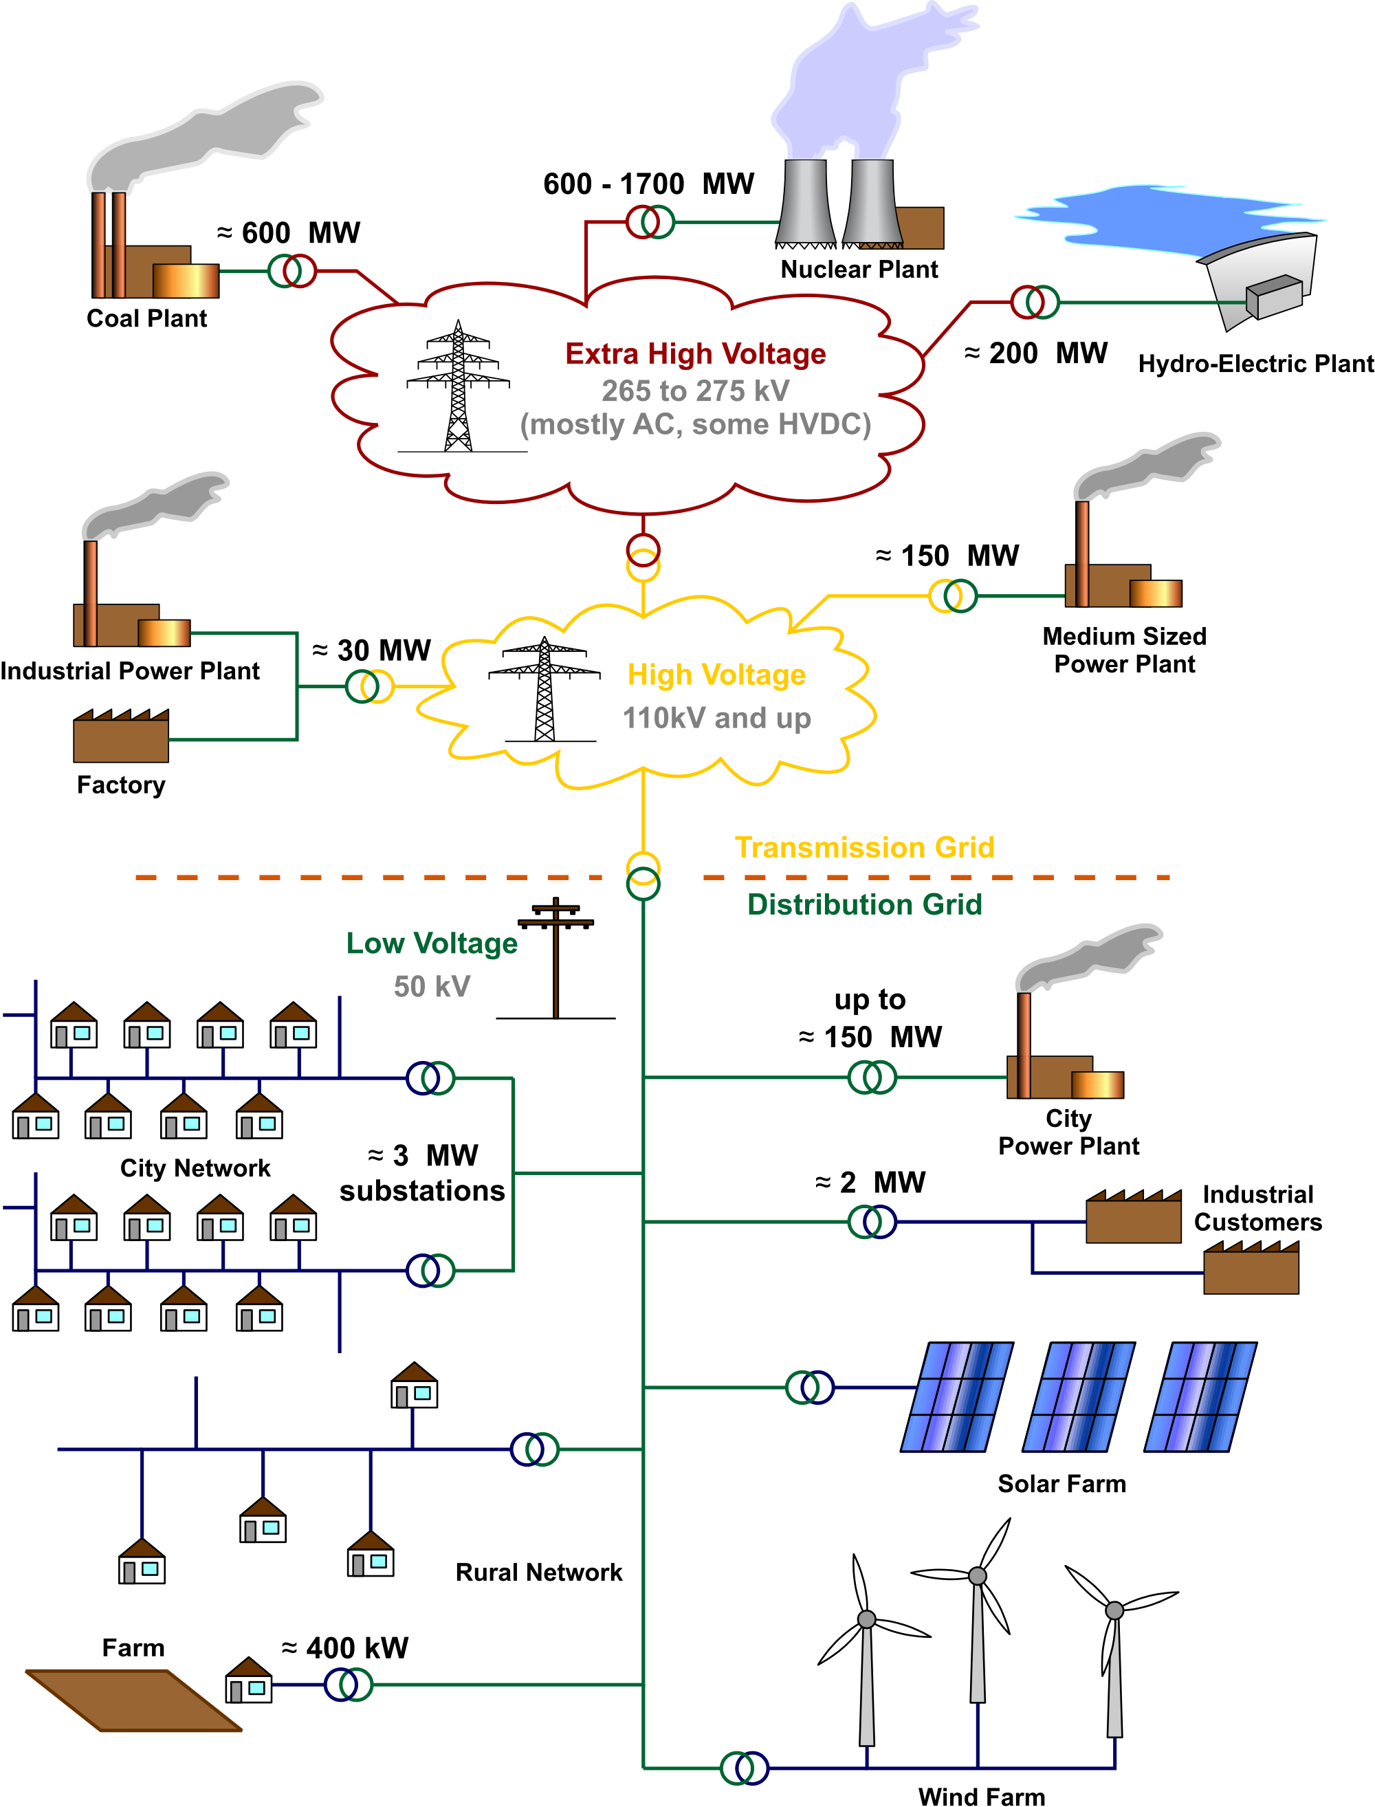
Wikipedia offers this depiction of a generic electrical grid:
Which includes some very useful numbers about U.S. power plants:
Their typical "capacity" (max output) is ~ 600 MW (Range: 100 – 2000 MW)
From the U.S. Energy Production & Consumption (pptx / pdf / key) note set:
U.S. power consumption is ~ ½ TW:
(½ TW) / (600 MW) ~ 800 plants
According to the EIA the actual number,
which includes small/old plants
and small/new technology plants
is a bit over 8000 ¹
1) https://www.eia.gov/tools/faqs/faq.php?id=65&t=2
Figure: http://en.wikipedia.org/wiki/Electrical_grid

Slide 4
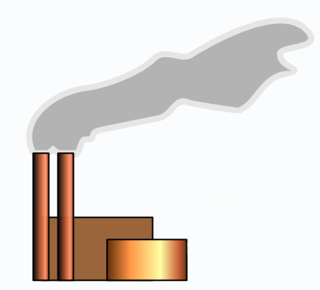
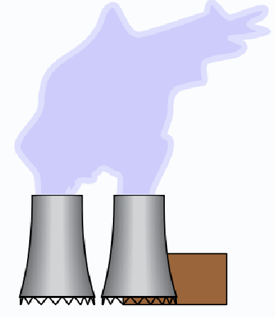
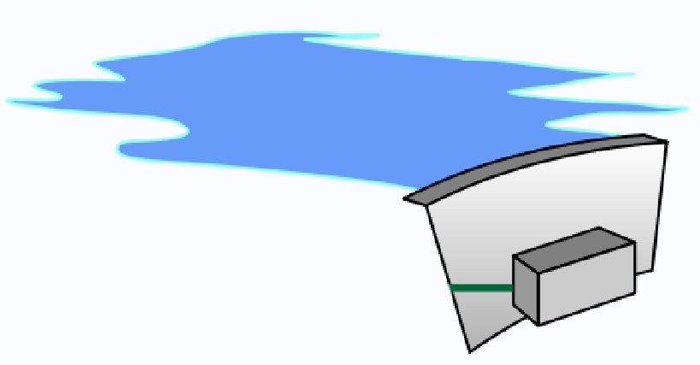

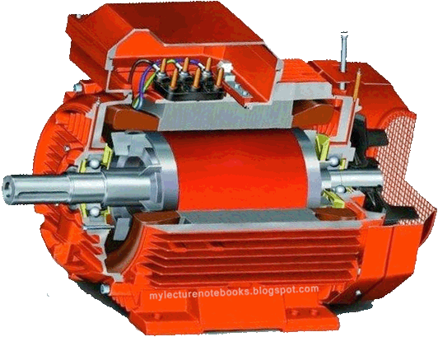
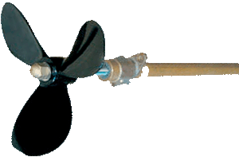
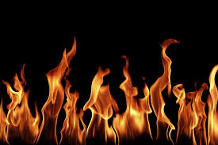
From that illustration, we can extract these power plant icons:
OR
OR
These power plants appear to be very, very different
But while their outward appearances do indeed differ
The MAJORITY of power plants consist of this:
http://knowledge.wharton.upenn.edu/article/stressed-work-youre-alone/
http://mylecturenotebooks.blogspot.com/2013/07/how-does-generator-create-electricity.html
http://www.nauticexpo.com/prod/baeksan-propeller-co-ltd/boat-propeller-shafts-26399-173731.html
http://www.chuckbauman.com/real-flames-photos.htm

Slide 5
That is:
1) A heat source
2) A boiler in which water is heated to above 100°C
Causing it to form steam, which expands 1700 times in volume
3) A propeller that is turned by the resulting high pressure steam flow
Although it is then called a steam turbine (or just "turbine")
4) An electrical generator (from the preceding note set) turned by that propeller
(2)
(3)
(4)
(1)

Slide 6
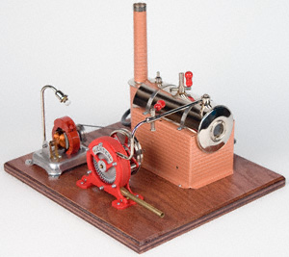
This is so simple that:
You can actually buy your own table-top steam-powered power plant: ¹
Boiler
Generator
Heat Source
Turbine
1) https://www.ministeam.com/acatalog/Turbine-Power-Plant-JN95G.html

Slide 7
How U.S. steam-powered plants produce their steam (in 2018): ¹
27.4% of them boil water by burning coal
19.3% of them boil water inside nuclear reactors
1.5% of them boil water by burning biomass
~1% of them boil water by burning other things
0.4% of them boil water by tapping into geothermal heat
And, while 35.1% U.S. power plants burn natural gas,
only one type of natural gas power plant (CCGT) boils water
    See note set on Fossil Fuels (pptx / pdf / key) for details
1) See my note set on U.S. Energy Production & Consumption (pptx / pdf / key)

Slide 8
How efficient are such steam-powered powered plants?
That is, what is the ratio of: Electrical Energy Output / Heat Energy Input ?
Unlike steam locomotives, steam power plants conserve water by operating in a cycle:
- Heat is applied to the steam, causing it to increase in temperature & volume
- The steam's volume expansion then turns a turbine connected to a generator
- Cooling is applied to the steam, causing it to decrease in temperature & volume
In 1824, Nicolas Carnot produced a weirdly idealized model of this cycle:
It assumes, once vaporized, that water is never allowed to recondense AND that:
A heat source causes it to expand (while remaining at ~ constant temperature!)
The heat source is then removed, temperature changes, expansion continues
A cooling source causes it to contract (again, while at ~ constant temperature!)
The cooling source is then removed, temperature changes, contraction continues

Slide 9
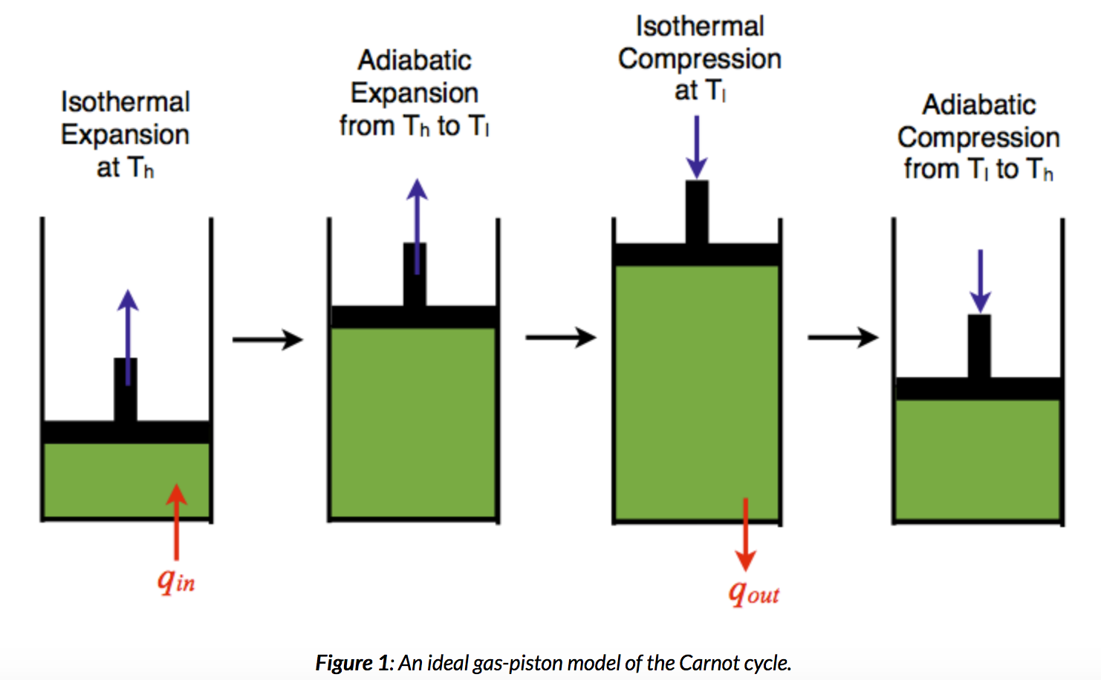
Carnot's weirdly idealized cycle, shown pictorially:
"Isothermal" = While at constant temperature
"Adiabatic" = While zero energy is allowed to flow in or out
https://chem.libretexts.org/Core/Physical_and_Theoretical_Chemistry/Thermodynamics/Thermodynamic_Cycles/Carnot_Cycle

Slide 10
Only via this weird idealization could Carnot calculate an efficiency:
Carnot Cycle "heat engine" efficiency = (T_{high} – T_{low}) / T_{high}
Where T_{high} = Temperature of the heating source ("heating reservoir")
And T_{low} = Temperature of the cooling source ("cooling reservoir")
But in real steam power plants, steam IS repeatedly condensed back into liquid
With makes them examples of the much more complex "Rankine Cycle"
Further, in both the Carnot Cycle and Rankine Cycles:
Heat application => Simultaneous steam expansion + temperature increase
Cooling application => Simultaneous steam contraction + temperature decrease
The Carnot Cycle thus provides only an idealized upper limit on efficiency
But it is nevertheless used to highlight a power plant design imperative:
Maximize the steam's low to high temperature excursion!

Slide 11
How efficient are real-life steam power plants?
Traditional oil & coal-fired plants are relatively simple and unconstrained
Which facilitates their use of very high steam temperatures (e.g., 540°C ¹)
Their resulting real-life efficiencies are 32-42% ² ("typical" ~ 33-35% ¹)
New "ultra-supercritical" coal plants (such as the Karlsruhe RDK 8) reach 620°C
Which has allowed it to achieve a real-life efficiency of 46% ³
Nuclear power plant cores are complex and multi-functional,
constraining their core temperature/pressure, lowering efficiencies to 30-35% ^{1, 2}
Solar thermal power plants are new, with different still rapidly evolving designs
California's Ivanpah water-vapor (steam) plant was designed for 29% efficiency ⁴
Newer oil-vapor / molten salt plants should be substantially more efficient
1) Chapter 5 in Engineering and the Environment by Edward S. Rubin
2) Steam Turbine Power Plants - Engaged in Thermodynamics: http://cset.mnsu.edu/engagethermo/systems_stpp.html
3) RDK 8s Three Little Words: http://www.powerengineeringint.com/articles/print/volume-18/issue-5/Special_Project_Report/rdk-8s-three-little-words-efficient-reliable-and-flexible.html
4) https://en.wikipedia.org/wiki/Ivanpah_Solar_Power_Facility

Slide 12
Leaving what types of non-steam U.S. power plants?
7% of U.S. power plants instead turn the turbine & generator via hydro power
Converting water's gravitational potential energy at nearly 90% (!) efficiency ¹
6.6% of U.S. power plants instead turn the turbine & generator via wind power
Converting wind's kinetic energy at about 40% efficiency ¹
Plus: The 1.6% of U.S. electrical power that comes directly from photovoltaic cells
And technologies so minor that the E.I.A. does not even provide data about them
See U.S. Energy Production & Consumption (pptx / pdf / key) notes for info on U.S. power
1) Chapter 5 in Engineering and the Environment by Edward S. Rubin

Slide 13
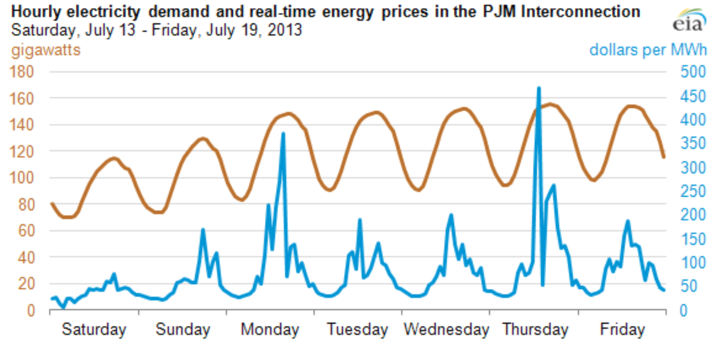
But our demand for electrical power varies:
Our typical daily cycle of power consumption (brown) and its price (blue):
(also from that U.S. Energy Production & Consumption (pptx / pdf / key) note set)
Consumption
Price
Source: https://www.eia.gov/todayinenergy/detail.php?id=12711 (to which I've added the yellow lines)
An Introduction to Sustainable Energy Systems: WeCanFigureThisOut.org/ENERGY/Energy_home.htm

Slide 14
A typical daily demand cycle thus resembles this:
Peak Power
80%
"DISPATCHABLE POWER"
60%
"BASE POWER"
Midnight
Noon
Midnight
There is a "BASE" power demand (from 0% up to about 60% of the demand peak)
On top of this is an oscillating "DISPATCHABLE" power demand
Which cycles up from about 60% of peak, to 100% of peak at about 6 pm
Which gives that ~ sinusoidal oscillation an average of ~ 80% of peak power
Which also makes the average daily power ~ 80% of peak power

Slide 15
Power plant production should follow this same cycle:
Peak Power
80% of Peak Power = Average Power
60% of Peak Power
Midnight
Noon
Midnight
BUT THERE IS A BIG PROBLEM:
Only one type of power plant can efficiently follow such a cycle
HYDROELECTRIC PLANTS
Which need only throttle their water input valves more open or closed
But hydroelectric plants can now supply less than 7% of U.S. power demand

Slide 16
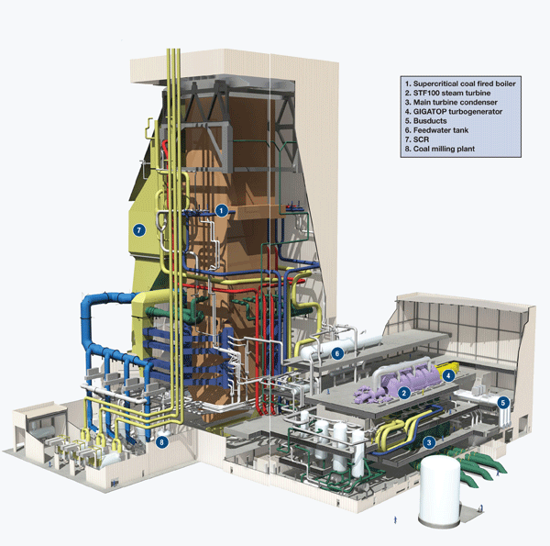
What's the problem our majority steam-driven power plants?!
The problem is with their boilers
Which, rather than resembling this toy's boiler:
Instead look more like this:
See those minuscule rectangles at the bottom? They're doors for the employees
http://www.powerengineeringint.com/articles/print/volume-18/issue-5/Special_Project_Report/rdk-8s-three-little-words-efficient-reliable-and-flexible.html
?

Slide 17
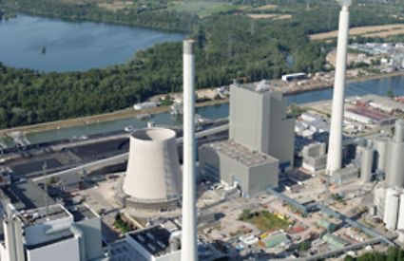
An aerial view of that boiler once it was enclosed:
The new 912 MW #8 boiler at the RDK coal power plant in Karlsruhe Germany: ¹
Boilers must heat water from ambient temperature to over 100°C
But you get ZERO power out until you cross 100°C and steam begins to form
All the heat energy expended in GETTING TO 100°C is, in a sense, wasted
As is energy heating the very thick steel of the high-pressure boiler and piping
As is heat flowing into the supporting and enclosing structures
Photo:
https://www.ksb.com/ksb-en/Products_and_Services/Energy/selected-power-plant-ksb-en/rdk-karlsruhe-germany/330208/
1) http://www.powerengineeringint.com/articles/print/volume-18/issue-5/Special_Project_Report/rdk-8s-three-little-words-efficient-reliable-and-flexible.html

Slide 18
And it takes 4-8 hours for steam boilers to reach full temperature ! ⁽¹⁾
And once there, it takes MORE time to significantly increase/decrease steam output
During which heat energy will again be used wastefully
Coal, Nuclear, Biomass/fuel steam plants thus best produce our Base Power
Or, with some throttling (and thus lower operating efficiency), perhaps this:
60% of Peak Power
¾ of Average Power
"BASE POWER"
Midnight
Noon
Midnight
Peak Power
80%
60%
Midnight
Noon
Midnight
1)To Survive, Power Plants Must Become More Flexible: https://www.reuters.com/article/coal-power-generation/column-to-survive-coal-power-plants-must-become-more-flexible-kemp-idUSL5N0J42YG20131119

Slide 19
Leaving us with the problem of producing DISPATCHABLE POWER
Which is that big rise in our power consumption in the late afternoon / evening:
Throttling of hydroelectric or steam plants can help out a little bit
But they still cannot deal with the 2-3 hours of PEAK evening consumption
We instead add Peaking Power Plants which turn on ONLY for those 2-3 hours
Powering up and down very quickly, these plants cannot use steam
Sitting idle for 21-22 hours a day, they must be inexpensive to build
Even if that means using technologies that are expensive to operate
"DISPATCHABLE POWER"
Midnight
Noon
Midnight

Slide 20
Today's choice for Peaking Power Plants: Natural Gas OCGT
Where OCGT stands for Open Cycle Gas Turbine:
= A natural-gas-fired jet engine attached directly to a generator
- Which can go from full off to full on in seconds
- Is far simpler and thus far cheaper to build/buy than other power plants
- But which, while on, consumes expensive natural gas fuel
Fully described, along with CCGT, in Fossil Fuels (pptx / pdf / key) note set
Giving us today's typical power production profile:
Peak Power
Peaking Power:
OCGT + Hydro
Throttled Base Power:
Coal, Nuclear, Hydro, CCGT
Biomass/fuel
80%
60%
Midnight
Noon
Midnight

Slide 21
But there IS another possibility:
Choose the cheapest cleanest type(s) of power plants
Run them all day at full power, maximizing their bang per capital buck
Size them so their power = 80% of peak power = Average daily power
Then store excess power produced early in the day for use later in the day
But we cannot now store that much energy
And even MORE storage will be required for a wind or solar driven grid
(Hence my half note set on grid batteries, and full note set on emerging energy storage technologies)
Peak Power
80%
Stored energy
Most effective power plants,
always at full power
Midnight
Noon
Midnight

Slide 22
What happened to our 6.6% wind power, and 1.6% solar power?!
Aside from now being sort of bit players:
Wind only weakly supports our demand cycle (peaking in late afternoon)
And solar is absolutely worthless in the evenings!
Sun
Wind
Peak Power
Midnight
Noon
Midnight
In fact, if/when wind + solar grow to more than ~ 15% of our power,
midday power storage will no longer be an interesting option
MASSIVE MIDDAY POWER STORAGE WILL BE AN IMPERATIVE!

Slide 23
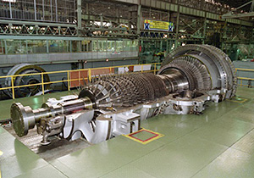
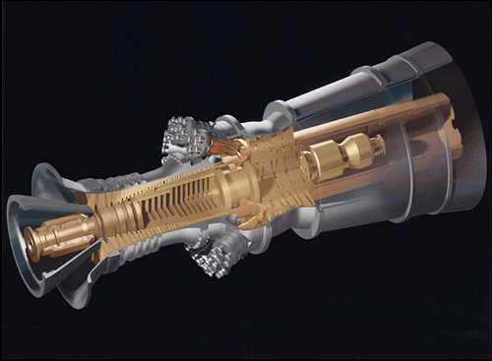
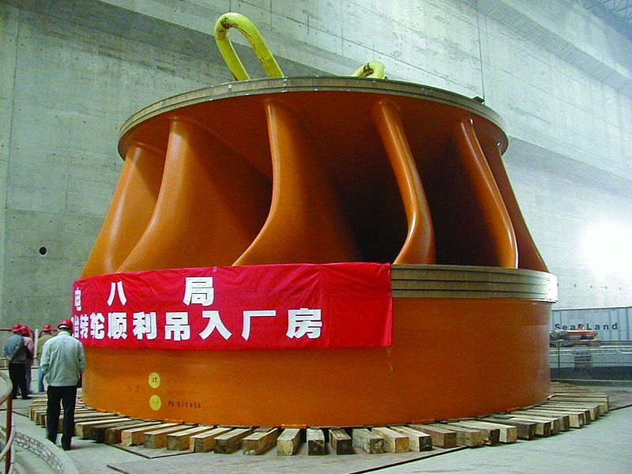
But moving to finish our overview of power PLANTS:
Turbines, which are in ALL power plants (except photovoltaic plants), look like this:
Steam plant: Natural Gas Plant: Hydroelectric Plant:
It's no coincidence that the left & center turbines closely resemble jet engines:
They are ALL driven by expanding gases (be it steam or combustion gases)
Some companies (like GE) actually make both power plant & jet turbines
But the 1000 times greater density of water demands much sturdier designs,
such as that in the "Three Gorges" hydropower turbine shown at the right
http://fossilfuel.energy-business-review.com/news/mitsubishi-to-supply-turbines-for-400mw-zerger-gas-fired-power-plant-in-turkmenistan-010416-4853879
http://en.wikipedia.org/wiki/Fossil-fuel_power_station
http://en.wikipedia.org/wiki/Francis_turbine

Slide 24
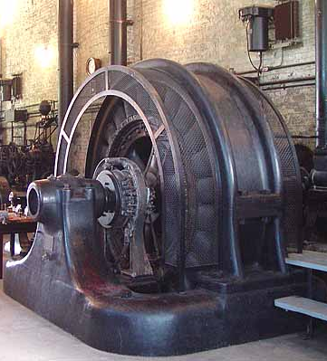
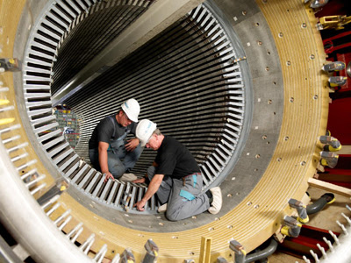
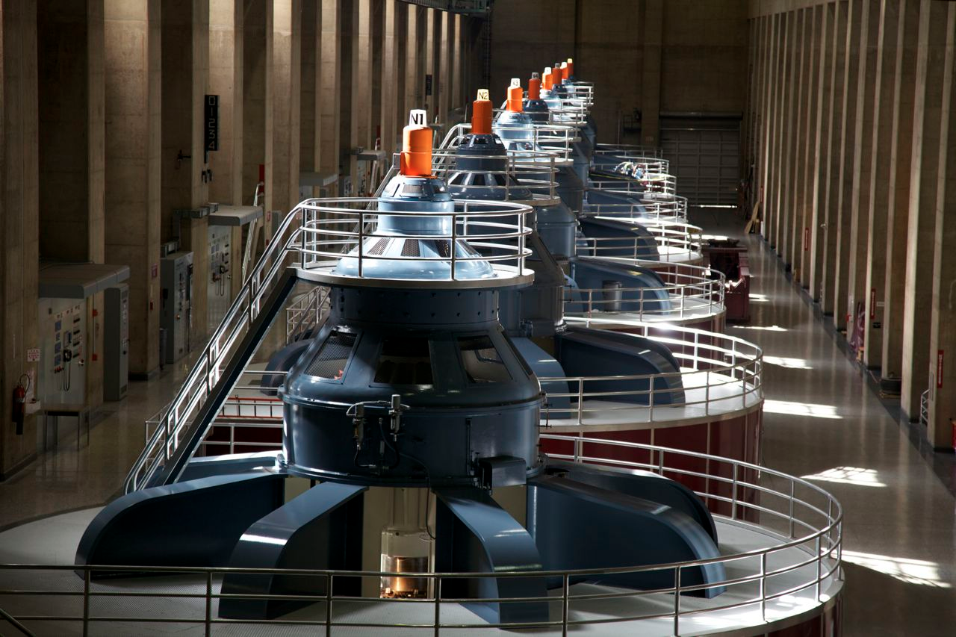
Those turbines turn electrical generators that look like this:
But despite their vastly increased size
these still clearly resemble the AC motor from my woodworking tool!
Because, at their heart, they DO still have the same components:
A stator (likely an electromagnet rather than a permanent magnet)
And a rotor (almost certainly an electromagnet)
All just waiting for something to turn that rotor!
http://www.inn-california.com/valleys/sacramentoC/powerplant.html
http://upload.wikimedia.org/wikipedia/commons/thumb/a/a7/Water_turbine_grandcoulee.jpg/683px-Water_turbine_grandcoulee.jpg
http://coalfiredpowerplants.blogspot.com/p/steam-electric-generators-look-at.html

Slide 25
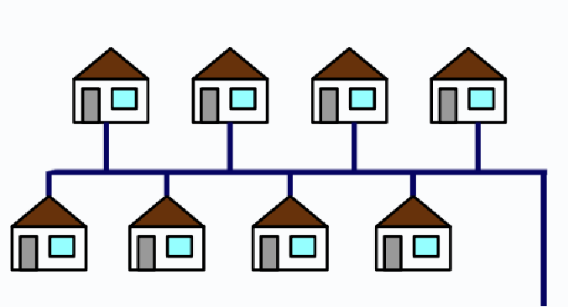
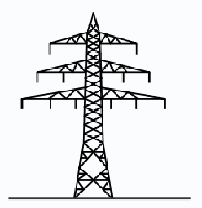

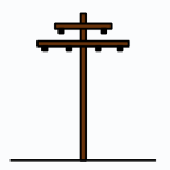
We now need to connect a power plant to YOU:
"Whoa! Things suddenly got awfully complicated!"
Yes, if you don't want to waste power while transmitting it to your house!
Electrons flowing through wires ("electricity") bump into metal atoms
transferring some of their energy to those atoms (as heat)
This is called Resistive Power Loss
To minimize resistive power loss, you must minimize electron flow:
You can exploit the fact that electrical power = Current flow x Voltage
by choosing to transmit power as (low current) x (high voltage)

Slide 26
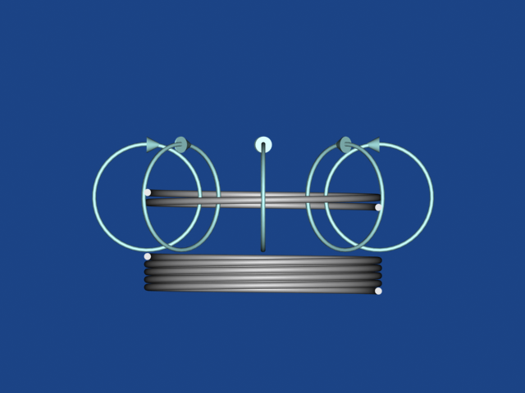
You reduce electron current via the last note set's AC transformers
=
Also sometimes represented as:
Which consist of two coils of wire coupled by a changing magnetic field:
Constantly changing AC of one voltage & current is sent into the 1st coil
Creating a variable magnetic field expanding/contracting through the 2nd coil
Which "Induces" AC of a different voltage & current out of that 2nd coil
But with the power input still equaling the power output via V_{in} x I_{in} = V_{out} x I_{out}
Transformed high voltage / low current power is sent through the long distance links:
Medium AC Voltage from power plant
Low AC Voltage
(110 VAC) to you
High Voltage / Low Current AC Transmission

Slide 27
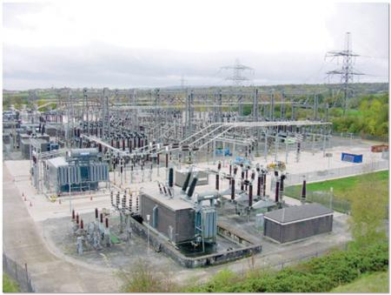
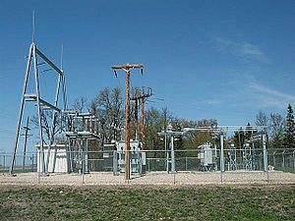
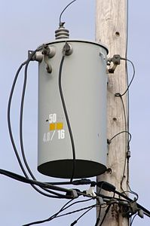
The transformers are located in "switching yards" or "substations"
http://rtcmagazine.com/articles/view/102190
http://en.wikipedia.org/wiki/Electrical_substation
Or right in your neighborhood:
The full sequence of AC voltages, power plant to your home, may be:
25 kV AC (from power station) => 275 kV AC (long distance transmission)
=> 100 kV AC (regional transmission) => 25 kV AC (local distribution)
=> 110 VAC (your home)
http://en.wikipedia.org/wiki/Transformer

Slide 28
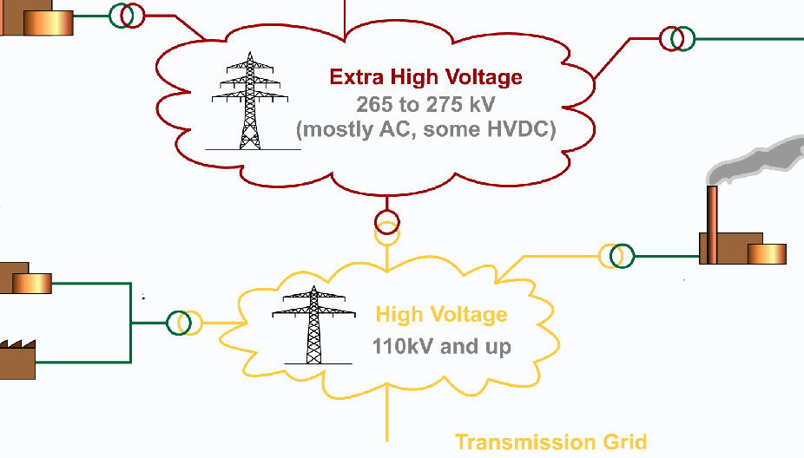
The quest for efficient transmission can drive voltages extremely high:
To hundred's of thousands or even a million volts – just to minimize current flow!
Which is also why long distance transmission towers have to be so tall:
Towers use the air itself as an electrical insulator
So wires must be very far from each other, and very far from the ground!
An Introduction to Sustainable Energy Systems: WeCanFigureThisOut.org/ENERGY/Energy_home.htm

Slide 29
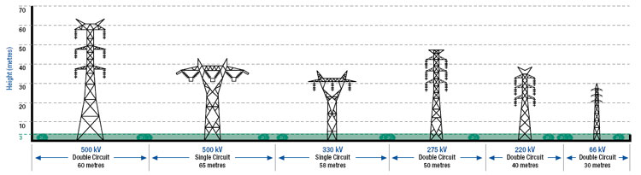
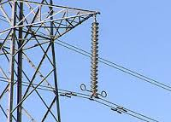
You can even identify transmission voltage from tower size:
http://www.ausnetservices.com.au/Electricity/Safety+&+Preparedness/Transmission+-+Easement+Use.html
Or by counting number of bell shaped insulator disks:
Rule of thumb: One disk per 10 kV of voltage used ¹
1) Source: Electric Power Systems – A Conceptual Introduction, page 181 – Alexandra von Meier
http://en.wikipedia.org/wiki/Insulator_%28electricity%29
An Introduction to Sustainable Energy Systems: WeCanFigureThisOut.org/ENERGY/Energy_home.htm

Slide 30
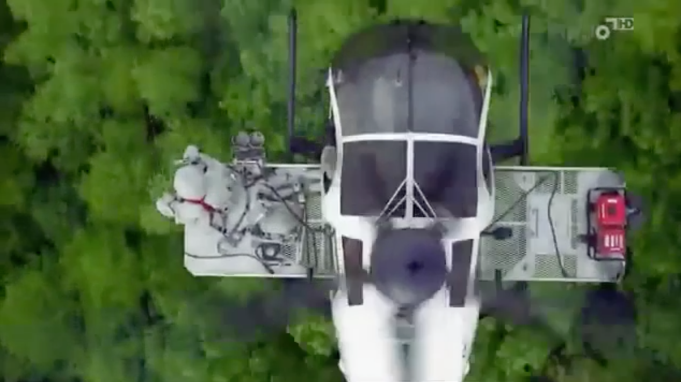
A Digression:
How do you service high voltage transmission lines & towers?
With the same cranes that were (presumably) used for their assembly?
No, at least not always:
Resources Webpage: Video of Helicopters in Action
An Introduction to Sustainable Energy Systems: WeCanFigureThisOut.org/ENERGY/Energy_home.htm

Slide 31
A problem: "Grids" almost always combine many power plants:
For redundancy, and/or to take advantage of plants' natural production cycles . . .
So our "generic" grid grows into something more like this:
Two (or more) power plants simultaneously supplying AC power => A Problem
AC voltage goes up & down, pushing electrons, then pulling electrons
If 1st plant pushes electrons while 2nd is trying to pull:
2nd plant will start absorbing 1st plant's power => Boom, sparks, fires . . .
They must push together & pull together = AC voltages must synchronize

Slide 32
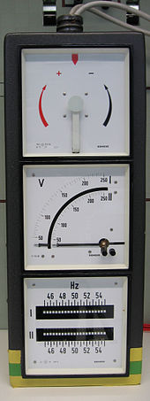
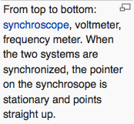
To synchronize AC from two nearby power plants:
1st plant starts up (or is already running)
2nd plant, monitoring power from 1st plant, starts turning its generator shaft
It speeds up, matching phase and speed to 1st power plant
Only when matched does it connect itself to the grid
How accurately must 2nd plant synchronize before it connects? ¹
Its AC voltage amplitude has to be within 5% of 115 Volts
Its frequency has to be within ~ 0.067 Hz of 60Hz
Its phase must be within 10° (i.e., 1/36th of cycle)
What about DISTANT power plants?
Electricity travels at almost the speed of light = 300,000 km/s
So travel time across U.S. is about 1/100 of a second
http://en.wikipedia.org/wiki/Synchronization_%28alternating_current%29
1) Per IEEE Standards C50.12 and C50.13

Slide 33
Oops! 1/100 ^{th} of a second is almost one full 60 Hz cycle
Thus AC phase from a distant power plant could be shifted by a lot more than 10° !
If that distant power plant serves only your town, there's an easy solution:
Have that distant power plant shift the phase of its AC generators
to compensate for the phase shift occurring during transmission
But your town is almost certainly not the only customer of those two power plants
Power plants send power all over the grid, over routes of all different lengths:
So on the scale of the US, it's impossible to match AC phase over all possible routes!
An Introduction to Sustainable Energy Systems: WeCanFigureThisOut.org/ENERGY/Energy_home.htm

Slide 34
But long distance phase matching ends up being almost moot
Because you can't (efficiently) transmit AC power across the US anyway!
Due to another strange consequence of magnetic induction
Called reactive power - which produces the stability limit
And it goes to the question of:
ARE MAGNETIC FIELDS REAL?
That is: Are they just a manmade mathematical abstraction used to infer forces?
Or do they really have a sort independent existence?
To answer (and explain reactive power), we can no longer avoid Maxwell's Equations
An Introduction to Sustainable Energy Systems: WeCanFigureThisOut.org/ENERGY/Energy_home.htm

Slide 35
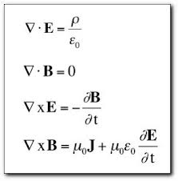
I've tried to buffer you from them, but here they are:
Maxwell's Equations:
They relate Magnetic Field (B) and Electric Field (E) to things such as
ρ = The amount (density) of net charge at a given location AND
J = The amount (density) of net charge flow at that location
From which we get things like Lenz's Law (our electro-magnetism Hand Rule)
An Introduction to Sustainable Energy Systems: WeCanFigureThisOut.org/ENERGY/Energy_home.htm

Slide 36
Take a deep breath and bear with me:
In deep outer space there is almost zero charge, and zero charge flow
ρ and J thus fall to zero and Maxwell's equations become:
But despite vacuum's lack of charge & charge flow, everything has NOT fallen to zero
In fact, the last two equations now seem to be saying:
The Electric Field is proportional to the Magnetic Field's rate of change
The Magnetic Field is proportional to the Electric Field's rate of change
0

Slide 37
But out in the vacuum of space, how could B and E continue to exist?
BY BOTH OSCILLATING (one out of phase with the other)
Then: Collapse of a Magnetic Field => Growth of Electric Field
Until magnetic field falls to zero, and electric field maxes out
And: Collapse of an Electric Field => Growth of Magnetic Field
And then cycle repeats over and over and over
Science fiction? No it's a weird phenomenon . . . that we call "LIGHT"
Light is STARTED by movement of charges, but it can then propagate
for VAST distances ("light years!") in the complete absence of charges
So B and E fields ARE real: They exist and can even propagate on their own
And they can store and carry very real energy!

Slide 38
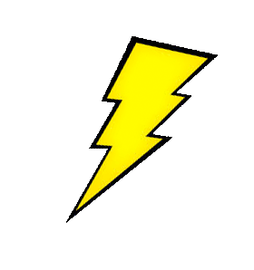
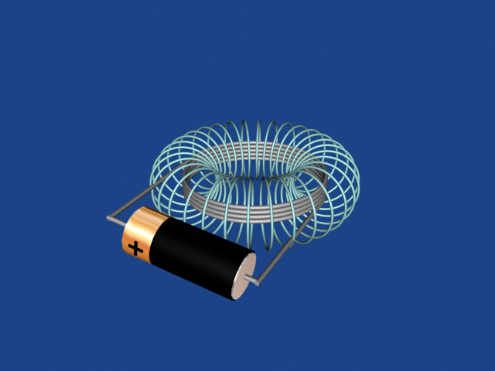
Applying this to our lowly wire coil:
When we connect a battery, it drives current (charge flow) through the coil
Part of the battery's energy goes into generating a magnetic field
Which we represent as loops (around the path of the current)
These loops act sort of like rubber bands (storing energy in their stretch!)
When battery is disconnected, unsupported stretch of bands leads them to collapse
But in doing so they briefly push current/voltage backward
This pushback can be so intense and quick that it produces sparks!

Slide 39
Using this to expand our water flow analogy of electrical current:
Imagine we first connected a long metal pipe to a faucet:
We then turn on the faucet, applying water pressure to the left end, initiating flow:
If we then disconnected the faucet? Flow just stops (boring!)
If we leave the faucet on? Water (flow & pressure) eventually comes out right end:
This is the old, pre-magnetic field, analogy to electrical current flow
An Introduction to Sustainable Energy Systems: WeCanFigureThisOut.org/ENERGY/Energy_home.htm

Slide 40
The new improved (magnetic field incorporating) analogy:
Our pipe is now made of highly stretchable rubber (it's become a hose):
We turn on the faucet, applying water pressure to left end:
ONLY PART of the water STARTS flowing down the pipe
OTHER PART "induces" a growing bulge in the hose's wall!
The energy stored in the stretched out rubber wall is analogous
to the energy stored in the induced magnetic field loops
An Introduction to Sustainable Energy Systems: WeCanFigureThisOut.org/ENERGY/Energy_home.htm

Slide 41
And if we then quickly disconnected the faucet?
Before turning the faucet off:
Immediately after disconnecting the faucet:
Propelled by the stretched out rubber, water shoots back in our face!!
And this continues until the bulge fully relaxes:
An Introduction to Sustainable Energy Systems: WeCanFigureThisOut.org/ENERGY/Energy_home.htm

Slide 42
What if we'd instead left the faucet connected?
Shortly after the faucet was connected and turned on:
Later: Bulge has spread out, whole hose has slightly expanded due to pressure:
And if we THEN disconnect from faucet?
Contracting to original diameter, pulse of water is expelled from both ends
An Introduction to Sustainable Energy Systems: WeCanFigureThisOut.org/ENERGY/Energy_home.htm

Slide 43
Our coil's behavior based on this enhanced water analogy:
After connecting battery, the initial charge flow is LOWER then expected:
Energy is being diverted into building up a magnetic field (rubber bands/hose)
But if we leave the battery connected, charge flow rises to expected level:
After magnetic field has been built up all along coil (stretched out rubber)
If at any point we disconnect the battery:
Charge briefly continues to shoot out the ends (due to contracting rubber)

Slide 44
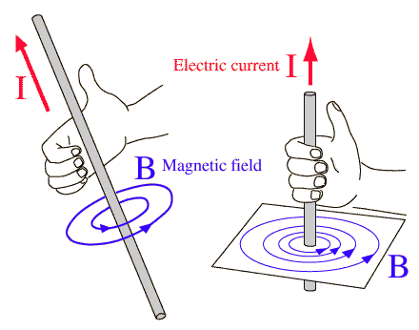
Does this ONLY apply to coils?
+ Charge Flow
- Charge Flow
B Magnetic Field
B Magnetic Field
Lenz's Law Hand Rule says magnetic field forms around ANY charge flow
So why aren't same effects seen with straight wires?
They are seen, but they are much much weaker
Because magnetic fields are not gathered together:
But rubber-band-like effects become noticeable in LONG straight wires
Which is exactly what electrical power transmission lines are!

Slide 45
So in long power transmission lines:
When we first apply a voltage (as in the start of an AC wave cycle):
Current (charge flow) in the wire builds up more slowly than expected
Because part of the driving energy is diverted to build up Magnetic Field
Acting like the growing bulge in our rubber hose
When applied voltage reaches maximum (as at the peak of an AC wave):
The energy diverted to build up of the Magnetic Field diminishes
Leaving more energy to push the electrons
And the growth of the current flow catches up
When applied voltage again falls to zero (at the end of an AC half cycle):
We expect the current flow to also fall to zero – but it doesn't!
As collapsing magnetic field continues to push electrons for awhile

Slide 46
Thus, exiting a long AC transmission line, current falls behind voltage:
What we expect – before taking induced magnetic fields into account:
But out the end of a moderately long AC transmission line we actually get:
And out the end of a very long AC transmission line we get:
Resultant Current
Voltage
Time
Resultant Current
Voltage
Time
Resultant Current
Voltage
Time

Slide 47
Weirdly interesting (perhaps), but why is this significant?
Specifically:
How does this kill the efficiency of long distance AC power transmission?
To answer, evaluate the power coming out the END of that power line
Employing the water flow analogy:
To do work I need not only water pressure but also water flow
Pressure with no flow will give you nothing, as will flow with no pressure
So for water: Delivered water power (at a given time) = Pressure (t) x Flow (t)
Similarly: Delivered electrical power (at a given time) = Voltage (t) x Current (t)
An Introduction to Sustainable Energy Systems: WeCanFigureThisOut.org/ENERGY/Energy_home.htm

Slide 48
Working out electrical power with and w/o magnetic induction:
If Current stayed in sync with Voltage : But for Current lagging behind Voltage:
Voltage (V):
Current (I):
Power = V I (falling to zero when EITHER V or I are zero):
We get far less power out when we account for induced magnetic fields!

Slide 49
But why is this only a problem for only AC power transmission?
Wouldn't there also be a current lag when you first applied a DC voltage?
And wouldn't current also flow for awhile after removing that DC voltage?
"Yes" to both questions (due to the same magnetic induction effects)
However: You don't turn DC voltage on very often, or turn it off very often
Soon after DC is turned on, current flow catches up and reaches its max
So DC voltage is then high at same time that DC current is high
Which gives you maximum possible power out
The problem with AC is that it is always turning on and off!
So AC current flow never manages to catch up to AC voltage
And you do NOT get maximum possible power out
And things get worse the longer the wire gets

Slide 50
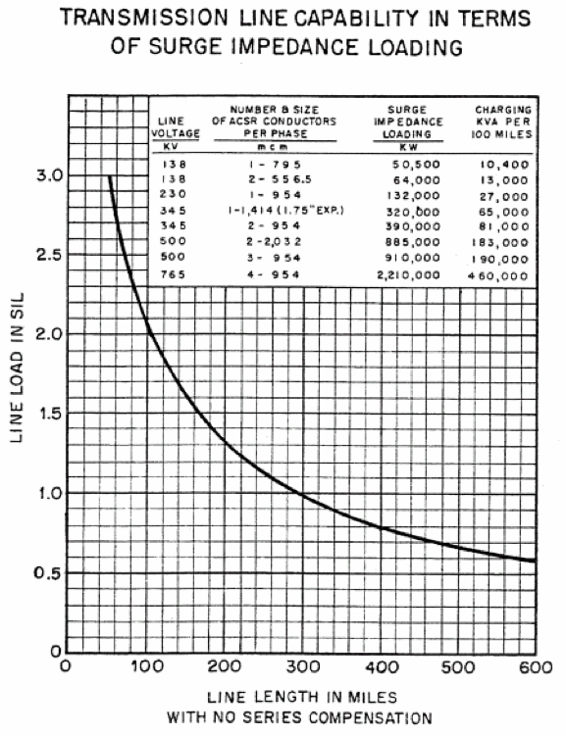
Leading to a figure I dug up from the American Electric Power Corp.:
Which essentially plots:
AC Power Out vs. Power Line Length
Note how fast the output power falls:
It plummets in a FEW HUNDRED MILES!
All due to the AC voltage and AC current
getting more and more out of step
at the far end of a long power line!
Source: "American Electric Power – Transmission Facts"
Original link has disappeared but a cached copy is available on this note set's Resources Webpage

Slide 51
So AC power transmission is limited by TWO effects:
1) Flowing electron current knocking into atoms, heating them up =>
"Resistive power loss" (or "thermal limit")
"Loss" because electrical power is lost by its conversion to heat
2) Current flow lagging behind the applied (pushing) voltage =>
"Reactive power" (or "stability limit")
This is not so much a true loss, but more like a worsening clog!
You just can't force as much electrical power through longer power lines!
In comparison, DC power transmission
also suffers from the 1st effect – but NOT from the 2nd effect

Slide 52
Thus HV DC power transmission = Key to an efficient long distance grid:
HV (high voltage): Minimizes 1st limitation by reducing necessary current flows
DC (direct current): Eliminates 2nd limitation by eliminating magnetic induction
Which stems from ever varying (growing and contracting) magnetic fields
But this produces a couple of dilemmas:
1) >95% of power plants like to produce AC power (from spinning things)
2) 100% of our homes and businesses are set up to use AC power
The solution requires AC to DC conversion, then DC to AC back-conversion
Classically facilitated by TRANSFORMERS, DIODES & CAPACITORS
An Introduction to Sustainable Energy Systems: WeCanFigureThisOut.org/ENERGY/Energy_home.htm

Slide 53
The following DOES get technical
Skim through it if you must
But if you've studied the preceding pair of Electricity & Magnetism note sets,
you've already "paid your dues"
and the following should now make sense
Further, the following not only describes some neat applications of "E&M"
it also provides a primer on "diodes"
which we will study later . . . as "photovoltaic solar cells"
and a primer on "capacitors"
which may provide one of our best ways of storing Grid electrical energy
So don't sell yourself short (I don't) – Give it a try!

Slide 54
Conversion of AC to DC, and then back again:
Step 1) Convert power plant AC to higher voltage AC with transformer
Input: Medium voltage AC: Transformer: Output: High voltage AC:
Higher voltage out means lower current flow => Lower resistive loss
Time
Time
An Introduction to Sustainable Energy Systems: WeCanFigureThisOut.org/ENERGY/Energy_home.htm

Slide 55
For the next step, we need a new device: a diode
Diodes act like one-way doors to electrical current
Passing current flow in one direction
But blocking current trying to flow in the other direction
Textbooks seem to believe only electrical engineers can comprehend diodes
But I think we can all understand them
We've just got to learn about special materials called semiconductors
Semiconductors are called that because they are almost insulators
Insulator's electrons all remain bound to atoms (= why they don't conduct!)
But atoms retaining all of their electrons are neutral
So we can represent pure semiconductor material as boring gray:
An Introduction to Sustainable Energy Systems: WeCanFigureThisOut.org/ENERGY/Energy_home.htm

Slide 56
The trick with semiconductors is to add special impurities:
The preceding base semiconductor sets the bonding rules:
  If it’s silicon (as it most commonly is), atoms of the crystal must have for bonds
Add some impurities with five valence electrons (e.g. Phosphorus or Arsenic):
  Just a little! Say a part per million to a part per thousand
  If one of them gets in a crystalline site, it will have an unused valence electron
    Which can then break loose to wander, carrying its negative charge
  But that will leave the parent donor impurity short of an electron
    Which will give that now fixed-in-place donor a positive charge
Which can be represented as this:
  A background of stationary donor impurities
    Plus their now wandering extra electrons
An Introduction to Sustainable Energy Systems: WeCanFigureThisOut.org/ENERGY/Energy_home.htm

Slide 57
Or instead add another sort of impurity:
Ones with only 3 valence electrons (e.g., Boron):
Again, just a little: A part per million to a part per thousand!
If one of them gets in a crystalline site, it will lack a bonding / valence electron
But it can steal an electron from a neighboring silicon atom
Thus completing ITS 4 bonds to the crystal
Leading it to be named an acceptor impurity (i.e., thief)
The victimized Si can then take an electron from its silicon neighbor
With that neighbor then taking an electron from its neighbor . . .
The now moving electron-deficient-bond, called a hole, carries a positive charge
All of which we can represent as this:
A background of stationary ionized acceptor impurities
Plus the now wandering positive holes

Slide 58
Now build a semiconductor junction = a DIODE
By using two (generally flat) layers of semiconductor
One layer with added acceptor impurities
The other layer with added donor impurities
Giving this (when viewed from the side via X-ray vision):
Left:
Fixed negative background of
now ionized acceptor impurities
+
The resulting wandering
electron-deficient and thus
positive holes
Right:
Fixed positive background of
now ionized donor impurities
+
Their now liberated and wandering
negative electrons

Slide 59
Finally, connect this to a battery and see what happens:
Apply voltage in one direction and current flows just fine:
+
-
Electrons are pulled out, making NEW holes at this end
While new are electrons
pushed into this end
What's lost in one place
is replaced at another!
At the center "junction:
Electrons pushed across fill in holes on the other side
(both being replaced by new ones added at the ends)
But apply the voltage in other direction and current flow soon grinds to a halt:
-
+
Electrons are pushed in, filling up holes
at this end!
Electrons are sucked
out at this end!
Nothing is replaced!Nothing is left to flow!
Nothing is left to conduct current thru the center!

Slide 60
You may now owe yourself a big pat on the back
Because if you stayed with me over the last four slides:
You now understand something (diodes)
no longer understood by many/most electrical engineering majors
and long since forgotten by many (most?) EE professors!
(Test them and you'll see!)
(We CAN Figure This Out!)
An Introduction to Sustainable Energy Systems: WeCanFigureThisOut.org/ENERGY/Energy_home.htm

Slide 61
These DIODES facilitate the second step in AC to DC conversion:
Step 2) "Rectify" the high voltage AC using a "Diode"
For which the symbol is: (symbol points in the direction current can flow)
Or via 4 diodes
and a simple circuit:
HV AC in:
Diode:
Rectified AC:
An Introduction to Sustainable Energy Systems: WeCanFigureThisOut.org/ENERGY/Energy_home.htm

Slide 62
For the next step, we again need a new device: a "capacitor"
Capacitors temporarily store charge => Smoothing out swings in voltage
This doesn't work because positives push on each other (as do negatives):
But fold it over and, if the two plates are close enough, this does work:
Because if plates are close enough, repulsion of like charges on one plate
is effectively canceled by their attraction to opposite charges on other plate
+
-
+
-
An Introduction to Sustainable Energy Systems: WeCanFigureThisOut.org/ENERGY/Energy_home.htm

Slide 63
Which facilitates the third step in AC to DC conversion:
Step 3) Smooth rectified AC into DC via a "Capacitor"
The "capacitor" symbol is just:
Capacitor temporarily stores charge => Smoothing by shifting peaks to valleys
Rectified HVAC in:
Capacitor:
High Voltage DC:
Which is now ready to be sent down a long power transmission line!

Slide 64
At the other end of that power line we need an on-off switch:
With which we'll start the conversion of DC back into AC
Step 4: "Chop" the DC power
By sending it through an opening and closing switch:
HVDC in:
Opening & closing switch:
Chopped HVDC:
This "chopped" DC now acts sort of like AC, facilitating next step:

Slide 65
For the final step we are back to transformers:
Step 5: Smooth and transform "chopped" HVDC back into into AC
Transformer works on chopped DC because its ups and downs mimic AC:
Chopped HVDC in:
Transformer:
Low Voltage AC:
Ready to be sent to your neighborhood!

Slide 66
Summarizing all of that:
AC
Long distance
Transmission Line
Power Plant
HVAC
Rectified
HVAC
Business or Home
HVDC
Chopped
HVDC
AC

Slide 67
That clearly wasn't easy!
As a result, high voltage DC transmission is still relatively rare
Despite low resistive losses + ability to transmit long distances
Complexity is part of the problem
But bigger barrier is cost/reliability of some of those conversion devices
Transformers are pretty simple and well developed
We are also pretty good at capacitors (= metal plates and gaps)
Switches are simple, but they can be eroded by inductive sparks
Diodes are not only difficult but they can be killed by inductive sparks
So, until recently, high voltage switches and diodes have been the bad actors
But both can now be made with new high voltage tolerant semiconductors
=> Far more recent interest in efficient, long distance, HVDC transmission!
An Introduction to Sustainable Energy Systems: WeCanFigureThisOut.org/ENERGY/Energy_home.htm

Slide 68
= A rather complete overview of today's power plants and grid
TODAY's Grid still depends on high voltage AC (HV AC) for power transmission
But you've now also seen why:
Power could be sent much further
via high voltage DC (HV DC)
Which, as we'll see in later note sets,
will be ESSENTIAL if we are ever to
make heavy use of WIND & SUN power
An Introduction to Sustainable Energy Systems: WeCanFigureThisOut.org/ENERGY/Energy_home.htm

Slide 69
Credits / Acknowledgements
Some materials used in this class were developed under a National Science Foundation "Research Initiation Grant in Engineering Education" (RIGEE).
Other materials, including the WeCanFigureThisOut.org "Virtual Lab" science education website, were developed under even earlier NSF "Course, Curriculum and Laboratory Improvement" (CCLI) and "Nanoscience Undergraduate Education" (NUE) awards.
This set of notes was authored by John C. Bean who also created all figures not explicitly credited above.
Copyright John C. Bean
(However, permission is granted for use by individual instructors in non-profit academic institutions)
An Introduction to Sustainable Energy Systems: WeCanFigureThisOut.org/ENERGY/Energy_home.htm

