Slide 1
Batteries and Fuel Cells
John C. Bean
Outline
Battery History / Battery Science
Batteries in TODAY's homes & ground vehicles
Your car's starting battery: Lead Acid
Your home's economy disposable battery: Zinc-Carbon (actually Zn / MnO2)
Your home's premium disposable battery: Zn-MnO2 based Alkaline
Your home's older rechargeable battery: Ni-Cd based Alkaline
Your home's newer rechargeable battery: Nickel Metal Hydride based Alkaline
Your home's, car's, tool's, solar array's . . . newest reusable battery: Something based on Lithium
Batteries in TOMORROW's homes & ground vehicles
Including future Li-Ion batteries, Aqueous Hybrid Ion / Saltwater, and Lithium Air batteries
Why practical battery-powered air & sea transport are a long way off
Airplanes's need for power produced from very little mass - for which fossil-fuels are hugely better
Ships's need for vast amounts of stored energy
Batteries in TOMORROW's greener electrical Grid
Which may be key to the large-scale integration of solar and wind power
But which requires HUGE amounts of stored energy (whatever the volume & mass!)
Leading to weird new batteries including: Flow, Molten Sodium, and entirely Molten batteries
Fuel Cells: Closely related to batteries, but with important differences
(Written / Revised: July 2023)

Slide 2
A Battery Glossary:
Suggested by definitions given in "What are Batteries, Fuel Cells and Supercapacitors?" ¹
Cell: Basic building block, typically one anode and one cathode, between which is an ion-conducting electrolyte (and possible separator).
Battery: One or more electrically connected cells, plus terminals/contacts to pass electrical energy to outside world.
Primary Battery: Fully charged as built (based on its constituents). Discharged once and then discarded.
Secondary Battery: Usually discharged as built. Charged, and subsequently rechargeable, by application of an external voltage (as possibly supplied by a Primary Battery).
Anode: Negative electrode of a cell, associated with "oxidative" chemical reactions that release electrons into the external circuit.
Cathode: Positive electrode of a cell, associated with "reductive" chemical reactions that gain electrons from the external circuit.
Electrolyte: Material that provides pure ionic conductivity between the positive and negative electrodes of a battery cell.
Separator: An inert physical barrier between the electrodes of some cells. Added to inhibit electrical shorts and/or mixing of two electrolytes, while maintaining the flow of key ions.
1) What Are Batteries, Fuel Cells, and Supercapacitors? Winter and Brodd, Chemical Reviews, 104, pp. 4245−4269 (2004)

Slide 3
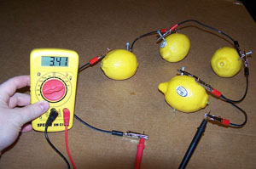
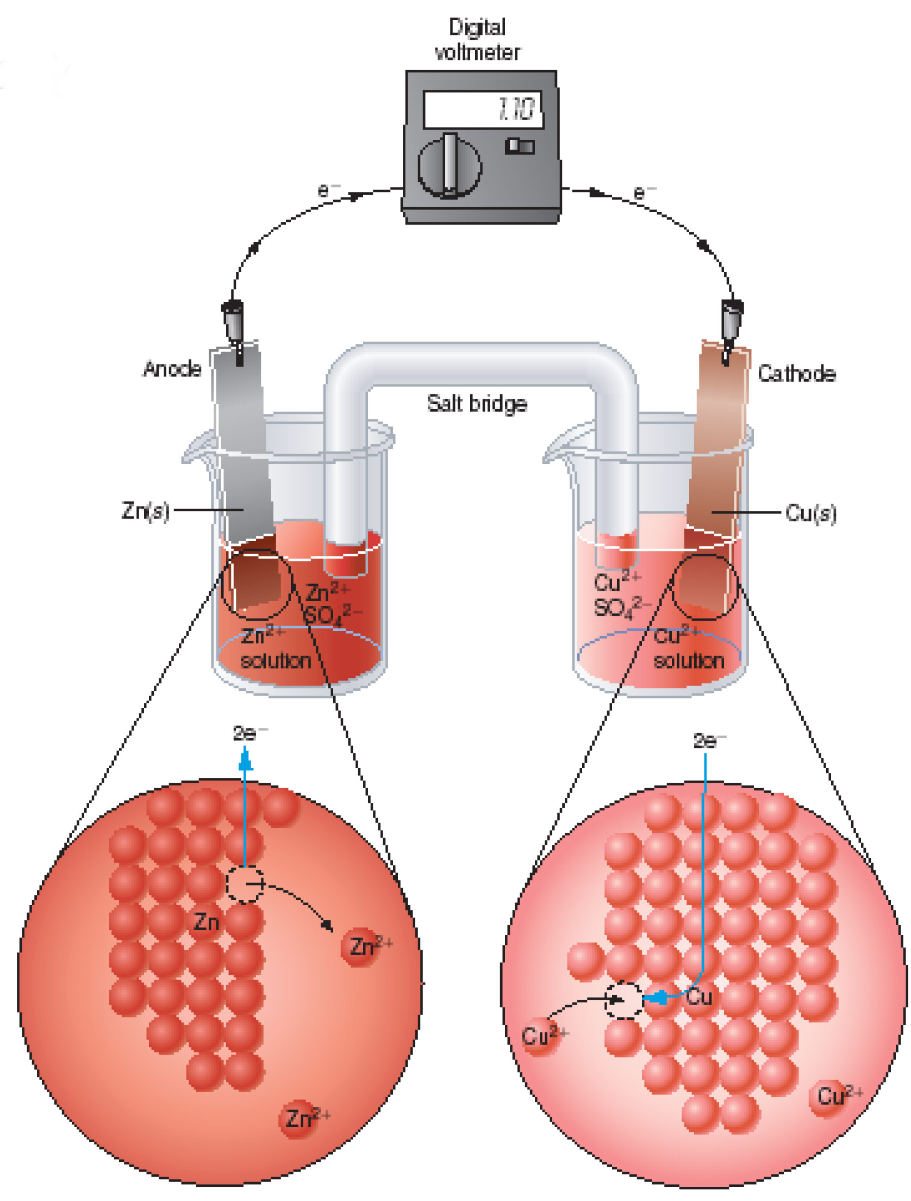
Many of my teachers were fascinated with batteries
Elementary school teachers had us wire together slivers of metal stuck into lemons
Which WERE a lot of fun to mess around with
But they looked like no battery I'd ever seen!
High school Chemistry teachers then went on and on (and on) about how metals
dissolved into water as ions (and the converse),
which they breathlessly labeled "Redox reactions"
Our textbooks said this enabled batteries looking like this:
Which ALSO looked like no battery I'd ever seen!
AND which had unexplained features (e.g., glass "salt bridges")
that seemed both bizarre and hopelessly impractical
Top figure (and excellent tutorial): http://www.edinformatics.com/math_science/how_does_a_battery_work.htm
Bottom figure: http://courses.washington.edu/bhchem/c456/ch11.pdf

Slide 4
And batteries didn't have a big impact on my day-to-day life
Yes, they powered an occasional portable radio or toy
And, if I'd stopped to think about it, they kick-started the family cars
But their major function seemed to be powering household flashlights,
something they could do for only a frustratingly short period of time
And when I left school and joined the Research Division of Bell Telephone Labs,
(then the biggest and most productive industrial research lab in the world)
I was given a free choice of my own research direction
But mentors (including Chemists) counseled me against battery research
because they considered it not only slow moving (if not stagnant)
but also of limited relevance to real world or Bell System problems
All of which effectively curtailed my interest in, and study of, batteries

Slide 5
But in the 1990's batteries were back in the news (and the news was bad)
During the 1980's we'd become addicted to desktop personal computers
In the 1990's we decided what we really needed were portable personal computers
Early models of which were fragile beasts weighing 10-15 pounds,
that were limited by either their battery's 1-2 hour lifetime
or by our shoulder's refusal to lug around that hulking battery
The millennium added similar addictions to PDA's, and then to mobile phones
Thus by 2010 the public certainly wanted hugely improved batteries
Which stimulated a renaissance in worldwide battery research
But did we really need hugely improved batteries?
Would our technological society collapse if they did not soon appear?
A cynic (e.g., a socially unconnected baby-boomer) might plausibly argue no

Slide 6
But there is now an unequivocal NEED for better batteries:
Climate change threatens not only technological human society
but also non-technological cultures, and indeed the earth's entire biosphere
That assertion is explored at length in the final three note sets of this website:
Climatology & Climate Change (pptx / pdf / key)
Greenhouse Effect, Carbon Footprint & Sequestration (pptx / pdf / key)
Where Do We Go from Here? (pptx / pdf / key)
From those and other note sets on this website, the takeaways are that:
1) Ground vehicles must eliminate (or hugely decrease) their use of fossil-fuels
With the obvious alternative being a switch to the use of BATTERY power
(Plausible alternatives for sea & air vehicles are NOT similarly obvious,
for reasons that will be explained later in this note set)
2) Those batteries must be charged from non-fossil fuel power sources
3) Electrical power in general must eliminate (or hugely decrease) use of fossil-fuels

Slide 7
But that will require more than just improved vehicle batteries
Why? Because the sun sets and winds die down
Daily sunlight energy cycles: Typical wind energy cycle:
100%
100%
Summer
Winter
Midnight
Noon
Midnight
Midnight
Noon
Midnight
Which means that, in a Grid built largely around solar and wind energy,
when the sun is up, or the winds are strong,
we will have to store a whole lot of power for use at other times in the day
An Introduction to Sustainable Energy Systems: WeCanFigureThisOut.org/ENERGY/Energy_home.htm

Slide 8
Green Grid = Green Energy Sources + Massive Energy Storage
This is discussed further in my note set:
Power Cycles & Energy Storage (pptx / pdf / key)
It includes discussion of alternatives to battery energy storage now being explored
But batteries remain our best developed & most versatile present day alternative
Further, for applications where weight and/or size are critical (e.g., most types of vehicle),
batteries (or closely related fuel cells) have clear and outstanding advantages
Battery technology & research are thus very much "back on my radar"
And in this note set I will share what I have now learned (and continue to learn)
This includes getting into details that were glossed over in my chemistry classes:
Details that are now crucial for increasing battery energy capacity & charging speed
Details that also affect things like the probability of a battery bursting into flames
From my newly motivated interest in batteries, let me begin with:

Slide 9
A Brief Review of Battery History
An Introduction to Sustainable Energy Systems: WeCanFigureThisOut.org/ENERGY/Energy_home.htm

Slide 10
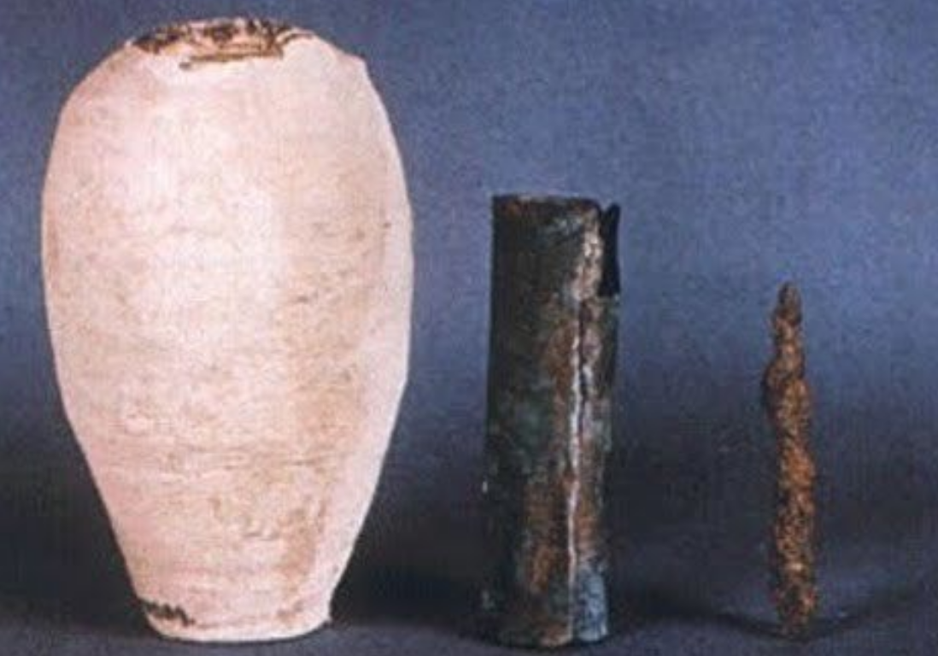
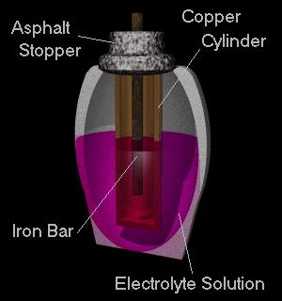
Starting with: What WAS going on in the batteries taught about in school?
Including the 2000 year old Baghdad Battery: ¹
The artifacts: ² Their likely operating mode: ³
Elementary school's citrus fruit battery: ⁴
High school's salt bridge battery: ⁵
1) https://en.wikipedia.org/wiki/Baghdad_Battery 2) https://www.atlasobscura.com/places/bagdad-battery
3) http://www.unmuseum.org/bbattery.htm
4) http://www.edinformatics.com/math_science/how_does_a_battery_work.htm
5) http://courses.washington.edu/bhchem/c456/ch11.pdf

Slide 11
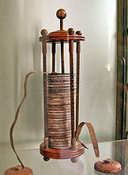
Baghdad & Citrus batteries exploit a dissolving metal + an acid's hydrogen ions
They thus resemble the "1st modern battery" invented by Allessandro Volta in 1800: ¹
(After whom our unit of electrical potential, Volts, was named)
In it, atoms from a zinc metal anode dissolved as ions in an acid:
Zn (anode) => Zn⁺² (in acid) + 2 e⁻ (left behind in anode)
Those electrons flowed out of the anode & back into a metal cathode,
where they attracted the acid's hydrogen ions to form H2 gas molecules:
2 H⁺ (in acid) + 2 e⁻ (released from cathode) => H₂ (gas)
Anode (Zn metal atoms ionizing/dissolving)
Cathode (hydrogen de-ionizing/forming H₂ gas)
-
+
H₂
+
H⁺
-
-
+
+
+
H⁺
+
+
Reference #1 and photo above: http://www.edinformatics.com/math_science/how_does_a_battery_work.htm
H⁺
+

Slide 12
Power (electron flow) depended upon ONLY one metal + acid's ions
Changing the second metal (the one used in the "cathode") has no effect
At least if that second metal does not itself tend to dissolve & ionize in the acid
Power (electron flow) is supplied as long as BOTH reactions continue:
Zn (anode) => Zn⁺² (in acid) + 2 e⁻ (left behind in anode)
2 H⁺ (in acid) + 2 e⁻ (released from cathode) => H₂ (gas)
The solid Zn metal anode can supply LOTS of Zn⁺² ions
But the H⁺ ion supply in the acid is very much smaller
When H⁺ is depleted, power output ceases (the battery is "discharged")
Further, forcing electrons backward will NOT recharge this battery
Because the hydrogen released during discharge cannot be drawn back in
It's permanently lost, floating away as (potentially explosive) H2 gas
These batteries can ONLY be regenerated by pouring in replacement acid

Slide 13
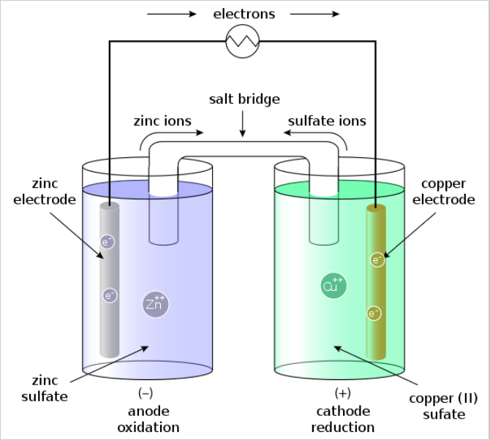
A slightly more recognizable battery was invented by Daniell in 1836 ¹
It used Zn and Cu electrodes, each immersed in an electrolyte containing that metal ¹
1) https://en.wikipedia.org/wiki/Daniell_cell
2) https://en.wikipedia.org/wiki/Salt_bridge
This is the "technology" still featured in many high school Chemistry textbooks
Including its generally unexplained / hopelessly impractical glass "salt bridge"
Which turns out to be an open glass tube filled with gel or stuffed with filter paper
that's been saturated with salts such as KOH, NaCl or KNO3 ²
Its supposed role? Passing charge (via the ions within those salts) but blocking
intermixing of the left (ZnSO4) and right (CuSO4) electrolytes

Slide 14
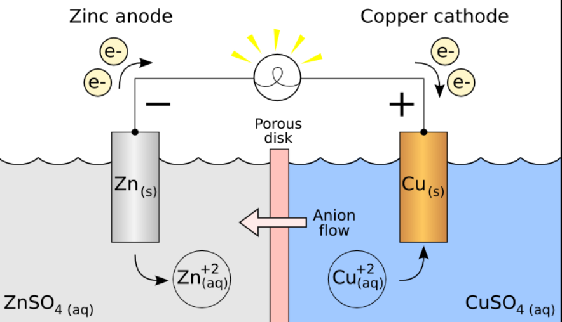
In a more modern version, the separator would be a "porous disc"
Which Chemistry textbooks ALSO generally left unexplained
But for which I found one vendor offering PTFE & polymer fiber versions ¹
Ions supposedly slip though microscopic passages between the disc's fibers
while electrons are blocked by their insulating PTFE ² & polymer materials
1) https://www.porex.com/markets/automotive-aerospace/battery-fuel-cell/
Figure from: https://en.wikipedia.org/wiki/Galvanic_cell
In both "salt bridge" and "porous disc" versions:
On one side a Zn electrode is immersed in a ZnSO₄ solution (=> Zn⁺² + SO₄⁻²)
On the other a copper electrode is immersed in a CuSO₄ solution (=> Cu⁺² + SO₄⁻²)
2) PTFE's trade name: "Teflon"

Slide 15
On each side, you can see how the battery action gets started:
On the left, Zn metal atoms from the anode dissolve into the electrolyte as Zn⁺² ions
And the electrons thereby released flow out that electrode into the wire
On the right, electrons returning via the wire flow into the Cu cathode where,
at its surface, they facilitate Cu⁺² de-ionization and plating onto that electrode
But with the only charge flow being electrons rightward,
the right half would quickly become net negative (and the left net positive),
building an electric field that would soon stop further electron flow
Zn anode (metal atoms ionizing/dissolving)
-
Cu cathode (metal atoms de-ionizing/precipitating)
+
+
+
-
+
+
-
+
+
+
+
+
+
+
An Introduction to Sustainable Energy Systems: WeCanFigureThisOut.org/ENERGY/Energy_home.htm

Slide 16
That's where the center "porous disk" and "anion flow" come in:
Negative electrons flowing to the right, via the wire, MUST be countered by either:
- Simultaneous movement of negative ions ("anions") back to left OR
- Simultaneous movement of positive ions ("cations") to right
EITHER prevents the build up of NET charge or electric fields
Here the moving ions are leftward negative SO₄⁻² ions from the CuSO₄ solution
Negative electrons rightward via wire + Negative SO₄⁻² ions leftward via disc
=> Balanced charge flow, allowing continued discharge of this battery

Slide 17
But what would happen if the porous disk were removed?
Solutions would mix:
And eventually we'd revert to local electron transfer between Zn and Cu atoms/ions
Eliminating electron flow
out through the wire
Eliminating the "electricity!"
Zn Anode
-
Cu cathode
+
+
+
+
-
-
+
+
+
+
+
+
Zn Anode
Cu cathode
+
+
+
-
+
+
+
+
+
-
+
+

Slide 18
But we now want a LOT of energy storage per volume or mass:
So we're not going to be satisfied with spread out structures such as these:
Instead, we're going to move the electrodes as close to one another as possible
Introducing another potential problem:
Recharging will require metal ions to come out of solution, back onto the electrodes
On the left, this: Will have to revert to this:
-
+
H₂
+
H⁺
-
-
+
+
+
H⁺
+
+
H⁺
+
+
+
+
+
+
+

Slide 19
But that is NOT how crystals (such as metals) usually grow
Didn't you ever use sugar water to grow sugar crystals?
Pretty crystal spires grow because atoms condense more quickly
on only certain planes of crystal surfaces
=> dendrites / dendritic growth
So metal ions re-depositing on electrodes (during recharge) more likely produce:
This: Producing this in a new
more compact battery:
Thus, in a modern denser battery (w/ closely spaced electrodes) recharge can easily:
"Short out" (i.e., permanently & directly connect) the electrodes
Indeed, this is what kills off most of my battery-powered tools!
Photo: http://geyserofawesome.com/post/102873046022/its-a-classic-case-of-science-vs-the-sweet

Slide 20
Critique of this Daniell battery from a modern energy storage perspective:
Need for porous disks or glass salt bridge "separators" is finally explained
Good News: Because things don't leave the cell, and reactions are reversible
Recharging now seems possible (at least for this general class of battery)
Bad News: Energy Storage Capacity is limited by initial Cu⁺ ion concentration at right
Which (as with Volta's H⁺ ions) can't be all that large
FURTHER BAD NEWS: Zn⁺² & Cu⁺² must eventually diffuse through the separator
And, indeed, I found certain sources alluding to this
That would occur, I'd guess, within days, weeks or (at most months)
Suggesting such batteries would die in days, weeks or months
(Which means that long life batteries must be made very differently!)

Slide 21
Battery Science
An Introduction to Sustainable Energy Systems: WeCanFigureThisOut.org/ENERGY/Energy_home.htm

Slide 22
Textbook examples are thus low capacity, impractical, short-lived . . .
Further, those historical examples leave so many things poorly explained
Such as the very different paths taken by ions and electrons
Such as criteria for choosing electrodes, electrolytes, separators . . .
To understand Today's battery R&D we need a much more complete
and intuitive understanding of what is going on deep within them
Indeed, as someone trained in Applied Physics, who then spent a
career trying to create entirely new / unnatural atomic arrangements
I want to know what is going on right down at their atomic scale
Which could provide deep answers to questions such as:
Why do metals fall apart in water as ions and not neutral atoms?
Why don't their liberated electrons also disperse into water?
Why do different metals have different tendencies to fall apart as ions?

Slide 23
Those questions reflect my Physics background
Physicists are obsessed with WHY something happens
Believing that understanding WHY reveals the fundamental laws of Nature
But WHY is easier to figure out for less complex phenomenon (e.g., single atoms)
Leading Physicists to often just ignore more complex phenomenon
Chemists are instead obsessed with HOW to get something working
With "something" (moles & moles of molecules) being HUGELY complex
This drives Chemists towards use of empirical (i.e., observation based) rules
Which have facilitated Chemists' great success in exploiting those complex systems
Even when (according to physicists) understanding of WHY may still be fuzzy
As an APPLIED Physicist, I will now try to find a middle ground by providing explanations
likely offensive to academics & purists in both camps ( . . . the story of my career ^{1, 2})
ONWARD!
Lists and links to: 1) My Publications 2) My Patents

Slide 24
My explanations revolve around water's exceptional properties
Chemist's refer to water as The Universal Solvent
Which exaggerates its abilities . . . but not by much
Water is also known for its "surface tension," manifestations of which include:
high viscosity and a tendency to cling to both itself and to other things
It is also known for the fact that, unlike most liquids, its expands upon freezing
Which all stem from H2O's small size plus strong charge imbalances (i.e., polarization)
High & left in the periodic table, H holds on to electrons very weakly
High & right in the periodic table, O holds on to electrons very strongly
In Chemistry speak, they're exceptionally electropositive & electronegative, respectively
As a result, electrons in water's bonds are pulled strongly toward the central O atom:
H2O
=>
=>
An Introduction to Sustainable Energy Systems: WeCanFigureThisOut.org/ENERGY/Energy_home.htm

Slide 25
H⁺ 's on one molecule are then attracted to O⁼ 's on adjacent molecules
When ALL H⁺'s lie adjacent to O⁼ 's, in 2D this produces:
This is the 2D version of water ice which,
like its 3D version, has lots of open space
At higher temperatures, liquid water molecules continuously jostle around
But as they move they also rotate trying to keep H⁺ 's near O⁼ 's,
which produces (in 2D) arrangements such as this:
Such less organized but tightly packed arrangements give liquid water its greater density

Slide 26
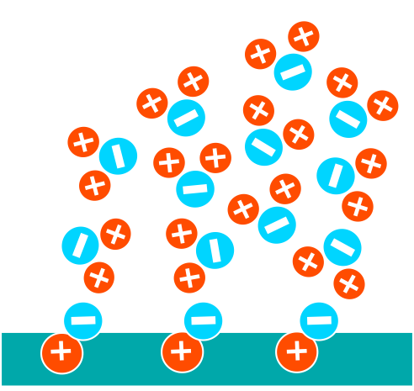
Molecular attraction thus explains water's unusually high viscosity
It also explains why water clings to so many things:
All that's required is that atoms on an object's surface also
have polarized bonds to which water molecules are attracted:
Relevant to batteries, it also means pulling water molecules apart requires energy:
+ ENERGY =>
An Introduction to Sustainable Energy Systems: WeCanFigureThisOut.org/ENERGY/Energy_home.htm

Slide 27
Energy that would also be required if metals dissolved as neutral atoms
Because a neutral metal atom dissolved in water would NOT attract water molecules
but it would obstruct THEIR ability to draw close to one another
A charged metal ion would still push water molecules apart
But its charge would attract water molecules => Lower energy organization
For instance, via tight arrangements such as:

Slide 28
Ions thus naturally form and move freely in water
But electrons do not - they need to latch on to an atom (drawn by its positive nucleus)
But in water molecules, the atoms don't tend to latch onto extra electrons
Putting this all together, in contact with water:
IONS tend to be liberated from metallic surfaces BECAUSE
metallic ions are easily created and dispersed in water,
while their abandoned electrons readily disperse into the solid metal
(Or for negative ion formation, electrons are supplied from that metal)
DISSOLUTION OF METALS IN WATER THUS PROVIDES A NATURAL WAY OF:
1) SEPARATING ELECTRONS FROM THEIR PARENT ATOMS
2) FORCING LIBERATED ELECTRONS TO TRAVEL DIFFERENT PATHS
Which, for batteries, is through wires & useful things in the our world
An Introduction to Sustainable Energy Systems: WeCanFigureThisOut.org/ENERGY/Energy_home.htm

Slide 29
Bringing me to my third question:
"Why do different metals have different tendencies to fall apart as ions?"
First, because the different bond strengths within metals means that the initial step
of metal-to-metal bond breaking requires different energies
Second, because liberated metal ions have different sizes and charge configurations,
so inserting liberated ions between water molecules requires different energies
The process of two different metals dissolving as positive ions in water:
+
+
+
-
+
+
+
-
Would thus be described by chemical reactions:
Metal₁ (solid) <=> Metal₁⁺ + e⁻ + ΔE₁ Metal₂ (solid) <=> Metal₂⁺ + e⁻ + ΔE₂
Where the net ΔE's would almost certainly be different
An Introduction to Sustainable Energy Systems: WeCanFigureThisOut.org/ENERGY/Energy_home.htm

Slide 30
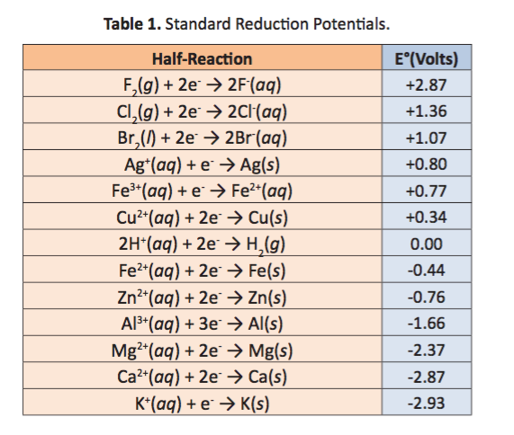
These "Redox half reactions" are tabulated in Chemistry textbooks
But those tables must deal with metals that dissolve as positive ions,
and metals that dissolve as negative ions,
and metals that can have multiple ionic charge states
Their reactions are thus consistently listed showing left to right
addition of electrons to the metal, which Chemists term REDUCTION
(as opposed to loss of electrons, which Chemists term OXIDATION)
This table is from:
https://www.chegg.com/homework-help/questions-and-answers/use-table-1-determine-2-half-reactions-standard-reduction-potentionals-redox-reaction-occu-q9429859
1) Footnote

Slide 31
And aha! The Eº 's must refer to the energy thereby released!
No, that's the Physicist in me jumping to a premature conclusion
Higher Eº values DO reflect a greater tendency of those reactions to proceed
But Chemists label these Redox HALF reactions because they cannot occur alone
Electrons MUST end up moving from one atom to another atom
Thus, in the bigger picture (such as a real world battery)
a rightward half reaction MUST BE COUPLED with a leftward half reaction
One such coupling would be: Cu⁺² + 2 e⁻ <=> Cu with: Zn <=> Zn⁺² + 2 e⁻
Adding these together yields a FULL atom-to-atom charge transfer reaction
(where, because 2e⁻ then appears on both sides, it cancels out): ¹
Cu⁺² + Zn <=> Cu + Zn⁺²
1) Chemistry sources can't make up their mind about how to express an ion's charge, e.g., Cu⁺² vs. Cu²⁺ In my own text and figures I'll just stick with the Physicist's convention of sign then number, e.g., Cu⁺²

Slide 32
Significance & utility of those Eº half reaction "Reduction Potentials?"
Sticking with the example of coupled copper and zinc, the table's entries were:
Cu⁺² + 2 e⁻ <=> Cu
Zn⁺² + 2 e⁻ <=> Zn
Eº = +0.34 V
Eº = -0.76 V
But we inverted the second reaction, which flips the sign on its Eº
Cu⁺² + 2 e⁻ <=> Cu
Zn <=> Zn⁺² + 2 e⁻
Eº = +0.34 V
Eº = +0.76 V
These are then added together to yield a full charge transfer reaction of:
Cu⁺² + Zn <=> Cu + Zn⁺² with a full Eº of: 0.34 V + 0.76 V = 1.10 V
1.10 V is the number with real world significance:
To a Physicist, it's the transferred electrons' change in potential energy / q
Where q = the charge carried by an electron = 1.6 x 10⁻¹⁹ Coulombs
To a Chemist, it's the Voltage established between the Cu and Zn electrodes
1) For a more extensive explanation I recommend these two sources:
https://en.wikipedia.org/wiki/Galvanic_cell https://www.britannica.com/science/oxidation-reduction-reaction/Redox-potentials-for-common-half-reactions

Slide 33
To which one qualifier + one elaboration must be added: ^{1, 2}
Qualifier: Tabulated half reaction Eº potentials assume 1 molar ion concentrations
For other ion concentrations Eº's shift according to the Nernst Equation ³
Elaboration: Combined Eº half potentials => Change in electron potential energy
But while kinetic energy is absolutely defined by the equation 1/2 mv²
Potential energies are not absolute, and are only manifested by their change
e.g., by the change in gravitational energy when an object rises or falls
Eº half potentials are similarly not absolutely defined, instead:
The half reaction 2 H⁺ + 2 e⁻ = H2 is arbitrarily assigned Eº = 0.0 Volts
A Metal's Eº is then defined as the voltage from a cell combining an
electrode of that metal with a "Hydrogen reference electrode" ^{2, 4}
1) https://en.wikipedia.org/wiki/Galvanic_cell 2) https://www.britannica.com/science/oxidation-reduction-reaction/Redox-potentials-for-common-half-reactions
3) https://en.wikipedia.org/wiki/Nernst_equation 4) https://courses.lumenlearning.com/boundless-chemistry/chapter/standard-reduction-potentials/

Slide 34
Batteries in TODAY's homes & ground vehicles
An Introduction to Sustainable Energy Systems: WeCanFigureThisOut.org/ENERGY/Energy_home.htm

Slide 35
Your Car's Starting Battery:
The Rechargeable Lead Acid Battery ¹
Which accounts for nearly one half of today's worldwide batteries
Despite being invented in 1859 (not long after Volta's & Daniell's batteries)
As in other batteries that follow, somewhat conductive metal oxides play a key role:
Lead Acid batteries use Pb as one electrode and PbO2 as the other
These are separated by a sulfuric acid electrolyte (H2SO4 => 2 H⁺ + SO4⁻²)
During discharge, at the somewhat porous / spongy lead anode: ²
Pb is released as ions:
Which react with the acid's SO4⁻²:
Pb(s) => Pb⁺²(aq) + 2 e⁻
Pb⁺²(aq) + SO4⁻² => PbSO4(s)
That PbSO4 solid then precipitates onto the anode's surface
Yielding a combined effective anode half reaction (which is here already reversed):
Pb(s) + SO4⁻² => 2 PbSO₄(s) + 2 e⁻
1) https://en.wikipedia.org/wiki/Lead–acid_battery 2) https://www.ausetute.com.au/pbbattery.html

Slide 36
The cathode discharge half reaction is also multi-step:
The charged cathode consists of solid lead dioxide, PbO2(s), on top of a lead core
During discharge: ¹
PbO2(s) decomposes:
Pb⁺² reacts with acid's SO4⁻²:
PbO2(s) + 4 H⁺(aq) + 2 e⁻ => Pb⁺²(aq) + 2 H2O(aq)
Pb⁺²(aq) + SO4⁻² => PbSO₄(s)
That PbSO4 (s) then precipitates onto the cathode's surface
Yielding a combined effective cathode half reaction of:
PbO2(s) + 4 H⁺(aq) + 2 e⁻ + SO⁴-2(aq) => PbSO4(s) + 2 H2O(l)
Adding anode and cathode half reactions yields the full cell discharge reaction:
Pb(s) + PbO2(s) + 4 H⁺ (aq) + 2 SO4⁺² => 2 PbSO4(s) + 2 H2O(l) Eº = 2.05 Volts
This battery's discharge converts BOTH the Pb anode into PbSO4(s) on a Pb core
AND the PbO2 on a Pb core cathode into PbSO4(s) on a Pb core
1) This is again based on the ONLY website I found providing a COMPLETE view of this battery's inner workings:
AUS-e-TUTE.com.au's https://www.ausetute.com.au/pbbattery.html

Slide 37
Those reactions are unusually complex
Ease of fabrication may thus explain the very early invention of Lead Acid batteries
Their fabrication begins with obtaining two IDENTICAL lead plates:
Which is easy because we've mined & refined lead for thousands of years
Pb
Pb
Next obtain sulfuric acid which, because it forms naturally from water + sulfurous rocks,
has ALSO been known and exploited by man for thousands of years
Immerse one of the lead plates in the sulfuric acid (along with a different metal electrode)
Apply a positive voltage to the lead, driving the reaction:
Pb (solid) + HSO₄⁻ => PbSO₄ (solid) + H⁺ + 2 e⁻
Repeat that process with the other lead plate, leaving you with:
PbSO₄
_{on Pb}
PbSO₄
_{on Pb}

Slide 38
With a gap between those two PbSO4 on Pb plates, immerse both in weak sulfuric acid:
PbSO₄
_{on Pb}
Weak
H₂SO₄
PbSO₄
_{on Pb}
(Discharged)
Apply negative voltage to the left plate, driving its surface back to pure lead:
PbSO₄ (solid) + H⁺ + 2 e⁻ => Pb (solid) + HSO₄⁻
As the positive voltage on the right plate drives its surface from PbSO4 to PbO2:
PbSO₄ (solid) + 2 H₂O => PbO₂ (solid) + HSO₄⁻ + 3 H⁺ + 2 e⁻
Both reactions liberate HSO4- which converts the formerly weak acid to strong acid
The result is a fully charged Lead Acid battery, ready for use:
Pb
Strong
H₂SO₄
PbSO₂
_{on Pb}
(Charged)
Discharge reverses those reactions, restoring the battery to the upper configuration

Slide 39
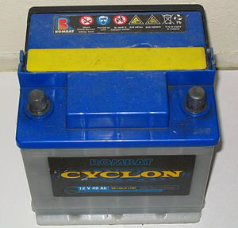
Two ancient technologies: Lead + Sulfuric acid
Which likely explains why the Lead Acid battery could be invented as early as 1859
Nevertheless, when six such cells are connected within a plastic box
you get the 20th century 12 Volt battery that still starts our cars
or the 21st century battery that still stores the energy from
a substantial fraction of our rooftop solar cell arrays
But Lead Acid battery energy storage per weight or volume is not particularly high: ¹
Energy / mass = 33-42 W-h / kg Energy / volume = 60-110 W-h / liter
And Pb-Acid batteries do use (and require the mining and disposal of) toxic lead
But this is mitigated by they're also being the world's most recycled battery:
"In the United States 99% of all battery lead was recycled between 2009 and 2013" ¹
Reference 1 and figure: https://en.wikipedia.org/wiki/Lead–acid_battery
An Introduction to Sustainable Energy Systems: WeCanFigureThisOut.org/ENERGY/Energy_home.htm

Slide 40
Expanded list of Reduction half reactions including metal oxides
As in Lead-Acid
As in Zn-C & Alkalines
From: http://ch302.cm.utexas.edu/echem/echem-cells/selector.php?name=std-red-potentials
Which, in turn, was drawn from a vastly longer Wikipedia listing: https://en.wikipedia.org/wiki/Standard_electrode_potential_(data_page)

Slide 41
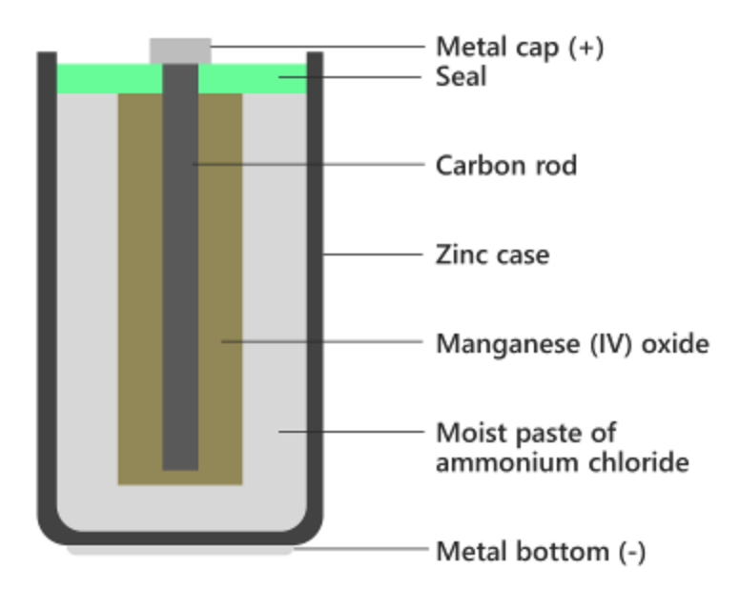
Your Home's Economy Disposable Battery:
The Non-Rechargeable "Zinc Carbon" Battery ¹
It's actually based on Zinc & Manganese Oxide (with carbon playing only a minor role)
A wet version using NH4Cl electrolyte was developed by LeLanche in 1876
A dry version changed the electrolyte to a water-based paste in 1886
That version went on to power the world's first flashlight
Today's heavy duty / dry version uses an electrolyte of NH4Cl plus ZnCl2
At the literal core of the "dry" versions IS carbon powder,
but it is surrounded by wet paper impregnated with MnO2 powder
That MnO2 provides the cathode's electrochemically reactive surface
(and is thus the TRUE cathode material)
The anode is the battery's outer Zinc metal case
The separating electrolyte is NH4Cl or NH4Cl + ZnCl2 paste:
1) https://en.wikipedia.org/wiki/Zinc%E2%80%93carbon_battery
Figure adapted from: https://www.diligentshopper.com/primary-batteries-types-and-performance/
& zinc chloride

Slide 42
Pinning down this battery's exact chemistry is surprisingly difficult:
Confusion is produced by the (often ignored) multiplicity of versions:
"Wet" with NH4Cl vs. "Dry" with NH4Cl vs. "Dry" with NH4Cl and ZnCl2
And by the failure of many/most academic & tutorial websites to even acknowledge
any but the oldest / now hopelessly dated and obsolete 1876 "wet" version
And by the fact that, within the newest Dry / NH4Cl + ZnCl2 / Heavy Duty version,
both H2 and NH3 gases are produced which, within the sealed battery,
then reabsorb via secondary reactions with the Zn, MnO2 & electrolytes
And by the fact that scientists are still arguing about those secondary reactions
From three such websites ¹⁻³ the incomplete/semi-obvious Anode & Cathode reactions were:
Anode: Zn(s) => Zn⁺² + 2 e- Cathode: MnO2 + 2e– => Mn2O3
But concerning the omitted details, for not one of the three Zn-C battery versions
could I seem to get even two of those three websites to fully agree!
1)Wikipedia: https://en.wikipedia.org/wiki/Zinc%E2%80%93carbon_battery 2) Cambridge University: https://www.doitpoms.ac.uk/tlplib/batteries/batteries_zn_c.php 3) Electrical4U.com: https://www.electrical4u.com/zinc-carbon-battery/

Slide 43
Thus focusing on only points of apparent agreement:
Regarding the more modern "dry" versions of "Zinc-Carbon" battery:
Discharge converts the Cathode's MnO2 to Mn2O3
And, at least along the way, discharge converts the Anode's Zn to Zn⁺²
During discharge battery output drifts significantly downward thru 1.5 Volts
Once discharged, a Zn-C battery cannot be recharged
Making it a Primary / Charged-as-built / Single-use battery
Sitting on a shelf (awaiting that single use) Zn-C batteries last only 1-2 years
Zinc-Carbon batteries enabled the 1st generation of portable electronic devices
But the stunning success & popularity of those devices only highlighted
the shortcomings of the Zn-C batteries upon which the depended
Which stimulated R&D on whole new types of batteries including:

Slide 44
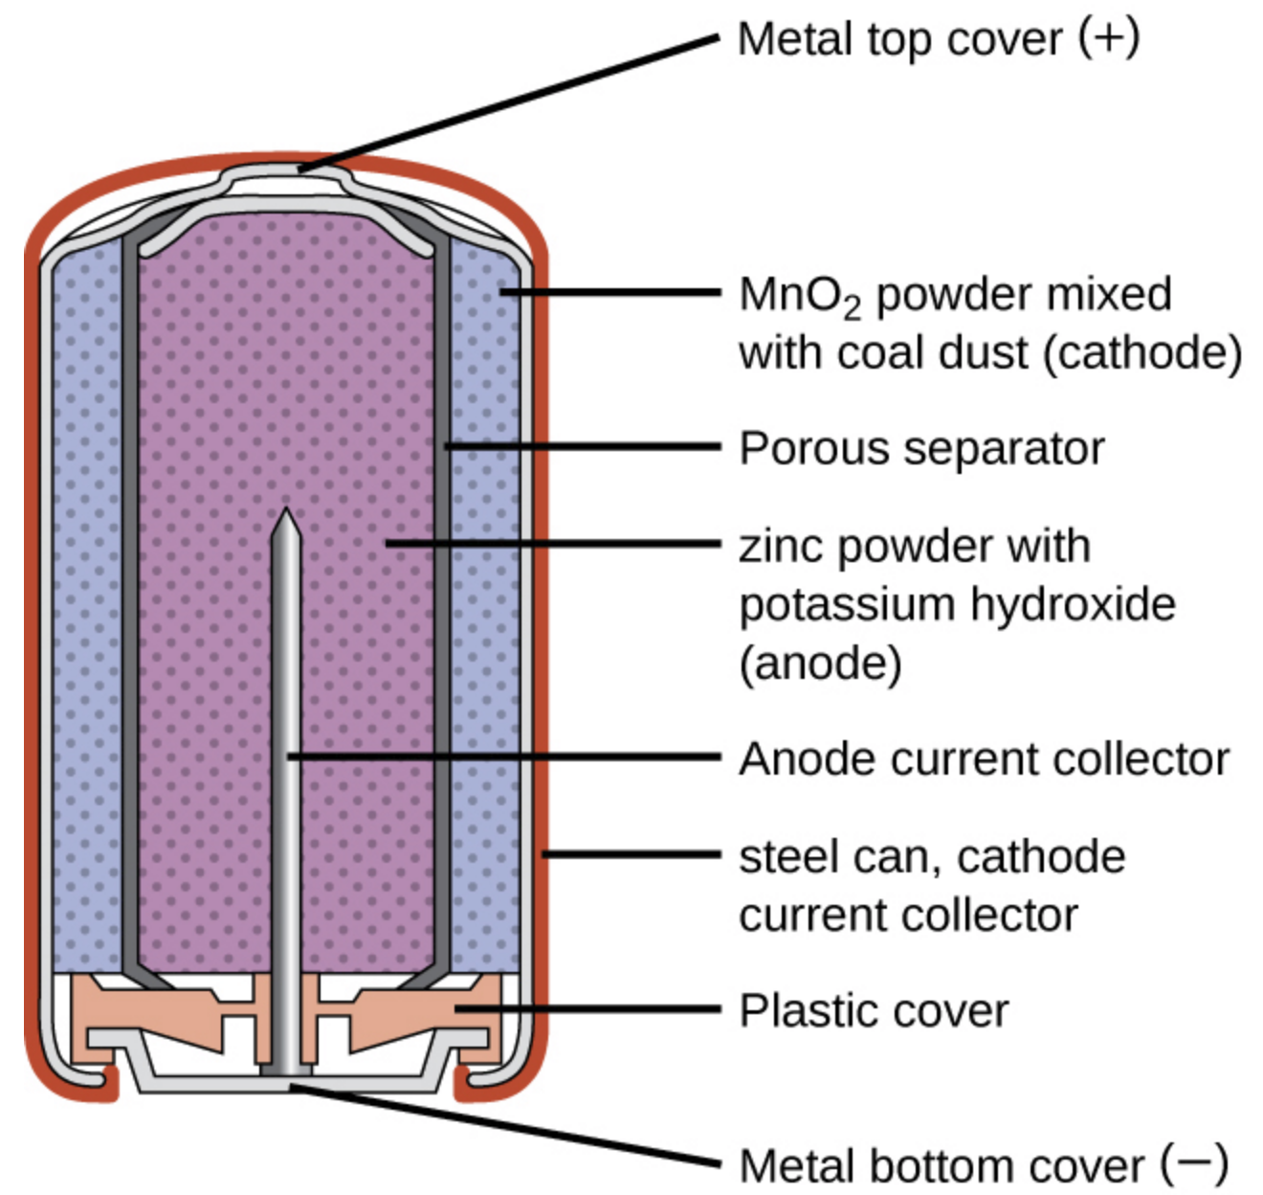
Your Home's Premium Disposable Battery:
The Non-Rechargeable Alkaline Battery
Early versions echoed the "Zinc Carbon" battery by also exploiting Zn and MnO2
which were both used in the form of wet compacted powders:
Figure: https://opentextbc.ca/chemistry/chapter/17-5-batteries-and-fuel-cells/
An Introduction to Sustainable Energy Systems: WeCanFigureThisOut.org/ENERGY/Energy_home.htm

Slide 45
But alkaline KOH electrolyte dramatically changed the inner workings:
With this chemistry, only OH⁻ ions move between the anode and cathode
And metal is neither dissolved from, nor deposited on, those electrodes
Instead, as seen in my simplified representation:
Anode (Zn/ZnO)
-
Cathode (MnO₂/Mn₂O₃)
O
H ⁻
-
O
O
-
H ⁻
O
H ⁻
O
H ⁻
During discharge the left Zn anode's surface literally oxidizes:
Zn (solid) + 2 OH⁻ <=> ZnO (solid) + H₂O + 2e⁻
With that oxygen coming from atoms leeched out of the MnO2 cathode:
2 MnO₂(solid) + H₂O + 2e⁻ <=> Mn₂O₃(solid) + 2 OH⁻
And then transported via the OH⁻ ions in the alkaline KOH electrolyte

Slide 46
Using Zn and MnO2:
This Alkaline Battery has the same 1.5 Volt output as the Zinc-Carbon Battery
But the Alkaline Battery has a longer shelf-life (up to 10 years vs. Zn-C's 1-2 years) ¹
Further, it stores significantly more energy per battery mass,
which is explained by its use of both dense MnO2 and its
elimination of the Zn-C's wet-paper-wrapped carbon powder core ²
But can these Alkaline Batteries be recharged (unlike their older Zn-C cousins)?
Yes and No
Standard Alkaline batteries can rupture upon attempted recharge
Ruining the battery and releasing its very corrosive KOH electrolyte
But tweaked versions can reportedly withstand a small number of recharges ^{2, 3}
(Classifying it as a barely / possibly-hazardously rechargeable battery?)
1) https://batteryuniversity.com/learn/article/primary_batteries
2) https://en.wikipedia.org/wiki/Alkaline_battery
3) https://batteryuniversity.com/learn/archive/will_the_reusable_alkaline_battery_have_a_future

Slide 47
Putting this all together, regarding Zn-MnO2 Alkaline Batteries:
Wikipedia's "Alkaline Battery" webpage reports that they: ¹
"Account for 80% of manufactured batteries in the US and over 10 billion individual units produced worldwide.
In Japan alkaline batteries account for 46% of all primary (non-rechargeable) ² battery sales.
In Switzerland alkaline batteries account for 68%, in the UK 60% and in the EU 47% of all battery sales including secondary (rechargeable) ² types.
Alkaline batteries contain zinc and manganese dioxide, which can be toxic in higher concentrations. However, compared to other battery types, the toxicity of alkaline batteries is moderate."
But that webpage succumbs to the recurrent tendency of mis-naming batteries
As seen earlier in the mis-naming of Zn-MnO2 Batteries as Zn-Carbon Batteries
And seen here in the equating of Alkaline Battery with Zn-MnO2 Alkaline Battery,
despite Ni-Cd & Ni-Metal Hydride Batteries ALSO being Alkaline Batteries!
1) https://en.wikipedia.org/wiki/Alkaline_battery 2) Parenthetical definitions added
But, that Wikipedia webpage seemingly compounds a tendency to misname

Slide 48
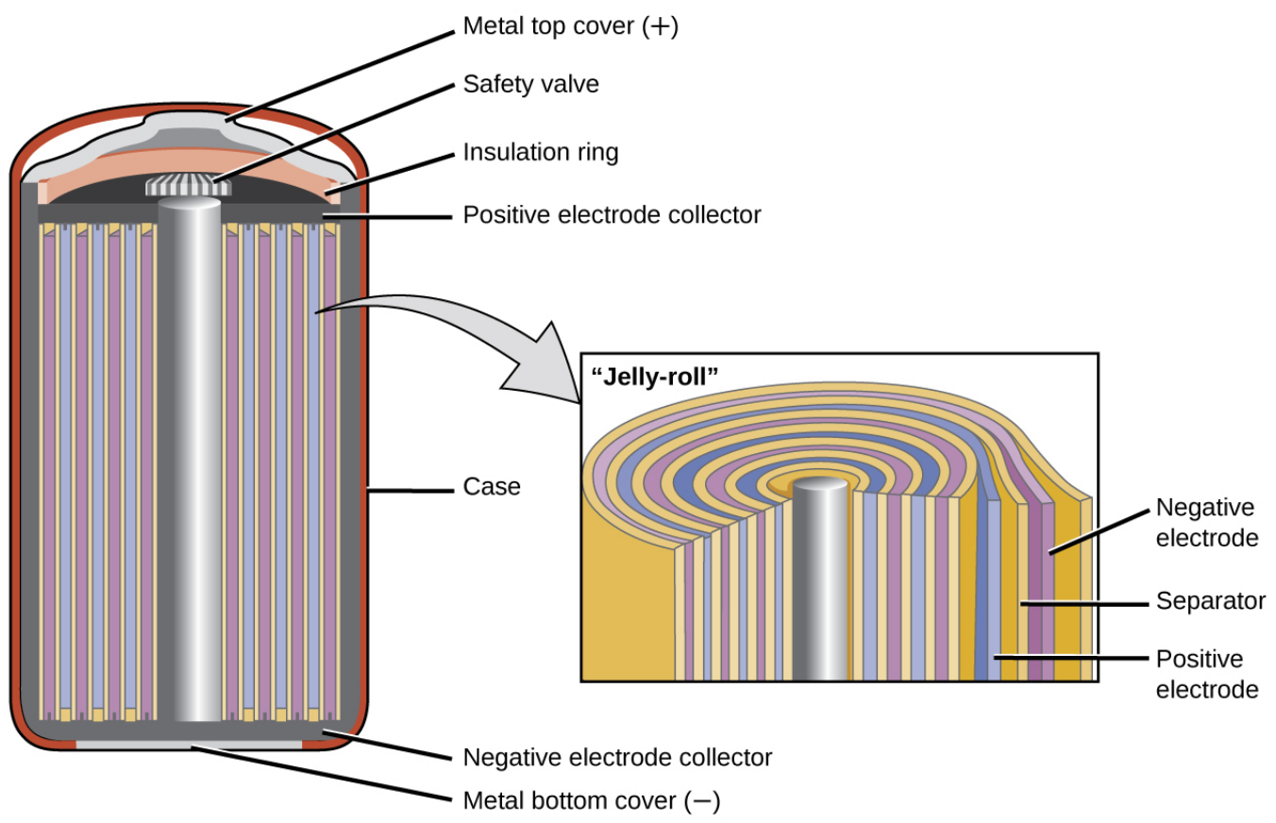
Your Home's Older Reusable Battery:
The Rechargeable Nickel Cadmium (Ni-Cd) Battery ^{1, 2}
Invented in 1899 and which, per my preceding editorial,
really should be called the Nickel Cadmium (Ni-Cd) Alkaline Battery
Which now mostly use a "Jelly-roll" spiral of stacked anode, separator & cathode layers
The half reaction within the spiraling cold-pressed-powder anode layer is:
Cd (s) + 2 OH⁻ (aq)=> Cd(OH)2 (s) + 2 e⁻
The half reaction within the spiraling "sintered" (hot-pressed-powder) cathode layer is:
NiO(OH) (s) + H2O + 2 e⁻ => Ni(OH)2 (s) + OH⁻ (aq)
Figure and reference #1) https://opentextbc.ca/chemistry/chapter/17-5-batteries-and-fuel-cells/ 2) https://en.wikipedia.org/wiki/Nickel%E2%80%93cadmium_battery

Slide 49
Ni-Cd Battery Pluses: ¹⁻⁴
They have an exceptionally long shelf life ¹
They are rechargeable as many as two thousand times ²
They can be recharged exceptionally quickly (< 1 hour) ¹
Once charged, they remain charged for moderately long periods of time ²
During discharge their voltage output is nearly constant (~ 1.2 Volts / cell) ^{2, 3}
During discharge they can sustain continuous exceptionally high currents ^{2, 3}
They are "one of the most rugged and forgiving batteries" => Continued airline use ¹
They are the cheapest battery in terms of lifetime energy delivered per cost ¹
Making them the "go-to" power tool battery well into the 21st century ⁵
1) https://batteryuniversity.com/learn/article/nickel_based_batteries 2) https://en.wikipedia.org/wiki/Nickel%E2%80%93cadmium_battery 3) https://opentextbc.ca/chemistry/chapter/17-5-batteries-and-fuel-cells/ 4) https://batteryuniversity.com/learn/archive/memory_myth_or_fact 5) Here I take issue with Wikipedia based on my decades of home DIY & Habitat for Humanity power tool experience

Slide 50
Ni-Cd Battery Minuses: ¹⁻⁴
The cost of their Ni and Cd constituents is relatively high ^{1, 2}
Their self-discharge rate is higher than desirable for many applications
Their energy stored per mass is lower than desirable for many applications
The toxicity of Cd means that they should not be disposed of in land fills ¹
Leading to a EU ban for all but replacement & special applications (e.g., medical) ²
They were reported to exhibit a Memory Effect: 2, 4
"Meaning that a nickel-cadmium battery could remember how much energy was drawn on previous discharges and would not deliver more than was demanded before." ⁴
For which the reported cure is periodic "rejuvenating" full battery discharges
Degradation (possibly catastrophic) ALSO occurs in batteries about to be discussed
So the source of NiCd "Memory" is worth closer examination:
1) https://batteryuniversity.com/learn/article/nickel_based_batteries 2) https://en.wikipedia.org/wiki/Nickel%E2%80%93cadmium_battery 3) https://opentextbc.ca/chemistry/chapter/17-5-batteries-and-fuel-cells/ 4) https://batteryuniversity.com/learn/archive/memory_myth_or_fact

Slide 51
A nanoscale explanation of Ni-Cd battery "Memory:"
As discussed (and depicted) in a slide far above:
Material leaving an electrode during discharge
Must be driven back onto (or into) that electrode during recharge
But returning atoms don't naturally lay back down in flat planes
On crystals they favor only certain planes, leading to growth of dendrite spires
As seen for sugar crystals: Or represented on a battery electrode:
Something similar occurs when Cd(OH)2 reforms on a NiCd's anode during recharge:
An Introduction to Sustainable Energy Systems: WeCanFigureThisOut.org/ENERGY/Energy_home.htm

Slide 52
As documented on a Battery University Webpage: ¹
Scanning electron micrograph of a new NiCd battery anode:
"Hexagonal cadmium-hydroxide crystals are about 1 micron in cross section, exposing large surface area to the electrolyte for maximum performance"
Micrograph of anode after many cycles of battery discharge-recharge:
"Crystals have grown to 50 to 100 microns in cross section, concealing large portions of the active material from the electrolyte. Jagged edges and sharp corners can pierce the separator, leading to increased self-discharge or electrical shorts."
Micrograph of anode after a pulsed charge or deep rejuvenation discharge:
"After a pulsed charge, the crystals are reduced to 3–5 microns, an almost 100% restoration. Exercise or recondition (a.k.a. rejuvenation) is needed if the pulse charge alone is not effective."
1) https://batteryuniversity.com/learn/archive/memory_myth_or_fact

Slide 53
Your Home's Newer Reusable Battery:
The Rechargeable Ni Metal Hydride (NiMH) Battery
Which is ALSO an "Alkaline Battery" - just using different electrode materials:
Anode half reaction: M (solid) + H₂O + e⁻ <=> MH (solid) + OH⁻
Where metal (M) is some combination of La, Ce, Nd, Pr, Co, Mn, Al, V, Zr or Ni ¹
Cathode half reaction: Ni(OH)₂ (solid) + OH⁻ => NiO(OH) (solid) + H₂O + e⁻
Electrolyte: As used in all of these Alkaline Batteries - Potassium Hydroxide
Then representable (via minimal relabeling) by my introductory Alkaline Battery figure:
Anode (Metal alloy)
-
Cathode (Ni(OH)₂)
O
H ⁻
-
O
O
-
H ⁻
O
H ⁻
O
H ⁻
1) https://en.wikipedia.org/wiki/Nickel%E2%80%93metal_hydride_battery

Slide 54
NiMH Battery Pluses:
A less toxic metal alloy anode replaces the toxic Cd anode of Ni-Cd Alkaline batteries ¹
Energy storage capacity is higher than Ni-Cd's (claims: 50% higher ² vs. 2-3X higher ¹)
Their high energy storage per mass approaches that of a lithium ion battery ¹
They can sustain high output currents
NiMH Battery Minuses:
"More delicate and trickier to charge than NiCd" / "Limited service life" ²
Standard version NiMH batteries have a high self-discharge rate ^{1, 2}
Output declines to 1.0-1.2 Volts ¹ vs. the 1.2-1.5 V of earlier Zn-C & Alkaline batteries
Consequently: NiMH batteries are NOT always an acceptable substitute
Wikipedia: "Voltage depression (often mistakenly attributed to the memory effect) from repeated partial discharge . . reversible with a few full discharge/charge cycles" ¹
Battery University: "Less prone to memory than NiCd, can be rejuvenated" ²
1) https://en.wikipedia.org/wiki/Nickel%E2%80%93metal_hydride_battery 2) https://batteryuniversity.com/learn/article/nickel_based_batteries

Slide 55
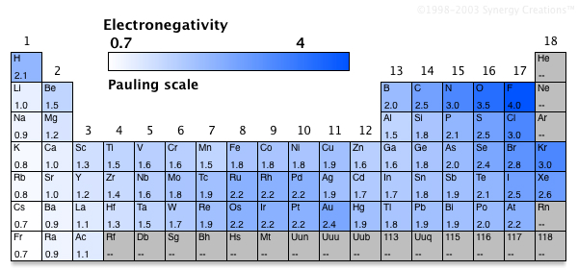
Bringing us to the broad category of Lithium-Based Batteries ¹
These batteries increase their output voltage (and hence power)
by pairing electrodes with radically different "electronegativities"
(which is a measure of how strongly a material holds on to its electrons)
Least electronegative (more electropositive) are elements leftmost in Periodic Table
These "Group I" / "Alkali metals" are Li, Na, K, Rb, Cs, Fr
To maximize battery voltage, those electropositive alkali metals should be paired
with a highly electronegative atom (top / right in Periodic Table) or compound
Figure: http://www.chemistry-reference.com/pdictable/

Slide 56
Certain parings can double the battery's voltage
For instance, Li + MnO2 yields a 3.3 Volt battery (vs. 1.0-1.5 Volts of non-Li batteries)
For the same stored charge, that means twice the stored energy
Li has another advantage: High in the Periodic Table, it is the lightest Alkali Metal
Paired with light cathodes, Li-based batteries will thus be exceptionally light
Combining these points: Li-based batteries pack MUCH more energy per mass
Making them an obvious choice for portable electronic devices
And a seemingly obvious choice for battery-powered flight (more about that later)
But now comes the bad news: Oxygen is the second most electronegative element
Oxygen + alkali metal thus maximizes the energy of electron transfer
But oxygen is lurking all around us (not only in air but in water & its ubiquitous vapor)
Alkali metals begin to smolder almost immediately in the presence of oxygen
Alkali metals burst into flames and/or violently explode in the presence of water

Slide 57
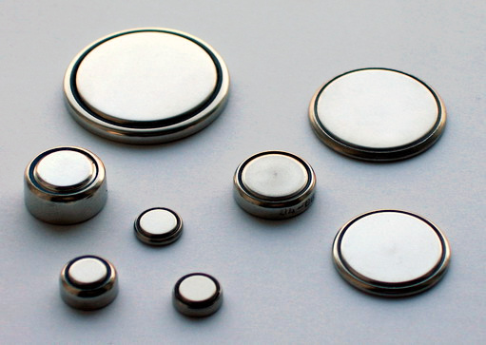
Your Home's tiniest batteries:
The Non-Rechargeable Lithium Battery / Lithium Metal Battery ¹
The latter name is more descriptive as it suggests the use of pure Li metal
Which is indeed what is used as the anode in such batteries
Simplified schematic of Li Metal / MnO2 Battery: Actual Lithium Metal Batteries: ²
Anode (Li)
-
Cathode (MnO₂/Mn₂O₃)
+
-
-
+
+
+
But the choice of electrolyte suddenly becomes very complicated ¹
Because, unlike the electrolytes of ALL the batteries discussed to this point,
the electrolytes of Li-based batteries MUST NOT contain water
Instead, organic solvents are substituted (which, BTW, are flammable)
In a Li Metal / MnO2 battery, the electrolyte is LiClO4 dissolved in C4H6O3 ¹
1) https://en.wikipedia.org/wiki/Lithium_battery 2) https://learn.adafruit.com/all-about-batteries/lithium-batteries-and-coin-cells

Slide 58
Lithium Metal batteries cannot be safely recharged:
Because, as Li returns to the anode, it grows dendrites
Which, in a practically thin battery, can grow all the way to the cathode
And cannot be reliably blocked even when a separator is added
Anode (Li)
Cathode (MnO₂/Mn₂O₃)
Anode (Li)
Cathode (MnO₂/Mn₂O₃)
An anode-cathode spanning dendrite would instantaneously discharge the battery
Possibly even liberating enough power to split open it's shell,
which would then additionally allow the organic electrolyte to catch on fire
Li-Metal batteries are thus distinctly non-rechargeable
And, for consumer use, they are largely limited to small button-style batteries

Slide 59
Your Home's, Car's, Tool's, Solar Array's . . . Newest Reusable Battery:
A Rechargeable Lithium-Ion Battery
The name "Lithium-Ion" distinguishes these from the Lithium Metal batteries, above
But it doesn't actually explain HOW these Li Ion batteries are different
The difference is that these batteries eliminate pure Li anodes
and, during discharge, eliminate Li-coated cathode surfaces
They do this by exploiting Li's exceptionally small size,
which gives Li the ability to actually slither INSIDE certain other materials
Then, during discharge, there's more room for Li inside the cathode than on its surface,
which allows the battery to discharge longer / supply more power
And during recharge, going back inside the anode, Li dendrites are less likely to form,
which makes catastrophic short circuits less likely
Finally, closeted inside anodes & cathodes, Li cannot react as quickly with any invading O2,
which means that even if a short circuit does occur,
the chance of fire, or at least of intense fire, is reduced

Slide 60
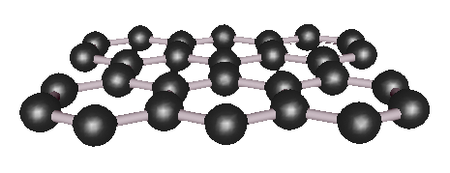
For the Li-absorbing Anode, the common choice is crystalline Graphite:
Graphite is one of carbon's two crystalline forms (the other is diamond)
In Graphite, carbon bonds into planes, which are only weakly attracted to one another
Forming, as shown in this interactive 3D model from my Nanocarbon webpage: ¹
As the anode of a Li-Ion battery, graphite can be represented edge on as:
Li charged anode:
Discharging anode:
Discharged anode:
-
+
1) https://www.WeCanFigureThisOut.org/VL/Nanocarbon.htm

Slide 61
For the Li-absorbing Cathode, a common choice is crystalline LiCoO2:
CoO₂ crystals also have layers between which Li can slither
As the cathode of a Li-Ion battery, LiCoO2 can be represented edge on as:
Charged battery:
Discharging battery:
Discharged battery
-
+
Combining these Anode and Cathode behaviors
produces what is called the Lithium Cobalt Oxide (LCO) Li-Ion Battery:
An Introduction to Sustainable Energy Systems: WeCanFigureThisOut.org/ENERGY/Energy_home.htm

Slide 62
The LCO Li-Ion Battery structure and behavior:
DISCHARGE transfers Li from inside the anode to inside the cathode:
-
-
Anode:
Li desorbing
and ionizing
+
Cathode:
Li absorbing and deionizing
-
+
CHARGING transfers Li back from inside the cathode to inside the anode
-
-
Anode:
Li absorbing
and deionizing
+
Cathode:
Li dissolving and ionizing
-
+
Where is the added anode / cathode separator

Slide 63
But other materials can be used as the cathode:
Possible replacements for Lithium Cobalt Oxide (LiCoO2) - LCO include:
Lithium Manganese Oxide (LiMnO2) - LMO
Lithium Nickel Manganese Cobalt Oxide (LiMnCoO2) - NMC
Lithium Iron Phosphate (LiFePO4) - LFP
Lithium Nickel Cobalt Aluminum Oxide (LiNiCoAl02) - NCA
Why bother with so many alternatives?
Because they subtly alter the Li-Ion Battery's characteristics
Which, in turn, changes the applications for which the battery is best suited
Drawing from the exceptionally complete Battery University website, ¹
but augmented by data from additional sources, ²⁻⁵ here is a comparison table:
1) https://batteryuniversity.com/learn/article/types_of_lithium_ion 2) https://en.wikipedia.org/wiki/Comparison_of_commercial_battery_types 3) https://iopscience.iop.org/article/10.1088/1757-899X/211/1/012005/pdf 4( https://iopscience.iop.org/article/10.1088/1757-899X/252/1/012058/pdf 5) https://www.osti.gov/biblio/1561559

Slide 64
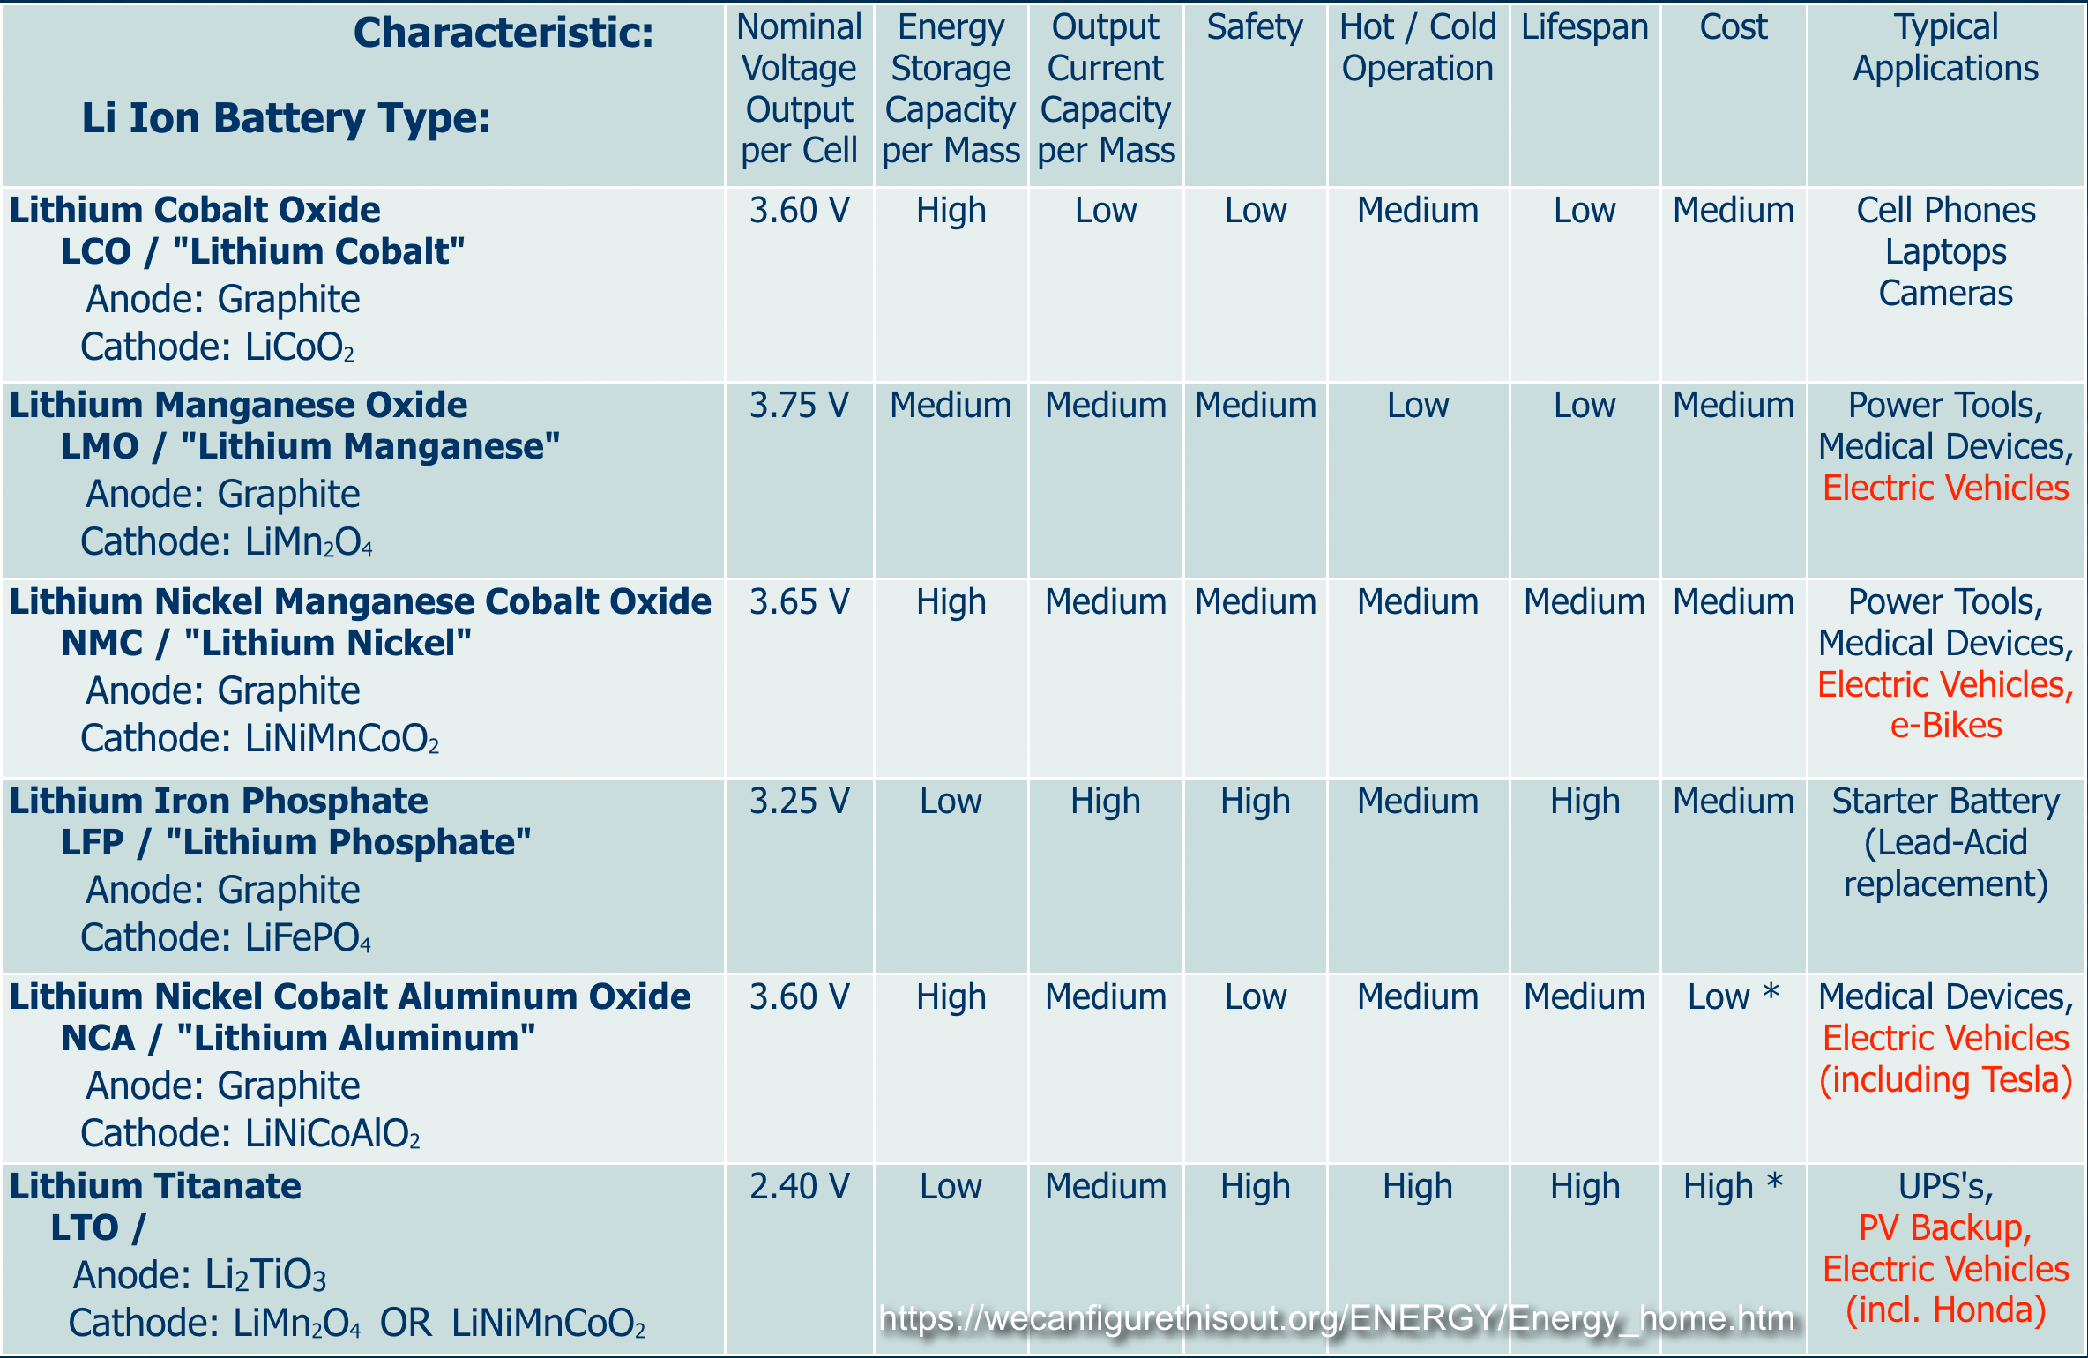
Comparison of the most common Li Ion Battery types ¹
1) This table was largely constructed from data on: https://batteryuniversity.com/learn/article/types_of_lithium_ion
* But where that source's text & figures were inconsistent, data from multiple additional sources was also incorporated

Slide 65
But if you read that table very carefully, you also noticed that:
The final Lithium-Ion Battery did NOT use Graphite as its anode
And it's name and acronym did NOT refer to its cathode
Instead, the so-called Lithium Titanate - LTO battery used:
LiTiO4 as its anode
And either LiMn2O4 or LiNiMnCoO2 as its cathode
Is LTO the only Li-Ion battery NOT using Graphite at its anode?
No, an alternative is Silicon, which behaves in a very strange way,
often using non-naturally-occuring / manmade Nanostructures
Despite being just below C in the periodic table,
Si does not readily form a layered Graphite-like structure
But its does mimic C's other crystalline form, that of Diamond
And in Si's diamond-like form its Si atoms are more widely spaced,
allowing for potentially even greater & faster incorporation of Li atoms

Slide 66
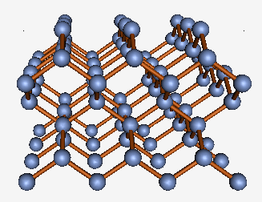
Comparison of Diamond Carbon and Silicon Crystals:
As depicted in the interactive 3D models elsewhere on this website:
Diamond Carbon (0.154 nm long bonds) ¹ Silicon (0.235 nm long bonds) ²
1) https://www.WeCanFigureThisOut.org/VL/Nanocarbon.htm
2) https://www.WeCanFigureThisOut.org/VL/Semiconductor_crystals.htm
Due to its long use providing the foundation of the microelectronics industry:
Silicon crystals of incredible perfection and purity are readily available
They come in huge sizes (30 cm dia. x meters long)
And can be purchased as precut fully polished wafers for only ten's of dollars
i.e., they are almost begging to be used as battery electrodes!
An Introduction to Sustainable Energy Systems: WeCanFigureThisOut.org/ENERGY/Energy_home.htm

Slide 67
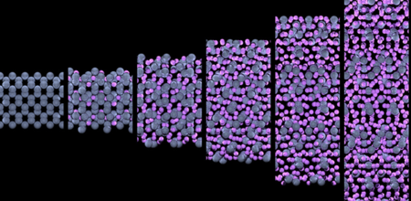
But there is still a problem (or challenge) for Si anodes:
To increase Li battery capacity we want to cram huge amounts of Li into the anode
But when that much slithers into its spaces, the Si crystal actually expands
With enough added Li, silicon expands by 2-3 times, actually changing its structure:
Top from my "Virtual Lab" website: https://www.WeCanFigureThisOut.org/VL/Semiconductor_crystals.htm
Bottom: http://www.greencarcongress.com/2014/02/20140204-nmr.html

Slide 68
But when a Li ion battery discharges, its Si anode must shrink & reorder:
And, at the very least, we want it to do that a few hundred times
But during charging it's likely that Li is not added uniformly to the Si
And during discharging it's likely that Li is not removed uniformly
The resulting non-uniform expansion and contraction of the silicon produces
huge non-uniform stress across the crystal,
leading to the development of cracks and fractures
With these cracks / fractures, as silicon shrinks upon battery discharge:
Si pieces separate meaning that
electrical contact between those pieces is lost
Shrinking the anode's effective size & capacity

Slide 69
A solution can be provided by forms of nanoscale self-assembly:
For instance: On a Si wafer, create a nanopattern of metal dots,
heat them to melting, and then expose them to SiH₄ vapor:
<= SiH₄ vapor approaching one of a vast array
of now molten metal dots
Si
The SiH₄ vapor decomposes, releasing Si to dissolve into the molten metal dot
Si
Si diffuses down to wafer where it solidifies creating a growing column of new Si:
Si
For details see my Nano class lecture note set: The Need for Self-Assembly

Slide 70
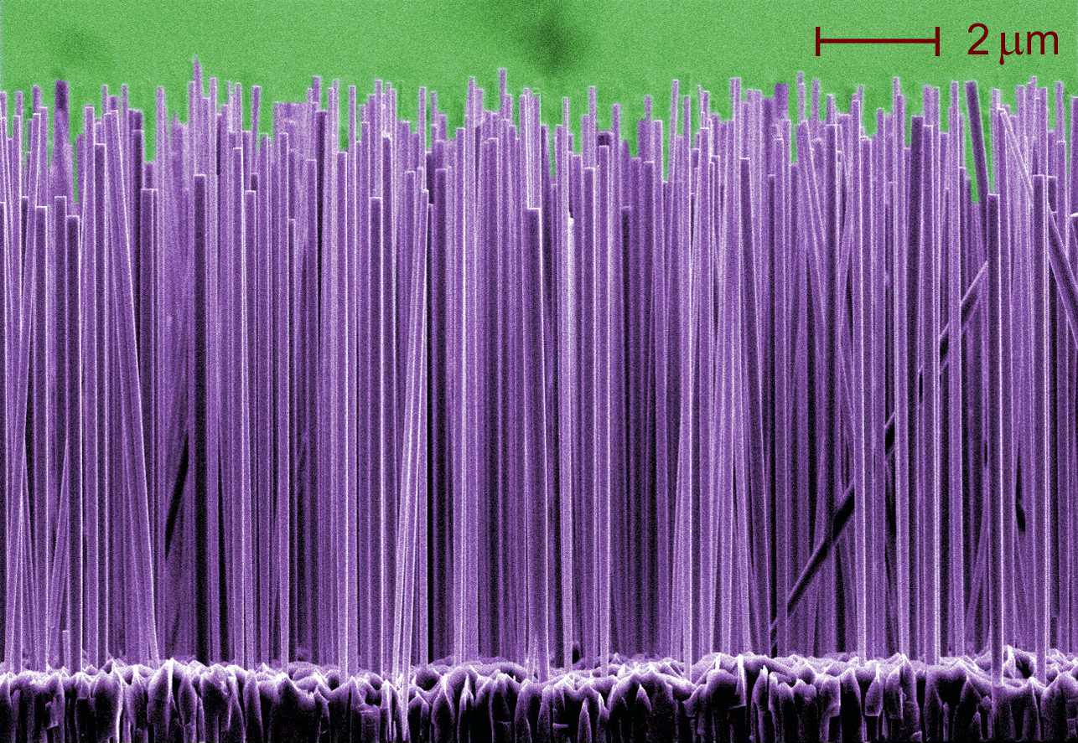
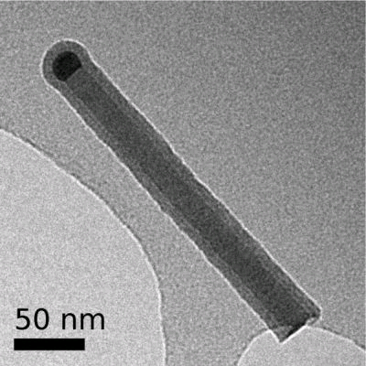
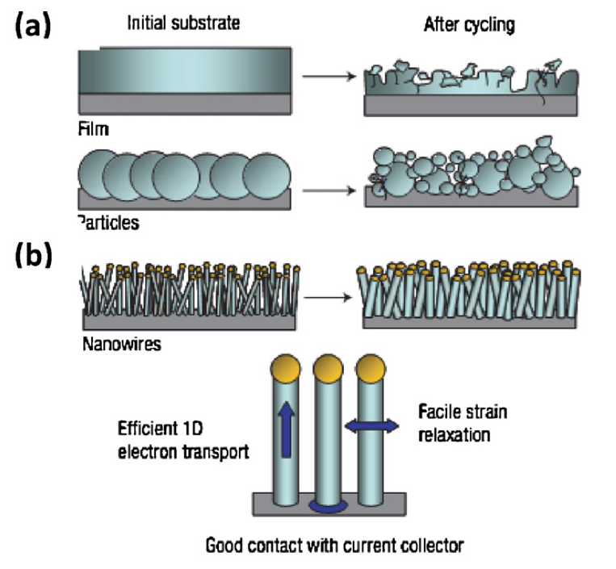
The result is a tight array of Silicon nanowires:
Lorelle Mansfield -NIST:
http://www.nist.gov/public_affairs/techbeat/tb2006_0525.htm
U. Helsinki: www.micronova.fi/units/ntq/research/nanowires.php
Small size / accessibility => Uniform Li absorption & stress, minimal Si cracking:
Nano-structured
Li ion battery anodes
Designing nanostructured Si anodes for high energy lithium batteries, Wu & Cui, Nano Today 7, pp 414-29 (2012)

Slide 71
But before moving on to such futuristic batteries
There is an important topic I've alluded to but now need to confront head on:
Li-Ion Battery Fires
The YouTube video below illustrates the explosive intensity of such fires (link) ¹
Li batteries are now credibly linked to at least six major on-aircraft fires ^{2, 3}
at least two of which progressed into fatal cargo aircraft crashes ^{4, 5}
And by 2017 the FAA said aircraft Li-battery fires were averaging one every ten days ⁶
1) Functional Macromolecular Laboratory - University of Maryland: https://www.youtube.com/watch?v=HCGtRgBUHX8
2) https://www.faa.gov/hazmat/resources/lithium_batteries/media/Battery_incident_chart.pdf
3) https://www.consumerreports.org/faa/battery-fire-in-delta-cargo-hold/
4) https://www.flyingmag.com/news/ups-747-crash-highlights-lithium-battery-danger/ 5) https://en.wikipedia.org/wiki/Asiana_Airlines_Flight_991 6) https://www.consumerreports.org/product-safety/whats-behind-the-increase-in-lithium-ion-battery-fires-on-planes/

Slide 72
All you need is a short-circuit
In that video, an external one was produced by wiring the battery's terminals together
But nature is perfectly capable of producing it own internal short circuits via
dendrites grown while recharging the solid Li anodes of Li-Metal Batteries
And adding dendrite-blocking separator barriers ( ) is less than 100% effective
Which is what led to the use of Li absorbing anodes in Li-Ion Batteries:
-
-
+
+
But, under certain conditions, dendrites can STILL form on such Li-absorbing anodes

Slide 73
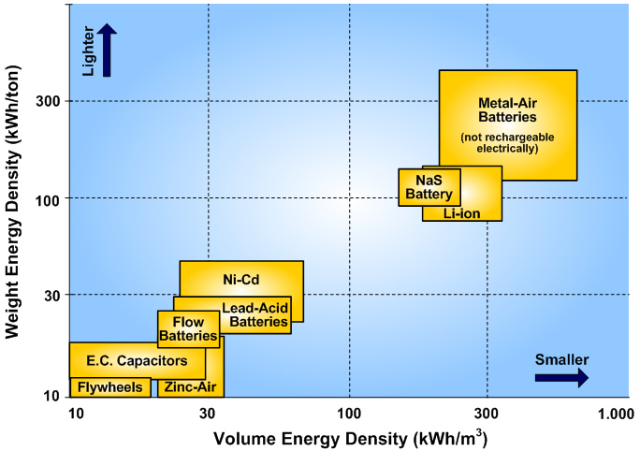
OK, but why is this a uniquely Li battery problem?
It isn't: Dendrites regularly short out all kinds of batteries
But when that happens (as it has repeatedly in my power tool Ni-Cd batteries),
other types of battery mostly just quietly (if expensively) DIE
Why? Because, when shorted out, they don't release ENOUGH energy
But Li-Ion batteries easily pack an order of magnitude MORE energy
Which, abruptly liberated, IS ENOUGH to start a fire or initiate an explosion
Li Ion batteries
More conventional batteries
Figure: http://www.sc.ehu.es/sbweb/energias-renovables/temas/almacenamiento/almacenamiento.html

Slide 74
So it's more about the intensity of failure, rather than the frequency
Because, as argued by American Chemical Society, frequency isn't extraordinarily high:
"Failure rates for rechargeable Li-ion batteries are on the order of one in 10 million
That’s not a reliability problem. It’s an exception" ¹
But when such an "exception" does occur, it is going to be intense,
intensity increased by Li batteries' necessary use of non-water electrolytes:
"Unlike other common types of batteries, in which the electrolytes consist of aqueous solutions of acid or base, the electrolyte in Li-ion cells typically consists of lithium salts in flammable organic solvents such as ethylene carbonate and ethyl methyl carbonate." ¹
Meaning that what begins as a simple Li oxidation fire
quickly becomes a Li plus electrolyte fire
which may soon be joined by a polymer-based separator fire
meaning that pretty much 100% of the battery will soon be contributing
(at least if the battery has not already blown itself apart)
1) http://cen.acs.org/articles/91/i6/Assessing-Safety-Lithium-Ion-Batteries.html

Slide 75
Batteries in TOMORROW's homes & ground vehicles
An Introduction to Sustainable Energy Systems: WeCanFigureThisOut.org/ENERGY/Energy_home.htm

Slide 76
Electric vehicles are now a prime target of battery R&D
Because clean power plants serving electrified ground transportation
offers one of our best ways of mitigating climate change
At least, if we transition to BOTH clean power plants AND electric vehicles
Because Electric Vehicles (EV's) powered by less than clean power plants
is just naive way of passing the greenhouse emissions buck
But if we DO soon get our clean power plant act together:
The number of electric ground vehicles x Battery capacity per vehicle = HUGE!
However, EV applications put stellar demands upon batteries - for instance:
We'd like EV batteries charging in the mere minutes we now use to fill gas tanks
And with EV's like Tesla's Model S packing 8,256 individual batteries, ¹
probability of fire per battery better be nothing short of spectacularly low
All of which puts tremendous pressure on the development of:
1) https://link.springer.com/article/10.1007/s41918-019-00060-4

Slide 77
Tomorrow's Li-Ion Batteries:
For which the search for better Li-storing electrode materials continues unabated
But new R&D also targets four other parts of the Li-Ion battery:
Possibly Li ion-blocking and/or dendrite-nucleating surface layers on the:
:
Anode ("Solid Electrode Interfaces" - SEI's)
Cathode ("Interfacial Protective Films" - IPF's)*
Anode
Cathode
Better Dendrite-Blocking Separators
Dendrite-Blocking Electrolytes
*In some publications ¹ these are instead labeled "Cathode Electrode Interface" (CEI ) layers
1) For instance: https://link.springer.com/article/10.1007/s41918-019-00060-4

Slide 78
Li-Ion R&D Parts I & II: Electrode Interface Layers:
Crystals form when the atoms of a material find
particularly low-energy / regularly-ordered ways of binding to one another
In Graphite, energy is minimized when each C atom has three bonding neighbors,
with those bonds equally spaced in 2D (120º apart):
But atoms at this crystal's EDGES DO NOT HAVE three bonding neighbors!
In Diamond C & Si, energy is minimized when each atom has four bonding neighbors,
with those bonds equally spaced in 3D (about 109º apart):
But atoms at this crystal's EDGES DO NOT HAVE four bonding neighbors!
Edge atoms are thus left very "unhappy" (i.e., chemically reactive)

Slide 79
In Li-Ion Batteries, both the Anode and Cathode are crystals:
And the atoms of their surfaces are thus left similarly unhappy / chemically reactive:
Anode
Cathode
But in the electrolyte's chemical soup, they can find lots of things to react with!
Leading to rapid formation of Surface Electrode Interface (SIE) anode layers
as well as Interfacial Protective Film (IPF) cathode layers
Anode
Cathode
An Introduction to Sustainable Energy Systems: WeCanFigureThisOut.org/ENERGY/Energy_home.htm

Slide 80
Which can potentially cripple Li-Ion Battery operation:
DISCHARGING: Li blocked from leaving the anode (preventing discharge) and/or
absorbing into the cathode (driving growth of surface dendrites):
-
-
Anode:
Li TRYING to desorb & ionize
+
Cathode:
Li TRYING to absorb & deionize
-
+
CHARGING: Li blocked from leaving the cathode (preventing recharge) and/or
absorbing into the anode (driving growth of surface dendrites):
-
-
Anode:
Li TRYING to absorb & deionize
+
Cathode:
Li TRYING to dissolve & ionize
-
+

Slide 81
But controlling those layers is exceptionally difficult:
SOME SORT of electrode surface layer is going to form whether you want it or not
Ideally, it will form from known constituents of the electrode & electrolyte
"Ideally" because that list is short => limited number of layer possibilities
Less ideally, layers will incorporate accidental trace impurities within the battery
Because, at only a few atomic layers thick, those layers don't need many atoms
And nature ALWAYS seeks the lowest possible energy configuration!
Further, the combination that nature DOES settle upon will depend on the exact
mixing & temperature processing sequences used in making the battery,
and upon the battery's earliest charging & discharging procedures
And even if successful fabrication recipes & procedures are identified,
the exact composition & structure of those only few-atom-thick layers
is extremely hard to determine - even using the best available analytical tools!
An Introduction to Sustainable Energy Systems: WeCanFigureThisOut.org/ENERGY/Energy_home.htm

Slide 82
Today's Li-Ion batteries thus require a bit of luck / black magic ¹
More accurately, they rely upon detailed fabrication & early charging recipes,
yielding surface layers that produce batteries with desirable characteristics,
even if the exact make up of those all important layers remains unclear
A solution:
Limit nature's role by preemptively engineering those critical surface layers
Many alternatives are being explored, including:
1) Deposited electrode surface coating layers: ²
- Which can inhibit undesirable electrode / electrolyte chemical reactions
- Prevent dissolution of electrodes into certain electrolyte solutions
- Trap particularly damaging electrolyte impurities (e.g., HF acid)
Inert metal oxides can provide the desired protection (e.g., TiO2, Al2O3, MgO & ZrO2),
but sustained Li⁺ flow requires that these layers be as thin as a single molecule
1) See: https://batteryuniversity.com/index.php/learn/article/how_to_prime_batteries 2) See section 4.1.2 of: https://link.springer.com/article/10.1007/s41918-019-00060-4

Slide 83
Other alternatives:
2) Core-Shell Cathodes ¹
Which, instead of relying upon applied monolayer scale protective layers,
build the cathode as a thick core designed to maximize Li storage
covered by an ~ 1 μm thick shell (i.e., ~ 10,000 atomic layers)
which serves the protective / Li⁺ ion passing role
But unlike the preceding monolayer scale coatings,
1 μm layers won't necessarily stretch with the underlying material
which can lead to cracking or delamination of those thicker layers
3) Concentration Gradient Cathodes ¹
Which try to avoid cracking / delamination by gradually changing composition
from their Li-storing core outward toward their protective/Li-passing surface
1) See section 4.1.2 of: https://link.springer.com/article/10.1007/s41918-019-00060-4
An Introduction to Sustainable Energy Systems: WeCanFigureThisOut.org/ENERGY/Energy_home.htm

Slide 84
Li-Ion R&D Part III: Dendrite-Blocking Electrode Separators ¹
Today's separators use polyethylene (PE) or polypropylene (PP) carbon polymers
which are fabricated into sheets with convoluted networks of micropores
through which a crystalline dendrite should have trouble growing
But aside from being flammable, those polymers melt at only 130 / 170ºC
meaning that under intense battery operation pores begin to collapse,
increasing the battery resistance, which further heats the battery,
eventually producing catastrophic separator failure
A counter intuitive separator solution: A PE / PP layered separator in which heating
abruptly - rather than gradually - closes down it's Li-Ion passing pores,
cutting off current so quickly that thermal runaway is prevented
Then, the still intact but closed down separator becomes an electrical barrier
which mimics a burned out fuse / tripped electrical breaker
1) See section 4.3 of: https://link.springer.com/article/10.1007/s41918-019-00060-4

Slide 85
A similar effect has be achieved by adding insulating powders
For instance, powders of strongly temperature resistant Al2O3, TiO2 or SiO2,
When densely packed within porous PE or PP sheets, as temperature rises
the polymers soften allowing the powder particles to compact together,
forming not only an electrical barrier but a very temperature-resistant one
Versus the intuitive strategy of just building a temperature resistant separator
which would not fail, and thus would not require fuse-like failure protection
Thermal stability can be enhanced by use of different (but still flammable) polymers
Candidates include polymers with acronyms of PMIA, PI, PET, PPESK, PVDF ²
Even more stable AND non-flammable separators might be entirely Al2O3 & SiO2
But those brittle crystalline oxides lack the flexibilty of organic polymers
Which might exclude use in more compact but convoluted battery structures
Such as the "Jelly-roll" configuration of Ni-Cd batteries:
1) See section 4.3 of: https://link.springer.com/article/10.1007/s41918-019-00060-4
2) See section 4.3.2 of: https://link.springer.com/article/10.1007/s41918-019-00060-4

Slide 86
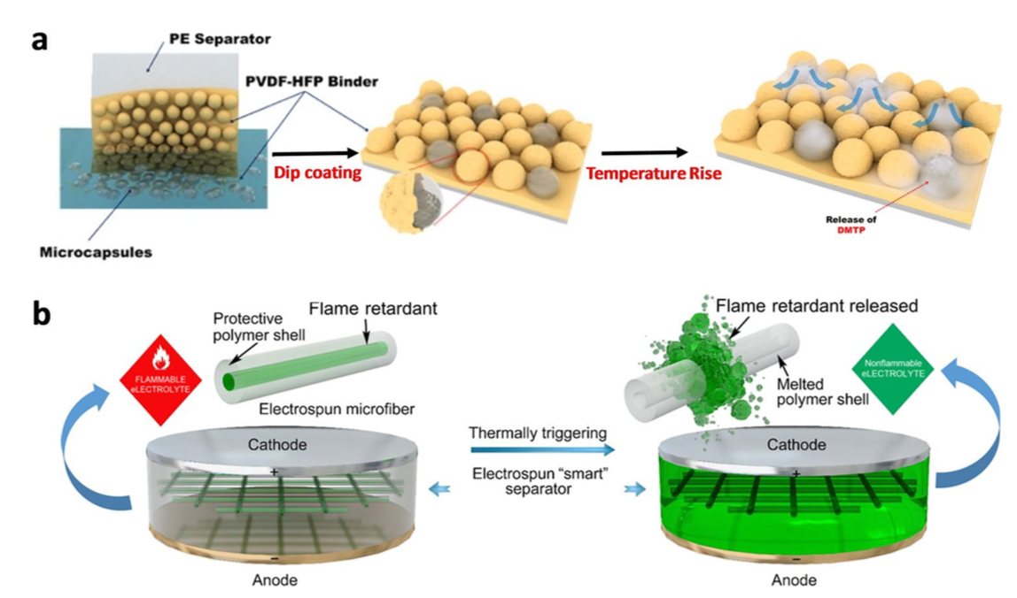
Plus one more sort of compromise separator solution:
Retain the flexible if flammable & meltable polyethylene & polypropylene polymers
but "functionalize" them with by adding chemicals or structures
that would suppress or sharply curtail Li-Ion battery fires
In other words: Instead of built-in fuses, build in fire extinguishers
Below is a scheme encapsulating fire retardant (DMTP) in plastic (PMMA) bubbles,
with those bubbles designed to burst open upon battery over-heating: ¹
1) See section 4.3.3 of: https://link.springer.com/article/10.1007/s41918-019-00060-4

Slide 87
Li-Ion R&D Part IV: Dendrite-Blocking or Inhibiting Electrolytes
Much of electrolyte R&D targets improved thermal stability, ^{1, 2}
stability of either the electrolyte itself,
or stability of electrode surface layers under exposure to that electrolyte
Or (as with separators) other R&D targets addition of "functional" fire suppressants
See, references 1 & 2 for more information on those topics, because . . .
I'm going to jump ahead to an electrolyte R&D thrust I find particularly intriguing:
Non-flammable, dendrite-blocking, SOLID state electrolytes
Which, in essence combines separator & electrolyte into a single robust layer
These solid state electrolytes must retain the ability to easily pass desirable ions
But, like the mostly water-based electrolytes they would replace, they must continue
blocking electron flow (thus forcing electrons out through the battery's terminals)
To do that, solid-state electrolyte materials must be electronic insulators
1) See section 4.4 of: https://link.springer.com/article/10.1007/s41918-019-00060-4
2) https://web.stanford.edu/group/cui_group/papers/Yayuan_Cui_NATENG_2019.pdf

Slide 88
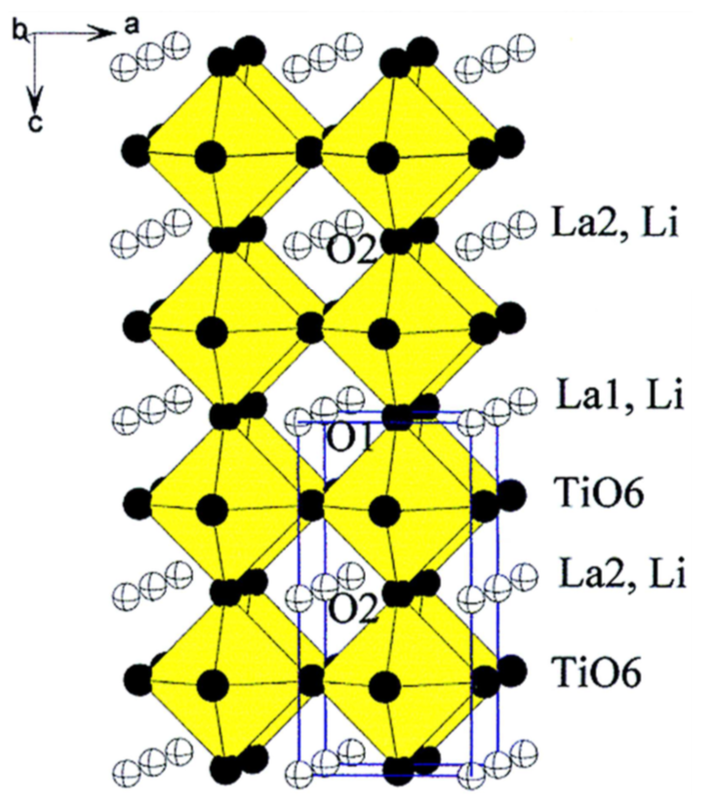
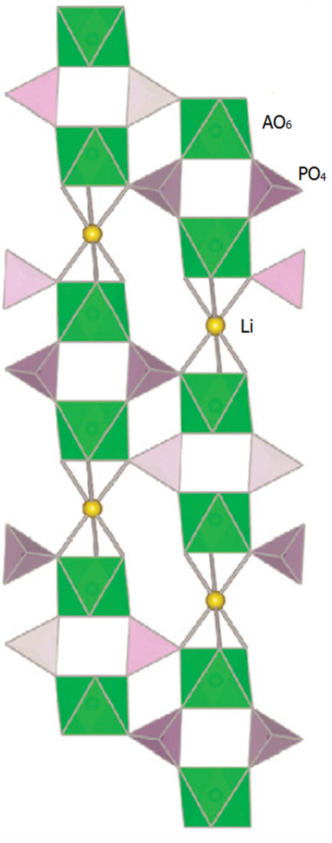
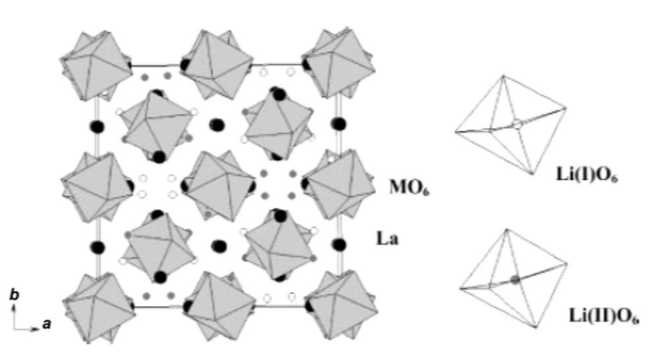
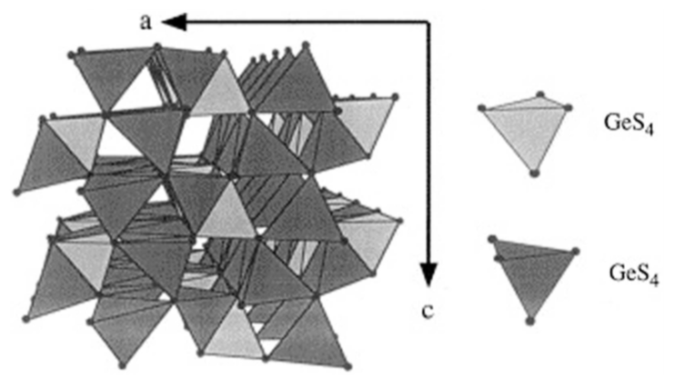
Candidate materials include crystalline structures such as: ^{1, 2}
PEROVSKITE's (e.g., Li3xLa(2/3)-xTiO3)
NASICON's (e.g., Na1+xZr2P3-xSixO12)
GARNET's (e.g., Li5La3M2O12 w/ M=Nb, Ta)
LISICON's (e.g., Li4-xM1-yMyS4 w/ M=Si, Ge, P, Al, Zn, Ga)
1) https://www.frontiersin.org/articles/10.3389/fenrg.2014.00025/full 2) https://link.springer.com/article/10.1007/s41918-019-00048-0

Slide 89
Challenges confronting Li-Ion battery Solid-State Electrolytes: ^{1,2}
In these solids, ions do not flow as easily as ions in liquid electrolytes
Which increases battery series resistance, lowers current, increases heating
There is also the difficulty of achieving ion flow into and out of electrodes
The issue here is that, while liquid electrolytes naturally flow onto the electrodes,
thereby assuring atomic-scale contact (and thus facilitating ion flow)
SHEETS of solid electrolyte will NOT automatically bond with electrodes,
and a gap of even a few atom widths could easily inhibit and/or block ions
Publications about solid state electrolytes acknowledge these layer contact issues,
but they provide little discussion of possible solutions
In fact, these papers give the strong impression that in-battery testing of
solid-state electrolytes (of any type) is still very, very limited
1) https://www.frontiersin.org/articles/10.3389/fenrg.2014.00025/full 2) https://link.springer.com/article/10.1007/s41918-019-00048-0

Slide 90
But the prospect of solid state electrolyte / separators seems real:
Research IS identifying materials with faster internal ion flows
And (ironically) from my note set about Tomorrow's Solar Cells (pptx / pdf / key),
I can see a way to producing intimate solid electrolyte to electrode contact:
Poly/microcrystalline layers of Perovskite are used successfully in solar cells
That success means micro-crystallites must be in intimate electrical contact
In such solar cell layers, contact is achieved by dissolving micro-crystallites into solvents
and then simply painting them onto surfaces which,
as the solvent evaporates, brings the micro-crystallites into atomic contact
In fact, with possibly minor degradation in the solid electrolyte's high temperature robustness,
one might even add in a little conductive polymer as a binder,
creating, in essence, something resembling a latex solid electrolyte paint
I see no fundamental reason why such a scheme could not ultimately work ¹
1) Which I say as one holding a significant number electronic material patents (link)

Slide 91
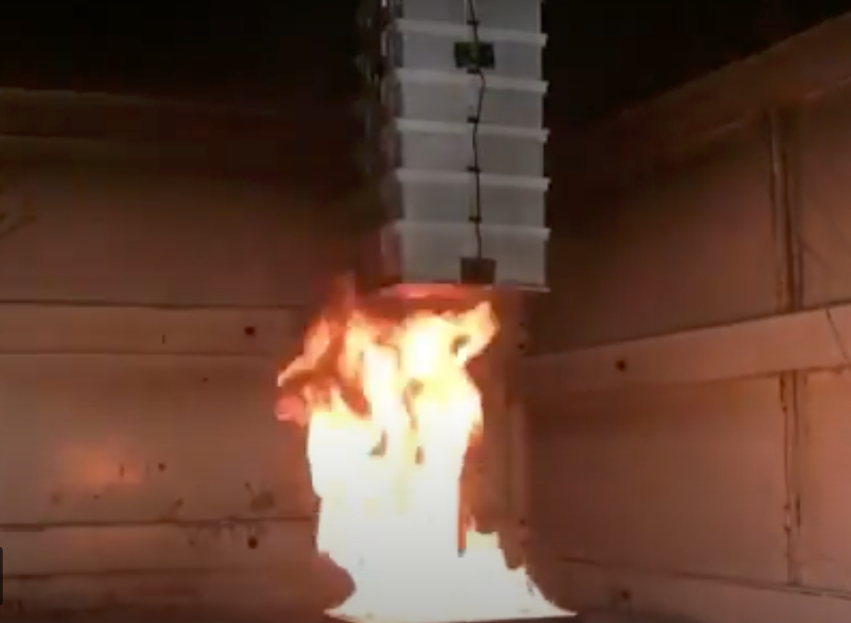
But the last dozen plus slides concerned only "Tomorrow's Li-Ion battery"
And viewed critically, they mostly concerned fixes to its safety problems
that would make that technology even more exotic (and thus more expensive)
Why not take a different path that completely engineers out such problems?
Producing, for instance, a battery that would not only not blow itself up,
but could even be cooked for 30 minutes over a large gas burner,
as was demonstrated in this YouTube video (link) ^{1, 2}
1) https://www.bluesky-energy.eu/en/saltwater_battery/
2) https://www.youtube.com/watch?v=HXmZW8Wnvko

Slide 92
That was a so-called Saltwater Battery
With that particular one now being marketed as the "Greenrock Saltwater Battery" ¹
Despite, as far as I can tell, using technology directly from Aquion Corp.
which labeled its version an Aqueous Hybrid Ion Battery (AHI)
On both the Aquion founder's website,
and in the PBS Nova science documentary Search for the Super Battery ³
Aquion's design goals were given as being:
A non-portable Grid & Solar Array energy storage battery
Using ONLY elements common in earth's crust
(Which should thus be cheaper and possibly less toxic)
For which there is NO possibility of fire or explosion
1) https://www.bluesky-energy.eu/en/saltwater_battery/
2) https://taspacenergy.co.nz/wp-content/uploads/2015/07/Redwood-Gate-Ranch-Enabling-Solar-and-Reducing-Diesel-Consumption.pdf
3) www.pbs.org/wgbh/nova/tech/super-battery.html

Slide 93
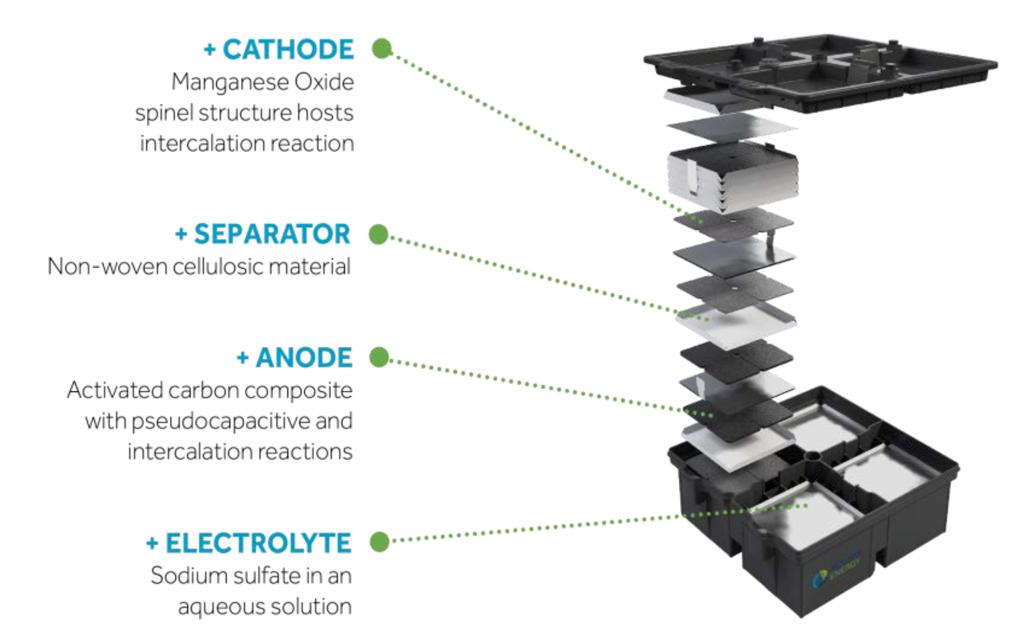
Which was depicted on both Aquion & Greenrock websites as: ^{1, 2}
Translation: Has atomic layers between which ions can slither
Translation: Cotton!
Translation: Has atomic layers between which ions can slither
That is: It is based on sodium alkali metal ions (rather than lithium)
It uses an "activated carbon" anode (which is largely graphite-like carbon sheets ³)
Into which the sodium ions intercalate (i.e., fit between the those sheets)
With a MnO2 cathode that also intercalates (i.e. fits sodium ions between its layers)
Between which is a "cellulosic' separator (actually cotton)
And a sodium sulfate water-based electrolyte
2) https://taspacenergy.co.nz/wp-content/uploads/2015/07/Redwood-Gate-Ranch-Enabling-Solar-and-Reducing-Diesel-Consumption.pdf
2) 1) https://www.bluesky-energy.eu/en/saltwater_battery/ 3) https://en.wikipedia.org/wiki/Activated_carbon

Slide 94
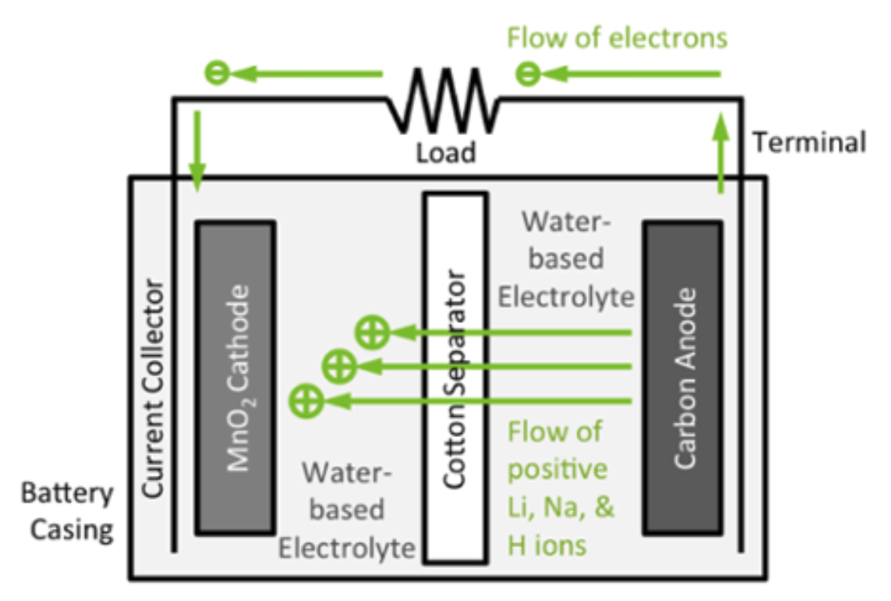
Thusly explained, the technology does not sound very exotic
Indeed, the only big changes seem to be
the use of sodium and a change to conventional water-based electrolyte
Aquion's website does not enumerate the electrochemical reactions involved
Nor explain why Na ions tolerate aqueous electrolytes, while Li ions do not
But on a blog by the company's founder (James Whitacre) I did find this figure
Which does indeed look remarkably conventional:
What’s Inside an Aqueous Hybrid Ion Battery?
hhttp://blog.aquionenergy.com/blog/bid/108285/what-s-inside-an-aqueous-hybrid-ion-battery-0

Slide 95
An Australian solar energy website supports that interpretation ¹
Describing the battery as "almost certainly the safest battery around " and that it is:
"about as non-toxic as a battery can get. If you are low on electrolytes I donʼt recommend drinking it because I donʼt know the lithium concentration, but if for some reason it leaks you can just mop it up and pour it down the drain. It is likely to cause less environmental harm than one mediocre cow fart.
(in the PBS documentary, the inventor actually DOES drink the electrolyte)
It's also noted that the original cotton separator was made from the inventor's shirt
And it mainly finds fault with only the battery's weight and size (per kW-h stored)
Which actually does not contradict the inventor's stated goal
of creating a fixed-position Grid & Solar Array energy storage battery
(applications where weight and size are not super critical)
Meaning that while this battery lacks the versatility & portability of Li-Ion batteries
It is nevertheless a very good candidate for two applications
likely to be essential in the greening of the Grid and home
1) https://www.solarquotes.com.au/blog/aquion-salt-water-battery/

Slide 96
Bringing us to a second rule-changing possibility: Lithium Air Batteries
Which, innovative as they are, actually build upon a battery already in widespread use:
The button-style Zinc Air battery which powers most of today's hearing aids ^{1, 2}
At its anode, Zn is conventionally ionized, releasing electrons: Zn (s) => Zn⁺² + 2e⁻
But air penetrates a uniquely porous cathode, traveling to the electrolyte interface
Where, drawing in electrons, O2 reacts with water: O2 + 2 H2O + 4 e⁻ => 4 OH⁻
Migrating through the electrolyte, Zn⁺² and OH- then react, forming Zn(OH)4⁻²
Figure & Reference #1) https://iolitec.de/en/node/648 2) https://en.wikipedia.org/wiki/Zinc–air_battery

Slide 97
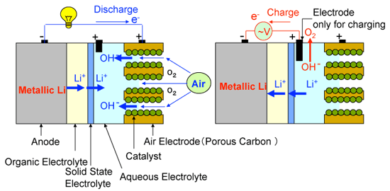
Something very similar occurs within a Lithium Air Battery
But this more detailed figure highlights the challenge of keeping liquid & air apart ^{1, 2}
To maintain that separation, a three layer (organic - solid - liquid) electrolyte is used,
extending from the anode, rightward into inter-layer gaps within the cathode
In this case it is Li⁺ ions that are liberated by the anode
But these once again meet up with OH⁻ ions liberated from the air / water
reaction now occurring within cathode pores or inter-layer gaps
With Li⁺ and OH⁻ ions sent into the electrolyte reacting to form LiO2⁺ or Li2O2⁺
Figure and Reference #1) http://www.aist.go.jp/aist_e/latest_research/2009/20090727/20090727.html 2) https://en.wikipedia.org/wiki/Lithium–air_battery

Slide 98
Advantages of Li Air? ¹⁻³
Li Air batteries can be rechargable (unlike their present day Zn Air cousins)
Li Air batteries have exceptionally high output voltage based on their paring of
the MOST electropositive element, Lithium,
with the SECOND MOST electronegative element, Oxygen
Because of Li's low mass, and with oxygen coming right out of the air,
Li Air batteries could be exceptionally light
Combined, that should give Li Air batteries outstanding energy storage per mass
And it's thus predicted that they might eventually achieve
5-10X the stored energy density of today's champion: Li Ion batteries ^{1, 3, 4}
Which, for instance, could make them the future's ideal vehicle battery
"Future," because one or more decades of additional R&D are likely required
1) https://batteryuniversity.com/learn/archive/weird_and_wonderful_batteries 2) http://www.aist.go.jp/aist_e/latest_research/2009/20090727/20090727.html
3) https://en.wikipedia.org/wiki/Lithium–air_battery 4) https://www.extremetech.com/computing/126745-ibm-creates-breathing-high-density-light-weight-lithium-air-battery

Slide 99
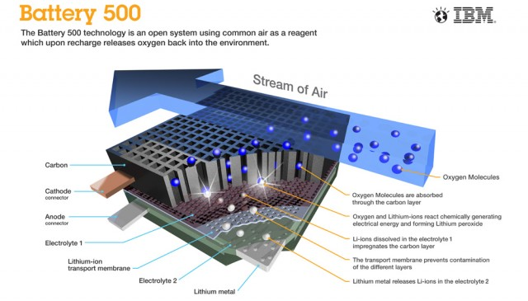
IBM (of all corporations) is investing in such a possibility: ¹
As seen in their illustration of a would-be 500 mile (800 km) electric vehicle battery:
(Is IBM having a little trouble with their corporate focus?)
1) https://www.extremetech.com/computing/126745-ibm-creates-breathing-high-density-light-weight-lithium-air-battery

Slide 100
Why practical battery-powered air & sea transport
is a long way off
An Introduction to Sustainable Energy Systems: WeCanFigureThisOut.org/ENERGY/Energy_home.htm

Slide 101
To this point I have carefully limited my discussion to:
Today's and Tomorrow's Home & GROUND Vehicle Batteries
It's time for me to finally explain why I have so carefully dodged the possibilities of
Battery Powered Airplanes & Battery Powered Ships
It's not because electric planes and ships are a bad idea:
Per the yellow-highlighting I've added to these 2017 EPA charts: ¹
Planes produced 0.29 x 0.09 => 2.6% of total U.S. greenhouse gas emissions
While ships produced another 0.29 x 0.03 => ~ 1%
1) https://www.epa.gov/greenvehicles/fast-facts-transportation-greenhouse-gas-emissions

Slide 102
The problem instead comes from a table spanning several note setes
A table in which I compared the energy stored per mass, and per volume
for just about every single energy storage technology
discussed anywhere on this WeCanFigureThisOut website
In addition to specific numbers for each technology,
in yellow highlighted columns and rows,
I compared each technology's energy storage to that of gasoline
Which yielded this rather sobering result:
An Introduction to Sustainable Energy Systems: WeCanFigureThisOut.org/ENERGY/Energy_home.htm

Slide 103
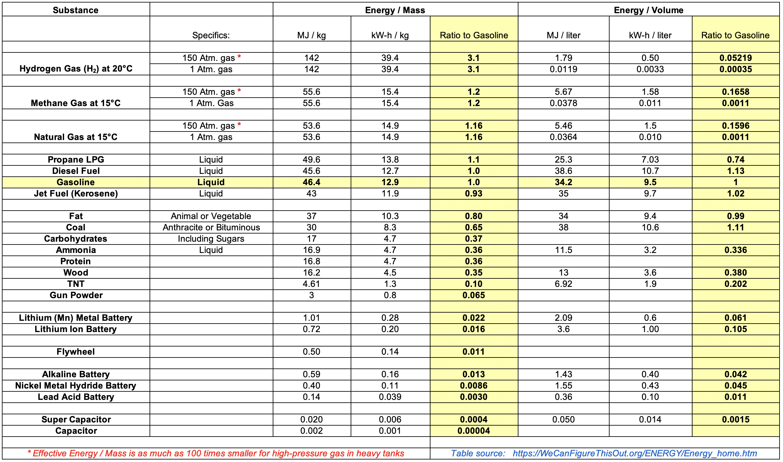
Energy of various Materials & Storage Technologies: ¹
1) Drawn from notesets: Fossil Fuels (pptx / pdf / key), Batteries & Fuel Cells (pptx / pdf / key), Hydrogen Economy (pptx / pdf / key)

Slide 104
Approximating those ratios to gasoline, and highlighting battery results:
Hydrogen (at 1 atm. of pressure)
Gasoline / Diesel / Jet Fuel
Fat / Coal
Carbohydrates / Protein / Wood
High Explosives
Lithium Ion Batteries
Flywheels
Conventional Batteries
Super Capacitors
Capacitors
Energy / Mass
3
1
3/4
1/3
1/12
1/60
1/100
1/150
1/2000
1/200000
Energy / Volume
1/3000
1
1
1/2
-
1/12
-
1/50
1/600
1/40000
BIG TAKEAWAY: Fossil Fuels pack 60X to 150X the energy of Batteries!

Slide 105
The impact of such a discrepancy upon Electric Flight:
We think of planes expending most of their energy pushing air out of their way
Which suggests that the key to lower energy flight will be streamlining
But from my note set on Energy Consumption in Transportation (pptx / pdf / key):
The energy efficiency of flight is actually best when
Half of the energy goes into pushing air out of the way
Half of the energy goes into pushing air downward
Air MUST be pushed downward to offset the pull of gravity upon the plane
It's just another example of Newton's "Action must equal Reaction"
Heavier planes must thus push proportionally more air downward,
requiring proportionally greater expenditure of energy per mile traveled
But then, if planes substitute heavy batteries for fossil fuel,
they're going to use more energy per distance traveled - But how MUCH more?
An Introduction to Sustainable Energy Systems: WeCanFigureThisOut.org/ENERGY/Energy_home.htm

Slide 106
To answer that, we need to know more about aircraft weight:
Assume we are talking about medium / large aircraft
carrying passengers and / or cargo,
over distances comparable to medium sized continents or oceans
The forces of physics & economics have driven a convergence of aircraft design
Which is why it's now difficult to tell one transport aircraft from another
A particularly successful / widely used / newer aircraft is Boeing's 777
Wikipedia's webpage on that aircraft included a massive data table
including entries for four different 777 models having different ranges ¹
On the following page I've edited together that table's entries pertaining to weight
For each model I then worked out the percentage of fully loaded aircraft weight
due to the empty aircraft itself, it's fossil fuel, and it cargo/passenger load
1) https://en.wikipedia.org/wiki/Boeing_777

Slide 107
From Wikipedia'a data table on the Boeing 777 ¹
Max Takeoff Weight
Empty Weight
From: Load (People + Cargo weight) = (Max. Takeoff weight) - (Max. Fuel weight), I get:
Range:
Aircraft:
Fuel:
Load:
10,000 km
138000 kg ~ 32%
137500 kg ~ 32%
160000 kg ~ 37%
11,000 km
160500 kg ~ 35%
137500 kg ~ 30%
162000 kg ~35%
13600 km
168000 kg ~ 32%
145500 kg ~ 28%
206000 kg ~ 40%
16,000 km
144400 kg ~ 29%
145500 kg ~ 30%
202000 kg ~41%
Aircraft, Fuel, and Load each account for ~ 1/3 of total weight!
1) With two expanded acronyms, excerpted from main table at: https://en.wikipedia.org/wiki/Boeing_777

Slide 108
Those huge fuel loads may surprise you
But that's how your carbon footprint from a single long flight can = 1 tonne ¹
Thus: (~ 250 passengers per jet) x (~1 tonne CO2 per passenger) => 250,000 kg CO2
Confirming that, yes, over a 100,000 kgs of fuel are burned on such a flight!
But the above ~1/3 ~1/3 ~1/3 aircraft weight distribution rule then implies:
If your aircraft replaced fossil fuels with batteries storing equivalent energy
and they weighed just 2X as much as the fossil fuel they replaced,
you'd have to unload ALL of the plane's cargo & passengers
which would then allow the plane to fly to its destination
even if it did thereby earn ZERO income
And your airline would set an industry record for going out of business quickly!
1) For more about personal carbon footprints, see my note set entitled Where Do We Go From Here? (pptx / pdf / key)

Slide 109
But that fantasy scenario was based on 2X heavier batteries
"Fantasy" because from my earlier Energy Storage Cross Comparison table:
Today's experimental Li-Ion batteries are 25X heavier
Today's commercial Li-Ion batteries are 75X heavier
Further, based on their documented tendency to catch fire and explode
(which is believed to have crashed two cargo planes)
Li Ion batteries cannot now even be legally shipped on passenger aircraft!
And looking even farther down my comparison table:
Acceptably safe & legal batteries are now 150X heavier than fossil fuels
Meaning that EITHER battery-powered transport aircraft are now totally impractical
OR that I have made an egregious error somewhere in my calculations
To check on the latter, I dug up a whole bunch of articles about battery-powered flight
An Introduction to Sustainable Energy Systems: WeCanFigureThisOut.org/ENERGY/Energy_home.htm

Slide 110
These articles had widely varying viewpoints & target audiences
Links to the articles, as well as cached copies
are provided on the Resource Webpage for this note set
In chronological order, the article titles and sources were:
Electric Aircraft - The Future of Aviation or Wishful Thinking? Phys Org, Aug 2015
The Age of Electric Aviation Is Just 30 Years Away, Wired, May 2017
Electric Flight is Coming, but the Batteries Aren't Ready, The Verge, Aug 2017
Preparing for Electric Flight, Royal Aeronautical Society, Aug 2017
The Long Road to an Electric Airplane Motor, ZDNet, Sept 2018
Short Hops, Clear Air and the Sweet Spot for Electric Aircraft, NewAtlas 2019
In that order, they stated or implied that today's batteries are overweight by a factor of:
43X, 50X, 43X, (?), 14X, 40-48X
Which, sadly, is entirely consistent with my analysis
An Introduction to Sustainable Energy Systems: WeCanFigureThisOut.org/ENERGY/Energy_home.htm

Slide 111
No article predicted near / mid term battery-powered air transports
The most enthusiastic articles instead dwelt on possible opportunities for
small short-hop aircraft and / or
immensely less cost-constrained corporate executive jets
With commercial passenger / cargo aircraft predicted to be ~ 30-50 years in the future,
based on their need for revolutionary & thus unpredictable battery breakthroughs
In fact, as described in my note set: Biomass and Biofuels (pptx / pdf / key):
A much more plausible near term path to green aviation
is the development of affordable biofuels
which, while their burning still releases greenhouse gases,
are net carbon neutral over their entire lifecycle ¹
1) https://www.greenbiz.com/article/heres-what-it-will-take-get-aviation-biofuels-ground

Slide 112
World's Largest All-Electric Aircraft Ready for First Flight
The Guardian, 27 May 2020 ¹
"Can carry nine passengers . . . range of 100 miles"
Its commercial application is likely feeding rural passengers into main hub airports
But passengers within ~ 50 miles may just drive into the hub airport
Plane's success thus likely depends on transporting passengers from ~50-200 miles out
But to allow for air traffic delays & weather diversions, international regulations
require that aircraft be able to stay airborne for at least an extra 30-45 minutes ²
To maintain such a reserve, this plane might be limited to routes well under 100 miles
Commercial viability thus likely requires at least doubling its range (& passenger load)
1) https://www.theguardian.com/world/2020/may/27/worlds-largest-all-electric-aircraft-set-for-first-flight?CMP=Share_iOSApp_Other 2) https://aviation.stackexchange.com/questions/3740/what-are-the-icao-fuel-reserve-requirements

Slide 113
Versus the possibility of Electric Shipping:
As noted above, shipping produces ~ 1% of our greenhouse gas emissions
Further, burning many of our rawest grades of fossil fuel,
it produces some our most health & environmentally damaging emissions
Which has prompted recent calls to curb and / or tax such emissions
Thus, as again cited and linked from this note set's Resource Webpage,
I found a number of articles discussing alternate ways of powering ships
Most such articles focussed on just tweaking today's fossil-fuel engines
But a few articles went on to mention solar, wind or even nuclear power
None, however, discussed the possibilty of battery-powered ships
So it's again time to invoke this website's name: WeCanFigureThisOut
An Introduction to Sustainable Energy Systems: WeCanFigureThisOut.org/ENERGY/Energy_home.htm

Slide 114
What do these large modern ships have in common?
Having crammed on top ever more stateroom decks or layers of cargo containers:
These ships are incredibly top heavy, and to prevent capsizing
they NEED low offsetting weight
Below their waterlines, beneath that income-producing upper deck space:
Batteries might supply that weight while powering such ships
But in contrast to aircraft, you wouldn't need light batteries, such as Li-Ion's
You'd instead want normal or even exceptionally heavy batteries
But below those waterlines, is there enough space for enough batteries?
Left: https://www.limos4.com/blog/european-cruising-largest-cruise-ships-in-2016 Right: http://www.shipspotting.com/gallery/photo.php?lid=2536561

Slide 115
To answer that question, we need to figure out two things:
The typical below waterline volume of such modern megaships
The energy needed to power such ships through the long legs of their voyage
Despite ship diversity, below waterline volume is often limited by a single consideration:
Retaining the option of someday using the Panama Canal
Figures and data from) https://en.wikipedia.org/wiki/Panamax
The Canal's older locks accommodate hulls with length x width x draft of:
290m x 32m x 12m which defines the so-called Panamax class of ship
The Canal's new (2016) locks accommodate hulls with length x width x draft of:
366m x 51m x 15m, which is called the New Panamax or Neopanamax class ¹
Crudely approximating those below deck spaces as simple rectangular boxes:
Panamax => 111,360 m³ Neopanamax => 279,990 m³

Slide 116
Next: Energy to move such a ship from China to the U.S. or Europe?
I found two sources giving the peak power of megaship diesel engines:
An exceptionally large 2004 engine produced up to 110 khp => 86 MW ¹
A broad 2007 study cited container ship engine powers of 22 - 54 MW ²
Container and cruise ships have since grown very significantly in size,
but during most of their voyage engines may operate at more like 50% power,
so let's estimate a new ship's trip-average power as ~ 50 MW = 50,000 kW
Which must then be multiplied by the duration of the trip:
Sources give trip length China to US as 20-35 days vs. ~ 30 days to Europe ^{3, 4}
Using 30 days, energy required = 50,000 kW x 30 x 24 hours = 36,000,000 kW-hr
From the Energy Storage Cross Comparison table shown a dozen or so slides above:
Today's BEST experimental batteries store ~ 0.5 kW-h / kg or ~1.2 kW-h / liter
1) https://newatlas.com/most-powerful-diesel-engine-in-the-world/3263/
2) http://www.dieselduck.info/machine/01%20prime%20movers/2007%20Wartsila%20engines%20for%20panamax%20containerships.pdf 3) https://www.chinaimportal.com/blog/how-long-does-it-take-to-ship-from-china/ 4) https://www.theodmgroup.com/calculating-container-shipping-time/

Slide 117
From those data, to provide voyage-long power:
Such a ship would have to carry: 72,000 tonnes of batteries
Which would occupy: 30,000 cubic meters
But you would also need massive shelves on which to secure those batteries
Plus intervening passages and / or overhead space to accommodate
servicing, cooling, and wiring between those batteries
Suggesting that overall battery space might be more like 60,000 cubic meters
But looking back at our estimated below-waterline hull volumes:
Panamax: 111,360 m³ Neopanamax => 279,990 m³
So this scheme could work in a Panamax ship, and work easily in a Neopanamax ship
especially as electric motors are much more compact than diesel engines
and should thus fit easily in the remaining below-waterline space
Unlike battery-powered long-distance flight (calculated to now be wildly impractical),
battery-powered long-distance shipping survives back-of-the-envelope analysis

Slide 118
Then what's holding up electric shipping?
The most likely answer is, of course, economics
Bloomberg New Energy Finance put 2018 Li-Ion battery cost at $175 / kW-h ¹
So our hypothetical megaship, requiring a voyage long 36,000,000 kW-hr,
might need as much as 6.3 billion dollars in batteries
(Which might need replacement every 5, 10, 15 years?)
For today's fossil-fueled megaships I found sources giving total construction costs of:
- 105 million dollars for a 12,000 container-capacity container ship ²
(today's container ships range up to 23,000 containers)
- Up to 1.5 billion dollars for cruise ships (e.g., Royal Caribbean's Allure of the Seas) ³
So it sounds like cost is indeed the problem:
Battery-powered container ships could cost as much as ~ 60X more to build
Battery-powered cruise ships could cost as much as ~ 5X more to build
1) https://about.bnef.com/blog/behind-scenes-take-lithium-ion-battery-prices/ 2) https://en.wikipedia.org/wiki/Container_ship 3) https://www.cheatsheet.com/culture/how-much-do-cruise-ships-cost.html/

Slide 119
Which explains why:
The claimed "World's Largest All Electric Cargo Ship" is this: ¹
Instead of carrying 12-20,000 containers, over 30 days, at 16-25 knots (18-29 mph) ²
this ship, launched by China in 2017, will carry "2,200 tons of cargo"
for a total of "50 miles at a top speed of 8 miles per hour"
before needing a two hour battery recharge ²
From the photo, assuming the total container stack is 4 high x 4 wide x pictured 6 long,
this ship's full container load looks to be no more than 100 containers
1) https://oilprice.com/Alternative-Energy/Renewable-Energy/China-Launches-Worlds-First-All-Electric-Cargo-Ship.html 2) https://en.wikipedia.org/wiki/Container_ship

Slide 120
I can think of an additional BIG challenge for battery powered ships:
Economics compels captains to absolutely minimize unproductive time in port
Container ships now unload, reload, and leave port within 24-48 hours
My postulated mega container ship needed 36,000,000 kW-hr of battery capacity
Which, in port, it would want to recharge within that same 24-48 hours
Assuming that its batteries could cope with such rapid recharging,
it would require incoming electrical power of 36000 MW-hr / (24-48 hr)
= 750 - 1500 MW
If that harbor served just ten such docked and recharging ships at any point in time:
The total necessary harbor electrical power would be 7.5 - 15 GW,
REQUIRING AT LEAST 5 TWO-REACTOR NUCLEAR POWER PLANTS
(or a larger, to hugely larger, number of non-nuclear plants)
An Introduction to Sustainable Energy Systems: WeCanFigureThisOut.org/ENERGY/Energy_home.htm

Slide 121
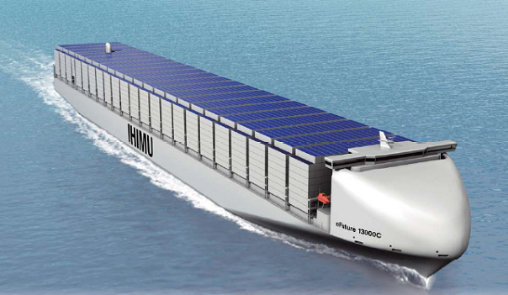
Why not just add solar roofs to the top layer of containers?
They could then power the ship & charge batteries during day, with that smaller number
of batteries continuing to power the ship overnight
Calculating deck sizes:
Panamax: 290m x 32m = 9280 m²
Neopanamax: 366m x 51m = 18,666 m²
Drawing on calculations given in my note set: Today's Solar Cells (pptx / pdf / key):
Averaged around the clock, for 20% efficient Si PV-solar cells, in different weather:
Output Power = 25 - 50 Watts / m² = 0.025 - 0.05 kW / m²
A full deck or container top solar array would thus produce average output power of:
Panamax: 9280 m² x (25-50 W/m²) = 232 - 464 kW
Neopanamax: 18,666 m² x (25-50 W/m²) = 464 - 933 kW
Comparing that to power now used moving such ships (estimated earlier at 50,000 kW),
SOLAR PV + BATTERIES => LESS THAN 1/50th POWER NEEDED FOR SHIPPING
Figure: https://www.industryabout.com/industrial-news/801-news-transportation/48073-historic-un-deal-for-shipping-industry-could-lead-to-solar-powered-ships

Slide 122
Batteries for TOMORROW's greener electrical Grid
An Introduction to Sustainable Energy Systems: WeCanFigureThisOut.org/ENERGY/Energy_home.htm

Slide 123
That Greener Grid will likely depend heavily upon Solar & Wind power
But while our need / desire for power peaks in the evening,
Solar power peaks midday: Onshore wind typically peaks late afternoon:
100%
100%
Summer
Winter
Midnight
Noon
Midnight
Midnight
Noon
Midnight
Meaning that evening life
with that Greener Grid
could end up looking like this:
Photo: http://www.dailymail.co.uk/femail/article-1241772/Im-frozen-time-What-like-live-TVs-Victorian-Farm-electricity-running-water-outside-loo-5c.html

Slide 124
The obvious solution is called: Grid Load Leveling
Which is the idea of just storing mid / late day power for later evening use
We have NOT yet implemented Grid Load Leveling to any significant degree
For details see my notes: Power Cycles and Energy Storage (pptx / pdf / key)
From that note set: Each day the U.S. now consumes about 11,089 GW-h
A Green Solar / Wind-based Grid would need to store as much as half
of that energy during the day, holding it for consumption 6-12 hours later
Batteries are perhaps our best near term bet for providing such storage
But these will have to be very different batteries - batteries that will:
Store ABSOLUTELY MASSIVE amounts of energy
But they'd need to do this for only a very short time
And they could be large and massive as they would likely
just be heaped into HUGE warehouse-like buildings

Slide 125
Batteries now be considered for "Grid load leveling:"
As cited in a U.S. National Renewable Energy Lab report ¹
- Lead-acid batteries
- Nickel-electrode batteries
- Molten sodium-sulfur modular batteries
- Zinc-bromine batteries
- Vanadium redox batteries
- Polysulfide-bromide flow batteries
Let's examine some of the more aggressive / revolutionary alternatives on that list:
1) Advanced Power Electronic Interfaces for Distributed Energy Systems
https://www.nrel.gov/docs/fy08osti/42672.pdf

Slide 126
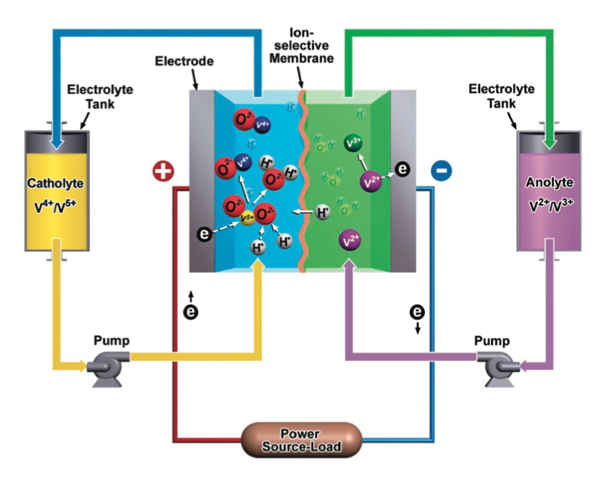
Ion Flow Batteries:
Which can be represented schematically as: ¹
To the left an right are huge storage tanks filled with two different electrolytes
Those electrolytes are pumped into a central cell
containing simple metal electrode plates
between which is an "ion selective membrane" (a.k.a., separator)
1) https://www.nytimes.com/gwire/2010/10/15/15greenwire-doe-promotes-pumped-hydro-as-option-for-renewa-51805.html
Figure from: Electrochemical Energy Storage for Green Grid, Yang et al., Chemical Reviews 111, 3577–3613 (2011)

Slide 127
Zooming in on the center structure of this vanadium ion version:
LEFT SIDE:
VO₂⁺¹ ion is pumped in
It reacts with H⁺ ion and
takes electron from electrode
Becoming VO₂⁺² ion
and releasing water
RIGHT SIDE:
V⁺² ion is pumped in
Giving electron to electrode
It is converted ion to V⁺³
CENTER:
H⁺ consumed on left is replaced by H⁺ selectively crossing membrane from right
That is, on left (cathode) side: And on the right (anode) side:
VO₂⁺¹ + 2 H⁺ + e⁻ => VO⁺² + H₂O V⁺² => V⁺³ + e⁻
Note: These electrodes are just acting as simple, dumb, inert, slabs of metal

Slide 128
Then zooming back out:
This Ion Flow Battery is completely discharged only when:
VO₂⁺¹ originally filling left tank is completely replaced by VO⁺² leaving cell
V⁺² originally filling right tank is completely replaced by V⁺³ leaving cell
To recharge: Reverse reactions by forcing electrons FROM left electrode to right
Editorial comment a la James Clerk Maxwell:
Tanks MUST ALSO contain charge-balancing negative ions
or electrostatic forces (charge repulsion) would blow them apart!

Slide 129
Big advantages of such ion flow batteries:
1) Battery capacity is NOT determined by cell size
Capacity is instead determined by simple external storage tanks
Which could be gigantic => Gigantic capacity!
2) Electrodes are not being rebuilt during recharging
Electrodes are instead just static metal plates
Thus no problem with dendrite short circuits between them!

Slide 130
This eliminates almost all common electrode problems:
Including: Limited size, slow surface reactions or diffusion in/out, dendrites . . .
The strategy is to make the solid metal electrodes almost superfluous
Instead transferring almost all of the action to (re-circulating) redox liquids
Another way of doing this would to be sticking with active electrodes
But making the electrodes, themselves, liquid
(Which then easily mix and refresh their redox-able surfaces)
But you must then somehow keep the two electrode liquids from mixing
Because if they did, they'd just swap electrons locally (atom to atom)
And we'd again loose electron flow out though wires (= "electricity")
An Introduction to Sustainable Energy Systems: WeCanFigureThisOut.org/ENERGY/Energy_home.htm

Slide 131
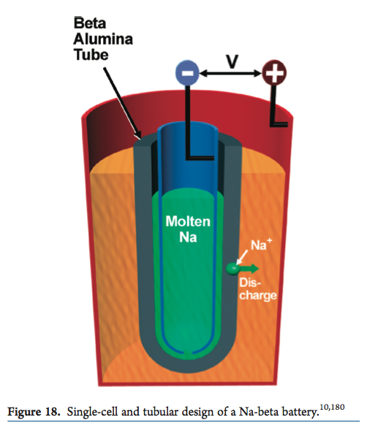
This is done in "molten sodium beta alumina" batteries
Their overall structure:
- Central (anode) reservoir of molten sodium (green)
- Membrane capable of passing Na⁺ ions (gray)
Typically: Al₂O₃ "beta alumina" ceramic
- Surrounding (cathode) outer cylinder (orange)
Typically: Sulfur / Sodium Sulfide (Na₂S_{x})
In the central anode: At the outer cathode:
2 Na => 2 Na⁺ + 2 e⁻ x S + 2 Na⁺ + 2 e⁻ => Na₂S_{x}
With Na⁺ ions formed in anode migrating through beta alumina toward cathode
These promise for long (50 year⁺) lifetimes + rapid (high power) discharge ¹
Figure: Electrochemical Energy Storage for Green Grid, Yang et al., Chemical Reviews 111, 3577–3613 (2011)
1) http://en.wikipedia.org/wiki/Molten_salt_battery

Slide 132
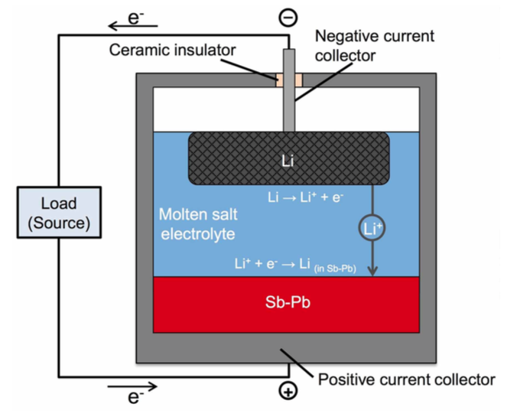
But in recent research wholly liquid batteries have been built:
With three liquids chosen for redox properties AND their mass density
Because goal is to have them naturally segregate into the three layers of:
Anode / Separating Electrolyte / Cathode
Top: Puddle of lighter liquid lithium
(floating at stainless steel rod / in Fe-Ni foam)
Middle: Denser molten salt electrolyte
Bottom: Very dense molten antimony-lead
As reported in: Molten metal batteries aimed at the grid, BBC News – Science & the Environment, 21 September 2014
Based on: Lithium–antimony–lead liquid metal battery for grid-level energy storage, K. Wang et al., Nature 514, p. 348 (2014)

Slide 133
Battery Operation:
The fully charged battery is described by this figure:
But when a load is connected, it discharges via:
- First, at top liquid to liquid interface (black/blue):
Li (liquid metal) => Li⁺ (in molten salt electrolyte) + e-
Lithium ions then diffuse down through that (blue) electrolyte layer
- Then, at bottom liquid to liquid interface (blue/red):
Li⁺ (in molten salt electrolyte) + e⁻ => Li (dissolved in molten Sb–Pb)
With everything just reversing when the battery is recharged
Molten metals? Top: Li metal must be above 180°C
Middle: 20% LiCl / 50% LiF / 30% LiI must be above 430°C
Bottom: 18% Pb / 82% Sb must be above 253°C
Molten metal batteries aimed at the grid, BBC News – Science & the Environment, 21 September 2014
Lithium–antimony–lead liquid metal battery for grid-level energy storage, K. Wang et al., Nature 514, p. 348 (2014)

Slide 134
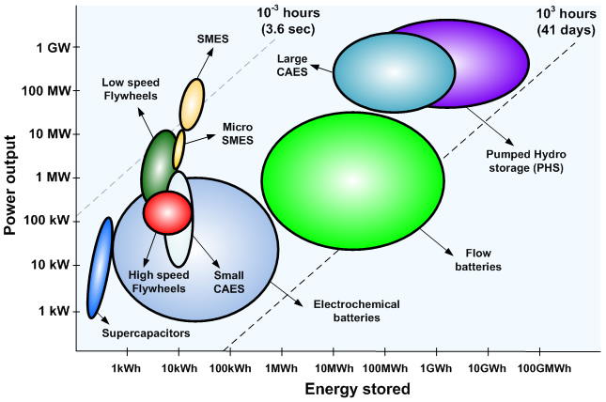
Comparison of the more established Grid load leveling batteries:
Comprehensive comparative data were very hard to find!
Most data instead pertained to batteries targeting transportation
This was the most complete data I found (from the University del Pais Vasco, Spain):
Ion Flow Batteries
Molten sodium
Lead Acid
Conventional Batteries
Non-battery energy storage alternatives
Ion Flow
http://www.sc.ehu.es/sbweb/energias-renovables/temas/almacenamiento/almacenamiento.html

Slide 135
Those (and other) batteries target Grid load leveling by:
Providing potentially huge energy storage capacities
Largely via extremely complete and effective use of their redox materials
And, given that redox materials are automatically refreshed by mixing / circulation,
overall battery designs end up being rather simple
All of which should, at least eventually, make cost per energy-stored small
However:
It's very unlikely that 450°C molten-metal batteries will ever go into your car
Further, Grid batteries are optimized to charge & discharge on Grid timescales
Grid timescale = Charging over many hours (when energy is too available)
= Discharging over the many hours of peak evening load
So let's move onto a final alternative (proposed for both the Grid AND your car):

Slide 136
Fuel Cells
An Introduction to Sustainable Energy Systems: WeCanFigureThisOut.org/ENERGY/Energy_home.htm

Slide 137
Batteries AND Fuel Cells call upon "REDOX" ionization / deionization reactions
But while batteries are typically energized by applied "electricity"
fuel cells are energized by introducing chemicals (fuel),
which are converted to other chemicals, some of which are ultimately exhausted
This fuel in / exhaust out behavior mimics gasoline internal combustion engines (ICEs)
But fuel cells can use carbon-free fuels & exhaust low greenhouse impact gasses
(Although, to be fair, ICEs CAN be reworked to burn hydrogen / emit water)
Hydrogen Fuel Cells are featured in most discussions of Sustainable Energy
where they are promoted for BOTH Grid energy storage AND road vehicle power
Hydrogen Fuel Cells will thus be the main focus of the slides that follow
But Ammonia Fuel Cells are thought to be more practical for future green ships
I'll touch on the reasoning, but a more complete discussion is provided in my notes:
Energy Consumption in Transportation (pptx / pdf / key)

Slide 138
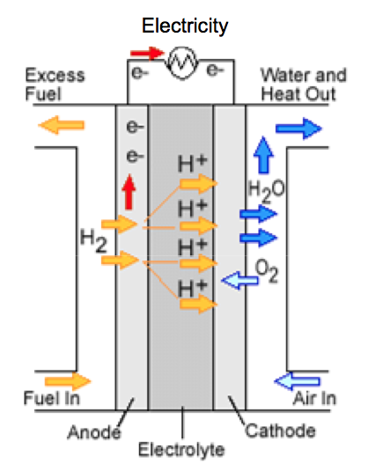
Here is the common representation of a Hydrogen Fuel Cell: ¹
Flowing Electricity
Excess H2 Fuel
Water (plus N2 + O2)
H2 Fuel
Air (N2 + O2)
Strictly speaking, this H2 fuel cell's emitted water vapor IS a greenhouse gas
In fact, water vapor is in our atmosphere's most significant greenhouse gas
But because oceans & lakes already add so much water vapor to our atmosphere
the likely added contribution due to H2 fuel cells is usually considered insignificant
1) https://en.wikipedia.org/wiki/Fuel_cell

Slide 139
The processes within a H2 Fuel Cell may be clearer in this schematic:
-
O
Outgoing water
H
H
Incoming H₂ gas
H ⁺
H ⁺
Incoming O₂ gas (in air)
H
H
O
O
H ⁺
H
H
O
O
H
H
H ⁺
H ⁺
O
O
High surface area
(or nano-porous) catalyst
High surface area
(or nano-porous) catalyst
Electrolyte capable of passing H⁺ ions:
Aqueous OR Solid Solution OR Proton permeable membrane
These processes RESEMBLE those within earlier ion flow batteries:
Where redox species were pumped from external tanks to inert metal electrodes
A key DIFFERENCE: Gasses don't naturally disassociate / associate on metals
The electrodes above must catalytically promote disassociation / association

Slide 140
Platinum is the chemists' favorite catalytic fuel cell electrode
But platinum is a very expensive noble metal: 25,172 $ / kg (as of 21 April 2020)
Fortunately, catalysis occurs only on surfaces:
And surface area increases when something is ground into a powder
So early fuel cells used electrodes of slightly compacted platinum powder
Hence my reference to use of "porous" metal in the preceding schematic
But for same quantity of Pt, smaller powder particles => more total surface area
=> Use of tiny minimally compacted particles (that don't squash back together)
OR, Pt atoms on the surfaces of some other (cheaper) porous nano material

Slide 141
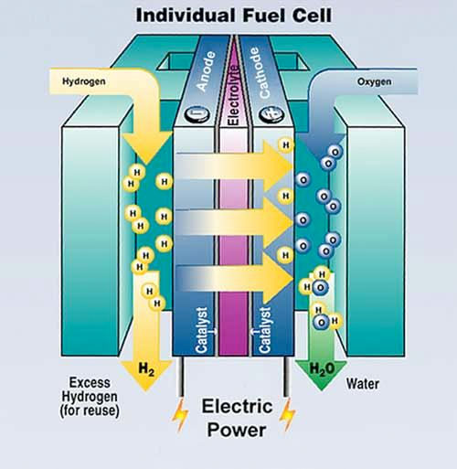
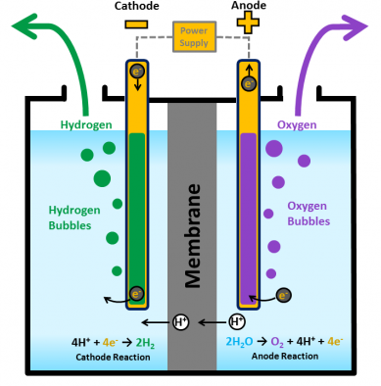
REDOX reactions are reversible, suggesting H2 Fuel Cells might be reversible:
Hydrogen Fuel Cells DO have a process-reversing analog: Water Electrolysis Cells
Hydrogen Fuel Cell:
Reactions consuming H2 and O2 gases
and releasing H2O vapor (gas) ^{2, 3}
Water Electrolysis Cell:
Reactions consuming liquid water
and releasing H2 & O2 gases ¹
Left figure: https://www.energy.gov/eere/fuelcells/hydrogen-production-electrolysis
Right figure: https://www.betterworldsolutions.eu/more-efficient-production-of-hydrogen-is-possible-says-stanford/
1) http://hyperphysics.phy-astr.gsu.edu/hbase/thermo/electrol.html
2) https://en.wikipedia.org/wiki/Fuel_cell 3) https://www.energy.gov/eere/fuelcells/types-fuel-cells

Slide 142
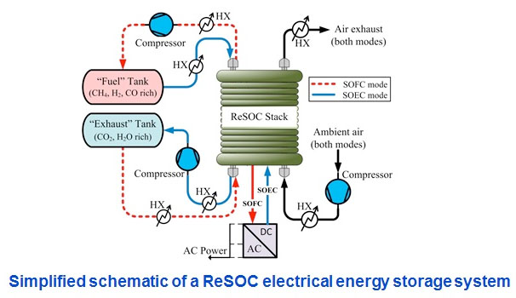
For a H2 Fuel Cell to become reversible, it must be part of a "closed system"
Where no chemicals are allowed to enter or leave,
and where gases can be transformed into liquids (aided by pumps & compressors)
This yields distinctly non-simple reversible Hydrogen Fuel Cell SYSTEMS,
generally based upon either Proton Exchange Membrane (PEM) cells, ^{1, 2}
or as depicted here, Solid Oxide Cells (SOCs) => "Re(versible) SOC" ³
Figure from: https://aes.mines.edu/design-and-analysis-of-reversible-solid-oxide-cells-for-electrical-energy-storage/
Imagine how complex the full non-simplified system must be!
1) hhttps://en.wikipedia.org/wiki/Regenerative_fuel_cell 2) https://www.altenergy.org/renewables/regenerative-fuel-cells.html
3) https://www.electrochem.org/dl/interface/wtr/wtr13/wtr13_p055_062.pdf

Slide 143
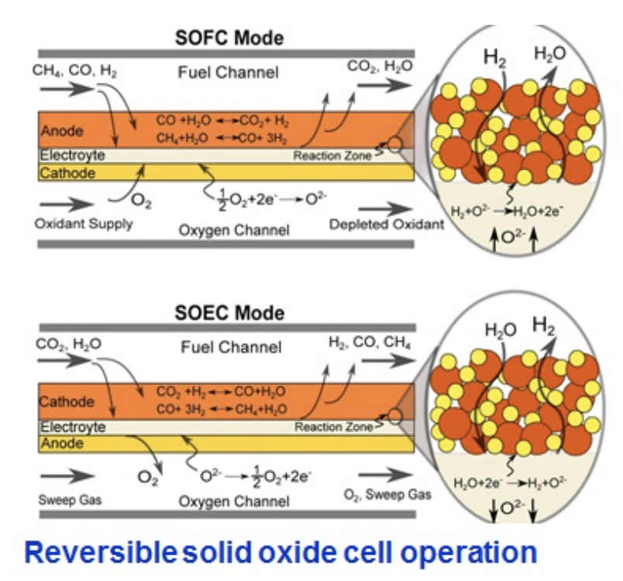
Further, to operate in both modes, atomic structures must also be very complex:
Solid Oxide Fuel Cell (SOFC) Mode
Solid Oxide Electrolysis Cell (SOEC) Mode
Green labels added to:: https://aes.mines.edu/design-and-analysis-of-reversible-solid-oxide-cells-for-electrical-energy-storage/

Slide 144
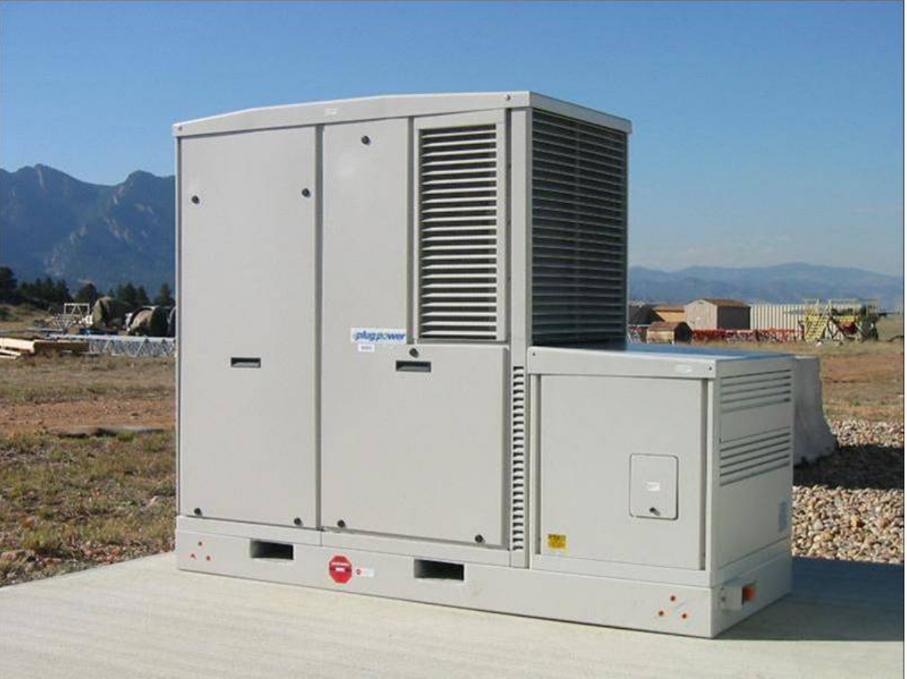
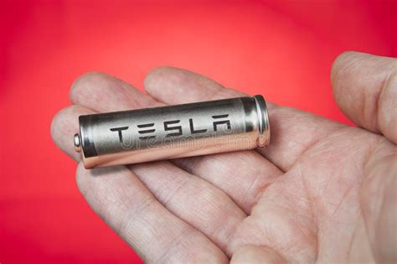
The above could yield a Fuel Cell-based Reversible Energy Storage System:
A compact example was pictured in a U.S. National Renewable Energy Lab report: ¹
Versus a compact example of a Battery-based Reversible Energy Storage System: ²
Such Fuel Cell Storage Systems might, someday, provide critical Grid energy storage
But home use for storage of rooftop solar cell energy seems unlikely
And vehicle use for regenerative braking energy storage exceedingly unlikely
1) https://www.nrel.gov/docs/fy09osti/44313.pdf 2) https://www.dreamstime.com/tesla-battery-lithium-ion-cells-pack-human-hand-st-petersburg-russia-november-close-up-holds-one-cylindrical-logo-image105208002

Slide 145
So let's return to simple / non-system / non-reversible H2 Fuel cells:
And compare* simple H2 fuel cells with simple batteries
as potential compact and green energy sources
to propel our our cars, trucks and possibly even airplanes
* For a less quick / deeper comparison, see my note sets:
Energy Consumption in Transportation (pptx / pdf / key)
Green(er) Cars & Trucks (pptx / pdf / key)
H2 Fuel Cell Pros:
1) H2 can be pumped into tanks in mere minutes vs. hours needed to charge batteries
Making quick stop (hydrogen) gas stations possible, while leaving
battery powered cars & trucks charging overnight in garages & parking lots
2) It's claimed hydrogen fuel cells + tanks might be substantially lighter than batteries
Reducing the kinetic energy (1/2 mv²) needed to propel fuel cell powered vehicles

Slide 146
Weight claims are based on hydrogen's energy density per mass
Which was detailed in the left half of my earlier table:
H2 packs 3 times the energy per mass as gasoline
and at least 50 times the energy per mass as lithium batteries

Slide 147
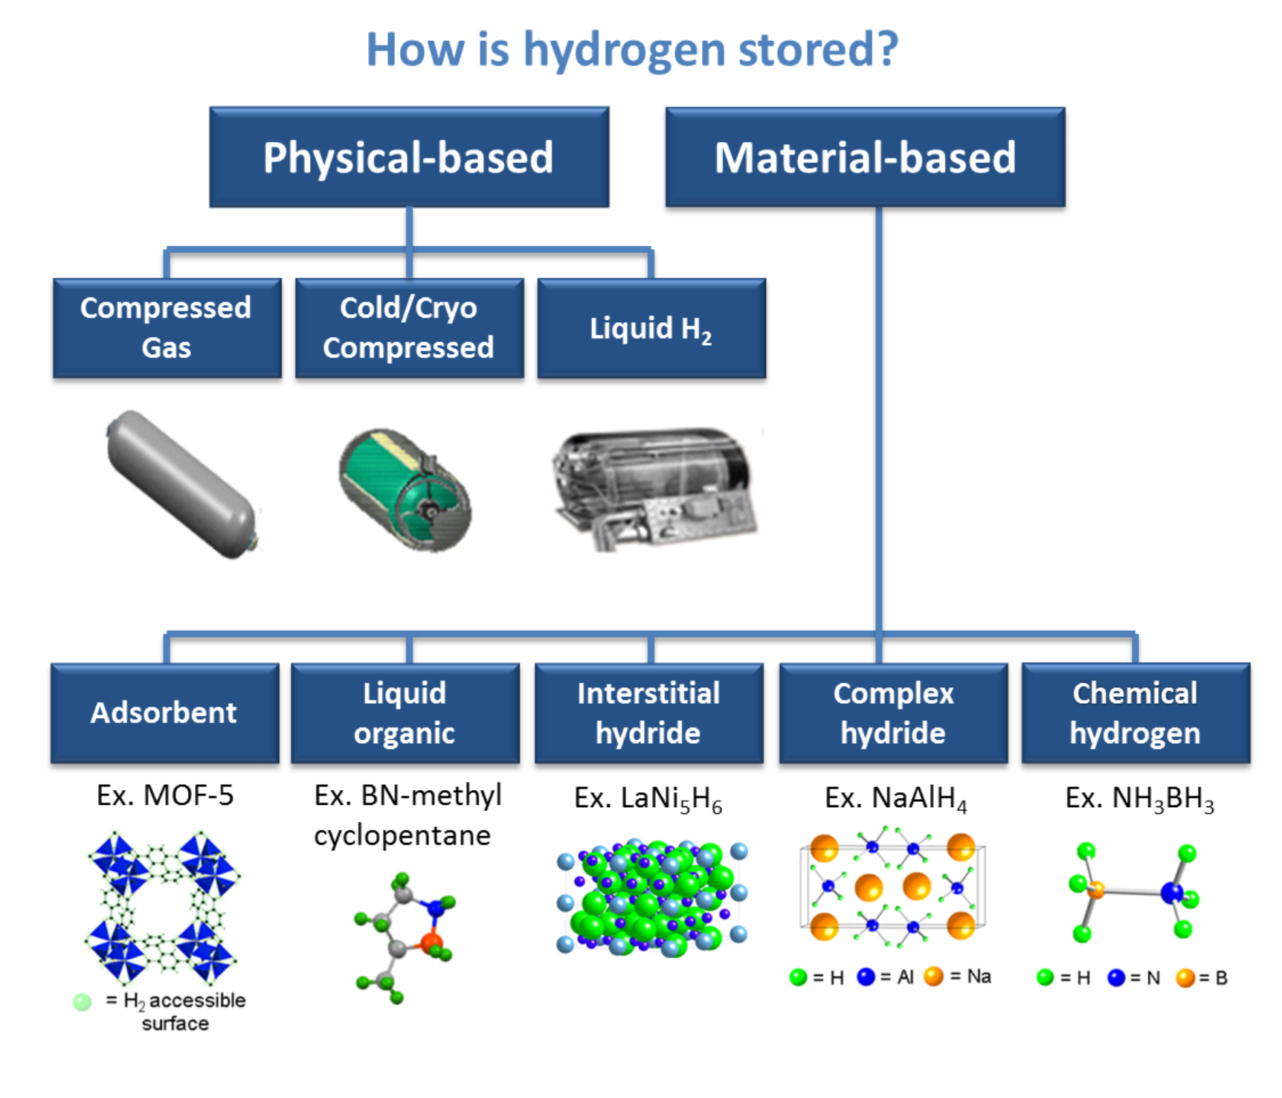
But how much mass must be ADDED TO CONTAIN such hydrogen?
On this question I found remarkably little discussion (much less data)
An exception was two webpages about possible H2 storage technologies from the
U.S. Department of Energy's Office of Energy Efficiency & Renewable Energy ^{1, 2}
Their alternatives:
1) https://www.energy.gov/eere/fuelcells/physical-hydrogen-storage
2) https://www.energy.gov/eere/fuelcells/hydrogen-storage

Slide 148
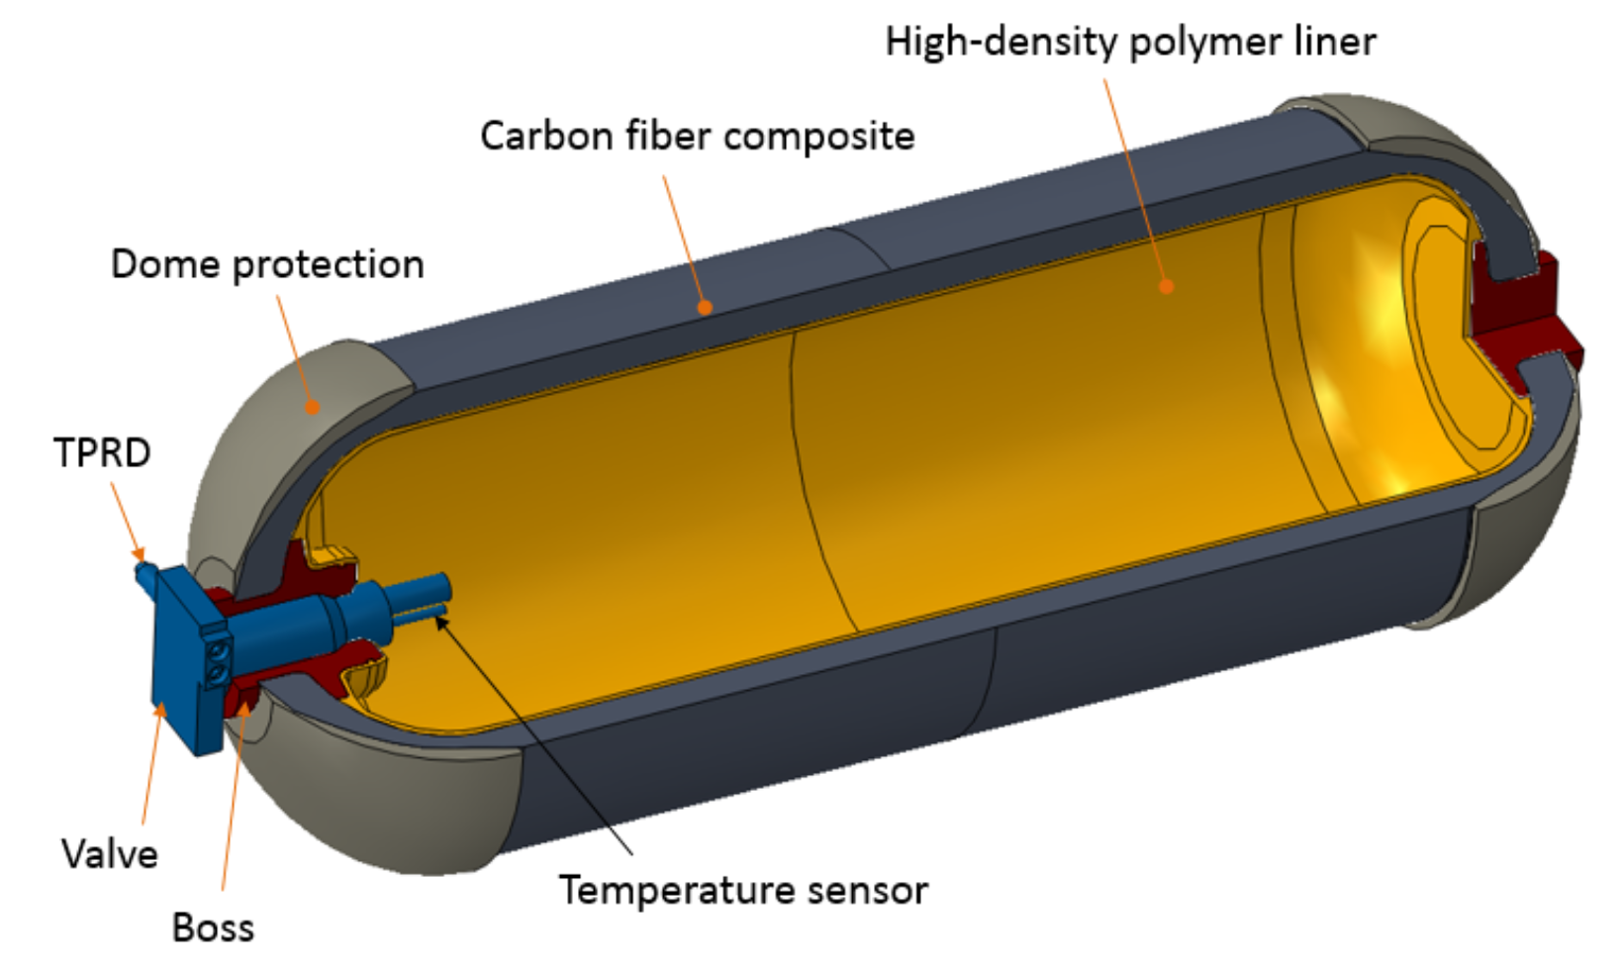
Those "Physical-based" H2 storage require massive tanks / systems
To withstand the liquifying pressures and/or provide the necessary hyper-refrigeration: ¹
The alternative is lighter but exotic / yet to be fully developed materials,
into which large quantities of H2 might temporarily slither and/or bond: ²
1) https://www.energy.gov/eere/fuelcells/physical-hydrogen-storage
2) https://www.energy.gov/eere/fuelcells/hydrogen-storage

Slide 149
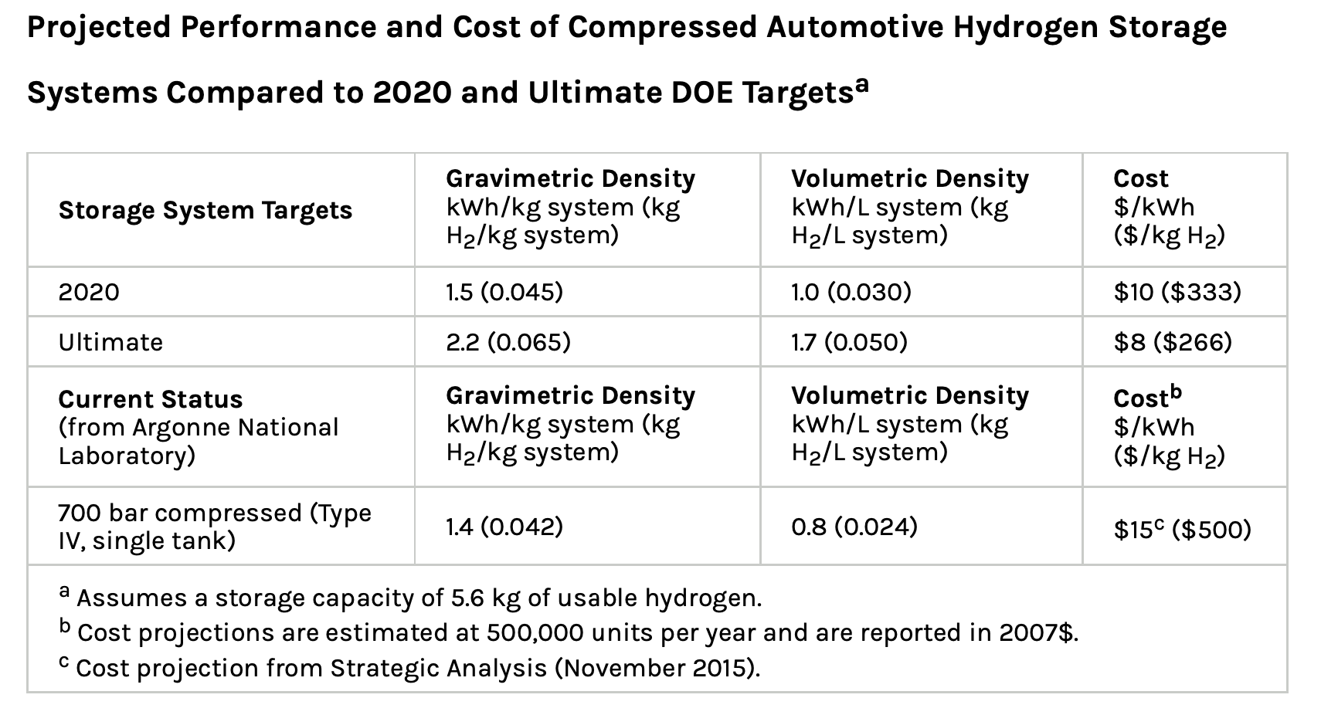
What sort of mass or volume energy densities are (or might be) achieved)?
From the second US DOE Office of Energy Efficiency & Renewable Energy webpage: ¹
Using results for COMPLETE STORAGE SYSTEMS (H2 , tank, pump, material, . . .)
for both 2020 and projected "Ultimate" storage systems,
I can add to my table arrows for the energy density of STORED hydrogen:
1) https://www.energy.gov/eere/fuelcells/physical-hydrogen-storage

Slide 150
Energy / Mass
Energy / Volume
H2 Storage System
H2 Storage System
2020
Ultimate
2020
Ultimate
"Ultimate" H2 energy storage density is predicted to be 5-7X LESS than Gasoline
Further, that "ultimate" density is only about 10X TODAY's Li Batteries

Slide 151
Superior stored energy density drives interest in AMMONIA fuel cell powered ships
The difference comes from the sharply contrasting properties of H2 vs. NH3:
Hydrogen boils at minus 253.9 ºC - Hugely below room temperature!
Making its bulk liquefaction almost certainly impractical
Leaving extreme high pressures as the only proven way of concentrating it
=> ~700 atmosphere pressures mentioned in my table & elsewhere
Which, in turn, demands the use of massive pressure tanks + pumping systems
Ammonia boils at minus 33.3 ºC and thus:
At room temperature it liquifies at only ~ 9 atmospheres of pressure ¹
Which requires only simple compressors & tanks, comparable to the air versions
used in our homes by carpenters and DIY'ers
OR if tanks are cooled to only -33.3 ºC, Ammonia pressure falls to 1 atmosphere
Requiring only lightly built and lightly cooled storage tanks
1) https://www.engineeringtoolbox.com/ammonia-pressure-temperature-d_361.html

Slide 152
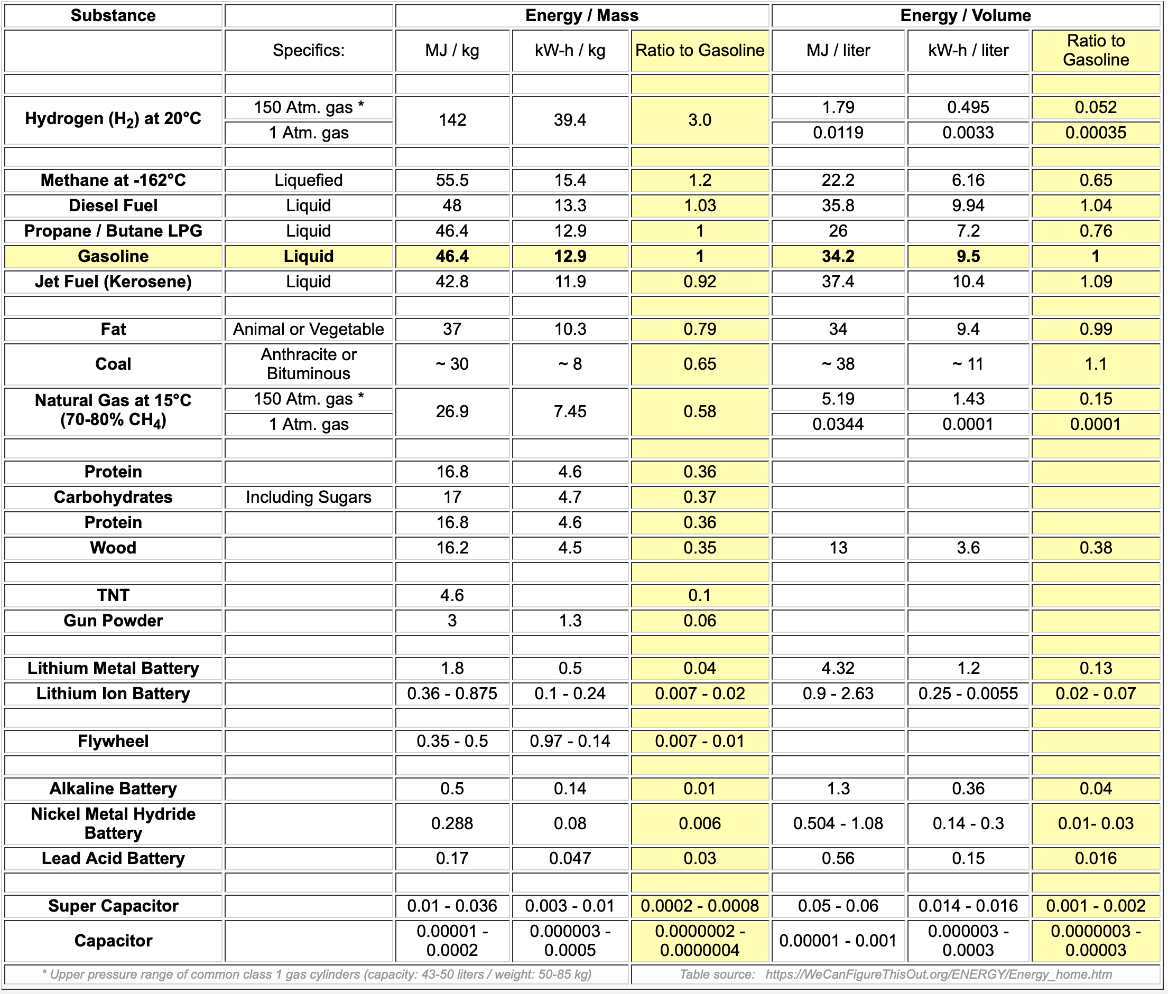
What sort of Ammonia energy storage densities might be thereby achieved?
According to a UK Royal Society study, ¹ using already established technologies,
+25 ºC Ammonia storage systems should achieve energy densities of ~3 kW-h / liter
-35 ºC Ammonia storage systems should achieve energy densities of almost 4 kW-h / liter
That compares with the earlier DOE Hydrogen energy storage system figures of
1 kW-h / liter in 2020, growing ultimately to 1.7 kW-h / liter
Giving Ammonia storage systems a near term advantage of 3-4X
1) Figure at right from page 7 in: https://royalsociety.org/topics-policy/projects/low-carbon-energy-programme/green-ammonia/

Slide 153
But DOE's projected limits might be slanted toward "Physical" H2 storage ¹
Because alternative "Material" based H2 storage is still in only early research stages
As an experienced nanoscientist, ^{2, 3} what might I expect from Material-based systems?
Tiny H2 molecules could easily slither into gaps in the above crystalline structures,
and might continue to do so until their accumulation began to stretch those crystals
Say that things continued until H2 molecules got within ~ 10 crystal atoms of each other
For crystal atom spacings of ~ 0.2 nm, H2 molecule spacing would then be 2 nm
=> H2 molecular concentration of 1 / (2 nm)³ = 1 / (2x10⁻⁷ cm)³ ~ 10²⁰ H2 molecules / cm³
700 ATM H2 gas would instead contain: ^{4, 5} ~ 2x10²² H2 molecules / cm³
Giving Material-based H2 storage a limit ~ 200 times smaller than 700 ATM H2
Corresponding to ~ 0.2 kW-h/ kg or 0.01 kW-h / l => Below DOE predicted maximums
1) Their two webpages (cited earlier) provide essentially no details
2) My patents: https://wecanfigurethisout.org/ABOUT/Patents.htm 3) My publications: https://wecanfigurethisout.org/ABOUT/Publications.htm
4) Calculated from the Ideal Gas Law: n/V = P / kT 5) My calculation checked via: https://www.gigacalculator.com/calculators/ideal-gas-law-calculator.php

Slide 154
Leaving H2 Fuel Cells a single unambiguous / undisputed advantage:
Fuel Cells can be recharged much more quickly than Batteries
Which is countered by one repeatedly cited disadvantage:
Fuel Cells have much lower Energy Return Efficiencies than Batteries
= Net Extractable Energy / Net Energy Required to Charge
As discussed much earlier, Batteries can return up to ~ 90% of the energy put into them
But Fuel Cells return far less of that energy
From an impressively extensive Wikipedia table, for H2 Fuel Cells: ¹
H2 Fuel Cell Type: Alkaline Proton Exchange Membrane Solid Oxide
Return Efficiency: 62% 30-50% 55-60%
Looking for corroboration of such low numbers from other sources:
1) https://en.wikipedia.org/wiki/Fuel_cell

Slide 155
Somewhat higher for some Fuel Cell types - But still far inferior to batteries: ¹
1) Yellow emphasis added to: https://www.energy.gov/sites/prod/files/2016/06/f32/fcto_fuel_cells_comparison_chart_apr2016.pdf

Slide 156
Or for Fuel Cells & Batteries designed for Grid Energy Load Leveling:
From the U.S. National Renewable Energy Lab: ¹
FC = Hydrogen Fuel Cell VR = Vanadium Redox Flow Battery
NaS = Molten Sodium Battery CAES = Compressed Air Energy Storage
Fuel Cell vs. Battery Bottom Line (at least for today)?
The energy return of Fuel Cells is 30-50% poorer than that of Batteries
1) Yellow emphasis added to: http://www.nrel.gov/docs/fy10osti/47547.pdf

Slide 157
Credits / Acknowledgements
Some materials used in this class were developed under a National Science Foundation "Research Initiation Grant in Engineering Education" (RIGEE).
Other materials, including the "Virtual Lab" science education website, were developed under even earlier NSF "Course, Curriculum and Laboratory Improvement" (CCLI) and "Nanoscience Undergraduate Education" (NUE) awards.
This set of notes was authored by John C. Bean who also created all figures not explicitly credited above.
Copyright John C. Bean
(However, permission is granted for use by individual instructors in non-profit academic institutions)
An Introduction to Sustainable Energy Systems: WeCanFigureThisOut.org/ENERGY/Energy_home.htm

