Slide 1
Prehistoric Nuclear Reactors?
John C. Bean
Outline
Review of U238 & U235 Fission:
Fast neutrons induce U238 fission, but that releases no replacement neutrons
Slow neutrons induce U235 fission, which does release new neutrons, but they're fast
Before they can chain react with more U235, they must be slowed down ("moderated")
If moderator is water, need > 3% U235 (in U238) to sustain chain reaction
From half-lives: U235 would have exceeded that abundance > 1.7 billion years ago
The alarming data, that was then reinterpreted as evidence for such reactors in Africa
How they likely formed:
Water flow concentrated Uranium by first dissolving, then re-depositing, its oxides
But for those oxides to form, there had to be a lot of oxygen in earth's atmosphere
Oxygen which was only liberated by spread of cellular life on earth
Before 1.7 billion years ago: Not enough life => Not enough O₂ => No natural reactors
But with life, geology suggests reactors pulsed on-and-off for hundreds of thousands of years!
(Written / Revised: August 2017)

Slide 2
Prehistoric Nuclear Reactors?
Could GEOLOGY ever produce a naturally occurring nuclear reactor?
Scientists believe this MIGHT have occurred
Long long ago . . . right here on Earth
The explanation comes right out of my preceding lecture:
Nuclear Power – But they blow up!
So I just had to share this fascinating story
Ideally, you should review the first half of that preceding lecture
But, in case you're in a hurry, I'll provide a quick review:
An Introduction to Sustainable Energy Systems: WeCanFigureThisOut.org/ENERGY/Energy_home.htm

Slide 3
On earth, uranium now has TWO significant isotopes:
Uranium 238 (²³⁸U):
It makes up 99.27% of the earth's current supply of uranium
It spontaneously falls apart, but extremely slowly: "half-life" = 4.6 billion years
But if a ²³⁸U atom is struck by a fast (high kinetic energy) neutron:
It tends to absorb that fast neutron
But it then becomes extremely unstable
And most quickly fall to pieces
But none of those pieces are free/lone neutrons:
b
238
etc.
239

Slide 4
The second significant uranium isotope is:
Uranium 235 (²³⁵U):
It makes up 0.72% of the earth's current supply of uranium
It spontaneously falls apart a bit more quickly: "half-life" = 703.8 million years
But if a ²³⁵U atom is struck by a slow (low kinetic energy) neutron:
It tends absorb that slow neutron
But it then also becomes extremely unstable
And most quickly fall to pieces
But its pieces include 1-3 fast neutrons:
235

Slide 5
But neutrons, of any speed, aren't usually flying around
So it's normally extremely boring:
After 4.6 billion years, half of the ²³⁸U atoms will have fallen apart
After 704 million years, half of the ²³⁵U atoms will have fallen apart
But when a ²³⁵U DOES fall apart, it can get briefly exciting
because its liberated hot neutrons can cause 1-3 ²³⁸U's to fall apart
And then it goes back to being extremely boring
b
b
etc.
238
238
etc.
239
239
235
b
etc.
238
239

Slide 6
UNLESS there is some water hanging around!
Then, a fast "hot" neutron can bounce off water's H atoms
Which, because H has about the same mass, will be kicked aside
taking away some of the incident neutron's kinetic energy
After multiple collisions, a fast "hot" neutron thus becomes a slow "cool" neutron
Which can THEN cause another ²³⁵U to fall apart
And THIS is the start a nuclear chain reaction!
O
H
H
b
etc.
238
O
O
H
H
H
H
239
235
235
H
H
O
b
etc.
238
239

Slide 7
The environment of a nuclear reactor promotes this chain reaction
But nuclear reactors also require:
That the uranium atoms are packed rather tightly together
Thus oxides of ²³⁵U and ²³⁸U are refined and compressed inside fuel rods
And light-water moderated nuclear reactors additionally require:
That the ²³⁵U concentration must be jacked up from 0.72% to 3-5%
Difficult because ALL uranium atoms have the same number of electrons
So they bond to the same things ruling out "chemical" purification
Nuclear enrichment plants thus use exotic "gas-diffusion" or "ultra-centrifuges"
As first developed for bomb manufacture in the World War II Manhattan Project
But those bombs required much more intense ²³⁵U enrichment
To levels of ≥ 80% 235U (rather than just 3-5%)

Slide 8
End of Review / Back to possible "prehistoric nuclear reactors"
Here we need to reflect on what a "radioactive half-life" really implies:
235U half life = 703.8 million years vs. 238U half life = 4.6 billion years
Right now, for every 9927 ²³⁸U's, there are 72 ²³⁵U's (from: 99.27% vs. 0.72%)
But, 1 billion years ago, the numbers were (based on the meaning of "half-life"):
²³⁵U = (72) x 2 ^{(1 billion / 703.8 million)} = 192
²³⁵U = 1.6%
238U = (9927) x 2 (1 billion / 4.6 billion) = 11,541
And 2 billion years ago the numbers were:
²³⁵U = (72) x 2 ^{(2 billion / 703.8 million)} = 516
²³⁵U = 3.7%
238U = (9927) x 2 (2 billion / 4.6 billion) = 13,418

Slide 9
So the 3% nuclear chain reaction threshold was met about . . .
1.7 billion years ago:
²³⁵U = (72) x 2 ^{(1.7 billion / 703.8 million)} = 384
²³⁵U = 2.9%
238U = (9927) x 2 (1.7 billion / 4.6 billion) = 12,825
But in the earth's crust uranium atoms are normally way too far apart
So now mix in some oxygen gas
Which reacts with uranium to form oxides
Which are somewhat soluble in water
THEN, flowing water can pick up both ²³⁵U and ²³⁸U ("leeching" it from the rocks)
And if that water flow happens to dry up in one place,
it will leave a residue of concentrated ²³⁵U and ²³⁸U

Slide 10
Which completes the requirements for a natural nuclear reactor
Scientists recognized this possibility as early as the 1950's
Indeed, one theorist, Paul Kuroda, published a supporting calculation in 1956 ¹
But his paper got largely ignored - Until a French security agency got involved
Why? Because security agencies worry a LOT about missing ²³⁵U !
After all, ²³⁵U is THE essential ingredient for making a fission nuclear bomb
In 1972, ore from the "Oklo" Gabon Africa mine was being processed in France
EVERYWHERE else in the world, uranium ore contains 0.72% ²³⁵U
But for Oklo, the concentration was found to be significantly lower ²
1) On the Nuclear Physical Stability of the Uranium Minerals. Paul Kazuo Kuroda in Journal of Chemical Physics, Vol. 25, No. 4, pages 781–782; 1956 (http://www.nuclearplanet.com/Kuroda%201956.pdf)
On average, the decrease was small: 0.7202% => 0.7171%. But in selected mine locations it fell as low as 0.44%. See:
2) A Natural Fission Reactor, Scientific American 1976 (https://www.scientificamerican.com/article/a-natural-fission-reactor/)

Slide 11
The French Atomic Energy Commission (CEA) was thus called in:
They quickly calculated the total amount of ²³⁵U that could be missing from Oklo
They didn't like the answer: Enough to build a half dozen nuclear bombs
But the CEA also knew just how hard it is to selectively remove ²³⁵U
And they found no evidence that the Oklo ore had been diverted
through one of the aforementioned nuclear enrichment plants
The CEA was thus reportedly "perplexed" ³ for several weeks
Until someone remembered those predictions of natural nuclear reactors
Which provided a much less alarming answer to where the ²³⁵U had gone:
3) The Workings of an Ancient Nuclear Reactor – Scientific American 2009 (https://www.scientificamerican.com/article/ancient-nuclear-reactor/)

Slide 12
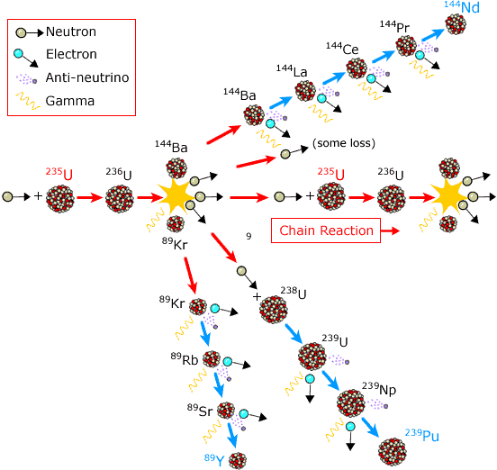
It had long ago fissioned away into other things: ²
The "things" that are produced when atoms fall apart, making other atoms
Otherwise known as the "daughters" produced in nuclear chain reactions
As only partially enumerated this figure from my introductory lecture:
And this all occurred, quite naturally, about 1.7 billion years ago
My modification of figure found at:
http://www.nobelprize.org/educational/physics/energy/fission_2.html
2) A Natural Fission Reactor, Scientific American 1976 (https://www.scientificamerican.com/article/a-natural-fission-reactor/)

Slide 13
That seems to wrap things up & tie it in a bow, right?
NO, there are still some loose ends to be explained:
Tracking radioactive half-lives backward, we calculated historic ²³⁵U percentages of:
Now:
0.72%
- 1.0x10⁹ BCE:
1.6%
-1.7x10⁹ BCE
2.9%
-2x10⁹ BCE
3.7%
Indicating that nuclear chain reactions could be sustained 1.7 billion years ago
But, at 3.7%, they would have worked even better 2 billion years ago
And they would have worked even better before that . . .
So why say natural nuclear reactions ONLY occurred ~ 1.7 billion years ago?
Because that was about the time life was getting started on earth
An Introduction to Sustainable Energy Systems: WeCanFigureThisOut.org/ENERGY/Energy_home.htm

Slide 14
And it took life to liberate large amounts of gaseous oxygen
Which, recall, was essential for doing this:
Oxygen gas reacted with widely dispersed uranium, to form oxides
Those oxides were somewhat water soluble
Allowing flowing water to pick up both ²³⁵U and ²³⁸U
Which, if it then dried up in one place,
would leave concentrated residues of ²³⁵U and ²³⁸U
So, getting even weirder, scientists suggest that prehistoric nuclear reactors
could not be formed until oxygen-liberating life began populating the earth
But it gets even stranger:

Slide 15
When they carefully analyzed those chain reaction products:
They concluded that these prehistoric reactors fired up 1.7 billion years ago,
and "operated" intermittently for hundreds of thousands of years
But that intermittent operation was not random - reaction products instead suggest:
The chain reaction ran for ~ 30 minutes
It was then extinguished for ~ 2 ½ hours
And then that cycle was repeated over and over and over . . .

Slide 16
All because sustained fission still requires neutron "moderation"
That is, fast/hot neutrons from ²³⁵U must be transformed into slow/cool neutrons
In manmade nuclear reactors, neutrons do this by ricocheting off liquid water
Prehistoric reactors apparently used the same process
But when those soggy-stuff-buried-in-the-ground-reactors (SSBGR) ⁴ fired up:
That patch of ground would start to get really hot
And after ~ 30 minutes, almost all of the liquid water would boil away
Then, deprived of that neutron "moderating" liquid water,
the nuclear chain reaction would be quenched
But THEN the ground would start to cool back down
And after about 2 ½ hours enough liquid water could seep back in
that the nuclear chain reaction would start back up!
And so on, and so on, and so on . . .
4) So named by Me

Slide 17
But how did they come up with the exact 30 minute / 2 ½ hour timing?
The ²³⁵U / ²³⁸U chain reactions are known to release multiple isotopes of Xenon
Some isotopes are released very early, some are released later
However, as a gas, Xenon doesn't normally stick around
But at Oklo, hot water slowly oxidized aluminum & silicon-containing minerals
Which could trap Xenon, at least if it hung around long enough
But while late-emerging Xe isotopes were found, early-emerging Xe was not!
Suggesting the ground was VERY hot when the early Xe emerged
Because extreme heat would pressurize that Xe, driving it out and away
But that the ground was cooler when the late Xe emerged
Allowing it to hang around long enough to be trapped by mineralization
Known timing of Xe generation then indicated: "30 minutes on + 2 ½ hour off" ^{3, 5}
3) The Workings of an Ancient Nuclear Reactor – Scientific American 2009 (https://www.scientificamerican.com/article/ancient-nuclear-reactor/)
5) Record of Cycling Operation of the Natural Nuclear Reactor in the Oklo/Okelobondo Area in Gabon, Phys. Rev. Lett - 2004
(http://journals.aps.org/prl/abstract/10.1103/PhysRevLett.93.182302)

Slide 18
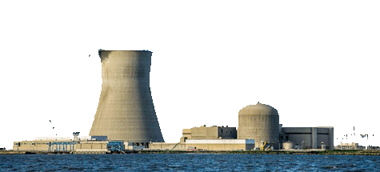
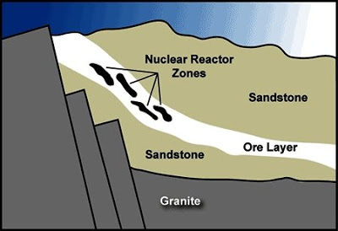
Leading to remarkably familiar-sounding African Ghost Reactors:
Experts OR particularly observant readers of my introductory nuclear lecture might figure out that I have not really chosen the most appropriate type of "ghost reactor" to depict in my figure above.
(HINT: Note type of reactor suggested by figure's reactor containment structure)
top: http://mashable.com/category/nuclear-reactor/
bottom:http://www.bldgblog.com/2009/10/fossil-reactors/

Slide 19
Other WeCanFigureThisOut.org note sets on nuclear energy:
Note set introducing nuclear energy & its accidents:
Nuclear Energy – But they blow up!
Note three sets on the possible future of nuclear energy:
Gen III/III+ Reactors: Confronting Cost & Operational Safety
Gen IV Reactors: Two Designs that Might Radically Reduce Nuclear Waste
Other Gen IV Nuclear Reactors
For links to these note sets (and their accompanying resources webpages) visit:
www.WeCanFigureThisOut.org/ENERGY/Energy_home.htm

Slide 20
Credits / Acknowledgements
Some materials used in this class were developed under a National Science Foundation "Research Initiation Grant in Engineering Education" (RIGEE).
Other materials, including the "Virtual Lab" science education website, were developed under even earlier NSF "Course, Curriculum and Laboratory Improvement" (CCLI) and "Nanoscience Undergraduate Education" (NUE) awards.
This set of notes was authored by John C. Bean who also created all figures not explicitly credited above.
Copyright John C. Bean
(However, permission is granted for use by individual instructors in non-profit academic institutions)
An Introduction to Sustainable Energy Systems: WeCanFigureThisOut.org/ENERGY/Energy_home.htm

