Slide 1
Smart Grid: Robust/Energy Efficient vs. Hackable Orwellian Nightmare?
John C. Bean
Outline
How major U.S. blackouts prompted thinking about a "Smart Resilient Grid"
  And how deregulation has since made the Grid even less reliable
The five elements proposed for such a robust and energy-efficient Grid:
  Sensing trouble: Phasor (phase and frequency) Measurement Units (PMUs)
  Isolating trouble: Local, smart, microprocessor-based sensors & circuit breakers
  Logging & managing trouble: Digital Supervisory Control & Data Acquisition (SCADA)
  Communicating trouble: An Intranet to linking whole Grid together
  Controlling demand thereby mitigating trouble: An Advanced Metering Interface (AMI)
The latter involving power companies monitoring and/or controlling your IoT home appliances
  Raising huge security and privacy issues (including hacker/governmental sabotage)
Versus some far less intrusive smart(ish) energy-saving tools & strategies
(Written / Revised: December 2017)

Slide 2
Smart Grid: Robust/Energy Efficient vs. Hackable Orwellian Nightmare?
As citizens, we've almost all heard about the "Smart Grid"
But, when push comes to shove, we're still a bit vague about what it is
Well, it turns out that the experts are a bit vague too
Indeed, many have very different views on what a "Smart Grid" is (or might be)
Some of which aren't really focused upon smartness
Some of which have little to do with the traditional Grid
In fact, the whole idea was originally driven more by what we wanted to avoid
Than by what we wanted to achieve
THIS was the sort of thing we really wanted to avoid:
An Introduction to Sustainable Energy Systems: WeCanFigureThisOut.org/ENERGY/Energy_home.htm

Slide 3
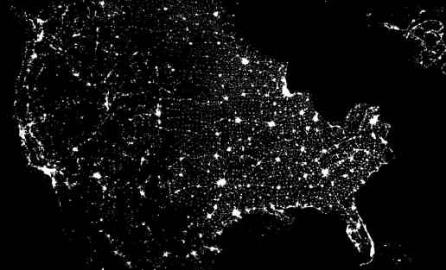
Satellite view of the U.S. on the evening of 14 August 2003:
Missing? Electrical power to 45 million people, spanning eight states!
http://thegetoutpost.com/

Slide 4
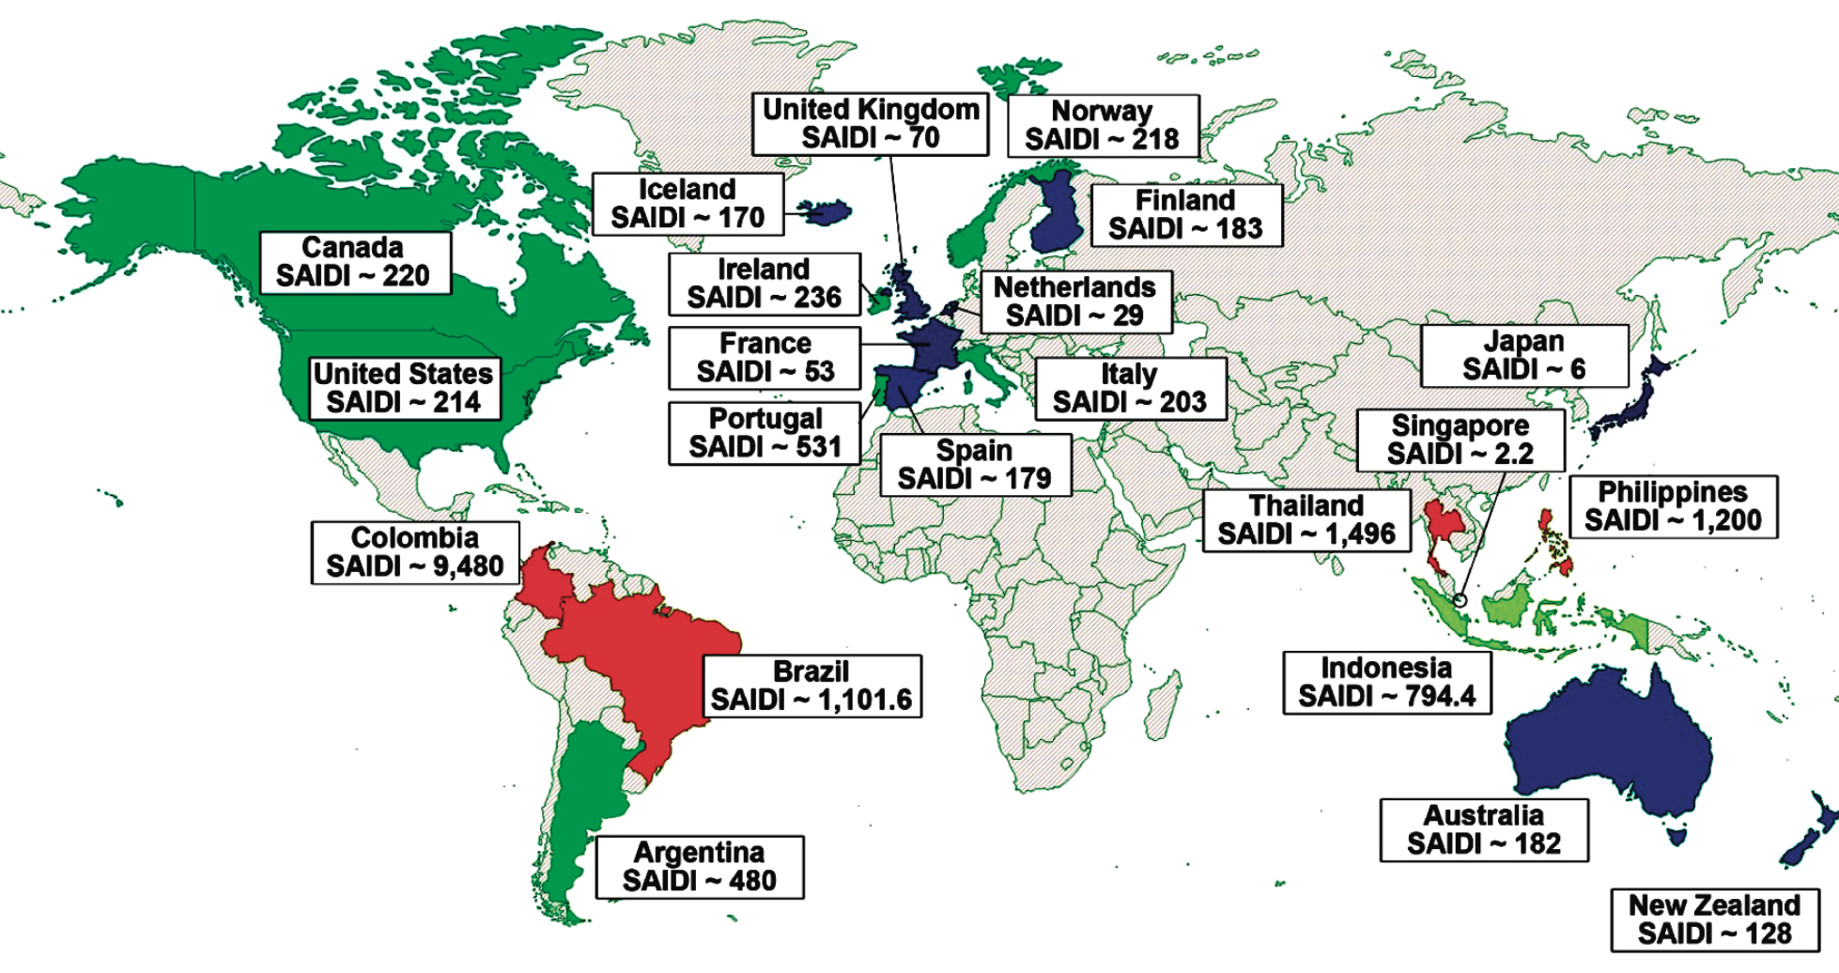
Problems with Grid were obvious at least a decade before:
For the period 1992-2001, excluding outages due to storms/hurricanes:
System Average Interruption Duration Index (SAIDI) =
Average time that customers are without power during the period analyzed
U.S. power system was already one of the least reliable in the developed world
SAIDI (in minutes):
220 – Canada
214 - U.S.
203 – Italy
182 – Australia
128 – New Zealand
70 – U.K.
63 – France
29 – Netherlands
6 - Japan
Terrorism and the Electric Power Delivery System, page 10, U.S. National Academies Press 2011
http://www.nap.edu/catalog/12050/terrorism-and-the-electric-power-delivery-system

Slide 5
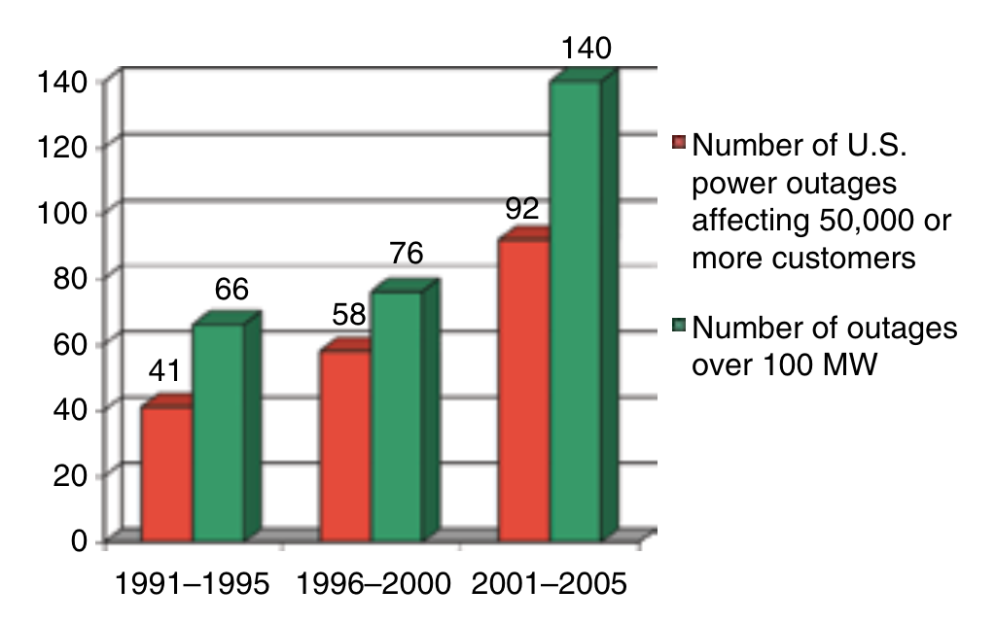
How have things been going since 2001?
Not very well:
The Electric Power Grid: Today and Tomorrow, Massoud Amin and John Stringer, MRS Bulletin 33 (April 2008)
http://massoud-amin.umn.edu/publications/The_Grid_Amin_Stringer.pdf

Slide 6
Observations from a range of sources:
"On any given day, 500,000 customers in the United States are without power for at least two hours" ¹
"The five-year annual average of outages doubled every five years . . . In the first six months of 2014, there were 130 reported grid outages - which puts that six month period as having more outages than all but four years since 2000" ²
"In the past decade alone, an estimated 679 widespread power outages occurred due to severe weather, costing the United States an annual average of between $18 billion and $33 billion.
Seven of the 10 costliest storm outages in United States history occurred between 2004 and 2012.
Blackouts cost the economy $112 USD per person per day, before accounting for injury, death, crime and delay, according to one analysis." ³
1) Securing the Grid, S. Massoud Amin: http://massoud-amin.umn.edu/publications/Securing-the-Electricity-Grid.pdf
2) http://insideenergy.org/2014/08/18/power-outages-on-the-rise-across-the-u-s/
3) http://natgeotv.com.au/tv/american-blackout/american-blackout-facts.aspx

Slide 7
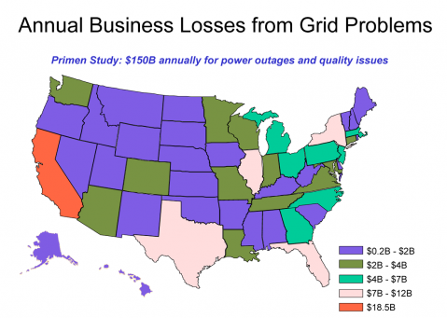
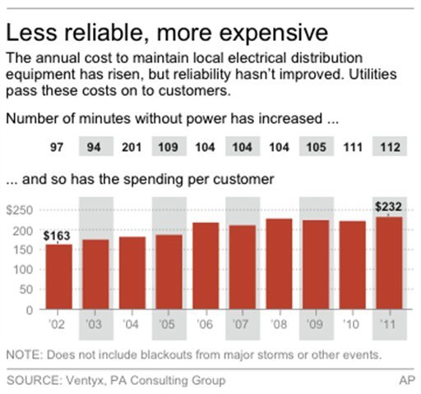
Speaking of costs:
Forbes Magazine: The Washington Post:
Left: Blackout Risk Tool Puts Price Tag On Power Reliability, Forbes Magazine (30 August 2013)
http://www.forbes.com/sites/williampentland/2013/08/30/blackout-risk-tool-puts-price-tag-on-power-reliability/
Right: http://www.washingtonpost.com/blogs/wonkblog/wp/2013/03/08/surprise-the-u-s-power-grid-is-getting-pricier-less-reliable/

Slide 8
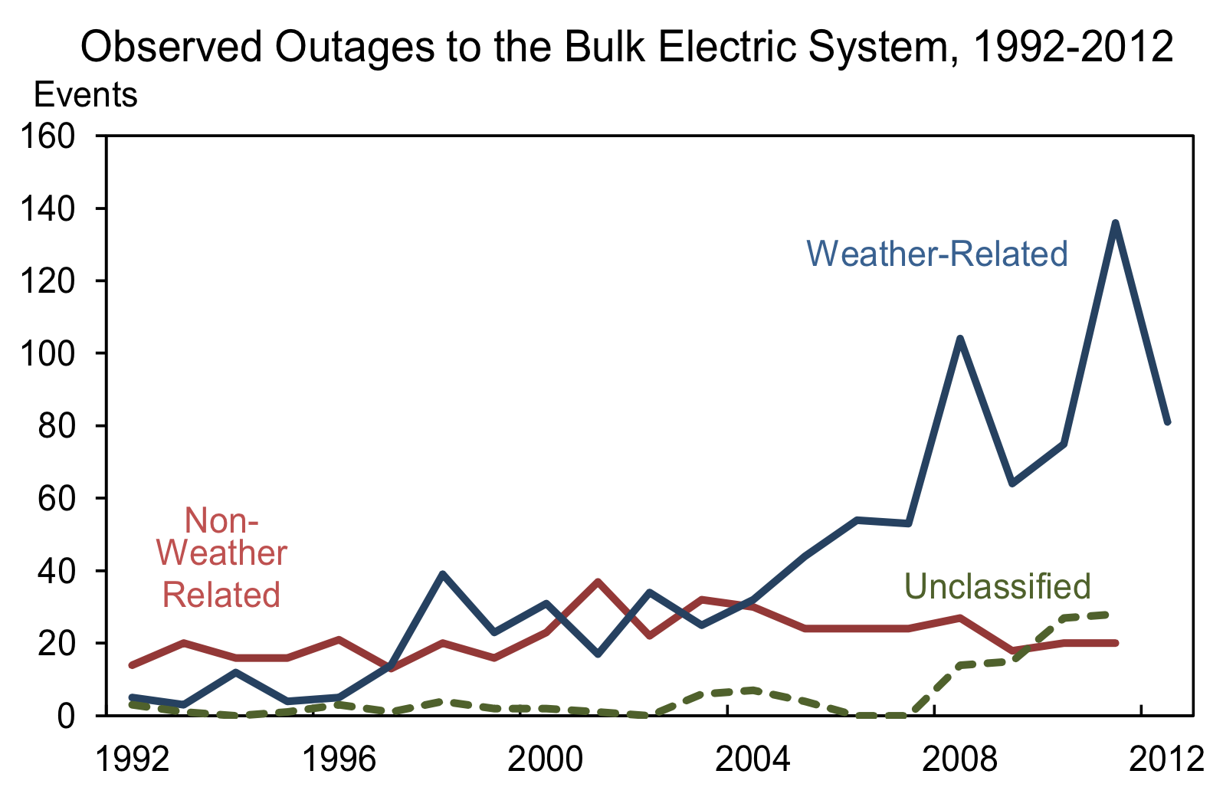
And if you include weather / possible global warming effects:
From a White House report:
p. 8, Economic Benefits of Increasing Electric Grid Resilience to Weather Outages – White House Report
http://energy.gov/sites/prod/files/2013/08/f2/Grid%20Resiliency%20Report_FINAL.pdf

Slide 9
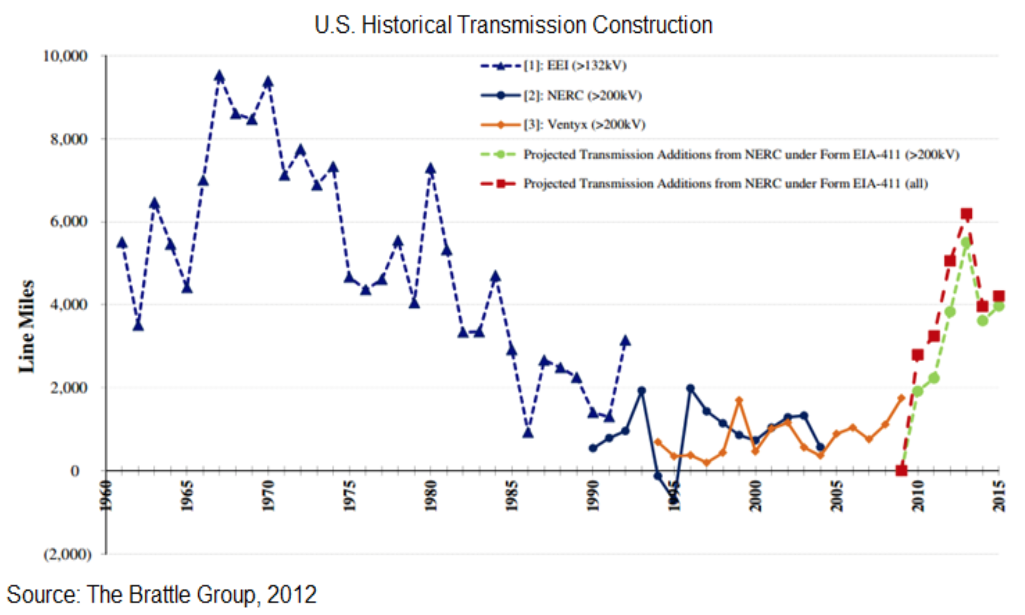
What's going on?
Well, for one, we are investing far less in our Grid:
Rise at right was only a projection of reaction to U.S. economic stimulus funding
(not independent private investment)!
p. 7, Economic Benefits of Increasing Electric Grid Resilience to Weather Outages – White House Report 2011
http://energy.gov/sites/prod/files/2013/08/f2/Grid%20Resiliency%20Report_FINAL.pdf

Slide 10
What led to this situation?
In 1978 Congress passed the Public Utility Regulatory Policy Act (PURPA)
Prior to this act, power companies were . . . power companies
That is, as government-regulated monopolies, they did it all
Both producing power and delivering power
But PURPA not only removed their monopoly on in-house power production,
It also compelled them to buy power from others when it cost less
And then distribute that power over their transmission networks
This was partially motivated by desire to open the Grid to emerging power sources
But major motivation was belief that free market might just better provide power
The same belief that led to break-up of Bell System (my former employer)
An Introduction to Sustainable Energy Systems: WeCanFigureThisOut.org/ENERGY/Energy_home.htm

Slide 11
This Act and others led to:
A change in Federal Energy Regulatory Commission (FERC) policy:
Which, in the 1980's and 1990's, began encouraging power companies to:
Sell off their in-house power generation capabilities
Substitute bought-in market-supplied power
If they fully responded: Power companies => Transmission companies ONLY
But the responsibility for the Grid then got really muddy:
These power/transmission companies were still government-regulated
And were still held responsible for delivering affordable, reliable power
Despite fact that they no longer fully controlled the power system
While their free-market power suppliers were NOT regulated
An Introduction to Sustainable Energy Systems: WeCanFigureThisOut.org/ENERGY/Energy_home.htm

Slide 12
And now add in the need for "power generation margin"
Power generation margin =
Extra power plants / transmission lines used only for power surges
This is a bit different from more common dispatchable power plants
Which are predictably required every evening as demand peaks
Generation margin is instead designed to meet unpredictable demand
As in emergencies, including (possibly) when:
2 minutes from now when something leads everyone to flick on their TV
Yes, a spike in TV viewing could cause a Grid "emergency"
Because there is essentially zero elasticity in electrical power:
Millisecond by millisecond, power produced must = power consumed
An Introduction to Sustainable Energy Systems: WeCanFigureThisOut.org/ENERGY/Energy_home.htm

Slide 13
Tolerable mismatch between power production and demand:
From my Generic Power Plant & Grid (pptx / pdf / key) notes:
AC voltage has to be held within 5% of 115 Volts
Frequency has to be held within ~ 0.067 Hz of 60Hz
Phase must be held within 10° (i.e., 1/36th of cycle)
The latter two frequency specs correspond to 0.1% and 0.5 millisecond shifts
So timing and precision are everything, and this compels power companies to:
Not only keep spare power plants off line (on standby), but also to:
Keep some power plants spinning idly, all of the time
So that they can be put into service, within seconds
HOWEVER: This equipment may be needed less than 1% of the time!
An Introduction to Sustainable Energy Systems: WeCanFigureThisOut.org/ENERGY/Energy_home.htm

Slide 14
What effect has deregulation had upon this safety margin?
Pre-deregulation power generation margins had been held at 25-30%
After the above changes in regulatory policy, they fell to 10-15%
(What MBA is going miss the opportunity to cut back on something used 1% of the time!)
While U.S. power demand in the 1990's rose by 35%
Investment in new transmission lines rose by only 18%
In this decade some predict that power demand might rise by another 20%
But transmission capability is expected to rise only 4%
Put another way (from the same source as numbers above¹):
"The (U.S.) power industry spends a smaller proportion of annual sales on R&D
than do the dog food, leather, insurance, or many other industries
- less than 0.3%, or about $600 million per year"
1) For the Good of the Grid, Massoud Amin, U. Minnesota + Electric Power Research Institute
http://massoud-amin.umn.edu/publications/FortheGoodoftheGrid.pdf

Slide 15
Muddied responsibility + MBA's => Reduced margins, investment, R&D . . .
Thus demand more often exceeds reduced power production margins
= Explanation for increased power blackouts, right?
Yes and No:
YES: Local failures have been caused by unexpected demand
Or by spot failures in power production and/or transmission equipment
NO: But this does not account for the massive size of many U.S. power blackouts
As seen in some of our biggest U.S. / Canadian blackouts:
An Introduction to Sustainable Energy Systems: WeCanFigureThisOut.org/ENERGY/Energy_home.htm

Slide 16
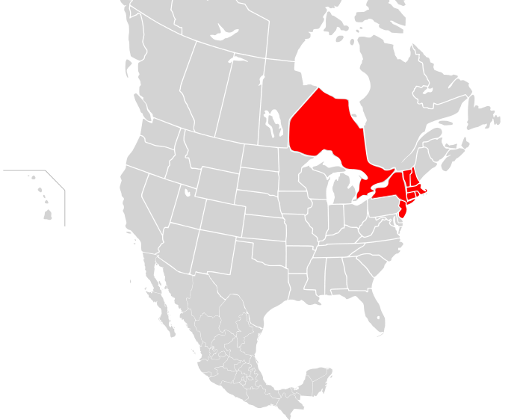
9 November 1965
Blacked out: 30 million people / 80,000 square miles
"Maintenance personnel incorrectly set a protective relay on one of the transmission lines . . . a small surge of power originating from the Robert Moses generating plant in Lewiston, New York caused the improperly set relay to trip at far below the line's rated capacity" ¹
Cause = 1 human error + 1 small surge, shutting down 1 local power line
http://en.wikipedia.org/wiki/Northeast_blackout_of_1965

Slide 17
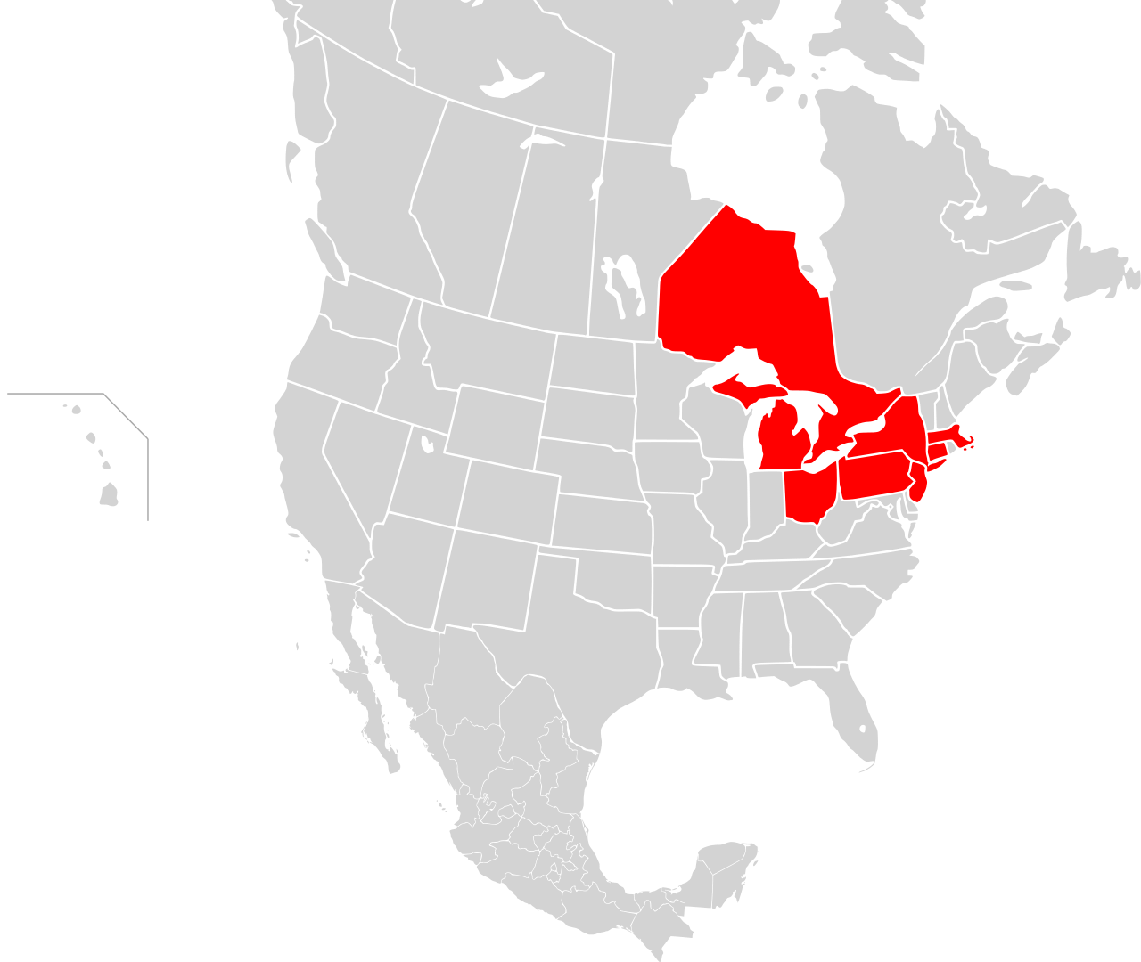
14 August 2003
Blacked out: 45 million people / Eight U.S. states
"The blackout's primary cause was a software bug in the alarm system at a control room of the FirstEnergy Corporation, located in Ohio. A lack of alarm left operators unaware of the need to re-distribute power after overloaded transmission lines hit unpruned foliage" ¹
CAUSE = 1 branch hitting 1 transmission line + 1 malfunctioning alarm
Which, led to 568 generators at 265 power plants tripping off!
http://en.wikipedia.org/wiki/Northeast_blackout_of_2003

Slide 18
Precipitating events were almost trivial:
Amount of power initially lost was insignificant on scale of area ultimately affected!
So while diminished power production margin might have caused local problem
It can't be wholly blamed for hugely larger eventual blackouts
As borne out by another blackout in 1966 starting at Oregon – California border:
Blacking out 13 states and provinces => 1.5 billion dollars in damage
But for which later analysis indicated that:
  "shedding (dropping) some 0.4% of the total load on the grid for just 30 minutes would have prevented the cascading effects and prevented large-scale regional outage" ¹
So problem is more about a fundamental instability in the grid
1) http://massoud-amin.umn.edu/publications/FortheGoodoftheGrid.pdf

Slide 19
So why IS the Grid so unstable?
And why didn't they
Just cut off 0.4% of their customers to stop the blackout?
Answers:
First (as noted above): Tolerance for anomalous power is razor thin
Second: Impact of anomalies spreads at almost the speed of light
This means protective actions have to be taken in milliseconds to seconds
- Human organizations cannot make decisions at that speed
- A human being cannot even fully comprehend the problem in that time
An Introduction to Sustainable Energy Systems: WeCanFigureThisOut.org/ENERGY/Energy_home.htm

Slide 20
So human beings must be removed from the (immediate) loop
AND "decisions" must be made at the site of the problem
The most basic action/decision? Open up a circuit breaker to isolate problem area
But a standard circuit breaker may be too slow (e.g., 100's of milliseconds!)
Further, it can only make rather simple / dumb decisions based on:
"Current is too high!" or possibly: "Voltage is too low!"
So we need ultrafast breakers capable of reacting to more complex faults
Frequency anomalies are particularly critical:
Frequency should be synchronized across grid to within 0.067 Hz of 60Hz
Generators can melt down if they are mismatched by just 2 Hz!
So we also need local sensors capable of detecting minute frequency shifts
An Introduction to Sustainable Energy Systems: WeCanFigureThisOut.org/ENERGY/Energy_home.htm

Slide 21
=> "A Smart Resilient Grid" - then shortened to just "A Smart Grid"
Which would involve these responsibilities / handled via these features: ¹
1) Sensing Trouble: Phasor Measurement Units (PMUs)
Sensors comparing local AC frequency and phase to the grid standard
GPS enabled + using satellites' hyper-accurate atomic clocks
2) Isolating trouble: Local microprocessor-based sensors & circuit breakers
Capable of analyzing and responding to complex / subtle faults
Based on programmable logic controllers (PLCs)
3) Logging and managing trouble:
Digital supervisory control & data acquisition systems (SCADA)
To make the required, almost instantaneous, protective decisions
1) http://www.epri.com/abstracts/Pages/ProductAbstract.aspx?ProductId=000000000001022519

Slide 22
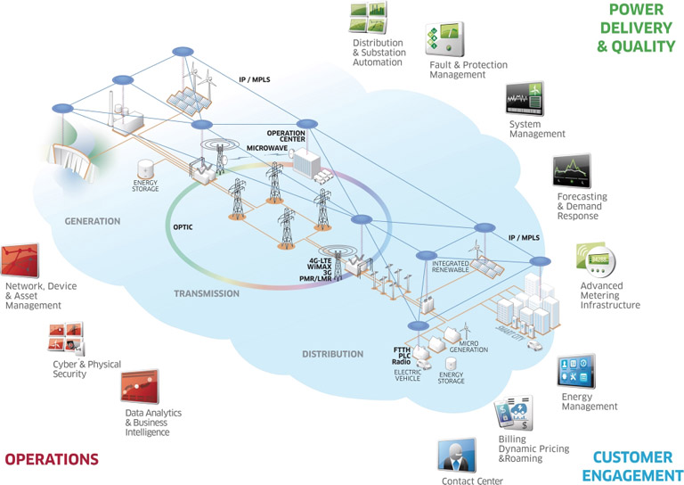
But that control system should be both local and distributed:
Local to take immediate protective actions
Distributed to instigate grid-wide protective measures
For example: Cueing human operators to start up reserve generators
https://www.csiac.org/journal_article/efficacy-and-challenges-scada-and-smart-grid-integration

Slide 23
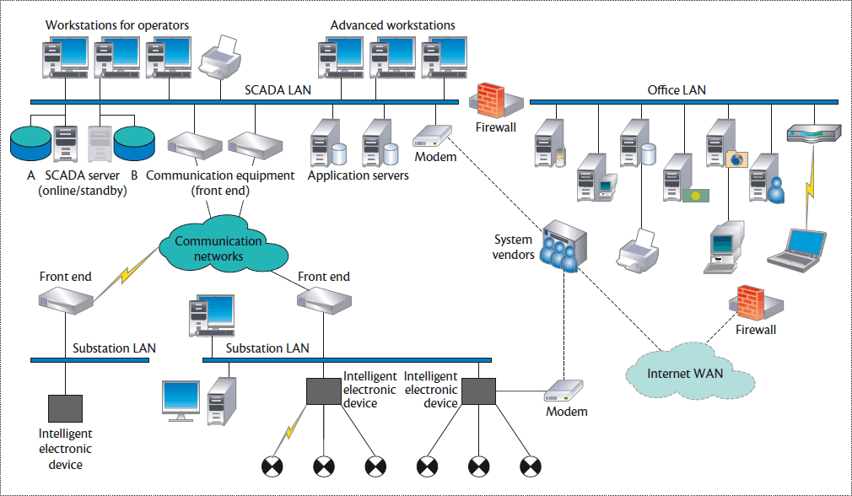
Distributed part of SCADA => 4th Smart Grid feature: An Intranet
With the responsibility of communicating trouble
Essentially a very high reliability, very high speed version of the Internet
You can't just break data into packets and idly sprinkle them into a network
(Which is what we do with our data on the Internet!)
Instead, power system alarm data must get through, intact, within milliseconds!
http://www.computer.org/csdl/mags/sp/2012/04/msp2012040062-abs.html

Slide 24
And it's not just about the hardware:
We are not really sure of HOW the SOFTWARE should operate!
The Grid is HUGELY more complex than normal industrial control systems
Power system complexity & critical timing begin resemble a human brain
So Grid software models have invoked or drawn analogies with (partial list only¹):
Optimal Control Theory Ecology Human Cognition
Glassy Dynamics Information Theory Bio-Systems
Microphysics of Clouds Kuramoto Oscillators Markow Processes
Random Fuse Networks Neural Networks
Maximum Entropy (e.g., as in Shannon communication theory) . . .
1) For Slightly more detail + references see: http://en.wikipedia.org/wiki/Smart_grid

Slide 25
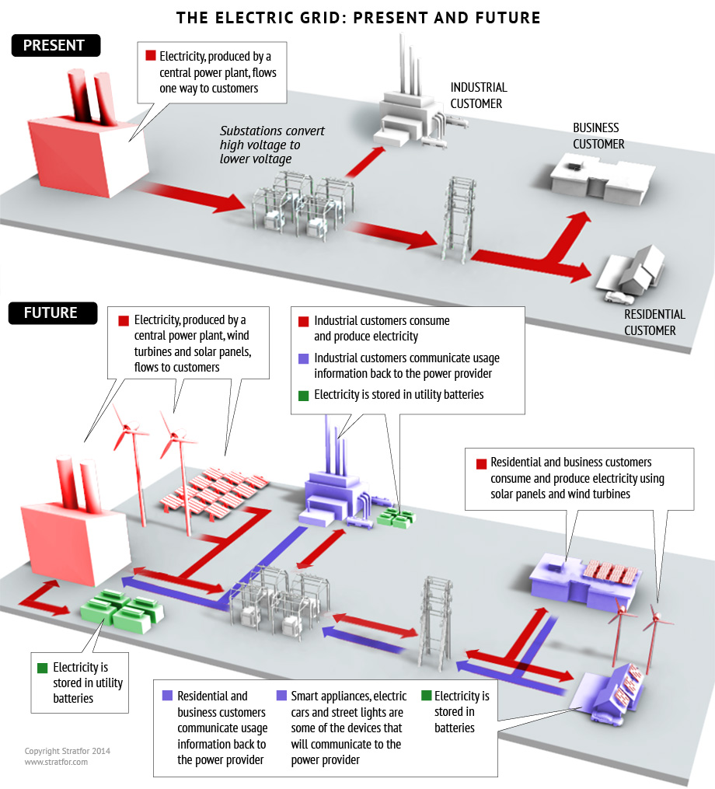
Some Smart Grid descriptions also emphasize changes in layout:
For instance, the need for multiple power delivery routes to enhance resiliency
But this is old news, the Grid has been doing this for a century!
Or 2-way power transmission:
For example, to accommodate
house-by-house production of
solar or wind power:
But contrary to impression given at right
Change is not new 2-way wires!
Wires are intrinsically 2-way
https://www.stratfor.com/analysis/architecture-electricity-evolving-albeit-gradually

Slide 26
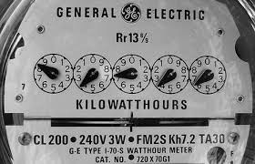
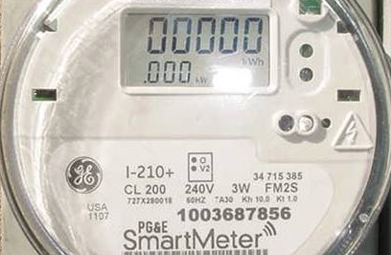
Change is instead at the ENDS of the wires:
In the 5th Smart Grid feature, an Advanced Metering Interface (AMI)
With the job of controlling demand, and thereby mitigating trouble
At its lowest level, this consists of a Smart Meter
Old power meters only recorded your total monthly power consumption
Smart meters instead tell the power company what power you consumed when
They also "run backward" if you produce power and send it back into the Grid
Old dumb meter: New smart meter:
http://www.treehugger.com/clean-technology/baltimore-announces-massive-smart-grid-program-2-million-meters-to-be-installed.html
http://www.wired.com/2010/03/smart-grids-done-smartly/

Slide 27
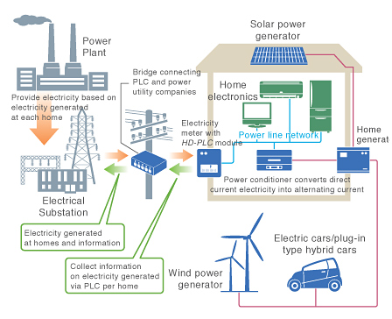
But full blown AMI would operate more like this:
As the interface with a whole-house power management/information system:
This, finally, sounds like the "Smart Grid" as it is known to most consumers
http://www.hd-plc.org/modules/feature/090619.html

Slide 28
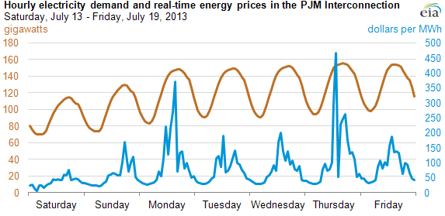
Which would enable Smart Grid functions of:
a) Billing for power based on its true cost of production at that time
= The prime incentive for smarter household/business consumption of energy
From Energy Production & Consumption (pptx / pdf / key) notes, looking at right axis:
Midday true cost of power can be 2X times cost in middle of the night
Evening true cost of power can be 4X times cost in middle of the night
www.eia.gov/todayinenergy/detail.cfm?id=12711

Slide 29
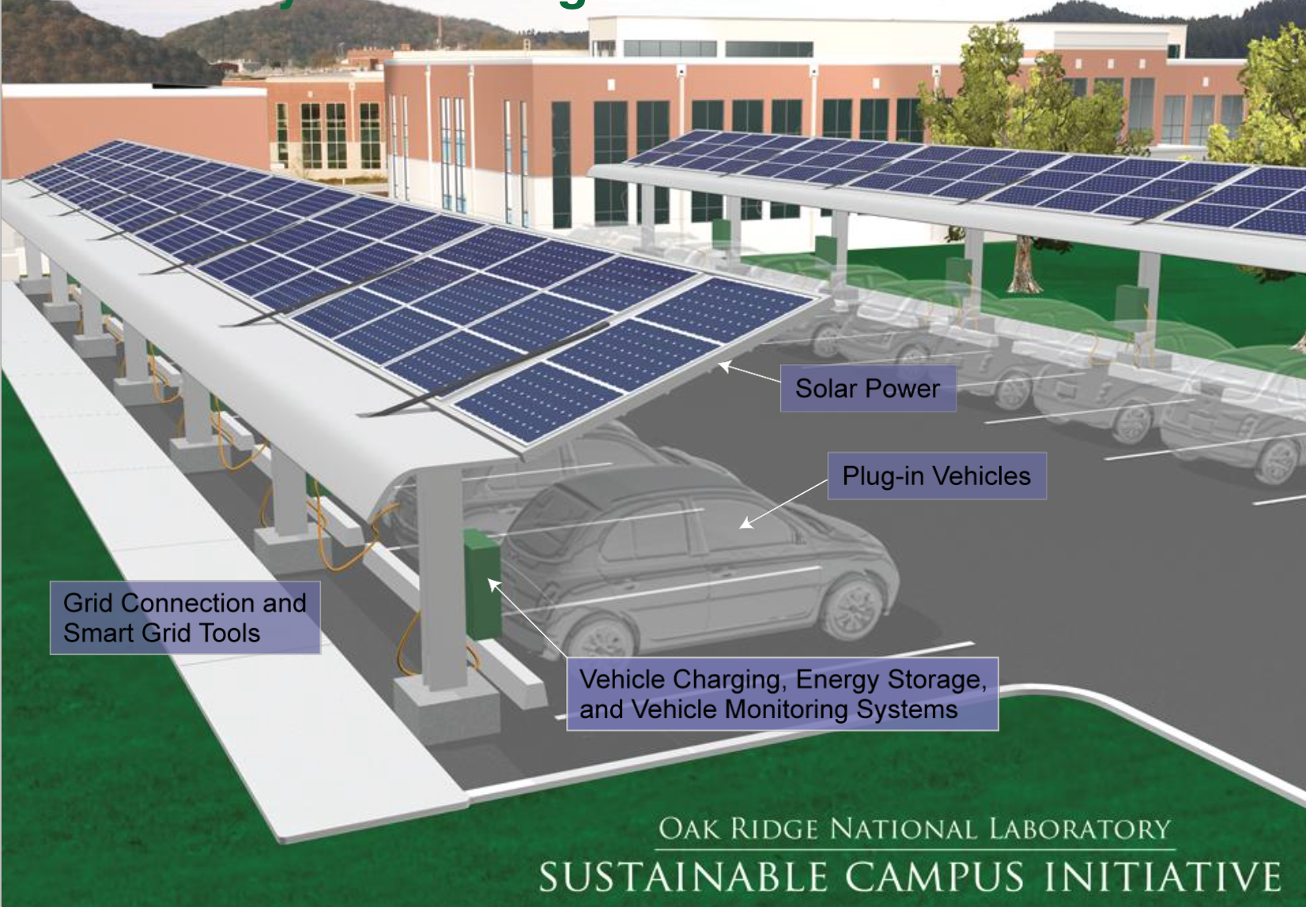
Full AMI would ALSO allow:
b) Payment for power put back into the Grid by "customers"
= Prime incentive for distributed household/business power production
Which would, in turn, incentivize the possibility of:
c) Home-based Grid energy storage
Via schemes such as Vehicle to Grid ¹ (V2G):
Or via new, more affordable and efficient, in-home batteries:
"Tesla Unveils Batteries to Power Homes" ²
"The rechargeable lithium-ion battery unit would be built using the same batteries Tesla produces for its electric vehicles . . . The system is called Powerwall and Tesla will sell the 7kWh unit for $3,000 while the 10kWh unit will retail for $3,500"
1) For details on V2G see my "Electrification of Transportation" lecture notes
2) http://www.bbc.com/news/technology-32545081

Slide 30
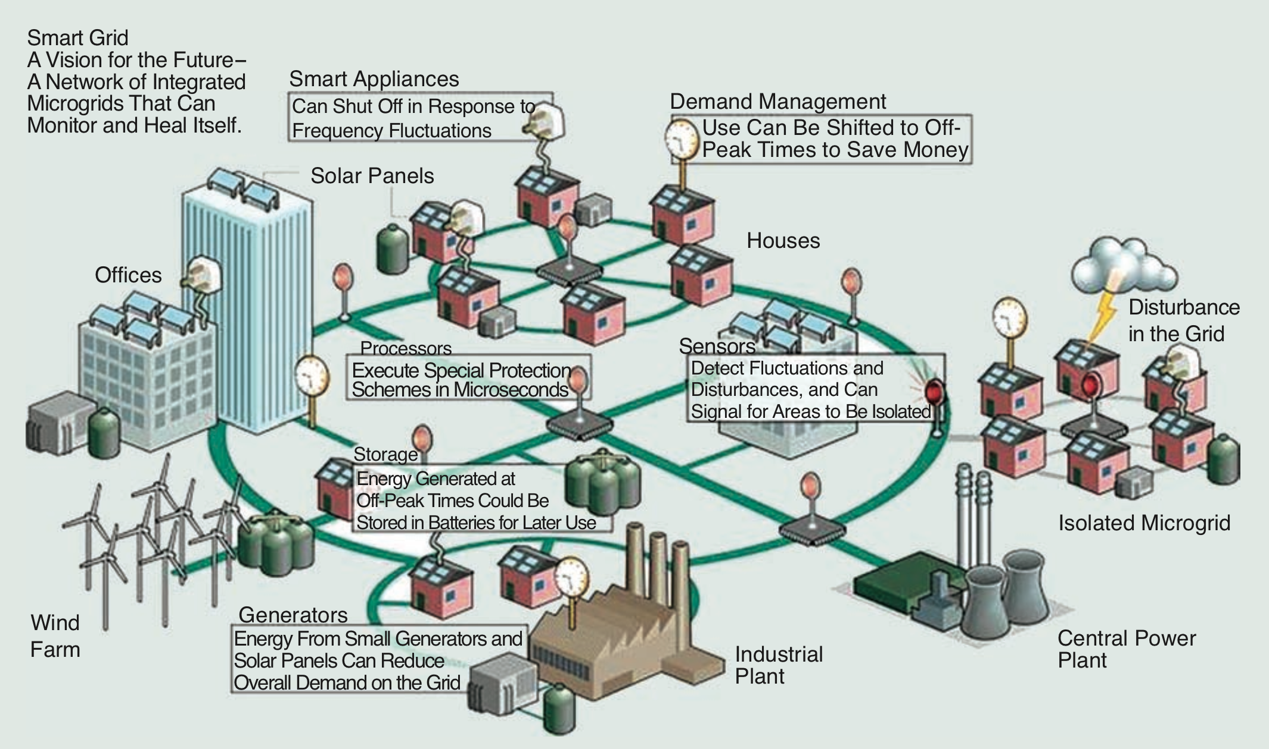
Putting this all together = A Smart Resilient Grid:
http://massoud-amin.umn.edu/publications/FortheGoodoftheGrid.pdf

Slide 31
Paraphrasing those almost unreadable boxes, this Grid would:
Monitor and heal itself by:
Detecting fluctuations and disturbances, signaling areas to be isolated
Using processors executing special protection schemes in microseconds
Protect our homes by:
Using smart appliances that shut off in response to frequency fluctuations
Enhance Grid efficiency by:
Demand management shifting power use off peak, saving money
Allowing energy generated off peak to be stored in batteries for later use
Using small home/business generators to reduce overall demand on grid
http://massoud-amin.umn.edu/publications/FortheGoodoftheGrid.pdf

Slide 32
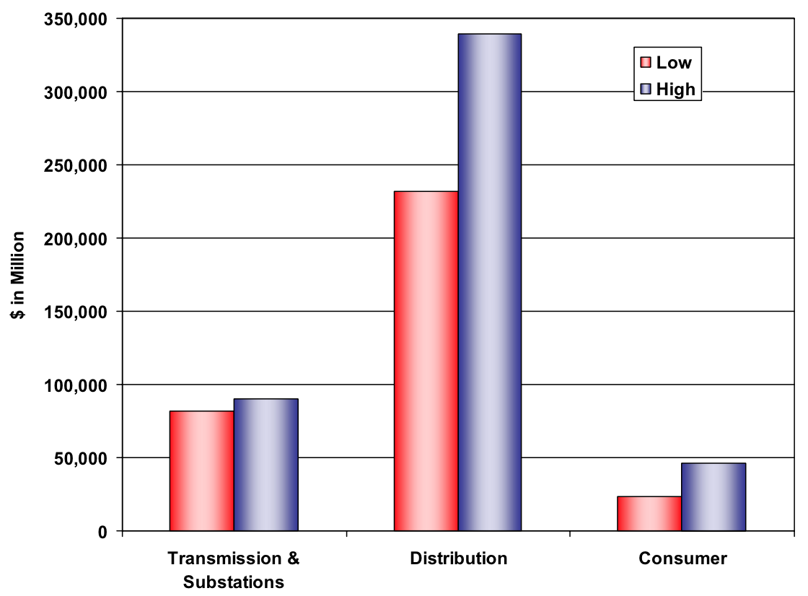
OK, sounds pretty good so far, what are the issues?
First, of course, is cost: From New York Times article ¹ based on an EPRI study: ²
"Deployment of smart grid technology from U.S. utility control centers and power networks to consumers' homes could cost between $338 billion and $476 billion over the next 20 years"
WHERE would that money need to be spent? Mostly on the power distribution system: ²
With very little going into the "smart" things in or near our homes
And only a minor share going into long-distance power transmission
Instead, spending => Smart circuit breakers, PLCs, PMUs, SCADA, and power intranet
1) http://www.nytimes.com/cwire/2011/05/25/25climatewire-smart-grid-costs-are-massive-but-benefits-wi-48403.html?pagewanted=print
2) http://www.epri.com/abstracts/Pages/ProductAbstract.aspx?ProductId=000000000001022519

Slide 33
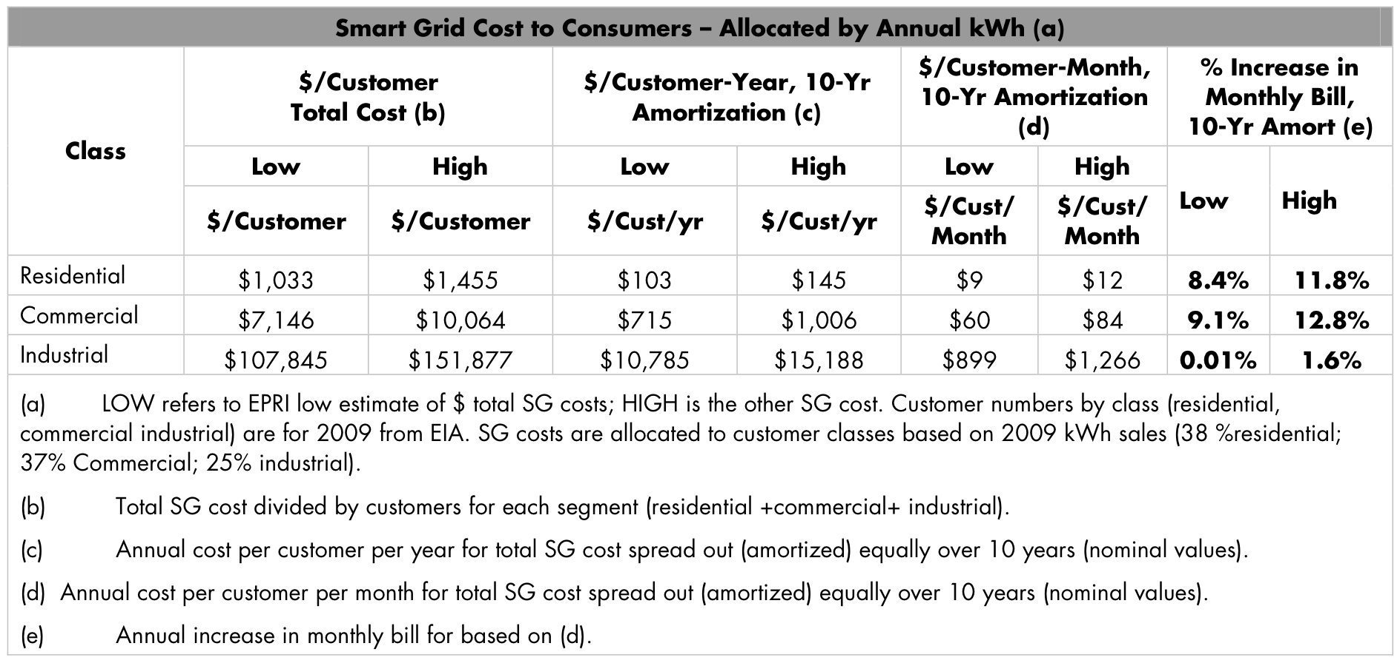
Who is going to ultimately foot the bill for this? We are, of course:
From that EPRI (Electric Power Research Institute) report: ¹
(yellow highlight added)
1) http://www.epri.com/abstracts/Pages/ProductAbstract.aspx?ProductId=000000000001022519

Slide 34
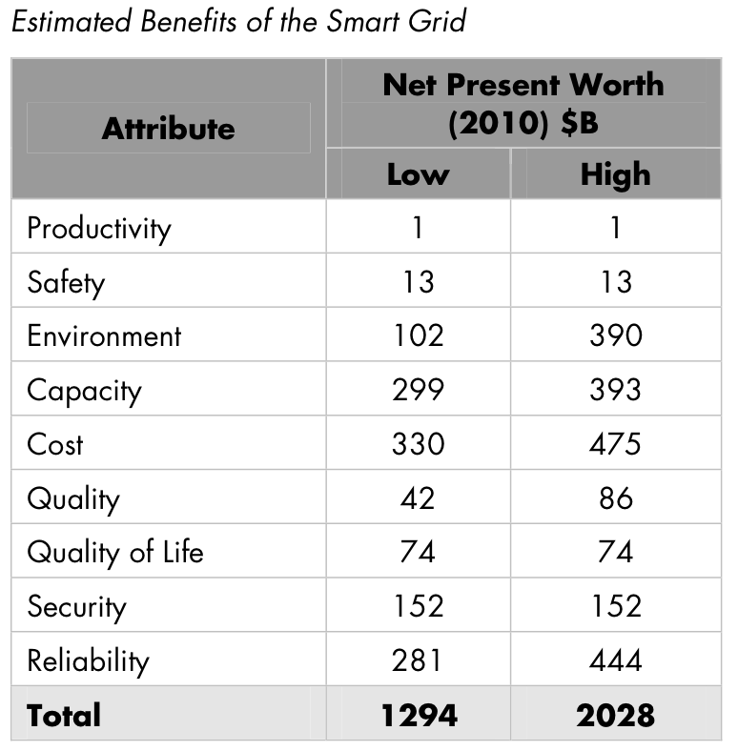
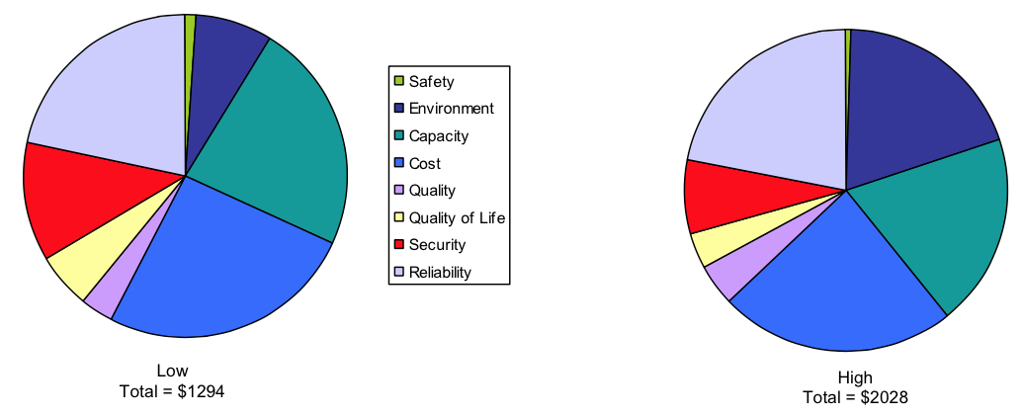
What will that investment get us?
"$1.3 trillion to $2 trillion in benefits over that period."
Benefit / Cost ratio ~ 3:1 to 6:1
With savings / benefits breaking down approximately as follows:
Also very important (for savings AND the environment):
"Demand response and efficiency gains enabled by smart grid technologies
would reduce annual electricity growth to less than 0.7 percent . . .
The growth rate in peak energy demand would be even lower."
http://www.epri.com/abstracts/Pages/ProductAbstract.aspx?ProductId=000000000001022519

Slide 35
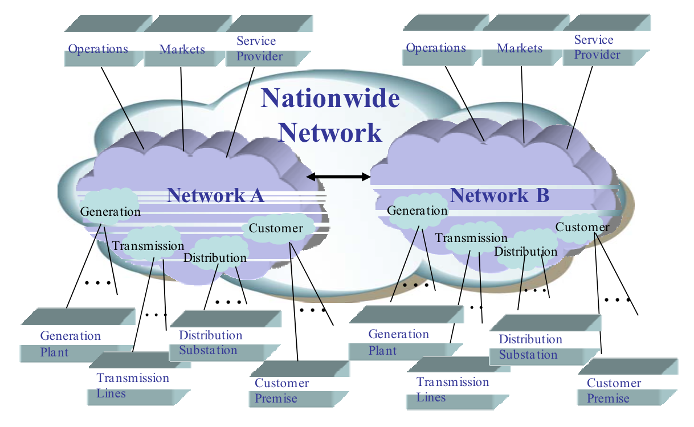
But EPRI also points out that this will require a nationwide effort:
To work, 48 states and dozens (hundreds?) of power companies must fully cooperate
Meaning that the U.S. government will have to lead in BIG way
Is this likely in an era where: BIG + Government => Gridlock ?
http://www.epri.com/abstracts/Pages/ProductAbstract.aspx?ProductId=000000000001022519

Slide 36
The U.S. has another unique cost + government issue:
As noted above, a Smart Resilient Grid requires a high capability intranet
Providing reliable millisecond interconnection of its control system (SCADA)
And that intranet also better be damned secure!
Further if, as is likely, it handles both Grid control AND customer transactions:
Firewall between those functions had better be exceptionally strong
All of this makes it likely that Grid intranet will be very expensive
Which makes it VERY tempting to look for other ways of making it pay
Power companies are thus talking about becoming digital service providers (DSPs)
Driving our existing DSP's / Cable / Satellite companies up the walls!
Thus Smart Grid projects sometimes move faster/farther in countries where
governments provide (or heavily regulate) BOTH power and DSP services!

Slide 37
Further, I glossed over a potential land mine:
Smart meters will allow power companies to charge you more for peak power
Or pay you more for home power generation during peaks
But full industry Smart Grid proposals ¹ call for much more:
Smart Grid intranet would talk to your individual appliances:
Through a new Home Area Network (HAN)
Also sometimes nicknamed The Internet of Things (IoT)
The HAN could use its 2-way appliance communication to do things like:
Changing temperature settings on heat, AC, refrigerators . . .
Even turning off certain appliances during peak demand
1) http://www.epri.com/abstracts/Pages/ProductAbstract.aspx?ProductId=000000000001022519

Slide 38
Do we really want to give power companies control over our appliances?
And implicit in that control:
Do we want the power company to know every time we push an "on" button?
Do we trust them with minute-by-minute information about our lives?
How long will it take an MBA to realize he/she can sell that information,
leading to this (eminently / imminently) possible scenario:
You open the door to your microwave oven
and instantaneously an advertisement for microwave popcorn
appears on the screen of your TV / iPhone / iPad / laptop / etc. . . . ?
Even if suitable privacy laws could be enacted (with gaping loopholes for the NSA?):
Are power companies capable of designing and implementing a
hacker-proof network stopping others from exploiting such information?

Slide 39
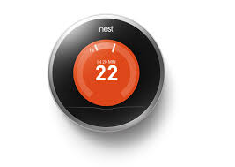
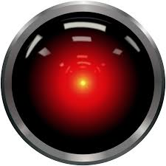
"Smart" home appliances are already being hacked (massively!)
Prime example: The Google-Nest Learning Thermostat
At the August 2014 "Black Hat USA" computer security conference ¹
Hackers needed 15 seconds to get thermostat to display this message: ^{2,3,4}
"Hello Dave"
"I know that you and Frank were planning to disconnect me,
and I am afraid that is something I cannot allow to happen."
1) https://www.blackhat.com/us-14/
2) http://venturebeat.com/2014/08/10/hello-dave-i-control-your-thermostat-googles-nest-gets-hacked/
3) http://www.computerworld.com/article/2476599/cybercrime-hacking/black-hat-nest-thermostat-turned-into-a-smart-spy-in-15-seconds.html
4) http://www.theinquirer.net/inquirer/news/2359748/hackers-root-googles-nest-thermostat-in-15-seconds

Slide 40
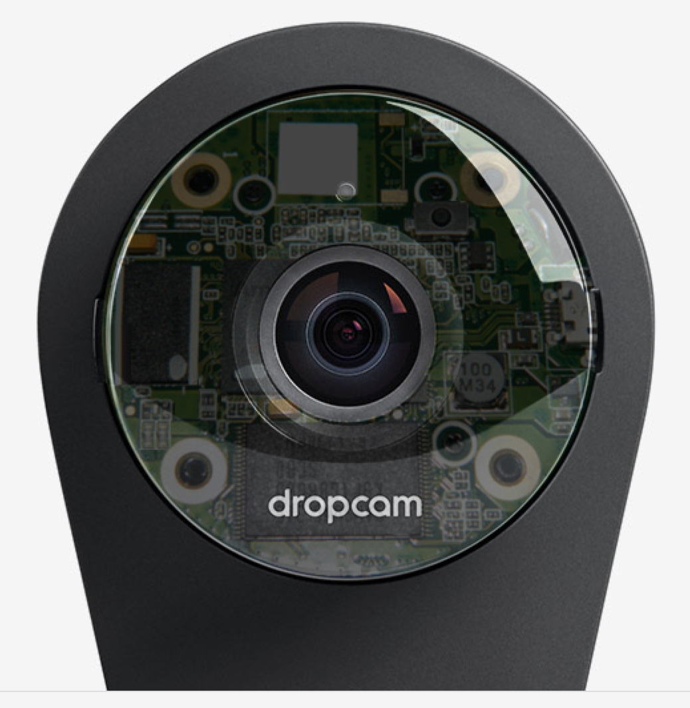
A Nest expert was interviewed about this
And he correctly pointed out that: ¹
"All hardware devices - from laptops to smartphones - are susceptible to jailbreaking;
this is not a unique problem. This is a physical jailbreak requiring physical access
But he then went on to recommend that:
"One of your best defenses is to buy a Dropcam Pro
so you can monitor your home when you're not there"
Dropcam is another Google-Nest company, which led to the article's headline:
"Hackers root Google's Nest thermostat in 15 seconds
Firm advises buying one of its security cameras"
(Psst! Google Guys: Might adding a web-accessible camera just compound the problem?)
(?)
1) http://www.theinquirer.net/inquirer/news/2359748/hackers-root-googles-nest-thermostat-in-15-seconds

Slide 41
Sample of now almost weekly reports on "Internet of Things" insecurity:
From a variety of computer security experts interviewed by CBS News: ¹
"future and current technologists will have to design
devices that are resilient on their own,
rather than assuming that the home network is already secure"
"Hackers who could get access to something as simple
as your historical thermostat records
could predict when you are in [or] out of the house (giving clues when to rob it)"
From "Spies in our Living Room" about a HP computer security report: ²
"70% of smart appliances have serious security weaknesses,
running the gamut from lack of encryption
to insecure firmware to easily guessed passwords"
1) http://www.cbsnews.com/news/keeping-smart-homes-safe-from-hackers/
2) http://www.geek.com/apps/the-spies-in-your-living-room-70-of-smart-appliances-vulnerable-to-cyber-attack-1600725/

Slide 42

And then there are the infamous refrigerator and Barbie Doll hacks:
From articles about a report from computer security firm Proofpoint:
"For the first time, hackers used a refrigerator to attack businesses:
  hackers broke into more than 100,000 everyday consumer gadgets, such as home-networking routers, connected multi-media centers, televisions, and at least one refrigerator, Proofpoint says. They then used those objects to send more than 750,000 malicious emails to enterprises and individuals worldwide." ¹
From Christmas 2015 articles in the Guardian ² (and elsewhere):
          "Mattel’s latest Wi-Fi enabled Barbie doll can easily be hacked to turn it into a surveillance device for spying on children and listening into conversations without the owner’s knowledge."
          "It connects to the internet via Wi-Fi and has a microphone to record children and send that information off to third-parties for processing before responding with natural language responses.
1) http://www.cbsnews.com/news/keeping-smart-homes-safe-from-hackers/
2) http://www.geek.com/apps/the-spies-in-your-living-room-70-of-smart-appliances-vulnerable-to-cyber-attack-1600725/

Slide 43

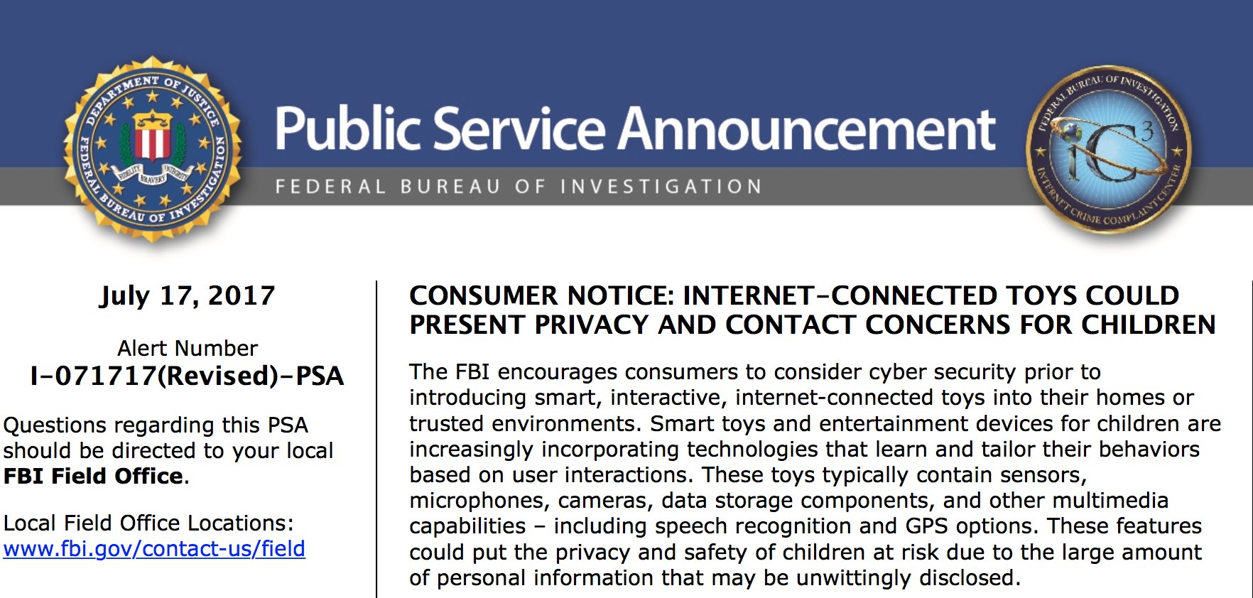
As reported in the December 2107 article in the New York Times entitled
A Cute Toy Just Brought a Hacker Into Your Home ¹
Even the FBI has issued a warning about "smart" IoT children's toys, which begins: ²
1) https://www.nytimes.com/2017/12/21/technology/connected-toys-hacking.html?smprod=nytcore-ipad&smid=nytcore-ipad-share
2) https://www.ic3.gov/media/2017/170717.aspx

Slide 44
Root Causes?
1) Security is just not built into or monitored in most IoT devices
From articles about the same Proofpoint report:
"IoT devices are typically not protected by the anti-spam and anti-virus infrastructures available to organizations and individual consumers,
nor are they routinely monitored by dedicated IT teams or alerting software to receive patches to address new security issues as they arise." ¹
2) Attitude that IoT device manufacturer owns data it collects (not you)
Implications for the "Smart" (home appliance accessing/controlling) Grid?
Nest is a Google company
Comments are from Internet's top security experts
What are the odds power companies will create a more secure network?
1) http://www.marketwatch.com/story/proofpoint-uncovers-internet-of-things-iot-cyberattack-2014-01-16?reflink=MW_news_stmp

Slide 45
Enter then head of the National Security Agency, Admiral James Clapper:
Who testified to the U.S. Senate about the IoT in February 2016
But his testimony was not to warn us about the risk of the IoT,
he instead pointed out opportunities it provided to the NSA:
  “In the future, intelligence services might use the [internet of things] for identification, surveillance, monitoring, location tracking, and targeting for recruitment, or to gain access to networks or user credentials”
In the same Guardian News article,¹ security expert Lee Tien noted that:
  “One of my technologists has a phrase: ‘internet of other people’s things.' Even if you bought it, it’s not necessarily truly yours – it may need to talk to the vendor’s machines to work, handing over data about you or those around you (if it has sensors); it may have features you don’t know about or don’t know how to control or can’t control.”
1) http://www.theguardian.com/world/2016/feb/10/internet-of-things-surveillance-smart-tv-cars-toys

Slide 46
And what if government monitoring becomes government cyber warfare?
In 2010, Iran's nuclear program was sabotaged by the Stuxnet virus: ¹
From the Nuclear Power - But they Blow Up! (pptx / pdf / key) note set:
235U's natural abundance is ~ 0.7%
238U's natural abundance is ~ 97.3%
Nuclear fission bombs require uranium "enriched" to ~ 80% ²³⁵U
Uranium is often "enriched" by spinning UF₆ gas in ~ 90,000 RPM centrifuges ²
=> ²³⁸UF₆ goes to the outside, but lighter ²³⁵UF₆ stays near the center
But these incredible speeds require vacuum plus magnetic levitation bearings
If centrifuge's power is interrupted, it can tear itself to shreds
Stuxnet cut power to Iran's centrifuges, reportedly destroying one fifth of them
(Leading suspects? Israel's Mossad collaborating with the U.S. CIA)
1) http://en.wikipedia.org/wiki/Stuxnet
2) https://en.wikipedia.org/wiki/Zippe-type_centrifuge

Slide 47
But how is Stuxnet relevant to the Smart Grid?
"Stuxnet’s design and architecture are not domain-specific and it could be tailored as a platform for attacking modern SCADA and PLC systems (e.g., in automobile or power plants) . . . Stuxnet reportedly ruined almost one-fifth of Iran's nuclear centrifuges" – Wikipedia
SCADA, sound familiar? ("supervisory control and data acquisition" systems)
And look closely at this earlier figure on Smart Grid's interface to our homes:
PLCs (programmable logic controllers)
So the Stuxnet virus might be EASILY adapted to attack the Smart Grid
http://en.wikipedia.org/wiki/Stuxnet

Slide 48
Prompting this U.S. Academies of Science and Engineering Report:
Terrorism and the Electric Power Delivery System (2010): ¹
"Electric systems are not designed to withstand or quickly recover from damage inflicted simultaneously on multiple components. Such an attack could be carried out by knowledgeable attackers with little risk of detection or interdiction. Further, well-planned and coordinated attacks by terrorists could leave the electric power system in a large region of the country at least partially disabled for a very long time. Although there are many examples of terrorist and military attacks on power systems elsewhere in the world, to date international terrorists have shown limited interest in attacking the U.S. power grid" (p.1)
This report focuses almost entirely on threats to the Grid, and not to "Smart Homes"
But while Grid will be defended by sophisticated systems and legions of IT experts
Preceding stories show that IoT systems are now woefully under-protected
Which, linked to the grid, will make them particularly attractive targets
Terrorism and the Electric Power Delivery System, page 10, U.S. National Academies Press 2011
http://www.nap.edu/catalog/12050/terrorism-and-the-electric-power-delivery-system

Slide 49
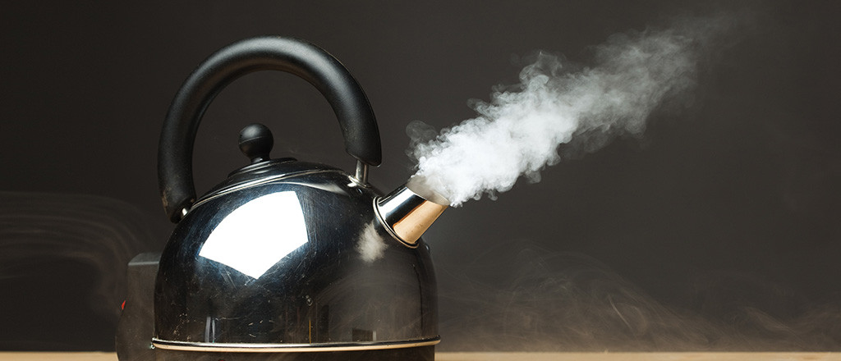
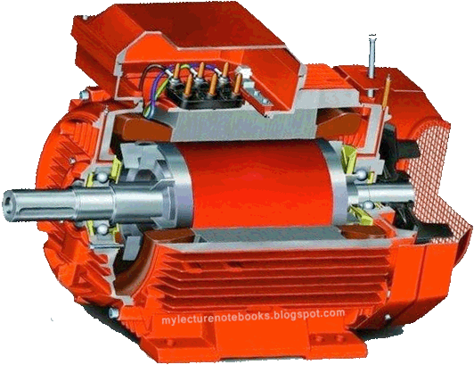
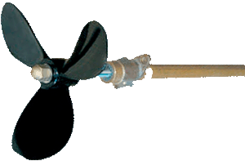

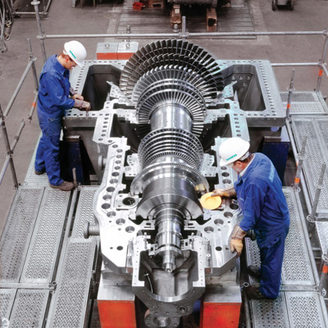
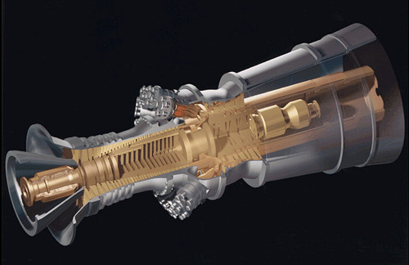
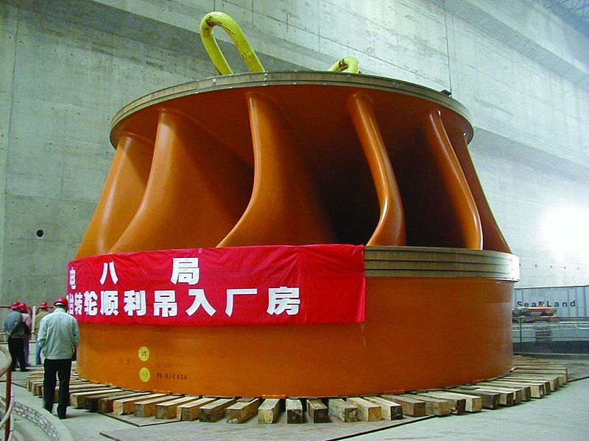
Leading some consumers to rebel against Smart Grid trials
So is there another way of getting MANY of the benefits of a Smart Grid
without dealing power companies
(or hackers) right into our home lives?
There might be! And it goes right back to the operation of AC generators:
Which I've depicted as:
With the key relevant element now being the actual turbines:
An Introduction to Sustainable Energy Systems: WeCanFigureThisOut.org/ENERGY/Energy_home.htm

Slide 50
As the load on such a turbine generator increases, it slows down:
Not by a whole lot - To stay within power system specs:
Frequency has to be held within ~ 0.067 Hz of 60Hz
But a fall of 0.067 Hz in frequency CAN be easily sensed!
Due to variable load during the day, Grid frequency thus does something like this:
Then: 60.00 Hz = Grid is at minimum load (and power is at minimum cost)
59.985 Hz = Grid is at moderate load (power is at middle cost)
59.97 Hz = Grid is at heavy load (power is at maximum cost)
100%
Grid Load:
60%
Midnight
Noon
Midnight
60.00 Hz
Grid Frequency:
59.90 Hz
Midnight
Noon
Midnight

Slide 51
So instead of appliance-by-appliance intranet connections to Grid:
Install simple frequency sensor / control into particular appliances
Which is possible via a single simple integrated circuit likely costing less than $5
(versus IoT features adding $100's to appliance costs)
Power company would then no longer control or even monitor our appliances
They are back to monitoring only the whole house's total power consumption
But appliance "knows" the Grid's load at this moment (i.e., it can infer it).
In fact: Tell the appliance the average local power cost and it could generate
a pretty accurate guesstimate of power cost at this exact moment!
And it could guess a relative power cost even without that information
That is: "It's now about twice the daily average cost"
An Introduction to Sustainable Energy Systems: WeCanFigureThisOut.org/ENERGY/Energy_home.htm

Slide 52
Which appliances could make energy / $ saving use of that info?
From my Energy Consumption in Housing (pptx / pdf / key) note set:
Water heaters account for 17% of our home power consumption
Water heater could make sure it does not fire up during peak evening load
Dishwashers and clothes washers could then help out even further:
They could beep you a warning if turned on during peak evening load
And offer to automatically start wash later when off peak (i.e., overnight)
THAT would also push major water heating load of the washers into overnight
Compounding your electrical power savings!
Power hog dryer could also offer "Wait for cheaper power?" start up mode
An Introduction to Sustainable Energy Systems: WeCanFigureThisOut.org/ENERGY/Energy_home.htm

Slide 53
Appliances with thermostats could also use that info:
Refrigerators are normally set to operate at ~ 38° F (3.3 ° C)
Sensing peak power demand, refrigerator could up this to 40° F
Control circuit could limit this reset to no more than two hours
This might cut refrigerator power to almost zero (if door not opened too much)
As refrigerator coasted slowly up to 40° F over those two hours
Result: +2° F (+1° C) for two hours => Trivial impact on food preservation
But with power costing ~ 4X more during those hours you could save $$
Furnaces could also turn down during (dinnertime) peak when we're more active
Turning temperature back up later as we slip into couch potato mode
An Introduction to Sustainable Energy Systems: WeCanFigureThisOut.org/ENERGY/Energy_home.htm

Slide 54
And as noted in my Green(er) Cars & Trucks (pptx / pdf / key) note set:
Grid load sensing (=> inferred price of power) is key to things like Vehicle to Grid:
1) Power Demand:
2) Power Production:
3) Location of PHEVs:
4) PHEV ⬄ Grid:
5) Onboard energy:
Home
Work
Home
Charge
Discharge
Charge
Discharge

Slide 55
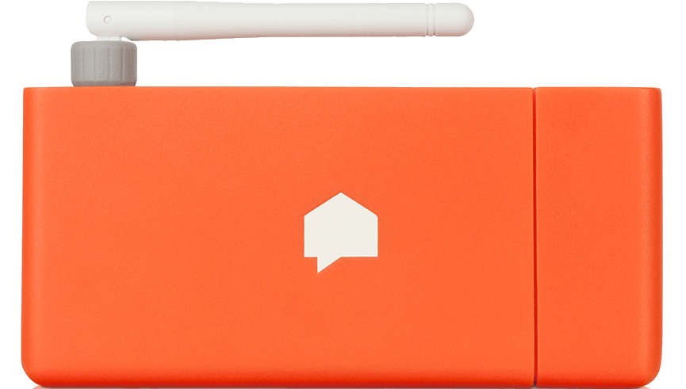
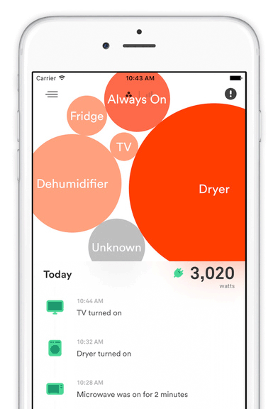
COMPREHENSIVE home energy monitoring WITHOUT Big Brother?
New "Sense" monitor clips onto home's incoming power lines
There it "listens" for tiny variations in power consumption
which differ for every single type of appliance
They even change when some appliances misbehave!
But it must "catalog" all these different energy consumption fingerprints
Which, for now, is done via connection back to an Internet Webserver
Which then sends ITS analysis back to your iPad
But once the library of appliance fingerprints is mature,
your iPad alone might be able to do the full analysis,
eliminating the link to a privacy-invading webserver

Slide 56

Ten minute long description on PBS's This Old House:
Cached copy on this note set's Resources Webpage
Original YouTube video (link)

Slide 57
Credits / Acknowledgements
Some materials used in this class were developed under a National Science Foundation "Research Initiation Grant in Engineering Education" (RIGEE).
Other materials, including the WeCanFigureThisOut.org "Virtual Lab" science education website, were developed under even earlier NSF "Course, Curriculum and Laboratory Improvement" (CCLI) and "Nanoscience Undergraduate Education" (NUE) awards.
This set of notes was authored by John C. Bean who also created all figures not explicitly credited above.
Copyright John C. Bean
(However, permission is granted for use by individual instructors in non-profit academic institutions)
An Introduction to Sustainable Energy Systems: WeCanFigureThisOut.org/ENERGY/Energy_home.htm

