Slide 1
Today's Photovoltaic Solar Cells
John C. Bean
Outline
What is electricity? => The need for "electron pumps"
What is sunlight? How does light interact with various materials
How to make an electron pump (vs. a non energy producing "photoconductor")
How to create free electrons & free holes by adding "donor" or "acceptor" impurities
Doing this side-by-side to form electron-pumping interfacial electric fields
Choosing solar cell material to milk the most power from sunlight – Shockley-Queisser Limit
Silicon's idiosyncrasies => The impact of "indirect bandgap" & "traps"
Today's diamond, gold, silver & bronze standards / Record solar cell efficiencies
Huge difference between average and peak solar cell output => My ½ x ½ x maybe ½ rule
Dealing with the possible loss of sunlight via reflection
A solar cell's lifetime energy output vs. lifetime energy input => E.R.O.I.
(Written / Revised: November 2019)

Slide 2
Today's Photovoltaic Solar Cells
"Photovoltaic" refers to the direct, single step conversion of sunlight into electricity
So, to start, both need to be explored in greater depth
What is electricity? That may sound like a very simple, or even dumb question
In which case: I've read an incredible number of "dumb" news stories
And "dumb" university press releases
And even occasional "dumb" comments from research scientists
Because they imply that:
"Electricity" = THING that can just ooze out of a lump of material
WRONG!
Electricity is not a thing – It is a process:
Of electrons being driven in a flow

Slide 3
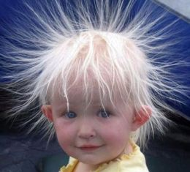
But why CAN'T we just squeeze electrons out (and then USE them)?
From notes on Electricity & Magnetism (pptx / pdf / key) & Magnetic Induction (pptx / pdf / key):
Maxwell's 1st Equation says Electric Fields build in proportion to net charge
"Net charge" = Positive charge density – Negative charge density
Electric Force is then proportional to the strength of that electric field
So just a TINY ACCUMULATION of net charge => HUGE FORCE
For a second or two this may happen:
Then there's a snap as charge dissipates
BOTTOM LINE:
On scales much greater than molecular dimensions
Nature will not LET you add or remove significant net charge!
(because the resulting HUGE force would then EXPEL that net charge)
joyerickson.wordpress.com/2012/08/05/pull-up-something-cool/

Slide 4
So "electricity" is instead all about pumping charge
We PUMP charge in one end of something and out the other end:
"Something" = Generator, solar cell, battery . . .
That's WHY it's called electrical current = An analogy to incompressible water:
We pump water THROUGH pipes, but if we try to increase water IN pipes => Explosion!
Generators, solar cells, batteries, . . . are all CHARGE PUMPS
And pumps are judged on basis of the flow and pressure they can generate:
Water Power = Flow x Pressure which is analogous to:
Electrical Power = "Current" x "Voltage"
So what we are NOW looking for is a solar-powered electron pump!
An Introduction to Sustainable Energy Systems: WeCanFigureThisOut.org/ENERGY/Energy_home.htm

Slide 5
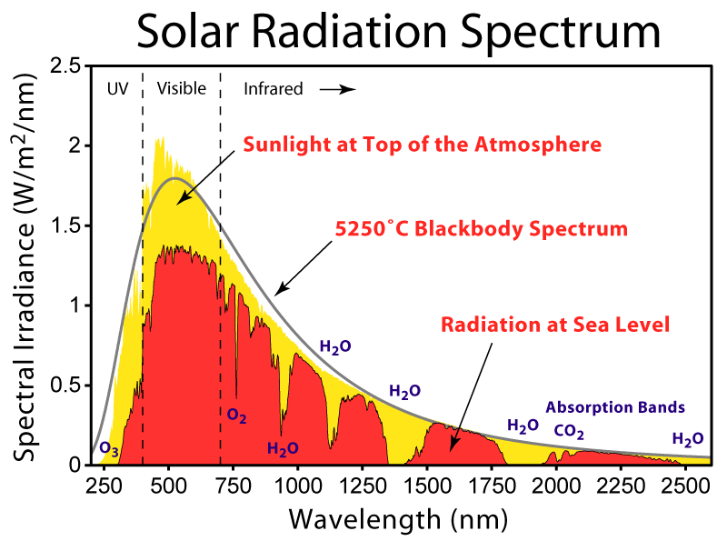
Moving on to the 2nd key question: What is Sunlight?
It is a very BROAD range of colors (a.k.a. "wavelengths")
Resembling a "Black Body Spectrum" ( = vibrating things randomly sharing energy)
Significant portions of which are absorbed in the atmosphere (yellow => red)
Source: en.wikipedia.org/wiki/Sunlight

Slide 6
How much power can sunlight provide?
Above the earth's atmosphere, total power is ~ 1350 Watts / square meter
This value is referred to as "AM0" (air mass zero)
But the atmosphere absorbs ~ 25% => ~ 1000 Watts / square meter
Referred to as "AM1.5" (air mass 1.5)
But that is the MAXIMUM solar power that can EVER reach the earth's surface
Because it is the value only when the sun is DIRECTLY overhead
Which happens only in certain locations, in certain seasons, once a day,
    when there is no haze, fog, or clouds to absorb or redirect sunlight

Slide 7
How to convert light's wavelength into photon energy:
Start with fact that light's energy is proportional to its frequency:
Energy_{light} = h f h = Plank's constant, f = frequency (in Hz = cycles /sec)
Add in the fact that, in one cycle, light travels one wavelength (= "λ")
So velocity of light = c = λ / (cycle time) = λ f
Plug second relationship into first relationship:
Energy _{light} = h f = h (c / λ) = hc / λ
Then, agree to express light energies in eV, and wavelengths in microns
Yielding relationship: Energy _{light} (in eV) = 1.24 / λ _{light} (in microns)
A Joule = (1 coulomb of charge) (crossing a 1 Volt potential)
An eV = (1 electron charge) (crossing a 1 Volt potential) = 1.6 x 10⁻¹⁹ Joules

Slide 8
Using this to revise the scale of earlier sunlight plot:
From formula above (and fact that 1000 nm = 1 micron):
And calling out spectral ranges by their common names:
Energy
Wavelength
5 eV
2 eV
1 eV
0.5 eV
UV
Vis
Infrared

Slide 9





We now need to know how these colors interact with matter
Because we want to exploit these interactions to CAPTURE the light's energy!
1) INFRARED (IR) LIGHT: 0.7 microns < Wavelength
Energy < 1.7 eV
If absorbed by matter, IR => heat = atomic & molecular vibrations
Uniqueness of an atom/molecule's vibrational energies => absorption bands
=> "IR" spectroscopies used by chemists AND
to absorption bands seen in AM1.5 spectrum:
Symmetric
Stretch
Asymmetric
Stretch
Scissoring
Rocking
Wagging
Twisting
Animated GIFs from: en.wikipedia.org/wiki/Infrared_spectroscopy

Slide 10
IR vibrations may be amusing (and quite useful elsewhere)
But, in the context of solar photovoltaics, the important fact is that:
Most IR light lacks the energy necessary to liberate electrons from atoms/bonds
Thus most Infrared light CANNOT DIRECTLY produce electricity
But Infrared's heat energy CAN be transferred to (absorbed by) other things
Especially if they are thick enough
The captured heat can then be used to boil water
Which, expanding, can drive the turbines of electrical generators
= Solar Thermal Energy as described in subsequent note sets
So Infrared light can INDIRECTLY produce electricity

Slide 11
As opposed visible light which CAN directly produce electricity:
1) VISIBLE (Vis): 0.4 microns < Wavelength < 0.7 microns
1.8 eV < Energy < 3 eV
Visible light CAN knock an electron free from an atom ("ionization")
Visible light CAN also knock one electron out of a covalent bond
That's probably why our eyes use visible light:
Infrared light just causes atoms in eye to vibrate
Vibrations CAN be transferred to other atoms (a.k.a. heat flow)
But it’s hard to imagine a heat-directing "optical nerve fiber"
In contrast, visible light can liberate electrons/ions (producing => electrical flow)
An Introduction to Sustainable Energy Systems: WeCanFigureThisOut.org/ENERGY/Energy_home.htm

Slide 12
What about ultraviolet light?
1) ULTRAVIOLET (UV): Wavelengths < 0.4 microns
3 eV < Energy
UV has MORE than enough energy to liberate electrons!
So we CAN ALSO use UV light to directly produce electricity
HOWEVER, UV light also has enough energy to BREAK MANY ATOMIC BONDS
Distinction: "Liberating" = Removing one of a covalent bond's paired electrons
Or extracting one electron from an unbonded pair (=> "free radical")
In both cases, pair can re-form later by capturing an electron
Whereas: "Bond breaking" = wiping out bond => changing molecular structure
Thus, over time, UV LIGHT can even DESTROY solar cell materials
= A particular problem for weakly bonded organic solar cell materials

Slide 13
Summarizing the different ways in which light interacts with matter:
Infrared
Visible
UV
Liberates electrons from bonds
IF the material has an electron liberation energy ≤ light energy
Liberates electrons from bonds
but gives them so much excess energy that they ricochet all around
Excess energy is lost as struck atoms start to vibrate (=heat)
Vibrates a few atoms
But MOST of it passes
right through thin
layers of material

Slide 14
Solar-powered electron pumps = Photovoltaics (a.k.a. "solar cells")
What happens when light strikes a material? From above:
Case 1) Photon energy < Material's bond energy:
Photon can't shake anything loose, most just proceed on through
Meaning that the material is ~ transparent to these too low energy photons
Case 2) Photon Energy ~ Material's bond energy
Photon IS now absorbed and its energy used to kick an electron out of a bond
Case 3) Photon Energy > Material's bond energy
Photon is absorbed: Part of its energy kicks an electron out of a bond
Rest of its energy also goes to that electron in the form of kinetic energy:
Photon kicks electron out of the bond, then kicks it in the butt!

Slide 15
So when a material is exposed to light having its bond energy:
That light is (at least eventually) going to be absorbed by a bond in the material:
Before: Atom cores (positive nuclei + inner electrons) + bonding electrons
In 1D: ~
+2 -2 +2 -2 +2 -2 +2 0 0 0 0
After: One negative electron is liberated, leaving behind a positive region:
0 +1/2 +1/2 -1 0 0 0 0
But electron is DRAWN BACK to positive region, falling back into bond
(or a FEW might wander out the left or right end)

Slide 16
This gives only a "photoconductor" and NOT a solar cell!
(Wake up all of you so-called science journalists!)
Most of the liberated electrons just wander around until pulled back into bonds
Or ones that DO exit are equally likely to exit right or left
Nothing is pumping (pushing) electrons to flow in one direction!
Application? ADD external battery/power supply and use as a light detector:
No light: All electrons in bonds, no current through sample (despite battery)
Light: Freed electrons
Battery can now suck them out one end and push back into other
But where does the light's energy go? Ultimately, into the atoms
Freed electrons later fell back into atoms' clutches,
giving those atoms a kick => Atomic vibrations (a.k.a. heat)

Slide 17
To produce power we've ALSO got to drive (PUMP) electrons somewhere!
The Classic Technique:
START with fully-bonded electrically neutral material, most commonly silicon
It sets the bonding rules with its crystal structure: Rule with Si = four bonds
ADD atom of almost the same size but with one less bonding electron (e.g., boron)
Fits into crystal, steals electron from elsewhere, making it an Acceptor ion (thief?)
Bond where electron was stolen from now becomes a positive Hole
Add neutral Acceptor atoms to Si => Negative ions + Liberated holes:
Silicon atoms = Grey (fixed neutral atoms)
Acceptor ions also FIXED in position
Holes = MOBILE Why?
ANSWER: Hole grabs electron from neighbor, leaving hole in a NEW place . . .
And holes don't fill with electrons from outside because that would add net charge

Slide 18
We can also add things that will shed electrons
Donor = Similar to Si in size, but with one additional bonding electron (e.g., P, As)
Fits into crystal but final electron has nothing to pair with and bond. Thus:
It easily loses that electron (ionizes), becoming a positive Donor ion:
With that last, now liberated, electron free to wander:
Add neutral Donor impurity atoms to Si => Positive ions + Liberated electrons:
Here only liberated electrons are MOBILE
And, as in other material, net charge is still zero!
So James Clerk Maxwell is still happy
And if mobile electrons return home, heat will eventually kick them back out!
NOTE: Acceptor and Donor impurities are called "DOPANTS"

Slide 19
The payoff comes when you put two such "doped" regions side by side:
Acceptor ions + Mobile Holes:
Donor ions + Mobile Electrons:
At the intersection ("junction”) mobile electrons rush across to FILL mobile holes!!
(Because holes ARE just bonds that have lost one of the normal paired electrons)
Mobile electrons filling the mobile holes (in the bonds) = "Recombination"

Slide 20
Central junction thus becomes depleted of ALL mobile charges (liberated electrons or holes):
But this leaves uncompensated FIXED acceptor ions (-) / donor ions (+) at the junction
Which produces a growing Electric field at that junction
Migration / recombination continues UNTIL field is strong enough to block further migration
Because Electric field pushes positive charges left and negative charges right
Electric field thus locks remaining mobile holes and electrons on their respective sides

Slide 21
NOW add light to knock electrons out of background silicon:
Light photon knocks an electron out of a bond, creating a
wandering electron + hole
(traveling together ="exciton")
New electron and hole can both wander, but if they reach the "junction:"
"Built-in" electric field traps new electron on right, but propels hole to left
If instead created on left, hole's trapped there, but electron's swept to right
= A CHARGE PUMP
(BTW this is also a DIODE: You can only force current through it in ONE direction)

Slide 22
Two ways of creating that boundary charge-separating electric field:
ABOVE: ONE MATERIAL but divided into TWO DIFFERENTLY BEHAVING REGIONS
Two regions made different by adding acceptor OR donor impurity atoms
ALTERNATIVE: Just put two DIFFERENT MATERIALS side by side
Electrons at higher energies on one side may try to cross over to other side
NET RESULT (again) = Build up of electric field at boundary

Slide 23
It's analogous to diatomic bonding in molecules:
Atoms of two different materials:
Possibility 1) Covalent Bond = Equal sharing of electrons in bond:
Possibility 2) Polar Covalent Bond = Unequal sharing of electrons in bond:
Slight Electric Field
Possibility 3) Ionic Bond = Transfer of electron from one atom to other:
Big Electric Field!
+
-

Slide 24
Solar cell materials MUST allow some electron movement, then:
At junction of two different materials, interfacial bonding can be polar or ionic:
OR: Both => Interfacial Electric field
UNLESS the electron energy levels of the two materials are too similar
Then electron in one material may not find a lower energy state in the other
And the interfacial bonding will remain covalent (and E field =>0)
If layers are of same material there's no reason for electrons to shift (and E =>0)
But we can then, instead, add different impurities to layers (as in Si cells):
Impurities => Interfacial Electric field
+
-

Slide 25
But remember, charge only shifts NEAR the interface:
Materials are composed of atoms which are intrinsically charge neutral
So natural state of any single layer is ALSO neutral:
And junction between two materials also "starts out" neutral
But if energy levels in materials are different enough, charge can cross interface:
However, charge shift builds electric field eventually blocking further charge transfer
So charge DEEPER in layers
will not get chance to cross!

Slide 26
Leading to common rules for almost all photovoltaics (solar cells):
You must have at least one set of paired materials:
Be it two distinctly different materials OR
One basic material (e.g., silicon) modified into two differently acting layers
In that pair, one layer/material must cling onto electrons more tightly
So that electrons will flow into it from the second material
Until shift of charge across boundary builds the INTERFACIAL ELECTRIC FIELD
to a level that stops further shifting of charge
That interfacial electric field will then provide the critical push
When light IS added, it liberates more electrons from bonds
But the ELECTRIC FIELD then pushes freed electrons all in one direction

Slide 27
But how much POWER will such a solar cell PRODUCE?
Power = Current x Voltage
Current comes from the number of electrons liberated by light / second
- A function of how strongly that material absorbs photons of that color
- AND of how much material is doing the absorbing (due to its layer thickness)
Voltage comes from charge driving/separating junction ELECTRIC FIELD
Which was created by process of bond filling/liberating. Leading to fact that:
Photo-electrons/holes are driven out of cell by ~ 60-70% of the liberation energy =>
Solar cell voltage ~ (0.65) (liberation energy) / (electron charge = "e")
For Si solar cell, "V_{oc}" ~ (0.65) (Si electron liberation energy = 1.1 eV) / e ~ 0.7 Volt
Larger liberation-energies => More VOLTAGE but Less CURRENT:
Why?

Slide 28
The somewhat complicated answer starts with the solar spectrum:
Energy Wavelength
If this strikes a solar cell made of a material having Small liberation energy =>
MOST colors liberate electrons, but they're driven out of cell by small voltages
If this strikes a solar cell made of a material having Large liberation energy =>
Only HIGH ENERGY light liberates electrons
But fewer electrons that ARE liberated will be driven by higher voltages!
So now try to find optimum combination (based on choice of optimum material):

Slide 29
Figuring out energy absorbed by cells made of different materials:
On the horizontal axis, plot the energy of variously colored solar photons
On the vertical axis, plot the energy such a photon can deliver to the material
Ideal result is a simple straight line: Photon Energy = Energy Deliverable
VIS
Energy absorbed by solar cell
0 eV
Light's Energy
5 eV
An Introduction to Sustainable Energy Systems: WeCanFigureThisOut.org/ENERGY/Energy_home.htm

Slide 30
Now take into account our solar cell's chosen material
Say our solar cell's material has a low "electron-liberation energy" ( = bandgap)
Below that energy, light is NOT strongly absorbed (mostly passing through)
But key thing is HOW energy that IS absorbed is USED by the material:
VIS
VIS
Energy absorbed by solar cell
Energy absorbed by solar cell
Electron
Butt Kicking
Energy Absorbed by Material
Material's
Bandgap
Electron Liberation
0 eV
Light's Energy
5 eV
0 eV
Light's Energy
5 eV
1st part of photon's energy is used to liberate an electron
But remainder of energy only accelerates that electron = Butt Kicking

Slide 31
Butt-kicked electron WASTES that extra energy:
1) Excessively energetic photon is absorbed by bonding electron:
2) Electron is freed and, with extra energy, crashes madly through the crystal:
3) Struck atoms absorb energy:
=> Atomic vibrations (= Heat) + Slowed down electron
Heat energy is not converted to electrical power!

Slide 32
Energy absorbed by cells made of different solar cell materials:
Cell with small "bandgap"
VIS
Cell with medium "bandgap"
Energy absorbed by solar cell
VIS
Butt Kicking
Cell with large "bandgap"
Electron Liberation
Energy absorbed by solar cell
0 eV
Butt Kicking
Light's Energy
5 eV
VIS
Electron Liberation
Butt
Kicking
0 eV
Energy absorbed by solar cell
Light's Energy
5 eV
Electron
Liberation
Gray Triangles => Energy lost to heating of the cell
Rectangles (only) => Electrical energy out of the cell
0 eV
Light's Energy
5 eV

Slide 33
Using that to plot the maximum possible efficiency of a solar cell:
SOLAR CELL EFFICIENCY = (Electrical Energy Out) / (Total Energy Absorbed)
= (Area of lower rectangle) / (Area of rectangle + Butt-Kicking triangle):
For our solar cell using small bandgap material:
Energy Absorbed vs. Light's Energy: Cell Efficiency vs. Light's Energy:
VIS
100%
VIS
Energy absorbed by solar cell
Electron
Butt Kicking
Solar Cell Efficiency
Electron Liberation
0 eV
Light's Energy
5 eV
0 eV
Light's Energy
5 eV

Slide 34
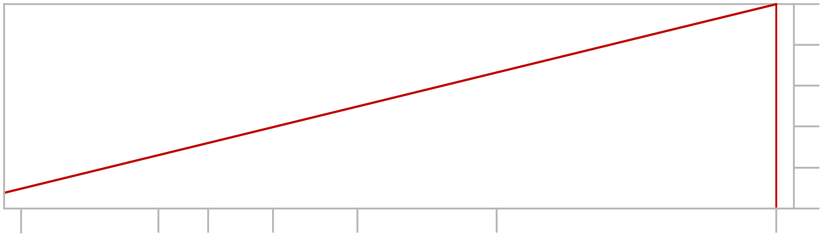

Instead plotting cell efficiency vs. light wavelength (~ flipping right-left)
Sun wavelengths (in nm)
250
500
750
1000
1500
2000
2500
100%
50%
0%
Electron Butt Kicking
For solar cell using material with 0.5 eV electron liberation energy (bandgap):
Cell Efficiency
Electron Liberation
5 eV
2
1.5
1.25
1 eV
0.75 eV
0.5 eV
Sun wavelengths (in nm)
250
500
750
1000
1500
2000
2500
100%
50%
0%
For solar cell using material with 0.75 eV electron liberation energy (bandgap):
Electron Butt Kicking
Cell Efficiency
Electron Liberation
5 eV
2
1.5
1.25
1 eV
0.75 eV
0.5 eV

Slide 35
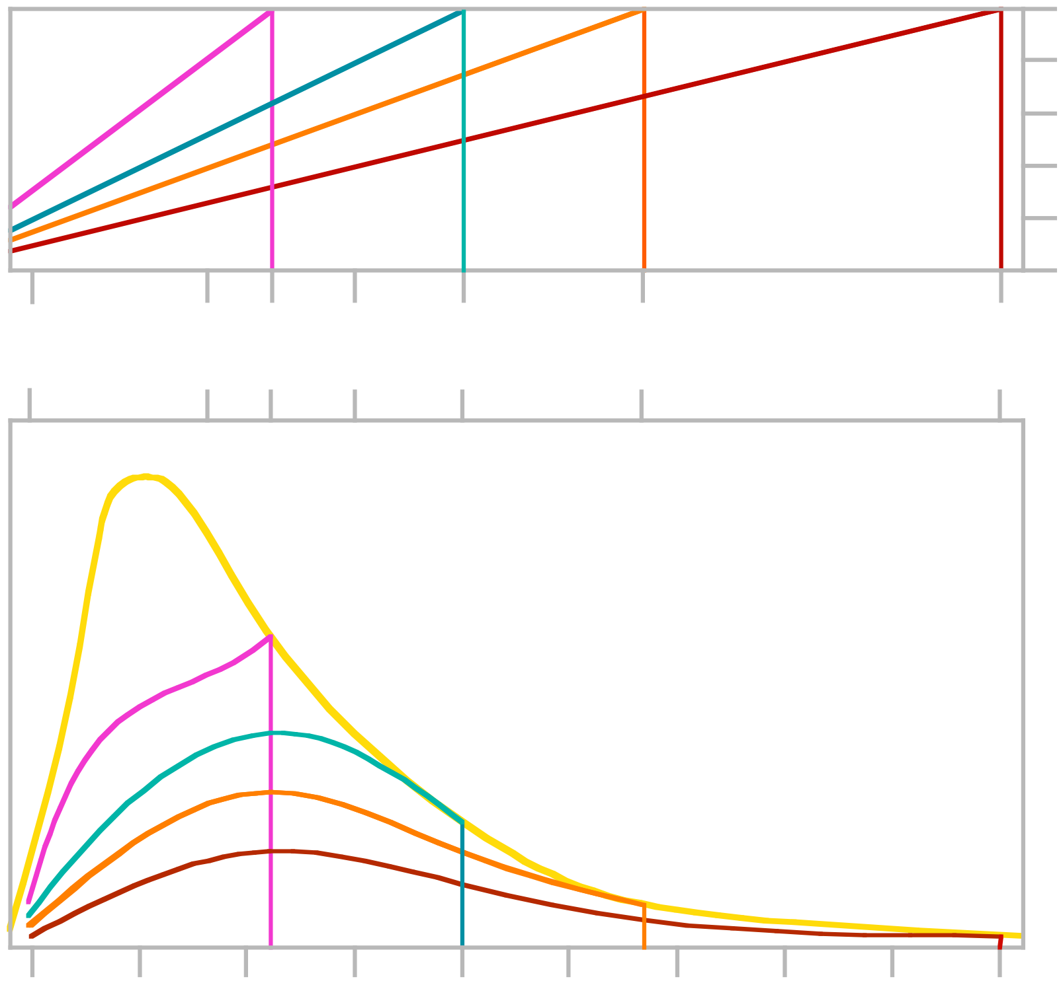
FINALLY: Comparing solar cells with a LOT of different bandgaps:
100%
50%
0%
PERCENTAGE of light's energy captured as electricity by different bandgap solar cells:
5 eV
2
1.5
1.25
1 eV
0.75 eV
0.5 eV
Sun's Energy Spectrum:
Energy captured by different bandgap cells:
= Top lines x AM0
* I really should've used
complex AM1.5 spectrum
Sun's AM0 Spectrum *
250
500
750
1000
1500
2000
2500
Wavelength in nm (or above, equivalent energy in eV)

Slide 36
Larger the area under a bottom curve => More solar energy captured
BIGGEST area comes between 1 eV and 1.5 eV curves
Material with a 1.3 eV bandgap could capture & convert ~ 35% of Sun's energy
It's called the Shockley-Queisser Limit after William Shockley & Hans Queisser
This 35% efficiency limit is NOT because of poor engineering!
It is instead because:
We ONLY CAPTURE that part of light energy liberating electron from bond,
REST of light energy is wasted giving liberated electron kick in the butt
All because a photon insists on giving ALL of its energy to a single electron
(even photons with enough energy to liberate multiple electrons!)

Slide 37
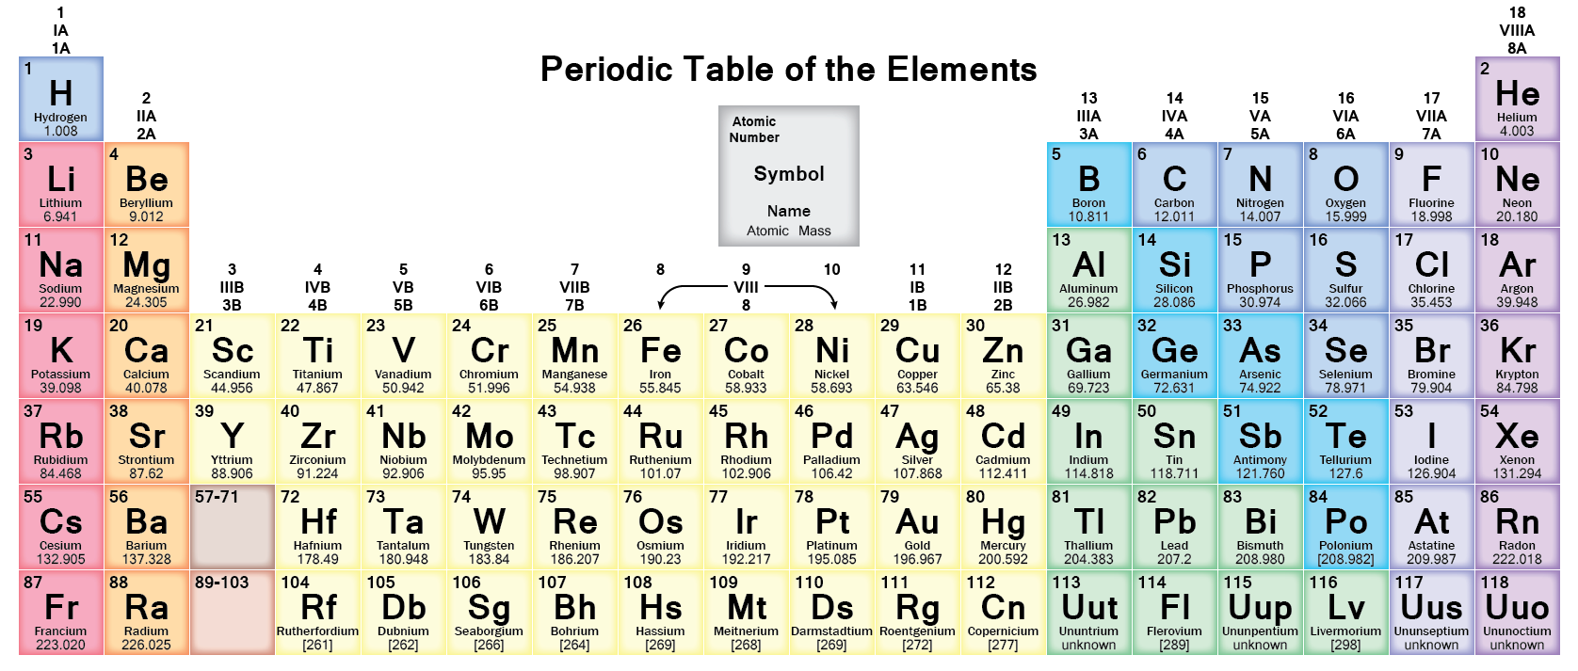
But in addition to having a 1.3 eV bandgap, the ideal material must also:
Be made of atoms that try to hold their own valence electrons within bonds
While allowing foreign acceptor atoms to steal electrons
and foreign donor atoms to liberate their electrons
Which sets up the necessary electron-pumping configuration (explained earlier):
Materials meeting those added requirements are called SEMICONDUCTORS
They're built of atoms from this
region of the periodic table:
Periodic table from:
http://byjus.com/chemistry/periodic-properties/

Slide 38
At the center of that region is silicon
Which is already the king of semiconductors based on its use in integrated circuits
But it also has a 1.1 eV bandgap near the Shockley-Queisser efficiency sweet spot!
However: Solar-cell-quality silicon is strangely expensive
Which stems from the peculiar way photons interact with it
In many semiconductors, energetic photons simply liberate electrons
But in silicon photons must get an assist from vibrating atoms
(Making silicon what is called an indirect bandgap semiconductor)
That makes it harder for silicon to absorb light, particularly low energy light
Which means that silicon solar cells must be unusually thick
(Hundreds of thousands of atoms thick = Tens of microns)

Slide 39
Making the cross-section of a silicon solar cell more like this:
Sunlight in
Electric Field
Light-liberated electrons
(and bond holes) created
Different photons are absorbed throughout the thick right layer
But for a photon absorbed early, there is a big problem:
The electron & hole it liberates have a long way to wander
before reaching the electric field at the boundary between the cell's layers
REMEMBER: That field is what makes this a solar cell (vs. a mere photoconductor)
Because that field sorts things out, sending + to the left and – to the right
= The absolutely essential solar cell pumping action

Slide 40
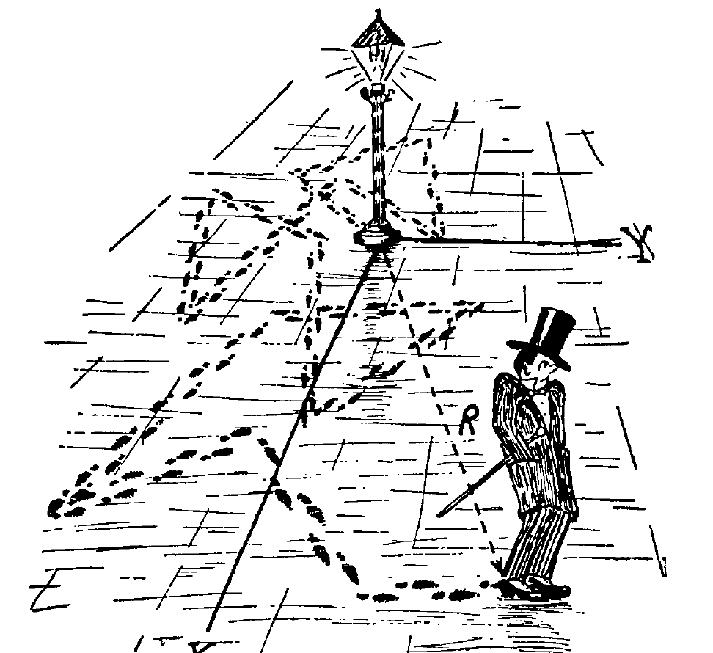
Before reaching the electric field, the electron & hole ARE just wandering
Liberated & created, they have no reason to move in ANY particular direction
This random wandering motion is called diffusion
Which is famously explained by the drunkard's walk
= Analogy of a drunk randomly bouncing off light posts:
But we've got two types of wandering drunks: electrons and holes
And these unique types of drunks can "annihilate" one another
That is, the electron can just fill the hole (in the bond) => zip!
To create a net flow (=> electricity) our drunks MUST reach boundary cliff
Over which the "electron drunks" will fall (and the "hole drunks" ascend)
Or the way I was first taught it: Electrons ~ Ball bearings (which fall DOWN)
Holes ~ bubbles (which FLOAT up)
Figure: http://www.sos.siena.edu/~jcummings/teaching/astronomy/lectures/reveal.js-master/ch10.html#/

Slide 41
But there is an additional complication: "traps"
Light-liberated electron & hole must not recombine before reaching the electric field
Normally, they cooperate by either not wandering into one another
OR by "orbiting" each other when then do meet (orbiting pair = an "exciton")
But if there are crystal faults (misbonded atoms) or certain impurities:
Wandering electrons or holes tend to get "trapped" at these flaws
and if both end up at the same trap, they quickly recombine => zip!
Using black blobs to represent such traps, our solar cell can end up more like this
Sunlight in
Electric Field
Light-liberated electrons
(and bond holes) created

Slide 42
Crystalline silicon succumbs to one type of trap but not the other
Silicon's bonds are extraordinarily strong
  It is the 3rd hardest material (after only diamond and silicon carbide)
That bond strength makes it possible to grow near perfect crystals:
Si solar cell crystals can have as few as one Si atom in 10¹⁵ mis-bonded
Which pretty much eliminates crystal flaws as traps
But in Silicon, metal impurities make exceptionally effective traps
Silicon for solar cells must thus pass through extra (expensive) purification steps
NET RESULT: Crystalline Si solar cells define today's "gold standard"
Commercial cell efficiencies are in the 20-25% range
Research versions push 30%
But (like gold) this comes with a steep price tag

Slide 43
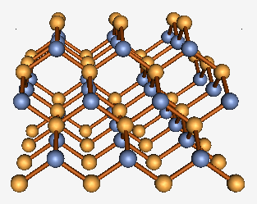
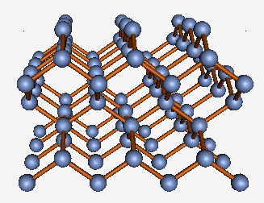
Gallium Arsenide offers competition for that gold standard:
It has a very similar crystal structure with weaker, but still strong, bonds:
GaAs's "zincblende" type crystal: Si's "diamond" type crystal:
GaAs's 1.5 eV bandgap is slightly closer to the Shockley-Queisser optimum
And, unlike silicon, its bandgap is direct allowing for use of thinner layers
Which, together, boost its cells to almost the full S-Q 35% efficiency limit
However, containing arsenic, it raises concerns about toxicity
And its crystals are even more expensive to grow
Qualifying it more as an (impractical?) diamond standard
Figures from my Virtual Lab website: https://www.wecanfigurethisout.org/VL/Semiconductor_crystals.htm

Slide 44
So what about more affordable silver or even bronze standards?
Today's silver standard is probably polycrystal silicon
Here crystal growth conditions are markedly relaxed yielding,
instead of a single crystal, a tightly packed collection of "crystallites"
Which can be represented as:
But wandering electrons & holes can now get trapped at crystallite edges
Where there are plenty of mis-bonded atoms
Which might acquire a charge attractive to those wanderers
Result? Polycrystal Si cells have efficiencies about 4/5th that of single crystal Si
But if cost is correspondingly reduced, they can still make sense!

Slide 45
And "amorphous Si cells" yield a candidate for the bronze standard:
By amorphous, we mean a cell in which there is almost no crystalline order:
Multi-crystalline Poly/microcrystalline: Amorphous:
You'd think, with virtually every atom either mis-bonded or unbonded,
that a super-abundance of "traps" would make amorphous solar cells hopeless
Amorphous cells of pure silicon DID turn out to be hopeless!
But then people (including a friend) tried adding hydrogen
which bonded with enough of those unhappy Si atoms
that trapping of electron & holes was radically decreased
=> Efficiency ~ ½ of single crystal Si cells, but at a much lower price

Slide 46
Trying to put these (and other) alternatives into perspective:
The U.S. National Renewable Energy Lab (NREL) publishes an annual plot of
the latest,
greatest,
possibly one of a kind,
maybe never even reproduced,
(and/or horrendously expensive),
research solar cell efficiency records:

Slide 47
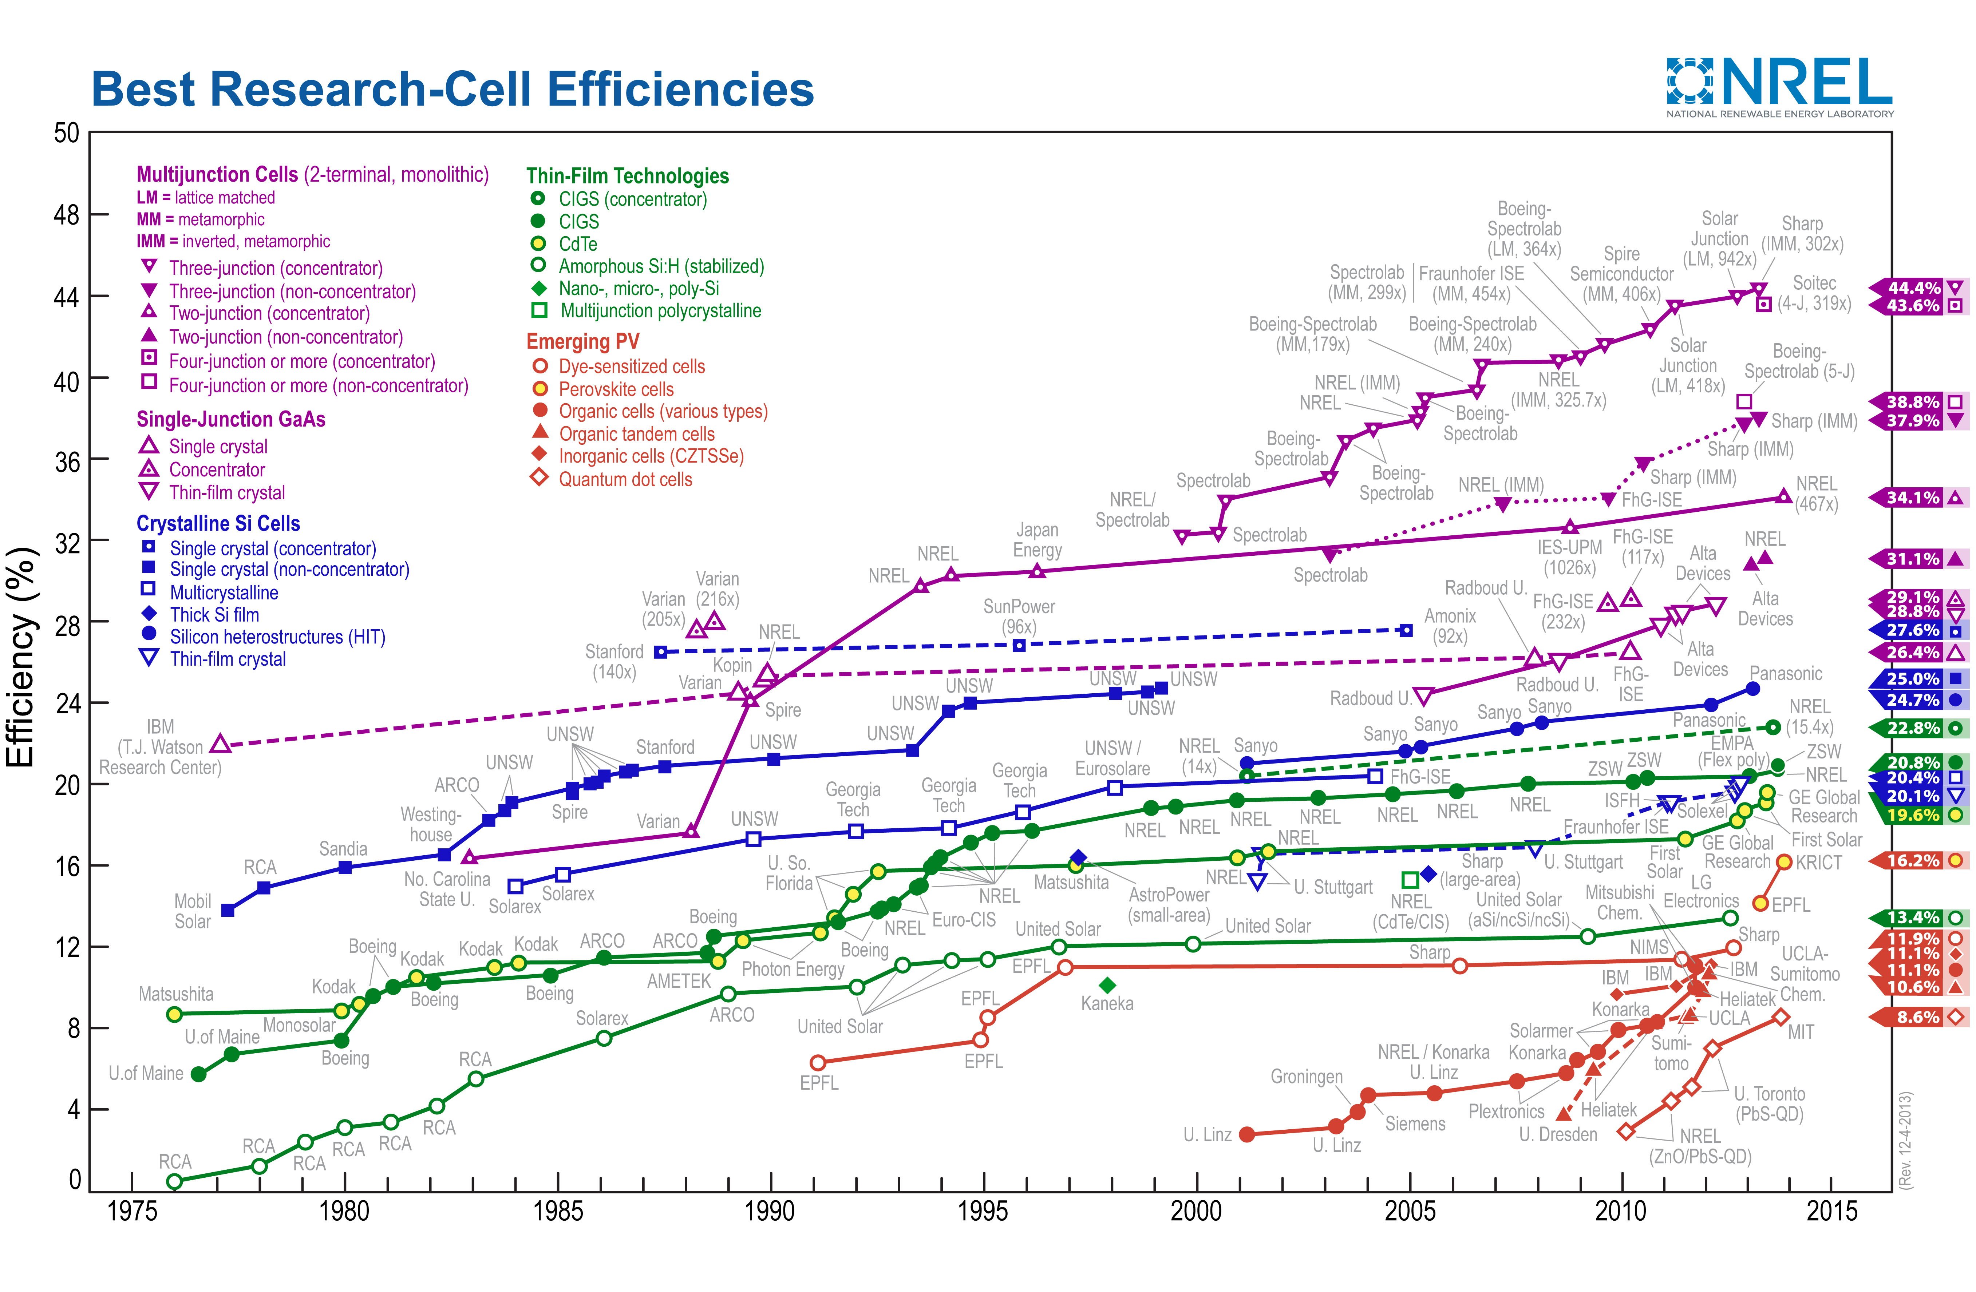
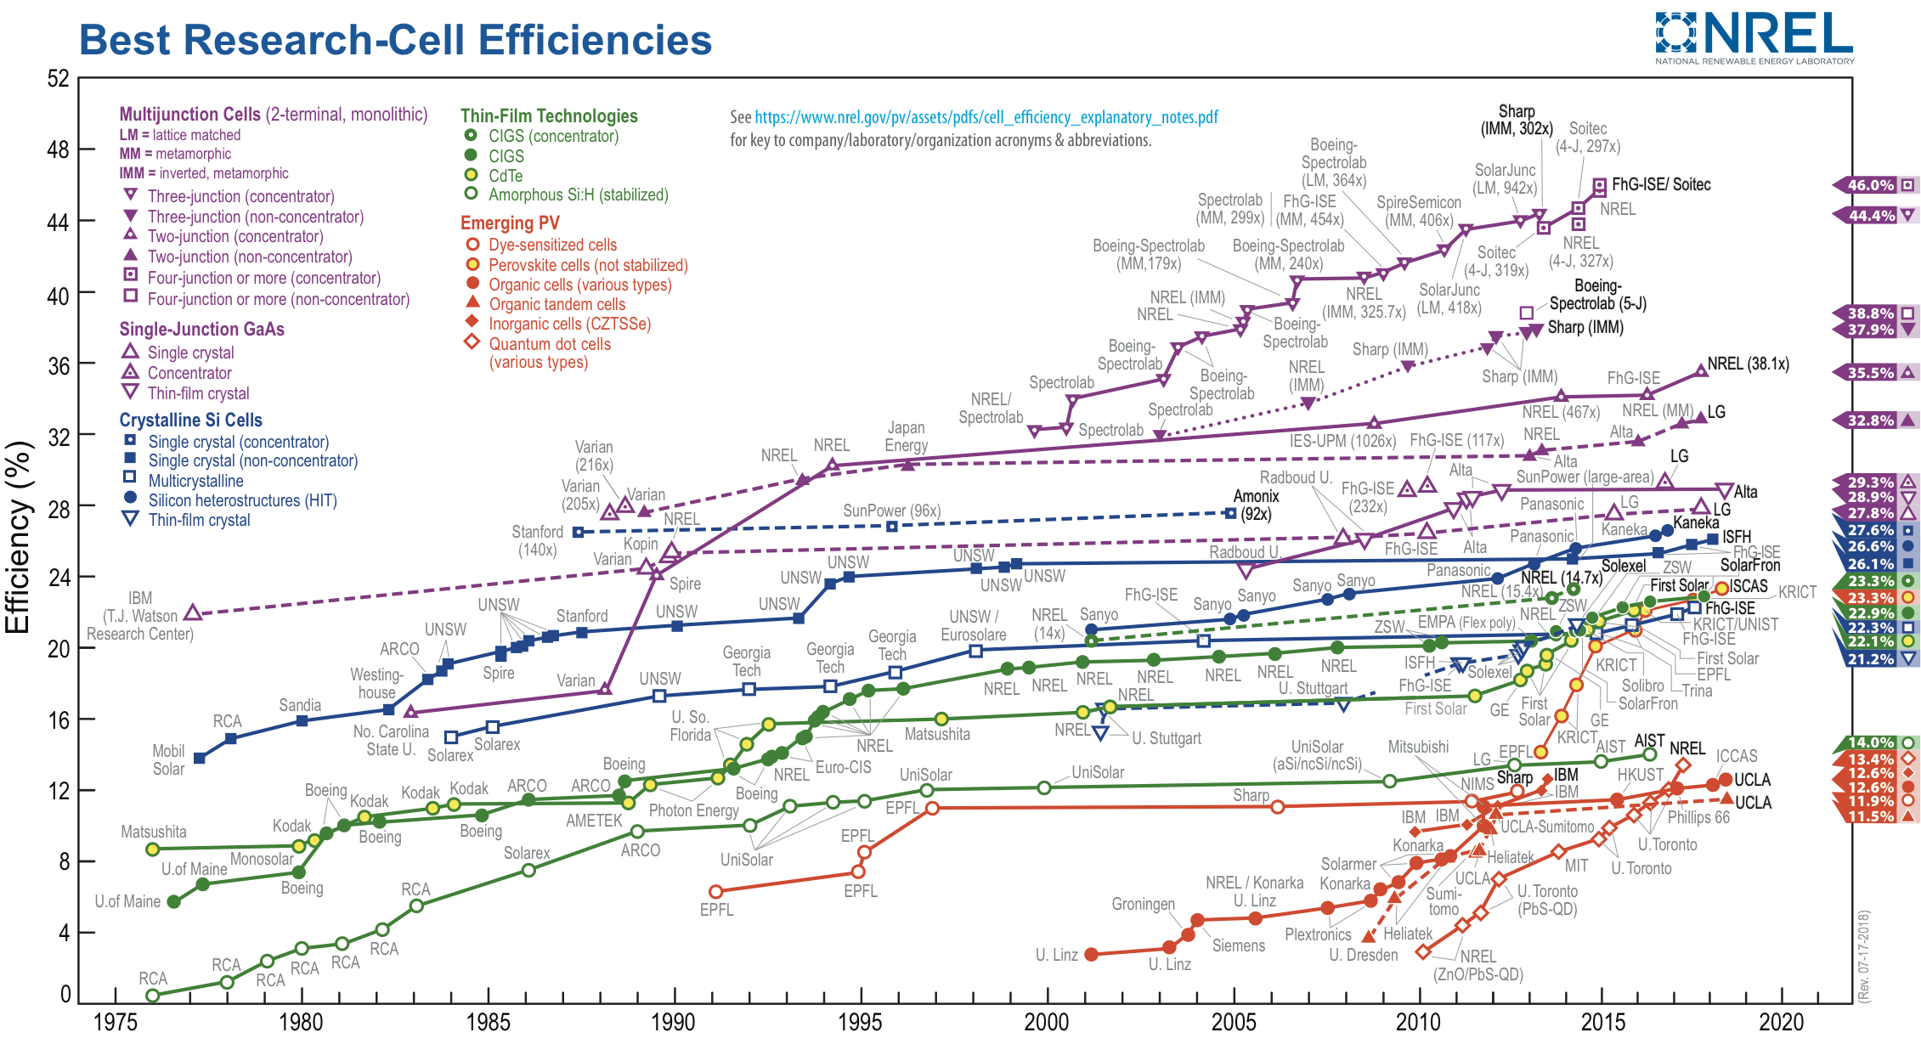
NREL: Best RESEARCH solar cells (1976 – 2018):
https://www.nrel.gov/pv/assets/pdfs/pv-efficiencies-07-17-2018.pdf

Slide 48
With some added guidance as to cell types:
Single crystal GaAs
Emerging multi-junction cells
Single crystal Si
Polycrystal Si
Mature thin films
Emerging thin film and/or quantum dot cells

Slide 49
"Hero" (best in lab / single shot) efficiencies, top to bottom:
Multi-junction solar cells: Highest at 46%
Beating but not shattering the Shockley-Quiesser Limit
Crystalline GaAs solar cells (more exotic/$ crystal than Si): 35.5%
Crystalline silicon solar cells: Highest at 27.6%
Thin-film cells (e.g. polycrystalline/amorphous Si and CdTe): Highest at 23.3%
Perovskite cells: Highest at 23.3%
Dye-sensitized, organic . . . cells: Highest at 12.6%
Quantum Dot solar cells: Highest at 13.4%
An Introduction to Sustainable Energy Systems: WeCanFigureThisOut.org/ENERGY/Energy_home.htm

Slide 50
What about all those very rapidly climbing "emerging" cells?
Well, they ARE still emerging which means that they:
Are still largely unproven
Employ radically different materials
And/or radically different device principles
Making them the subject of the note set Tomorrow's PV Solar Cells (pptx / pdf / key)
Emerging multi-junction cells
Emerging thin-film &
quantum dot cells

Slide 51
To finish this note set, here are some issues with today's PV solar cells:
First, going back to our earlier discussion of sunlight:
The MAXIMUM solar power EVER reaching the earth's surface
is called AM1.5 (air mass 1.5) and equals ~ 1000 Watts / square meter
But to capture that maximum intensity:
1) The PV solar cells must directly face the sun
2) The sun must be DIRECTLY overhead
So light takes the shortest path through the light-obstructing atmosphere
3) There must be no haze, fog, or clouds to absorb or redirect sunlight

Slide 52
At best, such peak conditions occur for an hour or so, a few days a year!
Thus: AVERAGE SOLAR POWER << PEAK SOLAR POWER
OK, then you read marketing literature or news articles declaring that:
"This new solar plant will produce Y kilowatts of power"
OR
"It will be able to power Z thousand homes"
But which power are they talking about?
AVERAGE power would most fairly represent the plant's likely impact
But marketing literature is much more likely to cite PEAK power
Which naive journalists then parrot in news headlines & articles
Leaving YOU to figure out how PEAK power relates to AVERAGE power!

Slide 53
My Solar Rule: Multiply by ½ x Another ½ x Maybe Another ½
Multiply by the first factor of ½ because:
Averaged over a year, the sun is up only 50% of the time
Multiply by the second factor of ½ because:
Solar intensity peaks near noon, falling to ~ zero at sunrise & sunset
Sun's motion means that power to a surface falls sinusoidally away from noon
Absorption via the longer atmospheric path makes that falloff even sharper!
Then maybe multiply by a third factor of ½ because:
Clouds, haze or smog stop the sunlight from reaching the solar cell
Pictorial explanation drawn from my Introductory Note Set (pptx / pdf / key):

Slide 54
Daily solar energy delivered to a solar cell:
Yellow = Clear summer day Gray = Non-summer and/or cloudy day
Green = Eyeball approximation of typical (possibly cloudy) day's solar power
Area of triangle = Power x Time = ENERGY per day per square meter
= (½)(base)(height) = (½)(½ day)(½ kW/m²) = ½ x ½ x ½ x (1 kW-day/m²)
= 1/8 x (Energy if sun were ALWAYS directly overhead in a clear sky)
Maximum possible incident solar power
1 kW / m²
Actual Incident Solar Power
0.5 kW / m²
0 kW / m²
12 AM
6 AM
12 PM
6 PM
12 AM

Slide 55
Leading to discussion of CAPACITY and CAPACITY FACTOR:
We use "capacity" to describe what some person or thing is capable of
That is, the best performance we can expect of them or it
In this sense, a solar cell's power capacity would equal its BEST possible output
Which would be its output at noon on those special few sunny days
= PEAK POWER which is so much larger than solar's AVERAGE POWER
To deal with this, power plants are also described by a CAPACITY FACTOR
CAPACITY FACTOR = TIME AVERAGED POWER OUT / POWER CAPACITY
Which, from above, I expect to be 1/4 for nearly cloud-free locations
Or possibly as little as 1/8 for more typically cloudy locations
So how important ARE cloudy days?

Slide 56
The U.S. Energy Information Administration evaluates CAPACITY FACTORS
And reports these, for every type of power plant, every year
As detailed in my note set Power Plant Economics (pptx / pdf / key)
The EIA consistently reports SOLAR PV CAPACITY FACTOR as being about 25%
= ½ x ½ and not ½ x ½ x ½, suggesting that clouds are NOT important
However, the EIA sensibly bases its estimates on current U.S. power plants
And the vast majority of U.S. solar plants are now in southwestern deserts
So while the EIA validates the first two parts of my "½ x ½ x maybe ½" rule,
It does not verify the final ½ and thus does not answer questions such as:
What if solar PV plants are built in less remote / more typical locations?
How much lower will their power output be?

Slide 57
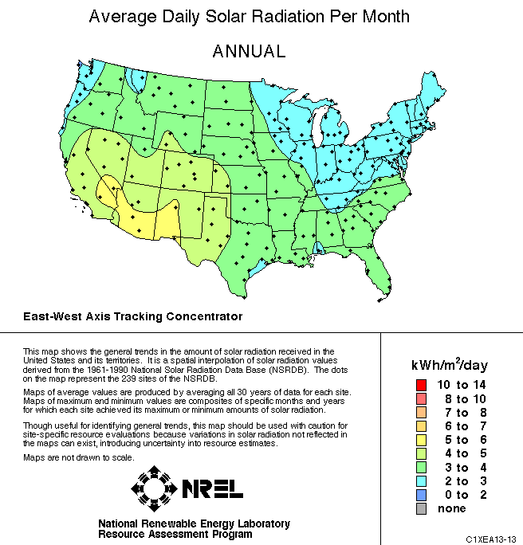
The U.S. National Renewable Energy Lab (NREL) provides an answer:
Their website maps yearly averaged and seasonal data, taking into account if:
PV cell arrays are fixed in one position
Or if they daily swing East to West tracking the sun's arc
AND/OR if they adjust their North-South tilt with changing season
Selecting for yearly averaged data, with only East to West daily tracking:
Power in currently used "best" southwest locations: 5-6 kW-h/m²/day
vs. 3-4 in west/south locations vs. 2-3 in midwest / northeast locations
In non-SW locations weather DOES knock power down by another ~½!
http://rredc.nrel.gov/solar/old_data/nsrdb/1961-1990/redbook/atlas/

Slide 58
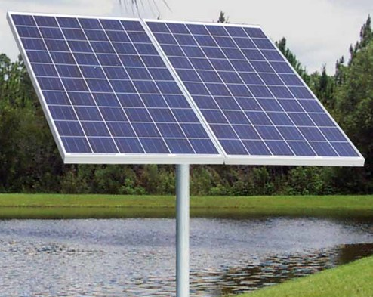
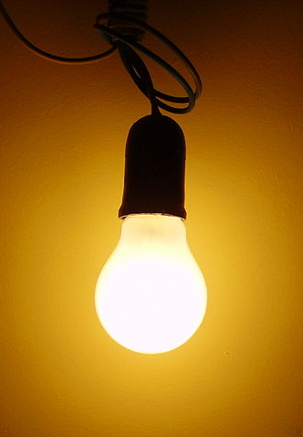
LIKELY TIME-AVERAGED SOLAR CELL POWER OUTPUT:
To calculate SOLAR POWER INPUT ("insolation") you first either:
1) START with maximum possible solar insolation ~ 1000 Watts / square meter
THEN apply my "½ x ½ x maybe ½" rule
2) OR use solar insolation mapping websites such as NREL's
Yielding ~ 2000-6000 W-h/m²/day ~ 80–250 Watts / square meter
BUT TO THEN GET A SOLAR PANEL'S POWER OUTPUT:
You must multiply by component solar cells' energy conversion efficiency
Which, from earlier discussion, is now typically ~ 15-20%, yielding:
Averaged solar panel power output => 12-50 Watts / square meter
Meaning that Could only power a
ONE of these: small ONE of these:

Slide 59
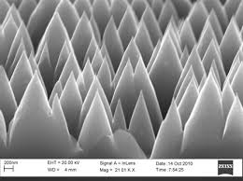
How optimized capture of sunlight leads to solar cell’s apparent color:
In addition to carefully tuning the absorption of sunlight within a solar cell
You must also minimize reflection of sunlight right off its front surface
Laboratory cells can almost eliminate such reflection via "surface micro-texturing"
SEM image of micro-textured Si: Effect on reflected light:
Reflected light is effectively trapped, forcing it to eventually penetrate into PV cell
Near total elimination of ANY color reflection makes this into "Black Silicon"
vs.
SEM Image: https://www.nanowerk.com/spotlight/spotid=19590.php

Slide 60
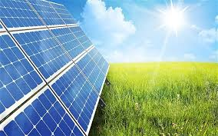
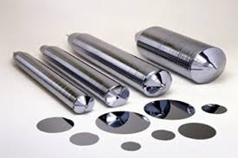
But commercial PV cells aren't black, most are in fact blue:
DESPITE being made of silicon
which has a silver-gray color:
Why? Because commercial cells suppress reflection using a different method
Which is considerably less expensive but also significantly less effective
A thin flat clear glass layer is added to the surface of flat PV cells
Light then reflects from both the top of the glass, and the top of the PV cell
www.upsbatterycenter.com/blog/a-new-and-more-efficient-solar-cell/
www.quora.com/Why-are-silicon-wafers-round

Slide 61
However, light is a wave, with both crests and troughs
If the crests of one reflected wave overlay the troughs of the other,
They can cancel each other = Destructive interference => No reflection
When will this occur? Consider a glass layer ¼ of the light's wavelength (λ) thick
If the incoming light ray strikes almost vertically,
the penetrating ray travels an extra λ/2 before returning to the surface,
where it meets up with the ray reflecting directly from that surface
But a half wavelength takes you from a wave's crest to a wave's trough
So that ray's troughs will overlay the other ray's crests => Cancellation!
λ / 4

Slide 62
Such "quarter wave plates" are the stock way of suppressing reflections
But what if you have light of multiple colors (as you do with sunlight)?
The wavelength of red light is almost twice that of blue: λ _{red} ~ 2 λ _{blue}
Say, trying to suppress reflection of red, you choose glass thickness of λ _{red} / 4
The penetrating red ray then travels extra distance λ _{red} / 2 => Cancellation
The penetrating blue ray follows the same path, so it also travels an extra λ _{red} / 2
But λ _{red} / 2 ~ λ _{blue} so the penetrating blue travels one of its wavelengths
That penetrating blue ray thus ends up strengthening the surface-reflected blue
Crests overlay crests, troughs overlay troughs => Reinforced blue reflection
Commercial Si PV cells, trying to capture as much energy as possible from sunlight,
employing analyses similar to my earlier Shockley-Quiesser optimization,
increase capture of red at the expense of reflecting blue

Slide 63
Closing with two common criticisms of today's silicon PV cells:
"Solar PV cells require more energy to make than they will ever produce!"
Yes, much of silicon's strength comes from its . . . well, strength
It does have extremely strong bonds, as reflected in its 1415°C melting point
And much of its processing does occur near or above that melting point
So it IS appropriate to question the amount of energy consumed in its manufacture
But that ends up being a valid concern for many energy technologies
Which is why I've written a whole stand-alone note set about EROI (pptx / pdf / key):
Energy Return On Investment = (Lifetime Energy Out) / (Lifetime Energy In)
Which, for energy production technologies, sure as heck better be >> 1 !
You can preview that EROI note set now, but its short answer on Solar PV is:
Solar PV EROI's ARE >> 1: About 10 for crystal Si => 35 for some thin films

Slide 64
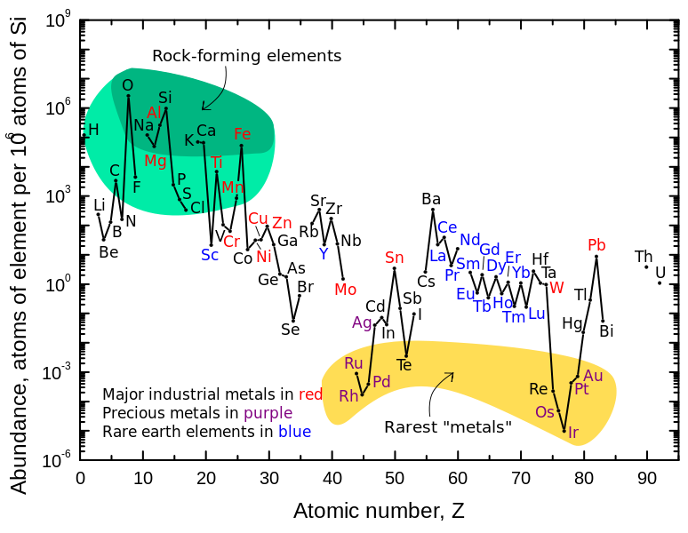
A second common criticism of today's silicon PV cells:
"Si is a rare and exotic material that requires
exceptionally toxic fluoride chemicals to extract and purify"
Well, here are elemental abundances in the earth's crust (look at the top left):
Source: http://www.webelements.com/

Slide 65
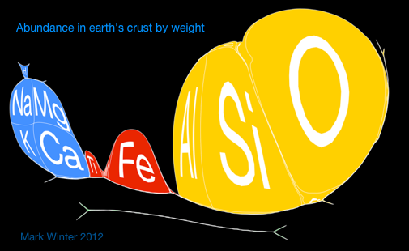
Which showed that Si is the 2nd MOST COMMON element in the earth's crust
As emphasized in this almost comically reworked version of The Periodic Table
in which cell size has been made proportional to an element's crustal abundance:
Narrow lines at the bottom = All of the other elements – drawn in proportion
Source: http://www.webelements.com/

Slide 66

And it's not hard to find silicon in the earth's crust:
Along with the #1 most common element, oxygen, it makes up beach sand
In the form of SiO₂ (a.k.a. "quartz" or "silica")
And beach sand is indeed the source of a PV cell's silicon:
But yes, if its separation required fluorine, that would be a concern
Because, among the halogens, fluorine is an extremist:
Oxidizing strength: F₂ > Cl₂ > Br₂ > I₂ Reducing strength: I⁻ > Br⁻ > Cl⁻ > F⁻
So fluorine compounds DO often have extreme (and very toxic) chemical properties
Including a tendency for even dilute residues to attack nerve cells
http://boraboraphotos.com/beautiful-white-sand-beach-in-bora-bora/

Slide 67
But it turns out that chlorine (not fluorine) is used in Si refining!
Silica sand (SiO₂) is first heated with carbon at 2000°C
Which burns off the O as CO₂ ¹
But the resulting purity is not then high enough for electronics (much less for PV)
So it is then heated to 300°C in the presence of HCl gas
Which produces liquid trichlorosilane (SiHCl₃)
Then, in the "Siemens Process,^{1,2} trichlorosilane is passed (at 1100°C)
over pure "seed" crystals of Si where trichlorosilane decomposes,
depositing hyper pure Si (and releasing chlorine gas)
So does Si refining does involve not very nice chemicals and byproducts? Yes!
But they are not atypical of chemicals used in most raw material extraction
1) http://www.techradar.com/us/news/computing-components/processors/how-sand-is-transformed-into-silicon-chips-599785
2) https://en.wikipedia.org/wiki/Silicon

Slide 68
Credits / Acknowledgements
Some materials used in this class were developed under a National Science Foundation "Research Initiation Grant in Engineering Education" (RIGEE).
Other materials, including the "Virtual Lab" science education website, were developed under even earlier NSF "Course, Curriculum and Laboratory Improvement" (CCLI) and "Nanoscience Undergraduate Education" (NUE) awards.
This set of notes was authored by John C. Bean who also created all figures not explicitly credited above.
Copyright John C. Bean
(However, permission is granted for use by individual instructors in non-profit academic institutions)
An Introduction to Sustainable Energy Systems: WeCanFigureThisOut.org/ENERGY/Energy_home.htm

