Slide 1
Utility Scale Solar Power Plants
John C. Bean
Outline
Why focus on only Utility Scale Solar?
Because of its strong cost advantage over Rooftop Personal Solar
Utility Scale Solar Photovoltaic (PV) Plants:
These plants now have power capacities matching conventional power plants
A few even match the capacities of Nuclear & Mega-Fossil Fuel power plants
But despite the wealth of candidate PV technologies,
crystalline Silicon solar cells dominate, challenged only weakly by Thin Film CdTe
Utility Scale Solar Thermal Plants:
These plants DON'T have power capacities matching conventional power plants
Only one plant in the world achieves "typical" power plant capacity
With all others still classifiable as "small/smallish" power plants
But over half of these achieve a green energy "holy grail:" post sunset power production
This enabled by their daytime stockpiling of superheated liquids
Utility Scale Plants of both types confirm solar energy's need for vast land areas
(Written / Revised: August 2022)

Slide 2
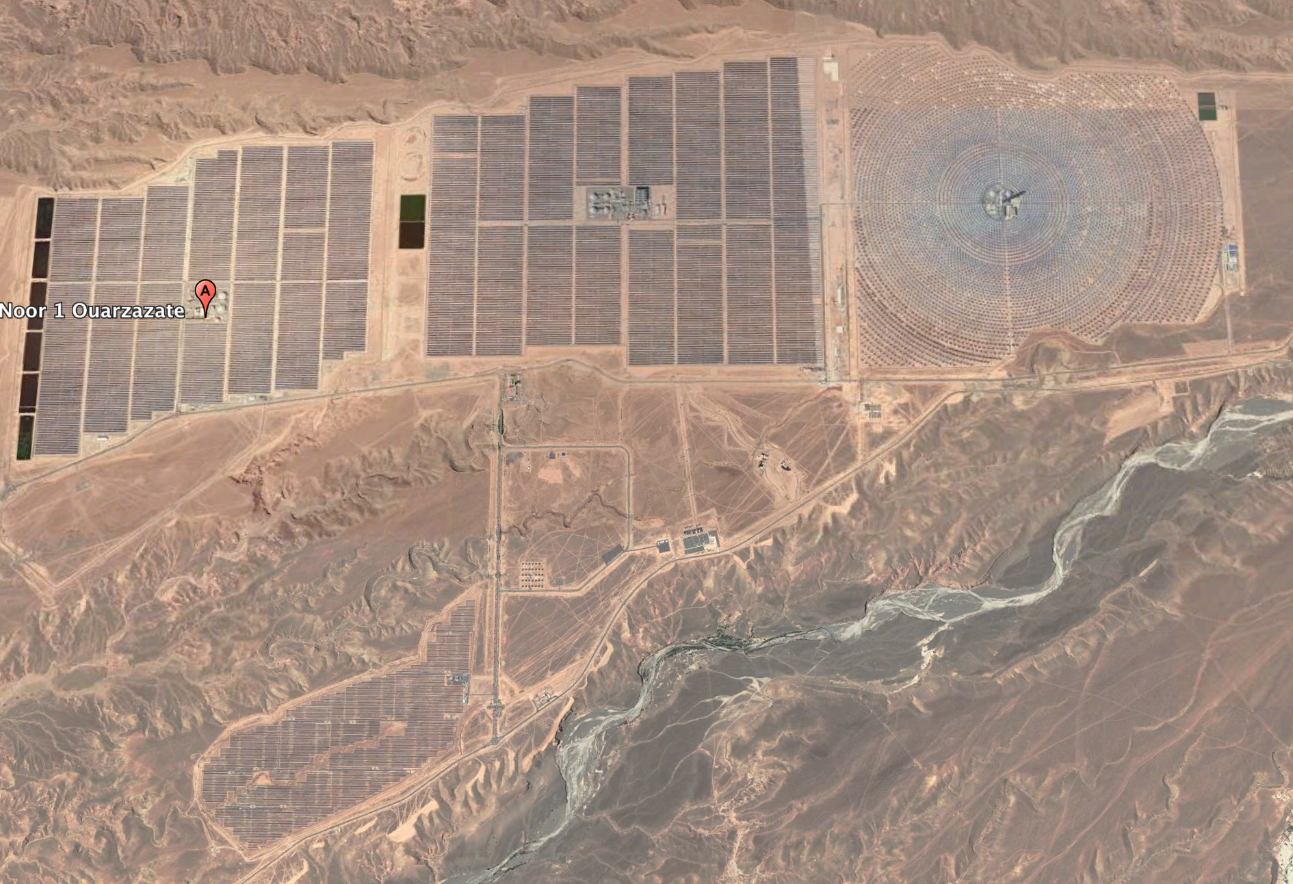
510 MW Solar Thermal Power Plant - with Heat Storage
Noor Quarzazate Solar Plant, Morocco
Noor I (2015) - 160 MW
Parabolic Trough Thermal Collectors
3 hr molten salt heat storage
Noor III (2018) - 150 MW
Solar Thermal Central Tower
7 hr molten salt heat storage
Noor II (2018) - 200 MW
Parabolic Trough Thermal Collectors
7 hr molten salt heat storage
North
Noor IV (2018) - 72 MW
Photovoltaic Cells
2 km
Data Source: NREL - https://solarpaces.nrel.gov/projects - (Noor I / Noor II / Noor III)
Image: Google Earth + added labels

Slide 3
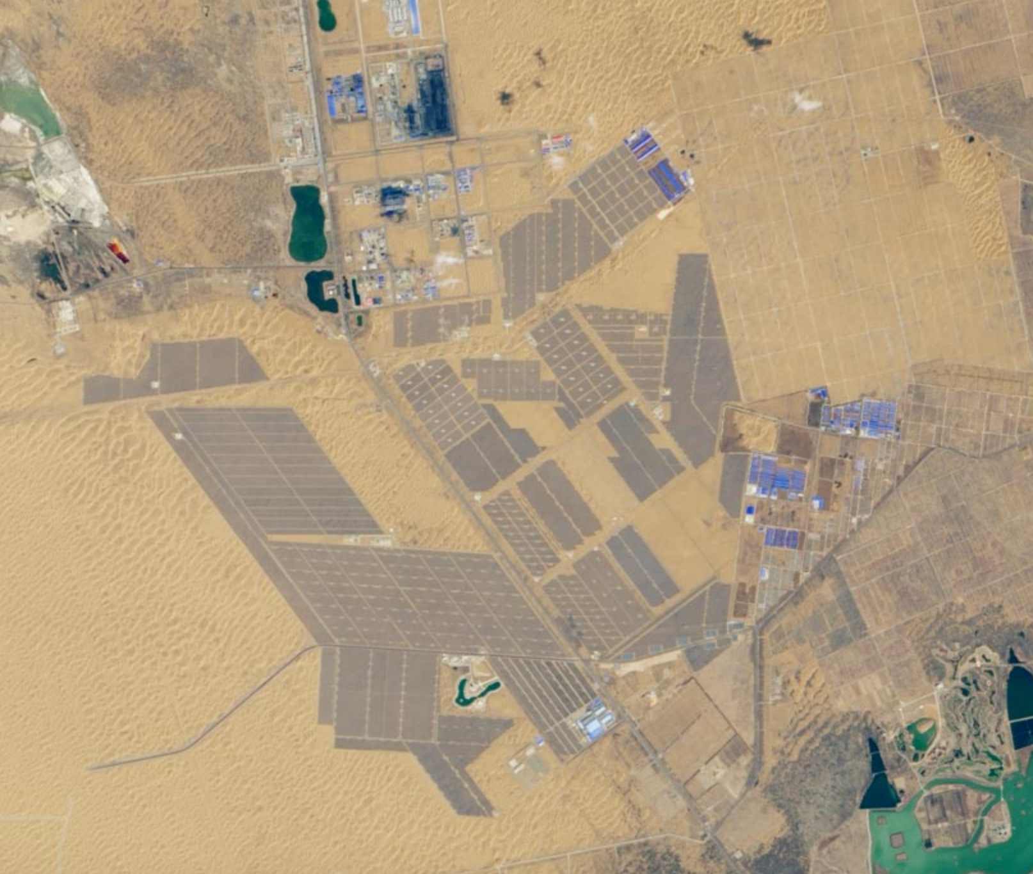
1547 MW Solar Photovoltaic Power Plant
Tengger Dessert Solar Park, China
2 km
Data Source: Wikipedia citing Chinese language report: http://www.escn.com.cn/news/show-310093.html
Image: NASA Earth Observatory - https://earthobservatory.nasa.gov/images/145159/solar-powered-china

Slide 4
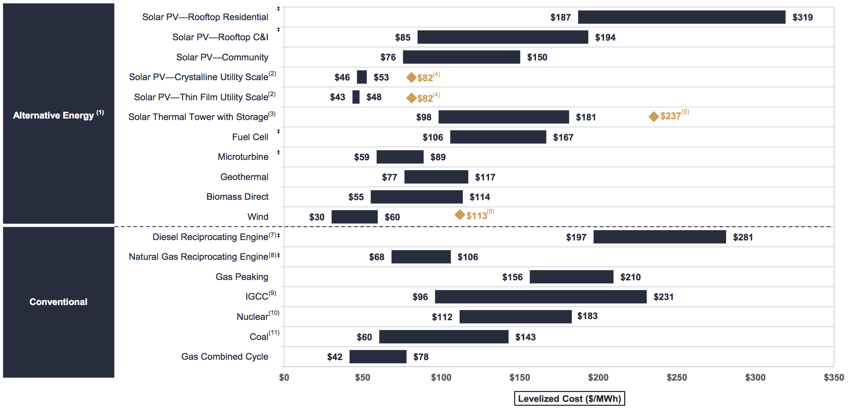
Why focus upon only "utility" (corporate or governmental) solar power?
Especially when so many dream of "going off the grid" via rooftop solar cells?
Because, as detailed in my web note set on Plant Economics (pptx / pdf / key),
Rooftop Residential PV power is now ~ four to six times more expensive than
power from Utility Scale Solar, Wind or leading non-green alternatives: ¹
1) From the 2016 Lazard analysis of unsubsidized levelized costs of energy (yellow highlighting added)
"Solar Power - Rooftop C&I" = Commercial & Industrial

Slide 5
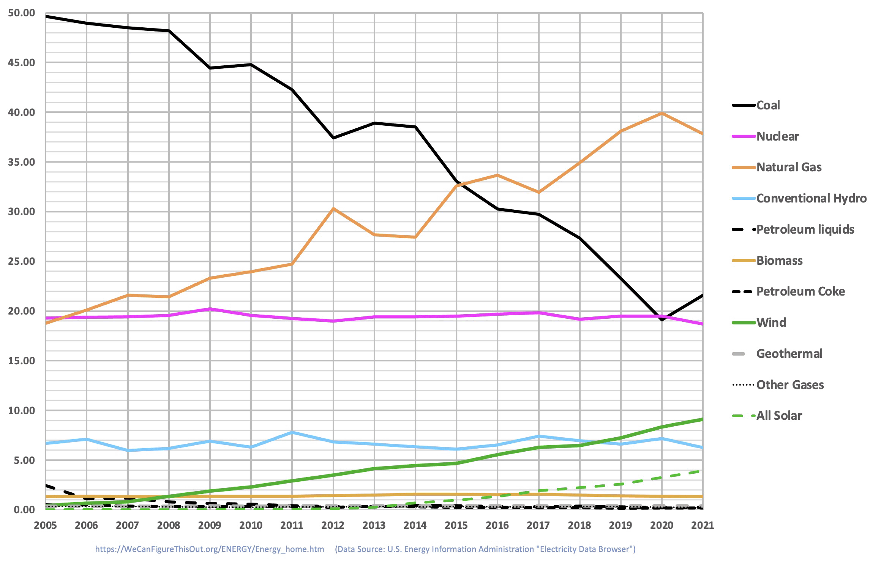
And even WITH lower cost, Utility Scale Solar Power is STILL struggling:
From my web note set on U.S. Power Production & Consumption (pptx / pdf / key):
U.S. Sources of Electrical Power (by percentage contribution)
<= Utility Scale Solar
2.7%
An Introduction to Sustainable Energy Systems: WeCanFigureThisOut.org/ENERGY/Energy_home.htm

Slide 6
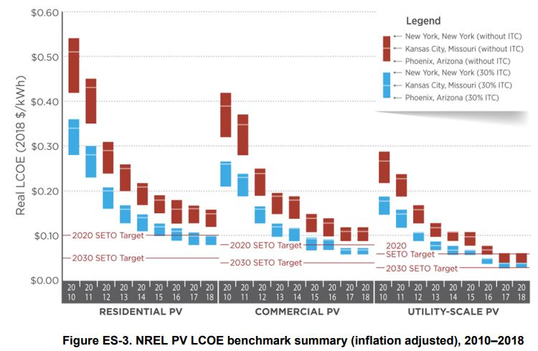
To which you might respond:
"But I've heard that Residential PV costs are declining"
Yes, but Utility Scale PV is maintaining a strong cost advantage,
as reported here by the U.S. National Renewable Energy Lab (NREL): ¹
1) U.S. Solar Photovoltaic System Cost Benchmark: Q1 2018, NREL
https://www.nrel.gov/docs/fy19osti/72133.pdf
NOTE: NREL states LCOE's in $/kW-h, rather than the more common unit of $/MW-h seen in the earlier Lazard figure

Slide 7
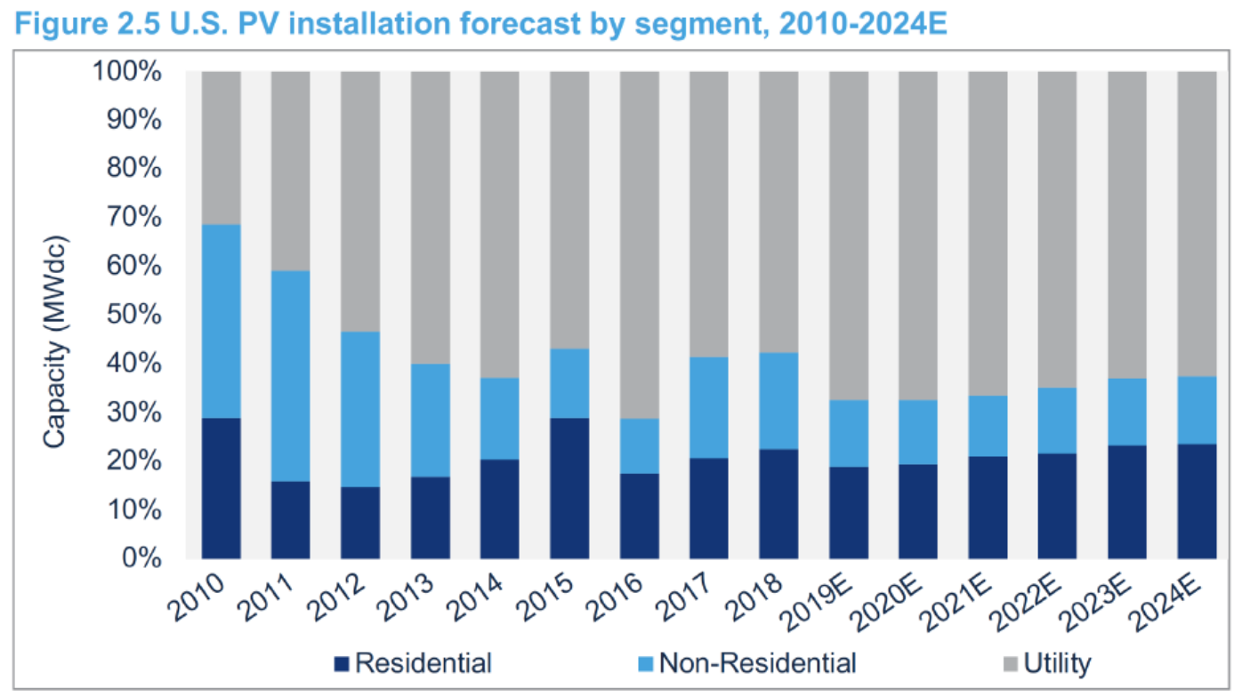
Because of Utility Scale PV's sustained cost advantage
It is projected to remain the dominant source of U.S. PV solar power:
2019 Projection from the Solar Energy Industry Association (SEIA) ¹
1) Solar Market Insight Report 2019 Q2 (SEIA)
https://www.seia.org/research-resources/solar-market-insight-report-2019-q2

Slide 8
But there is another reason to study Utility Scale Solar Power:
To make sense of the myriad solar power alternatives!
As seen in the preceding three web note sets:
Literally dozens of different PV cell designs are now under investigation
The science behind those PV cell designs is exceptionally complex and opaque
Making it really hard to identify those "most likely to succeed"
Add in a dozen or so Solar Thermal options and you end up with perhaps
fifty different solar power alternatives to choose from!
Utility Scale Solar has grown through both commercial AND governmental investment
Making it the product of a less than perfect "free market" competition
Nevertheless, it's been a crucible forcing choices between possible contenders
Utility Scale Solar may thus answer questions about ALL Solar Power
An Introduction to Sustainable Energy Systems: WeCanFigureThisOut.org/ENERGY/Energy_home.htm

Slide 9
What sort of questions?
Some that come immediately to my mind:
Can Solar (finally!) provide enough power to displace today's power plants?
Plants that "typically" produce ~ 500-600 MW
With the larger plants now producing 1000-2000 MW ¹
Which Solar Power technologies have thrived in the Utility Scale Solar market?
For PV, which semiconductors are being used?
For Solar Thermal, which concentration schemes are favored?
What land areas will be required for competitively sized Solar Power plants?
Will energy storage allow at least Solar Thermal plants to produce overnight power?
Meaning (at least for now) does molten salt heat storage appear viable?
1) The capacity of "typical" power plants is discussed in my web note sets:
A Generic Power Plant and Grid (pptx / pdf / key)
Power Plant Requirements: Land and Water (pptx / pdf / key)
An Introduction to Sustainable Energy Systems: WeCanFigureThisOut.org/ENERGY/Energy_home.htm

Slide 10
My search for answers:
For Solar PV, Wikipedia offers a list of power plants with capacity ≥ 200 MW ¹
Most entries are expanded upon in linked project-by-project Wikipedia webpages
But surprisingly, neither generally identify the PV technologies employed
For Solar PV, the trade press often reports on the "world's largest solar power plants" ¹
But, contradicting their titles, these lists most often include ONLY PV plants
And even more surprisingly, they ALSO fail to identify PV technologies employed
For Solar Thermal, Wikipedia offers a list of plants with capacity ≥ 100 MW ¹
But that list fails to identify the land areas of the plants
For Solar Thermal, the U.S. National Renewable Energy Labs (NREL) offers no lists
But provides a huge website searchable by country, project, technology or date ¹
But for Solar PV, NREL offers no comparably comprehensive website
For both technologies, my research & teaching experience supplied relevant factoids
Some of which led me down additional avenues of investigation
1) A complete list of the sources I used in writing this notes set (including links and cached documents) is provided on this web note set's Resource Webpage (link)

Slide 11
I entered the data I found into a large spreadsheet ¹
Which employed these acronyms:
And drew from these references:
To generate four different tables:
Utility Scale Solar PV Plants (200 MW or larger)
Utility Scale Solar Thermal Plants (100 MW or larger)
All Utility Scale Solar Plants (200 MW or larger) - sorted by SIZE OR DATE
1) That spreadsheet can be downloaded from this (link) on this note set's Resources Webpage

Slide 12
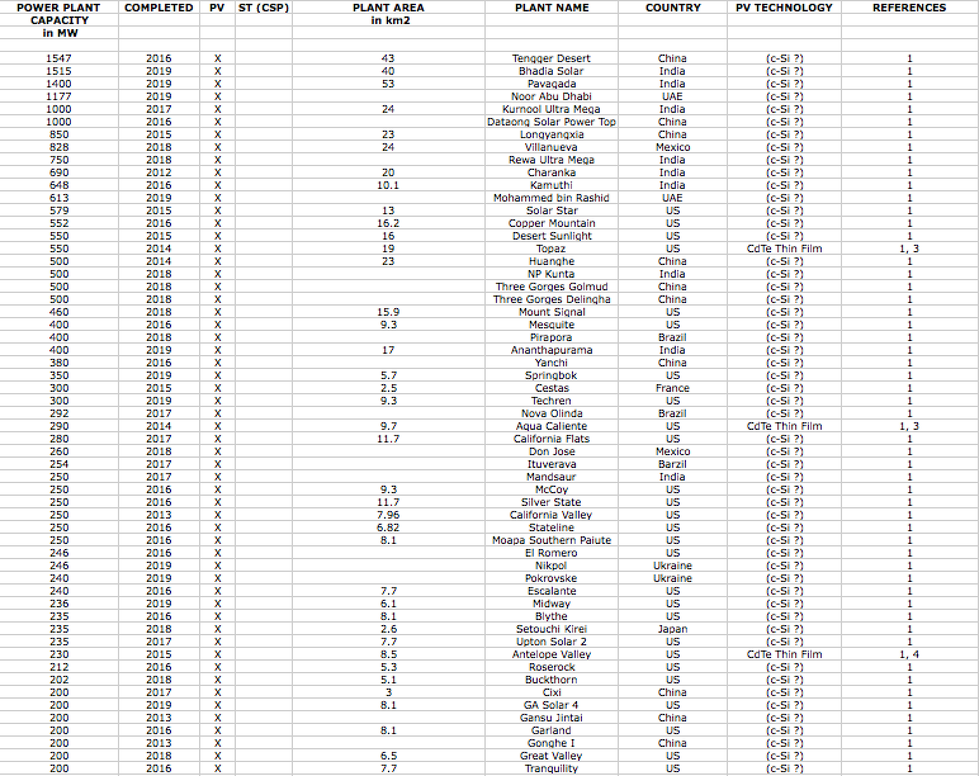
My Table on Utility Scale Solar Photovoltaic Power Plants (≥ 200 MW):

Slide 13
Questions & observations suggested by that PV Plant table:
First, why all of the question marks in the semi-final "PV Technology" column?
BECAUSE Wikipedia, trade press and plant websites OMITTED that information
MY GUESS: Single crystal silicon (c-Si) so completely dominates Utility Scale PV
that its near universal use is just being taken for granted
WHY would c-Si dominate?
Because of its high PV efficiencies (up to 25%) ¹ and exceptional cell lifetimes
Which is why I chose "c-Si ?" as the default "PV Technology" entry in my table
But thin film CdTe PV is almost as efficient (21%) ¹ and because its PV cells
are THIN films, they require far less (usually costly) semiconductor material
For which reasons I knew at least one plant ("Topaz" in CA) had installed thin film CdTe PV
By Googling CdTe PV I then identified several other thin film CdTe PV Plants ²
1) See discussion of NREL data in my note set Tomorrow's Solar Cells (pptx / pdf / key)
2) https://en.wikipedia.org/wiki/Cadmium_telluride_photovoltaics

Slide 14
But is thin film CdTe the ONLY successful challenger to c-Si?
Amorphous & polycrystalline Si PV are ALSO very well established technologies
PV efficiencies: a-Si PV 13.4% poly-Si PV 20.4% c-Si PV 25% ¹
As Si thin films, they require not only less expensive material but also less of it
Nevertheless, they have had little success in Utility Scale PV ²
Likely because their less stable atomic structures promote cell degradation
Thin film CIGS (Cadmium Indium Gallium Selenide) PV is also fairly well established
But unlike the Si technologies above, its PV cells are still improving rapidly,
climbing in recent years to 21.7% sunlight to electricity conversion efficiency ¹
But while the smallish 82 MW PV "Catalina" plant was commissioned in 2013 ^{3, 4}
CIGS PV cell manufacturing subsequently crashed
It's been reported that CIGS PV cell manufacturing has recently revived ⁵
but I could find no examples of new Plants yet committed to CIGS's use
1) See discussion of NREL data in my note set Tomorrow's Solar Cells (pptx / pdf / key) 2) https://energyinformative.org/best-thin-film-solar-panels-amorphous-cadmium-telluride-cigs/ 3) https://www.reuters.com/article/us-solar-frontier-idUSTRE80G1VK20120117 4) https://www.power-technology.com/projects/catalina-solar-project-kern-county-california/ 5) https://www.pv-magazine.com/2018/07/21/the-weekend-read-cigs-is-back-back-again/

Slide 15
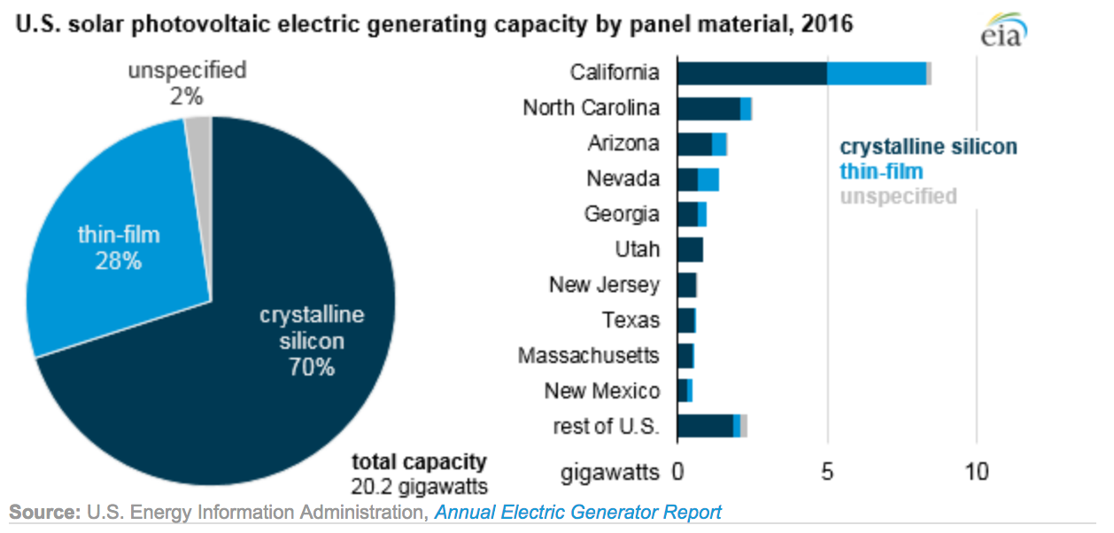
Had I thereby succeeded in identifying ~ ALL of the non "c-Si" PV Plants?
Confirmation was suggested by the title of a U.S. Energy Information Agency (EIA) webpage: ²
"Utility Solar Photovoltaic Capacity is
Dominated by Crystalline Silicon Panel Technology"
But that webpage included this figure:
70% crystalline silicon PV use falls well short of complete domination,
driving me to sort out what made up the figure's 28% thin film contribution
1)) https://www.eia.gov/todayinenergy/detail.php?id=34112

Slide 16
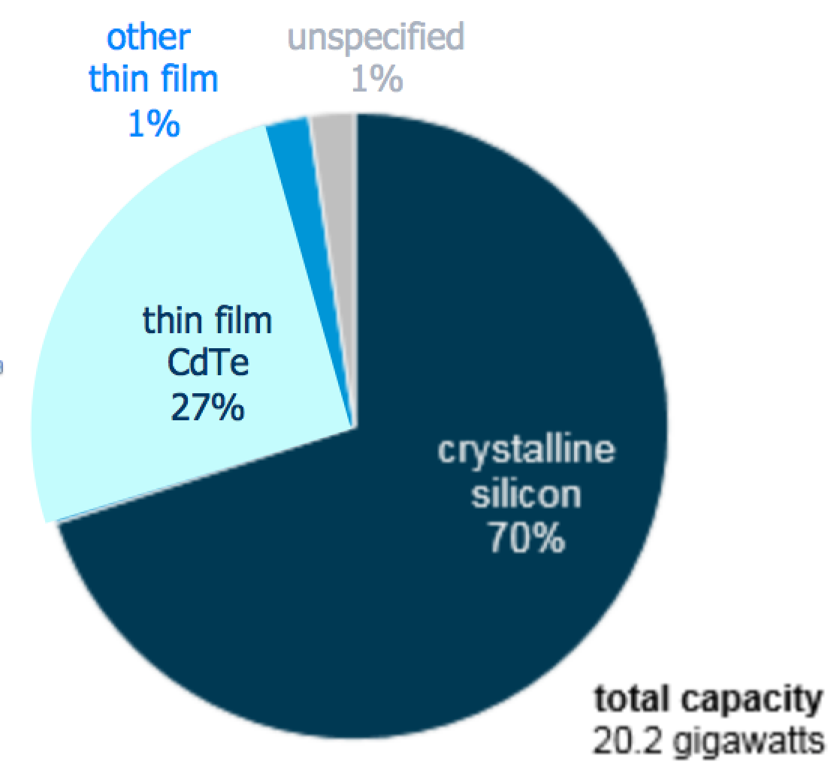
Additional information was provided in the webpage's text:
"CdTe is the most commonly used thin-film PV technology,
making up 97% of the total installed thin-film capacity in the United States"
By simply multiplying the figure's "other thin film 28%" by 97%
you find that film thin CdTe accounted for 27% of U.S. 2017 capacity
Allowing me to create this much more informative version of that EIA figure:
An Introduction to Sustainable Energy Systems: WeCanFigureThisOut.org/ENERGY/Energy_home.htm

Slide 17
Is that consistent with my table of Utility PV Plants ( ≥ 200 MW)?
My table identified 1070 MW worth of thin film CdTe U.S. plants
vs. 8197 MW for ALL U.S. plants
implying a thin film CdTe share of 13%
which is approximately half of what EIA claimed
Suggesting that some plants I labeled "c-Si?" are NOT c-Si
Or that my 200 MW lower limit overlooks a lot of U.S. capacity
including smaller plants apparently using thin film CdTe
The latter IS supported by the EIA figure's statement that
total U.S. PV capacity in 2017 = 20 GW (20,000 GW)
which is ~ twice the capacity included in my table
Calling for a much longer table (adding data on smaller plants)
plus unambiguous identification ALL plant PV technologies
An Introduction to Sustainable Energy Systems: WeCanFigureThisOut.org/ENERGY/Energy_home.htm

Slide 18
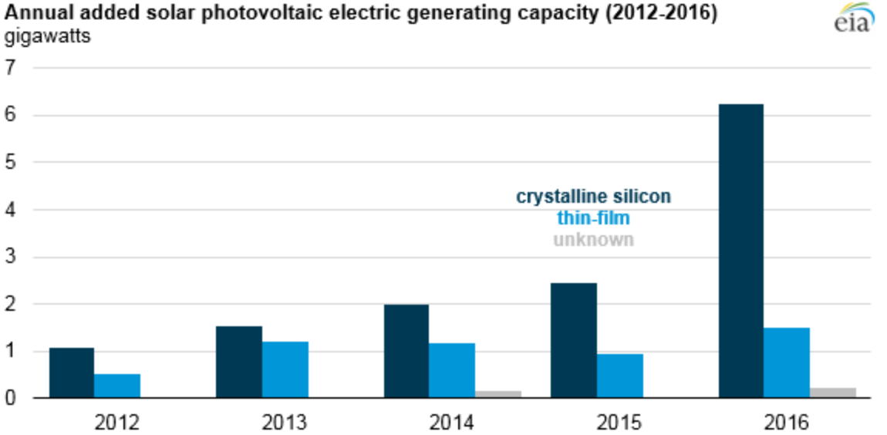
But that EIA webpage also included this figure:
Which, while it still obscures plant and thin film technology specifics,
shows unambiguously that thin film PV is LOOSING market share to c-SI PV
According to this figure, thin film PV's share of NEW installations has declined roughly as:
30% (2012)
44% (2013)
34% (2014)
27% (2015)
19% (2016)
An Introduction to Sustainable Energy Systems: WeCanFigureThisOut.org/ENERGY/Energy_home.htm

Slide 19
What ELSE is shown (or at least suggested by) my PV Plant table?
Very Significantly: Single PV plants are no longer just diminutive curiosities:
Recent plants rival "typical" non-green plants in size (500-600 MW capacity)
Some even match nuclear & large fossil fuel plants (>1000 MW capacity)
(at least in China, India, and the Middle East)
1) Footnote

Slide 20
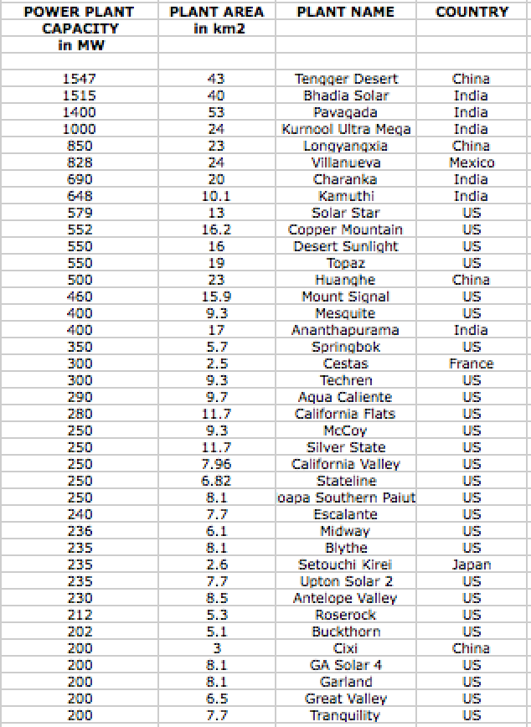
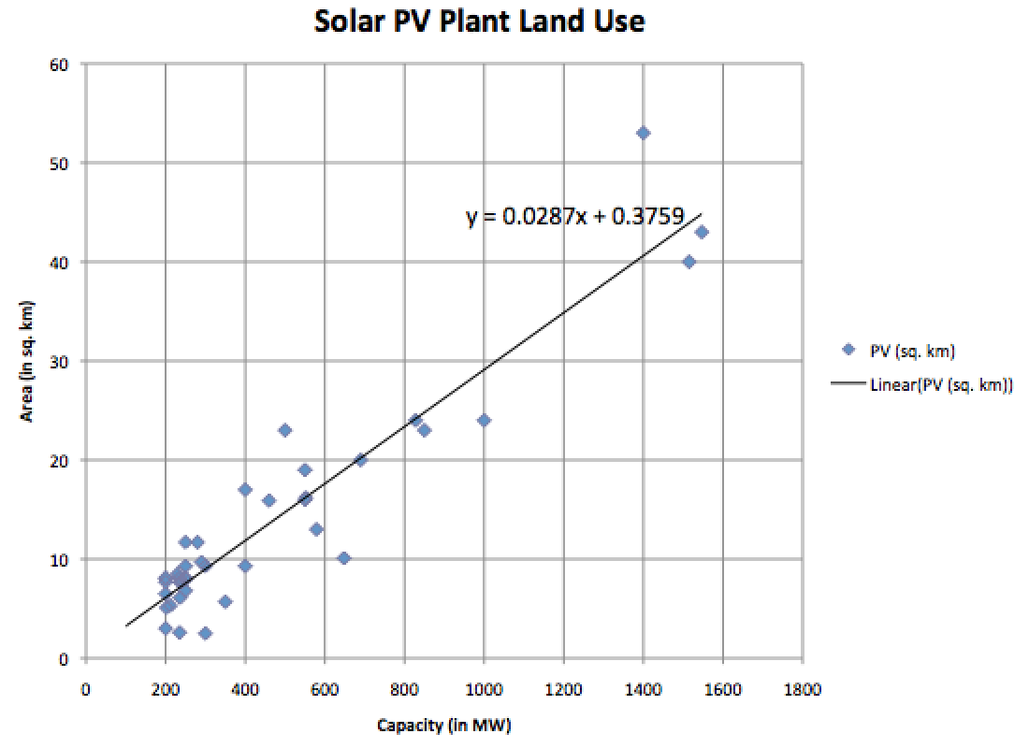
What are the land areas required for such Solar PV Plant capacity?
Remembering that "capacity" refers to maximum possible (noonish / cloud-free) power output
For plants with identified land areas:
Land Area vs. Plant Capacity plots as:
With surprisingly little scatter, the land use of these diverse Solar PV plants
can be fitted by a line with slope = 0.0287 km² / MW,
equivalent to 35 Watts of solar electricity OUTPUT per square meter
(vs. ~1000 Watts of sunlight INPUT power per square meter)

Slide 21
Why has PV Plant land use (per MW of capacity) not evolved?
First, despite a greater than 2:1 range in available PV cell conversion efficiencies,
Utility Scale Plants rely strongly on PV cells with nearly identical efficiencies:
c-Si PV peaking at 25% & Thin Film CdTe peaking at 21%
Second, while differing local weather can easily alter PV power by more than 2:1,
today's PV plants are still almost all located in high ~ cloudless desserts
Finally, despite alternate ways of positioning PV cell panels on the ground,
today's Utility PV plants are apparently using very similar panel arrangements
Which suggests their use of similar "sun tracking" schemes
What exactly is "sun tracking," and what are the alternatives?
An Introduction to Sustainable Energy Systems: WeCanFigureThisOut.org/ENERGY/Energy_home.htm

Slide 22
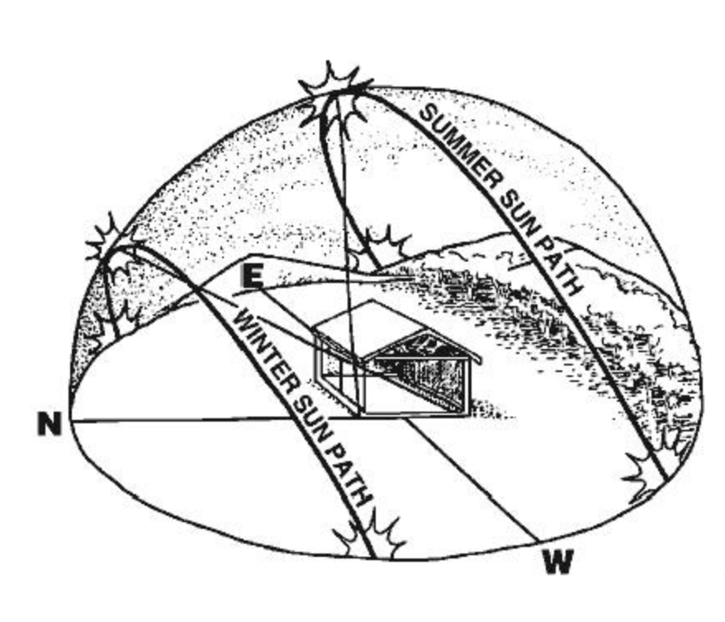
PV Sun Tracking (a.k.a., Solar Tracking):
From a PV cell's perspective, the sun moves east to west from dawn to dusk,
shifting lower to higher in the sky from local winter to local summer
Here as seen from Australia (which supplied this and the figures to follow): ¹
With sunlight peaking midday, the simplest way to mount a PV panel is
facing south (in the northern hemisphere) or north (in the southern hemisphere)
with a north-south tilt between the sun's winter and summer paths
(i.e., pointing toward the yellow circle I've added to this figure)
1) Figure: https://www.solarchoice.net.au/blog/solar-trackers/

Slide 23
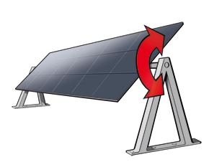
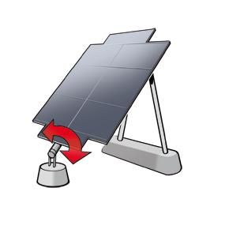
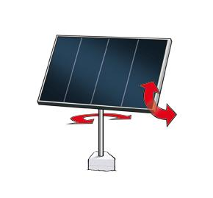
But most of the time a fixed panel would NOT directly face the sun
It would thus intercept a narrower beam of sunlight (containing less solar power)
Further, Its non-perpendicular surface would reflect away more of that beam
Seasonally varying N-S tilt captures a LITTLE more solar power (left figure)
Daily varying E-W tilt captures a LOT more solar power (center figure)
Combining both captures the MOST solar power (right figure)
The obvious downside: N-S or E-W "single-axis" tilting adds cost
N-S plus E-W "dual-axis" tilting adds even MORE cost
Figures: https://www.solarchoice.net.au/blog/solar-trackers/
An Introduction to Sustainable Energy Systems: WeCanFigureThisOut.org/ENERGY/Energy_home.htm

Slide 24
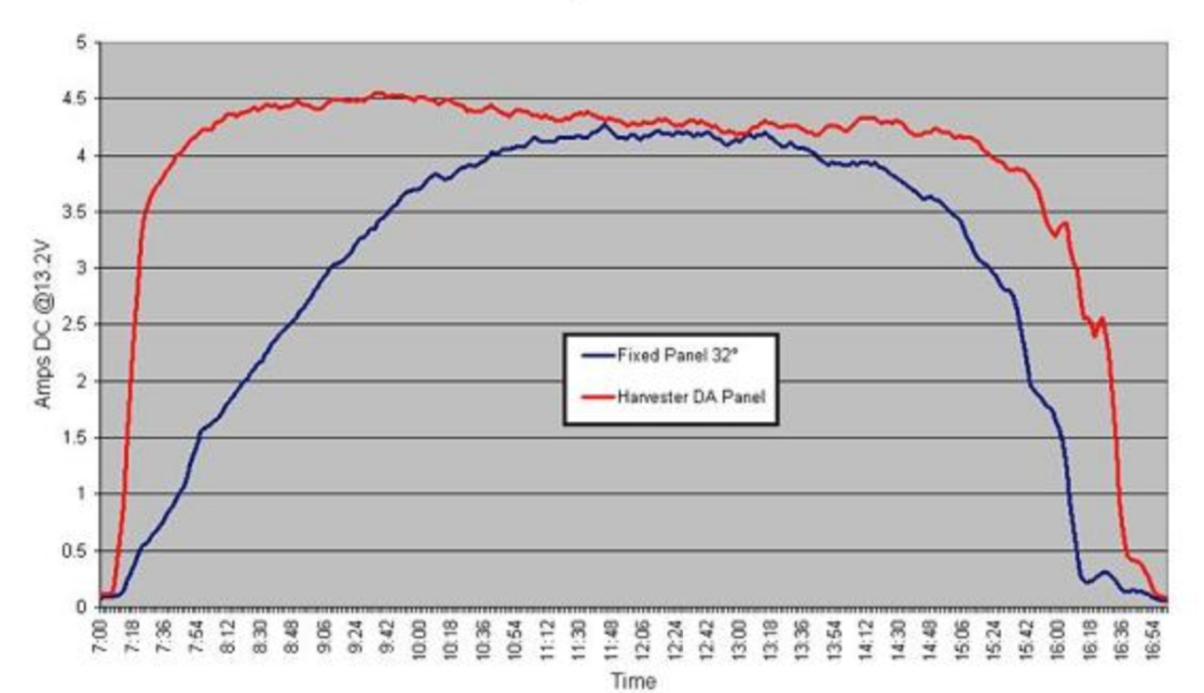
Another tracking downside / cost: Shadowing
Tracking's benefit diminishes if panels end up spending time in each other's shadows
Aggressive tracking thus requires greater panel separation (=> more land)
However, if the PV cells are very costly, tracking's added cost can still make sense
Because tracking might allow for use of FEWER of those expensive cells
Meaning that today's declining PV cell cost should drive reduced use of tracking
But tracking does something else VERY IMPORTANT to power companies:
Tracking increases a Solar PV Plant's power output morning & early evening
Which are two times we consumers especially WANT electrical power
Fixed PV Panel vs.
Dual Axis Tracking
Based on a figure from: https://www.solarchoice.net.au/blog/solar-trackers/
Fixed PV Panel vs.
Dual Axis Tracking
Fixed PV Panel vs.
Dual Axis Tracking
7 AM
7 AM
7 AM
Noon
5 PM
5 PM
5 PM
5 PM
5 PM

Slide 25
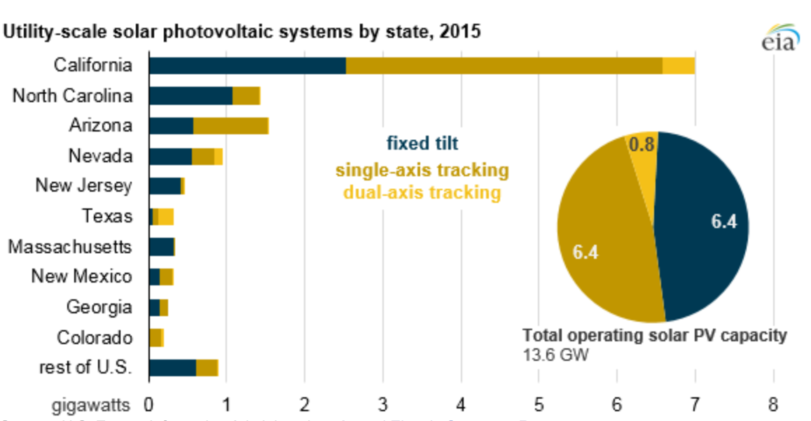
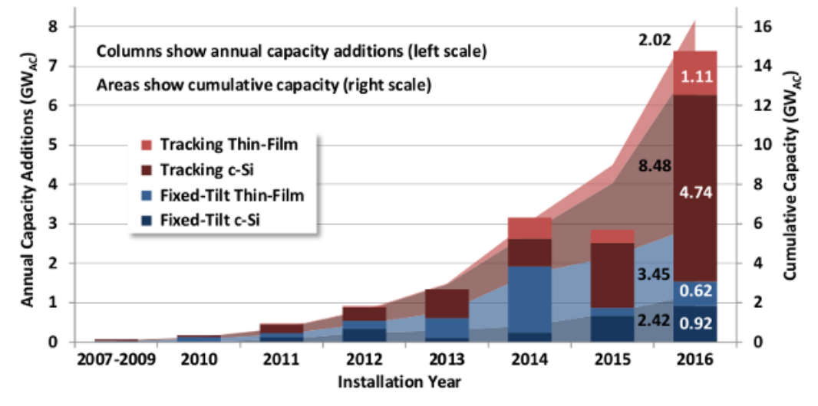
So do Utility Scale PV plants track or not?
U.S. EIA data on ALL U.S. PV Plants:
https://www.eia.gov/todayinenergy/detail.php?id=30912
PV Magazine (lines = all plants, columns = plants added in a specific year):
https://pv-magazine-usa.com/2017/09/20/trackers-dominate-u-s-utility-scale-solar-wcharts/
EXISTING U.S. plants are ~ evenly split between no tracking & single axis tracking
But NEW U.S. plants are making much more use of some form of tracking

Slide 26
PV TAKEAWAYS - As Suggested by Utility Scale Plants:
- Utility Scale PV is much cheaper than Residential Rooftop PV
At least for today's Plants located almost entirely in ~ cloudless desert locations
- Of the literally dozens of PV cell types & schemes, two now rule Utility Scale PV:
Single crystalline Si PV cells
and to a lesser (and apparently falling) extent, Thin film CdTe PV cells
- Dual axis (daily E-W + seasonal N-S) tracking is seldom worthwhile
- Use of Single Axis E-W Tracking & No-Tracking are now about even
But the former is growing at the expense of the latter
- Narrow range of options used => Near uniform PV land use of ~ 0.0287 km² / MW,
=> ~ 35 Watts Solar Electricity per square meter of land (not cell) area
This is MW CAPACITY = PEAK (noonish / cloud-free) - NOT AVERAGE POWER
An Introduction to Sustainable Energy Systems: WeCanFigureThisOut.org/ENERGY/Energy_home.htm

Slide 27
Moving on to:
Utility Scale Solar Thermal Plants
An Introduction to Sustainable Energy Systems: WeCanFigureThisOut.org/ENERGY/Energy_home.htm

Slide 28
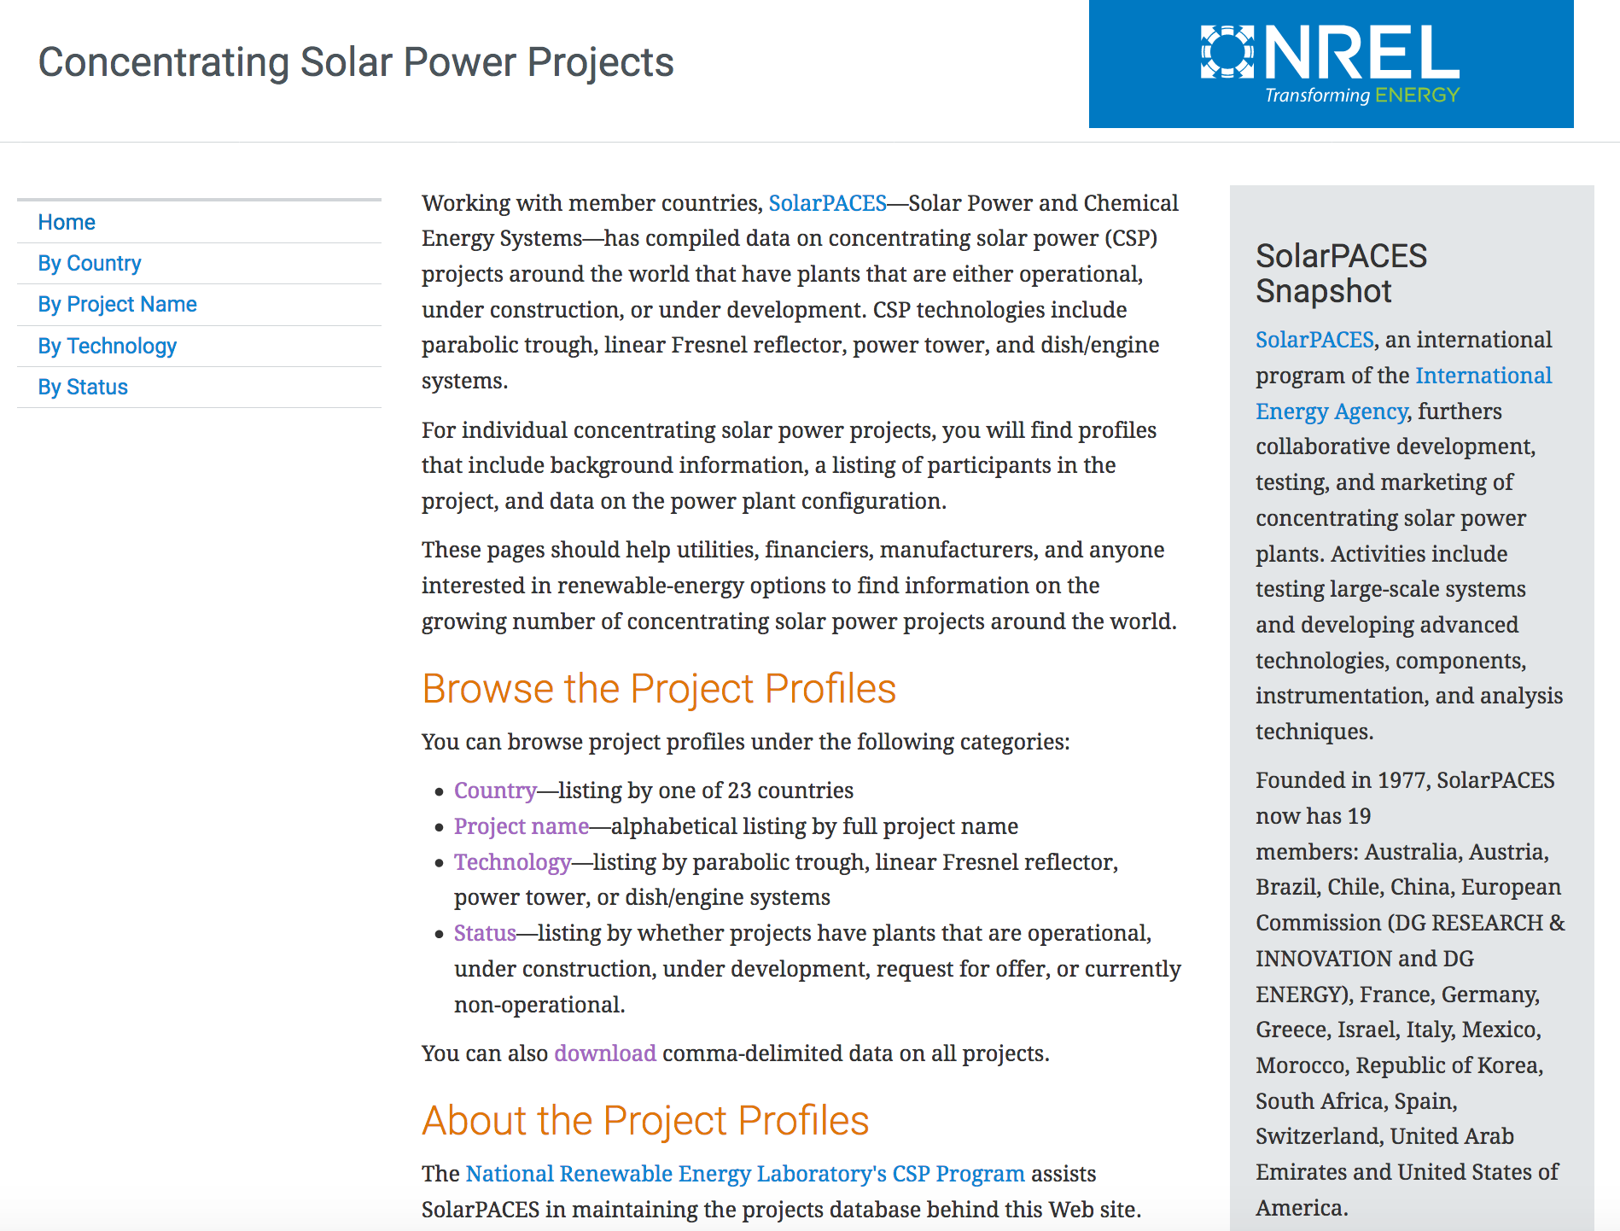
THE outstanding information source on Solar Thermal Plants:
The U.S. National Renewable Energy Lab's website: https://solarpaces.nrel.gov/
An Introduction to Sustainable Energy Systems: WeCanFigureThisOut.org/ENERGY/Energy_home.htm

Slide 29
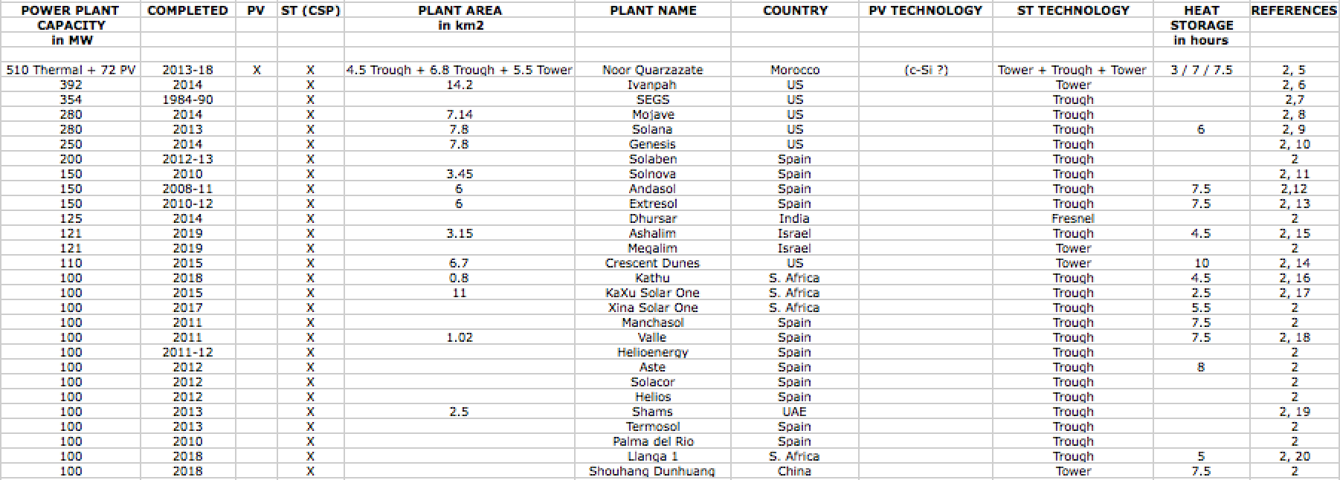
My Table on Grid Scale Solar Thermal Power Plants (≥ 100 MW):
This table covers worldwide Solar Thermal Plants of capacity ≥ 100 MW
It merges information from Wikipedia's List of Solar Thermal Power Stations
with project-by-project data from NREL's Concentrating Solar Power website
(When sources disagreed, I favored NREL data and/or data from governments & plant contractors)
1) https://en.wikipedia.org/wiki/List_of_solar_thermal_power_stations
2) https://solarpaces.nrel.gov/
An Introduction to Sustainable Energy Systems: WeCanFigureThisOut.org/ENERGY/Energy_home.htm

Slide 30
Questions & observations suggested by that Solar Thermal Plant table:
Observation #1: The Solar Thermal table is MUCH shorter than earlier Solar PV table
28 Solar Thermal Plants vs. 57 Solar PV Plants
Observation # 2: Had I leveled the playing field by using the same 200 MW lower limit,
the comparison would have been:
7 Solar Thermal Plants vs. 57 Solar PV Plants
Observation #2: I could also have invoked a more rigorous definition of "Utility Scale,"
i.e., that MOST of today's power plants have 500-2000 MW capacities,
Which would have made the comparison of truly utility scale plants:
1 Solar Thermal Plant vs. 20 Solar PV Plants
Indicating a severe shortfall in today's Solar Thermal Power Plant capacities
An Introduction to Sustainable Energy Systems: WeCanFigureThisOut.org/ENERGY/Energy_home.htm

Slide 31
HOWEVER: For Solar (and Wind) power, there is an elephant in the room:
As detailed in my note set Power Cycles and Energy Storage (pptx / pdf / key):
Demand for electrical power peaks strongly in the evening
When the sun has set (or is setting) and onshore winds are diminishing
Solar & onshore wind power thus naturally support only daytime power demand
With solar tracking only helping slightly in the early morning & late afternoon
Today's solution is construction of additional special "peaking" power plants
Which are turned on ONLY in the evenings
These are now usually "Open Cycle Gas Turbine" (OCGT) plants ¹
which, because of their simplicity, are cheap to build
But which waste much of the natural gas's energy
by sending it up a chimney as hot (greenhouse) gases
1) For details on OCGT plants, see my notes set on Fossil Fuels (pptx / pdf / key)

Slide 32
A much more desirable solution:
As also discussed in Power Cycles and Energy Storage (pptx / pdf / key):
Build more, clean, ecologically sensible, daytime power plants
To maximize their efficiency, keep them running full bore all of the time,
transforming them into what are called "base load" power plants
Then store their excess midday & overnight power output
for use during the high power-demand evenings
But for such a "Base Load + Energy Storage (only)" scenario to work,
MASSIVE amounts of energy must be stored for many hours
Pumped Storage Hydro has done this successfully in a few locations
Compressed air, flywheel, super battery & capacitor schemes are being tested
But power storage cost now matches or exceeds the original power production cost
Making today's stored power AT LEAST twice as expensive

Slide 33
But Solar Thermal plants heat storable liquids
Some heat special liquids (such as nitrate salts) stable to almost 600 ºC
During the day some super-heated liquid can be pumped into insulated storage tanks
Then, for many evening hours, it can be pumped back out of those tanks
to continue boiling water into the steam
driving the plant's electricity-generating turbines
Those storage tanks are centered in Noor Quarzazate's three Solar Thermal fields:

Slide 34
How much super-heated liquid can be stored during the day?
The quantity is (usefully) stated in terms of
how many hours it can sustain evening electrical power generation
Those durations are listed in my table's semi-final "Heat Storage" column:
Fully HALF of these plants now incorporate super-heated liquid heat storage
HALF of that half store enough super-heated liquid to BOTH:
Generate evening power AND pre-heat water back to boiling the next morning
eliminating the gas burning pre-heaters used at Ivanpah & other plants

Slide 35
Do the economics of stored power then begin to make sense?
YES (finally) - at least according to industry-respected sources such as Lazard: ¹
Solar Thermal with integrated Heat Storage can already compete with
conventional around-the-clock power sources as gas, coal & nuclear power
While other forms of solar (and at least onshore wind) require huge investment
in separate storage technologies to provide non-daytime power
1) From the 2016 Lazard analysis of unsubsidized levelized costs of energy (yellow highlighting added)

Slide 36
Energy Storage will be ESSENTIAL in a Green / Nuclear-free Grid
"But with minimal energy storage, wind power (at least) is already thriving!"
But it "thrives" now only because we use so little wind & solar power (< 13%)
and thus have lots of other sources (mostly dirty and/or undesirable)
still providing our evening power:
Figure from my note set:
U.S. Power Production & Consumption (pptx / pdf / key)
But when the solar + wind power contribution rises above ~ 20%
the Grid will begin to fail without massive daytime energy storage!

Slide 37
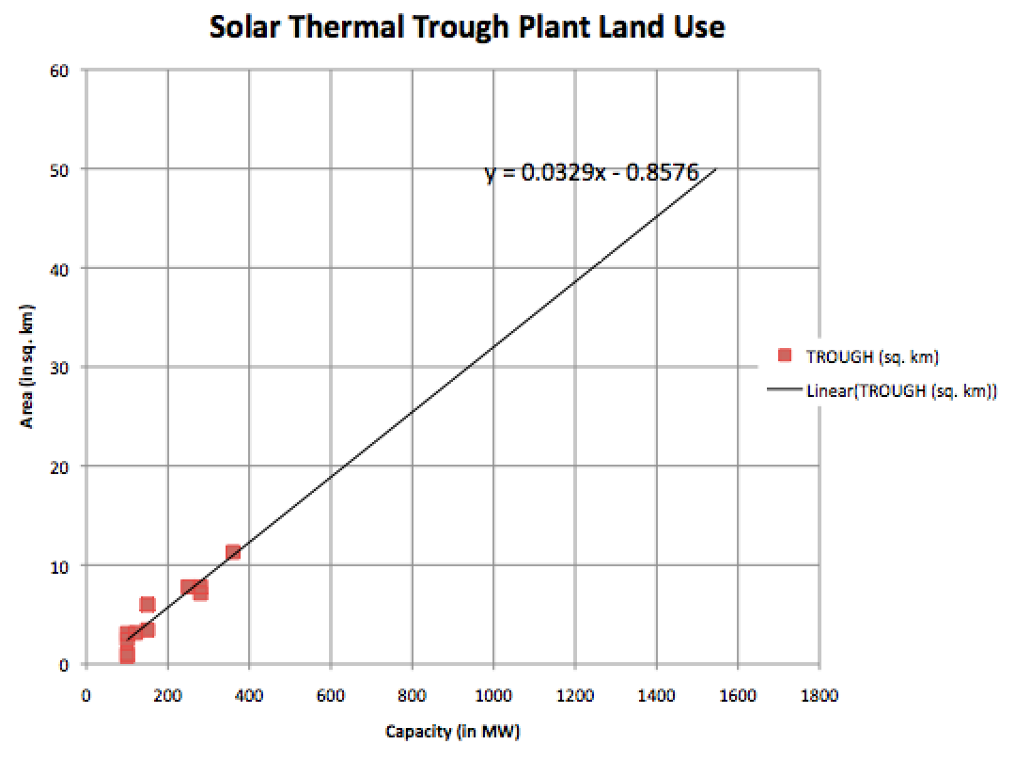
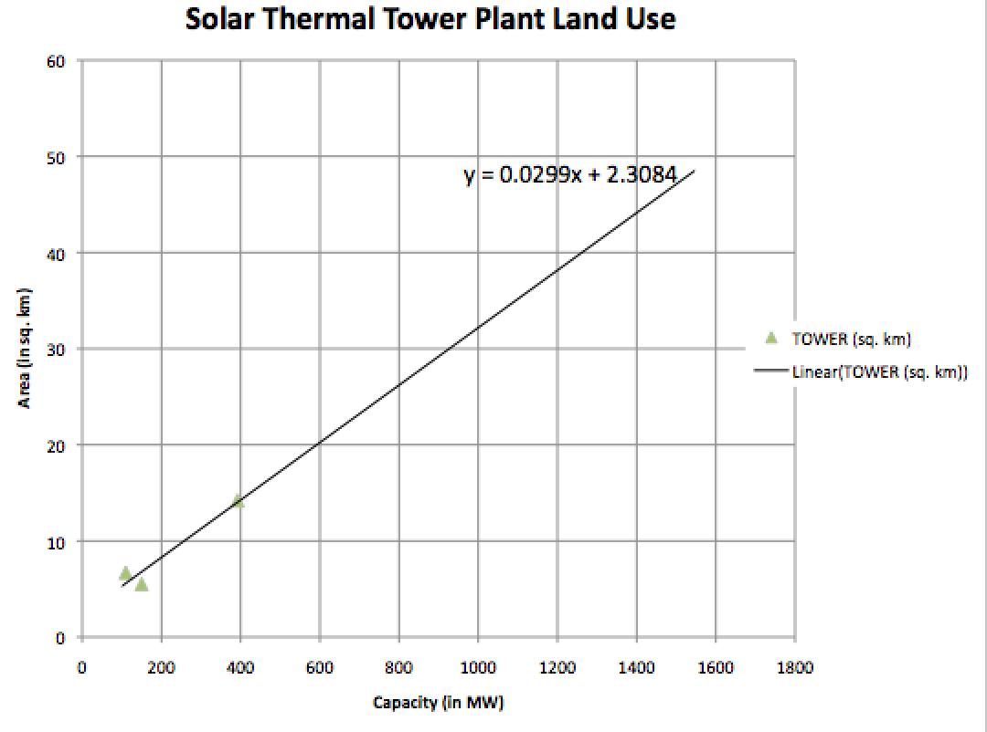
OK, but what about Solar Thermal's land use?
Drawing data from the above Solar Thermal & Solar PV tables:
The land use of Solar Thermal Power Plants
is virtually identical to that of Solar PV Power Plants
An Introduction to Sustainable Energy Systems: WeCanFigureThisOut.org/ENERGY/Energy_home.htm

Slide 38
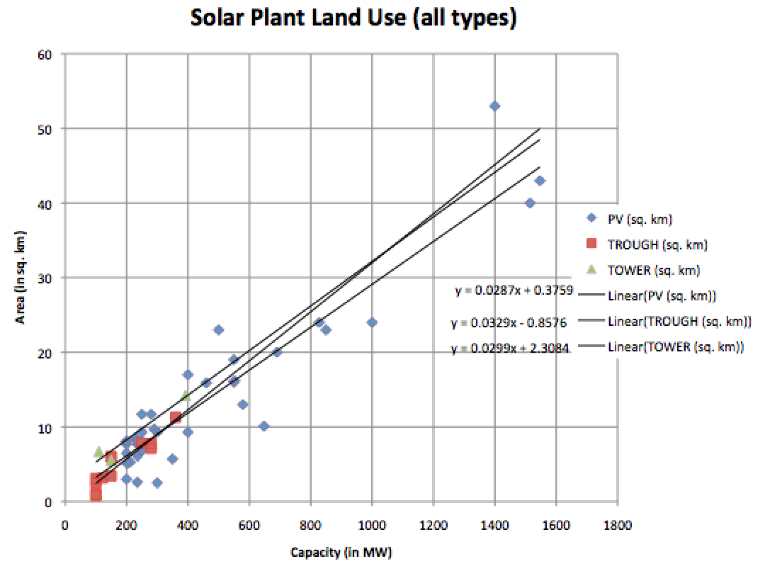
A cross comparison of land use for all solar technologies
Solar PV:
0.029 km² / MW
=> 34 Watts / m²
Thermal Troughs:
0.033 km² / MW
=> 30 Watts / m²
Thermal Towers:
0.030 km² / MW
=> 33 Watts / m²
Effectively for all: Land use ~ 0.03 km² / MW => Capacity of ~ 30 Watts / m²
An Introduction to Sustainable Energy Systems: WeCanFigureThisOut.org/ENERGY/Energy_home.htm

Slide 39
That comparison required some arbitration between data sources:
Mostly having to do with misunderstandings about the difference between:
Site area vs. Area occupied by collectors/reflectors vs. Total collector/reflector area
For instance, a trade magazine reported that the 100 MW Kaxu Solar Plant was:
"constructed on a 1,100 hectare site" (11 km²) ¹
Which was the same area cited by Wikipedia ²
While a second trade magazine clarified matters by reporting that
"project facilities have a footprint of approximately 310 hectare (3.1km²) on a 1,100 hectare (11 km²) site" ³
Or for the 100 MW Kathu Solar plant site, where you can just take your pick:
Wikipedia reported the area as 0.8 km² (unconfirmed in any of their cited sources) ⁴
While a trade magazine (not even specifying sources) reported that:
"Kathu Solar Park stretches over 4.5 square kilometers of a 10 km² site" ⁵
1) https://www.power-technology.com/projects/kaxu-solar-one-northern-cape/
2) https://en.wikipedia.org/wiki/KaXu_Solar_One
3) https://www.renewable-technology.com/projects/kaxu-solar-one-pofadder-northern-cape/
4) https://en.wikipedia.org/wiki/Kathu_Solar_Park
5) https://www.powermag.com/solar-baseload-in-the-kalahari-kathu-solar-park/

Slide 40
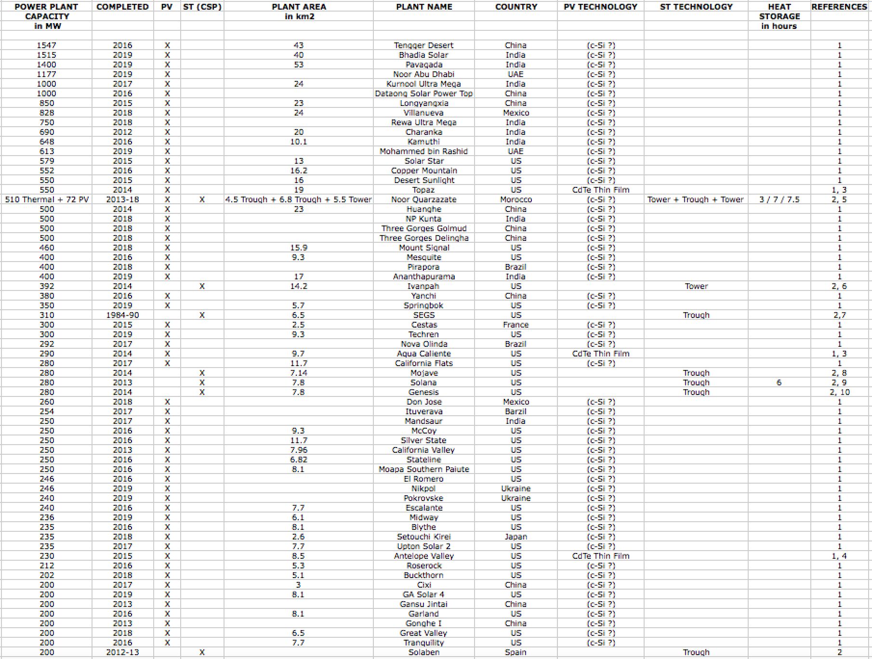
Finally: MY table of All Solar Power Plants (≥ 200 MW) - Sorted by capacity:

Slide 41
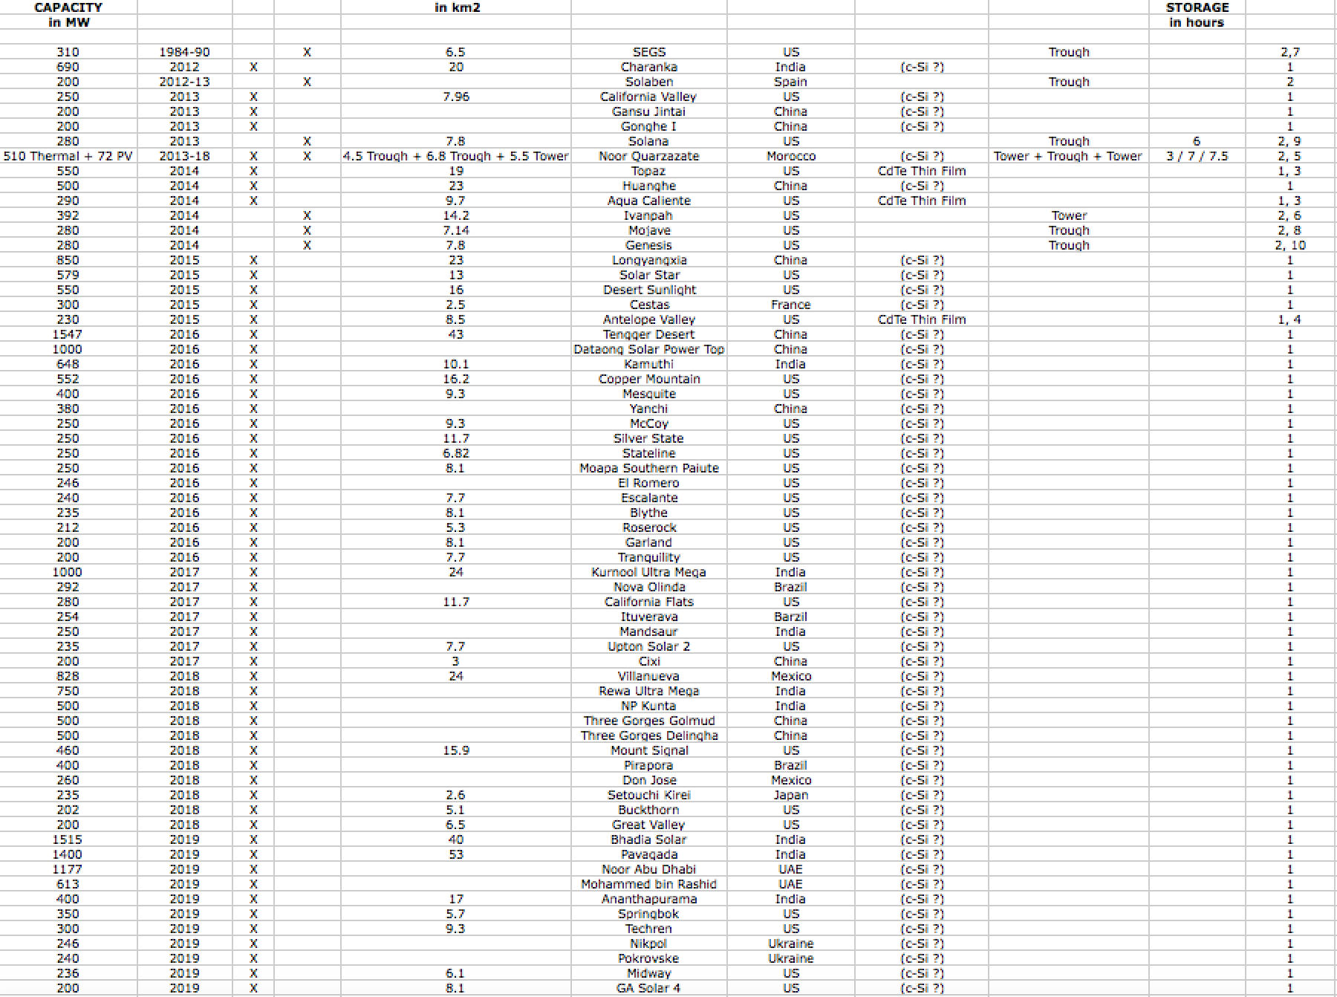
Or Sorted by date:
BUILT SINCE 2014: Solar PV ONLY

Slide 42
Final sort seems to throw "cold water" on my heat storage discussion:
In that Solar Thermal Plants,
which are the only type of Solar Plants capable of Heat Storage
(and thus capable of non-daylight electrical power generation)
seem to have now fallen distinctly out of favor!
The likely explanation?
Massive energy storage is required when wind + solar level reaches ~ 20%
That level may have been reached in Morocco due to Noor Quarzazate
But in larger / heavily developed countries that level has not been reached
E.G., the U.S.'s present day wind + solar level is less than 9%
Thereby relieved of the need for immediate action it appears that
in "developed" countries heads are still buried firmly in the ground
An Introduction to Sustainable Energy Systems: WeCanFigureThisOut.org/ENERGY/Energy_home.htm

Slide 43
Solar Thermal TAKEAWAYS - As Suggested by Utility Scale Plants:
In contrast to Utility Scale PV plants,
Solar Thermal Plants are still small / smallish
With only Noor Quarzazate achieving "typical" power plant capacity
The number of Solar Thermal plants is also comparatively small
For plants ≥ 200 MW: 7 Solar Thermal Plants vs. 57 Solar PV Plants
Most Solar Thermal Plants now employ parabolic trough reflectors
rather than fields of "heliostat" mirrors directing sunlight at solar towers
But Solar Thermal Plants are the only substantially sized "green" power plants
to achieve sustained post-daylight power production
And surprisingly, this capability (achieved via superheated liquid storage)
has been incorporated in over half of these nominally "first generation" plants
Including the very largest of these plants
Including BOTH distributed trough and central tower plants

Slide 44
A key TAKEAWAY about ALL Solar Power:
Heavy reliance on solar power will require huge land areas
In my earliest note set: Power Plant Requirements: Land and Water (pptx / pdf / key)
I estimated the minimum land area required for ANY single power technology
to meet 100% of the U.S.'s present day electricity demand
(which requires about 1 TW of power plant capacity)
For Solar PV I based my estimate upon only PV cell efficiency
For Solar Thermal I used early power production data from the Ivanpah CA plant
For both technologies I ended up assuming ~ cloud free high desert plant locations
I concluded that full U.S. power would require:
At least 20,000 km² of solar cells (equivalent to ALL of New Jersey)
Or ~ 100,000 km² of solar thermal fields (equivalent to ALL of Virginia)
An Introduction to Sustainable Energy Systems: WeCanFigureThisOut.org/ENERGY/Energy_home.htm

Slide 45
Utility Plant information now facilitates a much more solid estimate:
From that real-life power plant operational experience,
for BOTH Solar PV and Solar Thermal Power Plants
I now calculate land use of ~ 0.03 km² / MW of plant capacity
Multiplying that by the total required U.S. capacity of ~ 1 TW:
0.03 km² / MW x 1 TW = 0.03 km² / MW x 1,000,000 MW = 30,000 km²
which falls between my much earlier Solar PV & Solar Thermal estimates
and is roughly equivalent to every single square inch of Maryland ¹
But given Maryland's non-high-desert non-cloud-free weather
built on the East Coast, you'd instead need at least two Marylands
or, for instance, every single square inch of West Virginia ²
1) See Wikipedia's webpage on the sizes of U.S. states:
https://en.wikipedia.org/wiki/List_of_U.S._states_and_territories_by_area
An Introduction to Sustainable Energy Systems: WeCanFigureThisOut.org/ENERGY/Energy_home.htm

Slide 46
Credits / Acknowledgements
Some materials used in this class were developed under a National Science Foundation "Research Initiation Grant in Engineering Education" (RIGEE).
Other materials, including the WeCanFigureThisOut.org "Virtual Lab" science education website, were developed under even earlier NSF "Course, Curriculum and Laboratory Improvement" (CCLI) and "Nanoscience Undergraduate Education" (NUE) awards.
This set of notes was authored by John C. Bean who also created all figures not explicitly credited above.
Copyright John C. Bean
(However, permission is granted for use by individual instructors in non-profit academic institutions)
An Introduction to Sustainable Energy Systems: WeCanFigureThisOut.org/ENERGY/Energy_home.htm

