Slide 1
Solar Thermal Power / Heat Storage
John C. Bean
Outline
Appearance to the contrary, Solar Thermal IS just another way of boiling power plant water
Variations on Solar Thermal's essential light concentrator: Parabolic Mirrors
Concentrators' need for direct / unscattered sunlight => Mandatory use of desert locations
Novel / Non-Commercial Solar Thermal Schemes:
Updraft & Downdraft Wind Chimneys
Dish-Stirling Engine Plants
Mainstream / Commercial (albeit subsidized) Solar Thermal Plants:
Solar Towers / Power Towers / Central Receivers (three names for the same thing)
Parabolic Troughs
Linear Fresnel Reflectors
Including discussion of Receivers & Heat Transfer Fluids for all of the above
How heat storage might make Solar Thermal the first truly 24/7 green energy source
Ending its distinctly non-green marriage-of-convenience with Natural Gas power
While eliminating one of the two biggest hurdles to building a Green Grid
Solar Thermal's use of diminishing desert water supplies & its impact upon birds
(Written / Revised: November 2019)

Slide 2
Solar Thermal Power & Heat Storage
First, a necessary digression:
There are concentrated forms of Solar Photovoltaic Power ¹
And this note set includes un-concentrated forms of Solar Thermal Power
But as inaccurate and misleading as it may be, Solar Thermal Power
is often given the blanket label of Concentrated Solar Power (CSP),
especially by people in (or associated with) its industrial application
Why? Because outside of research labs & prototype development projects,
industrial Solar Thermal Power IS still ~ 100% concentrated
while industrial Photovoltaic Power IS still ~ 0% concentrated
Nevertheless, for accuracy and clarity, I'll stick with the term Solar Thermal Power
(despite the widespread use of "CSP" and dozens of other cryptic acronyms)
1) See my notes set: Tomorrow's Solar Cells (pptx / pdf / key)

Slide 3
A very incomplete list Solar Thermal acronyms / terms :
ARC Anti-Reflection Coating
CPC Compound Parabolic Concentrator
CRS Central Receiver System
CSP Concentrating Solar Power
CSTP Concentrated Solar Thermal Power
DCS Distributed Receiver Systems
DE (Parabolic) Dish + Engine (System)
DNI Direct Normal Incidence
DOE (U.S.) Department of Energy
DSG Direct Steam Generation
EIA (U.S.) Energy Information Agency
FOM Figure of Merit
FR Fresnel Reflector
HTF Heat Transfer Fluid
IR Infrared
ISCCS Integrated Solar Combined Cycle System
LCOE Levelized Cost of Energy
LEC Levelized Electricity Cost
LFC Linear Fresnel Collector
LFR Linear Fresnel Reflector
NREL (U.S.) National Renewable Energy Lab
PCM Phase Change Material
PT Parabolic Trough
PT Power Tower
PTC Parabolic Trough Collector
PTR Parabolic Trough Reflector
SD Solar Dish
ST Solar Tower
STE Solar Thermal Energy
STEG Solar Thermoelectric Generators
STPV Solar Thermophotovoltaic
STP Solar Thermal Power
TCS Thermochemical Energy Storage
TES Thermal Energy Storage
TPV Thermophotovoltaic
Colors highlight acronyms / terms that are redundant (or virtually redundant)
An Introduction to Sustainable Energy Systems: WeCanFigureThisOut.org/ENERGY/Energy_home.htm

Slide 4
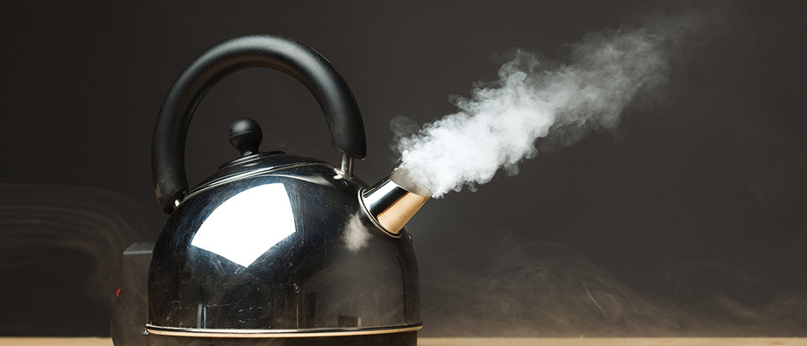
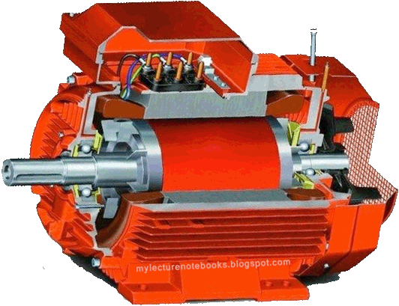
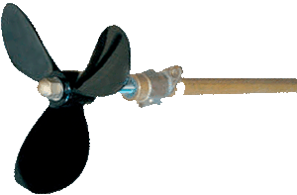
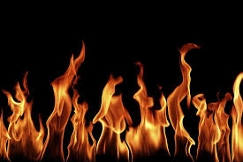
Solar Thermal Power Plants look very different than other power plants
But functionally, they are almost identical to fossil fuel, biofuel & nuclear power plants ¹
All of which include (working backwards):
4) Electrical Generators driven by
3) Propellers (in complex versions known as "turbines") which are propelled by
2) Steam rushing out of water-filled Boilers due to the presence of a
1) Heat Source - Which is the only thing really differing between these plants
The generators, turbines & boilers are virtually (if not completely) identical!
(2)
(3)
(4)
(1)
1) See my note set about Generic Power Plants (pptx / pdf / key)

Slide 5
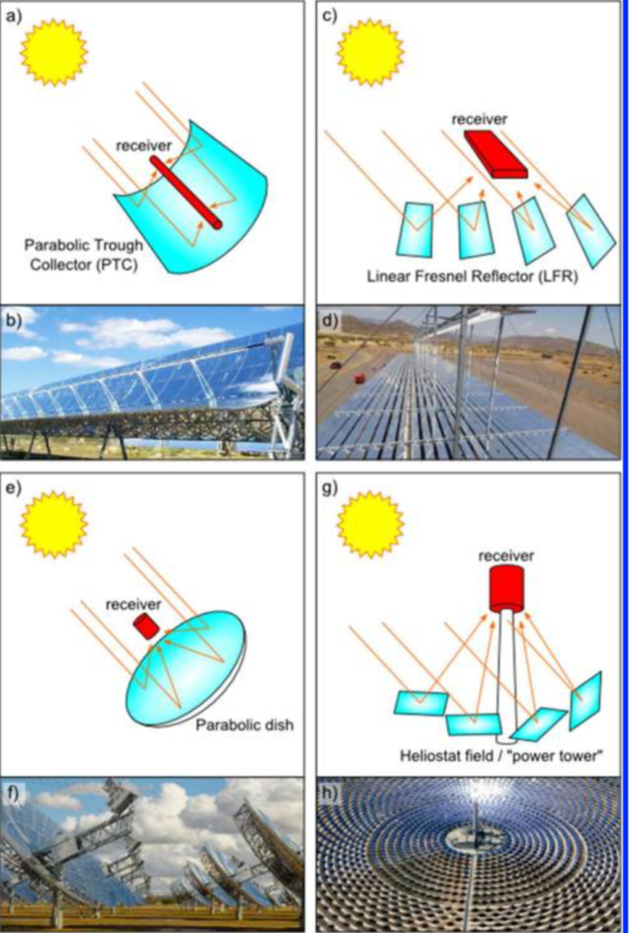
For their heat Solar Thermal plants require mirrors (and sometimes smoke ¹)
Parabolic mirrors focus light from ONE direction
The sun in our sky appears quite small, so its light
is almost ideally focused by such mirrors
These mirrors can be 2D "parabolas" (top figures)
Or 3D "paraboloids" (bottom figures)
They can be a single continuously curved shape (left)
Or divided into separate almost-flat facets (right)
Solar Thermal plants use all four combinations
But for now, the key point is that . . .
1) Many of today's solar thermal plants must be kick-started every morning by burning natural gas
(as discussed later in this note set)
Figure: Concentrating Solar Power, Weinstein et al., Chemical Reviews 115, pp. 12797-12838 (2015)

Slide 6
Without such focusing (concentration) sunlight cannot boil water!
Which would eliminate the possibility of steam-generated Solar Thermal Power
But concentration has a very significant downside:
While photovoltaic solar cells also use sunlight coming directly from the sun,
they can simultaneously absorb scattered sunlight coming from elsewhere
(such as that from thin clouds, haze, or even clear blue sky)
In contrast, parabolic mirrors collect light from ONLY ONE DIRECTION
effectively ignoring sunlight scattered from across the sky
That scattered sunlight, while generally weaker than direct sunlight,
nevertheless delivers a good fraction of the sun's energy to the earth's surface
This fraction of solar power is lost to concentrating solar thermal power plants
Which are therefore built in locations where sunlight scattering is minimal

Slide 7
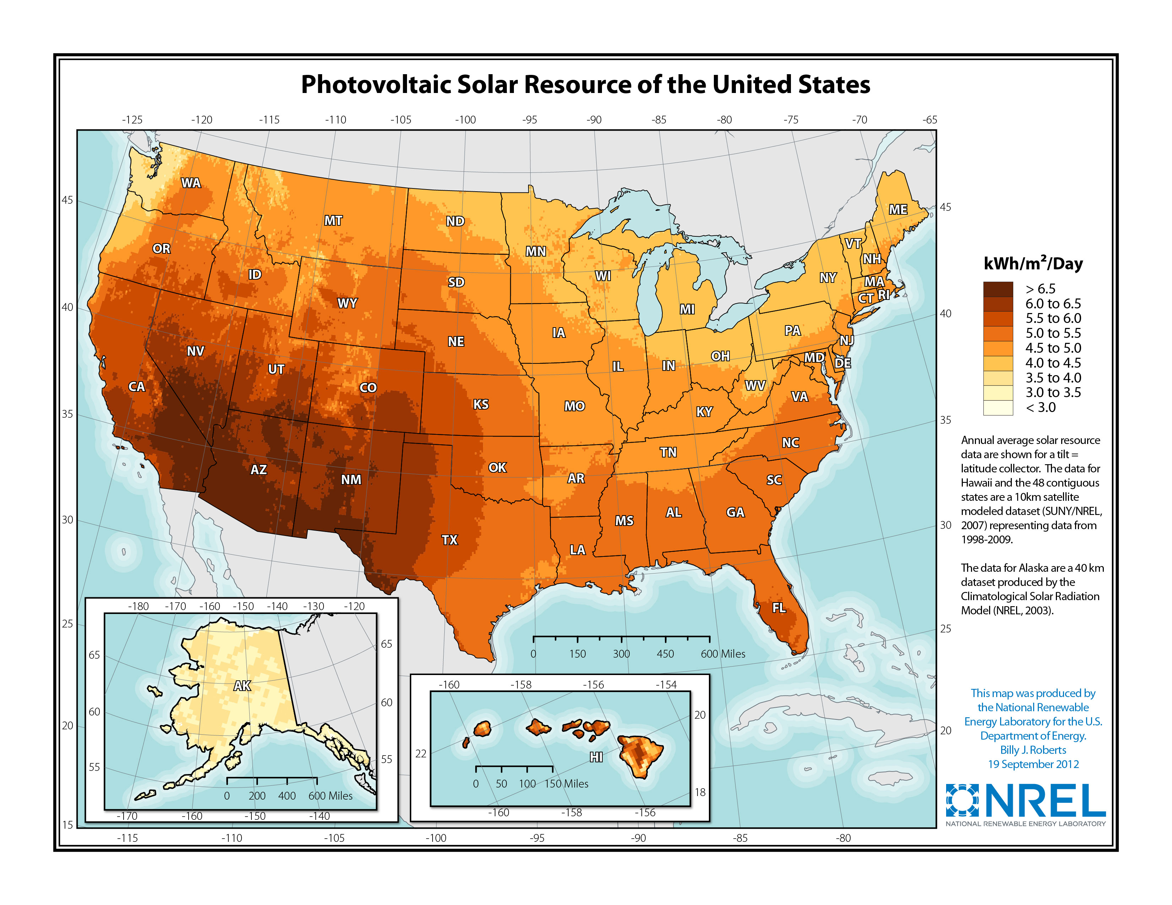
TOTAL Average Daily Solar Energy Incident Upon the U.S.:
This daily and annually averaged solar "insolation" from all sky directions is:
Weak in New England and the upper Midwest
Medium in South and lower Midwest
High in the West
Very High across the Southwest
Figure: https://www.nrel.gov/gis/images/eere_pv/national_photovoltaic_2012-01.jpg

Slide 8
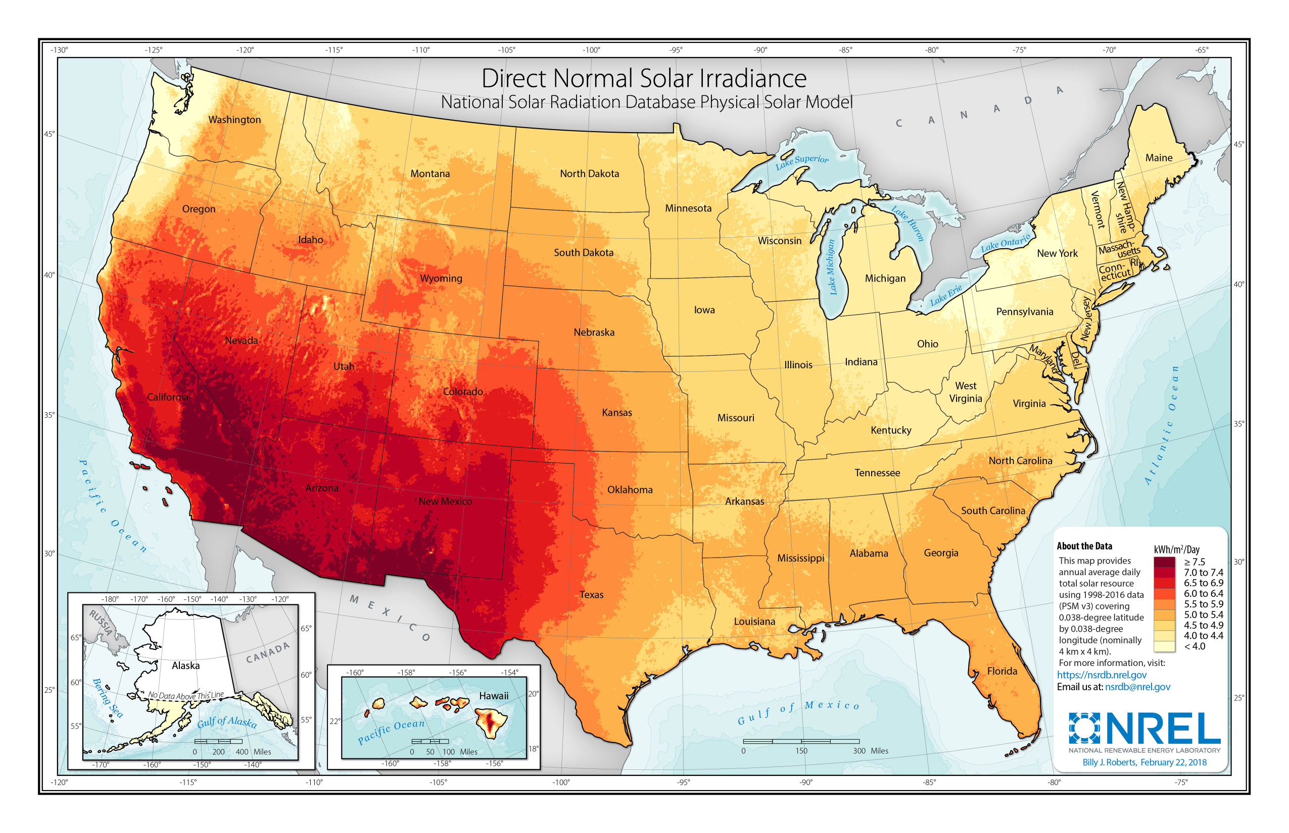
Vs. DIRECT Average Daily Solar Energy Incident Upon the U.S.:
NOTE: While very similar to the color coding of the previous map, the coding here is NOT identical
Daily and annually averaged solar insolation coming straight from the sun is:
Very Weak in New England and almost all of the Midwest
Weak in the South
Medium in the West
Highest by far in the deserts of New Mexico, Arizona, S Nevada, SE California
Figure: https://www.nrel.gov/gis/assets/pdfs/solar_dni_2018_01.pdf

Slide 9
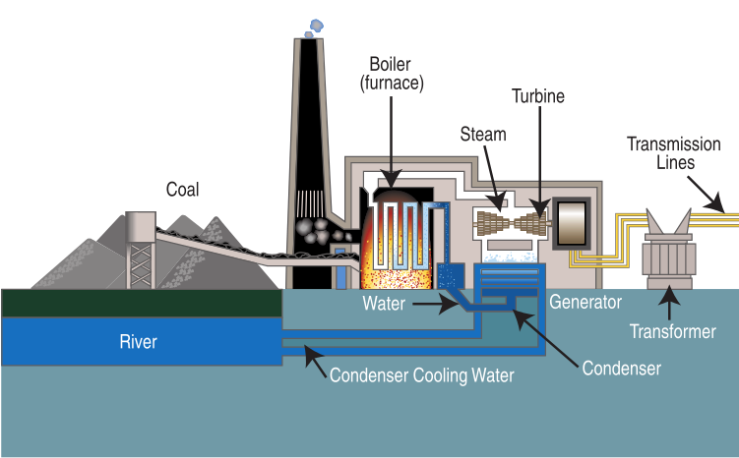
Solar Thermal Plants are built only in such near-ideal desert locations
And even there, today's complex Solar Thermal Plants must still be subsidized
In contrast, Solar PV is already cost-effective, even in less than ideal sunlight
And by locating some Solar Photovoltaic plants near our metropolitan areas
we postpone upgrading our long-distance power transmission grid
But way out in those dry deserts, Solar Thermal plants ARE STILL steam plants
ALL steam plants recycle the steam's water by cooling and re-condensing it
But WATER generally supplies that cooling
Often a LOT of water, such as a river or lake
Desert Solar Thermal Energy will thrive
ONLY if such water use is eliminated
(As discussed near the end of this note set)
Figure from my note on Fossil Fuel Power plants (pptx / pdf / key)
Source: http://en.wikipedia.org/wiki/Fossil-fuel_power_station

Slide 10
Ways of Concentrating and/or Collecting Solar Thermal Energy
An Introduction to Sustainable Energy Systems: WeCanFigureThisOut.org/ENERGY/Energy_home.htm

Slide 11
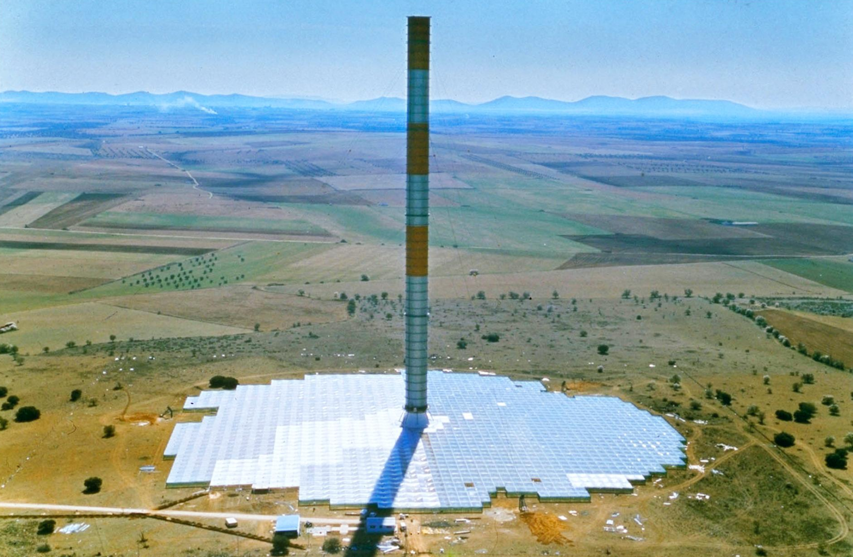
Let's first take a look at several novel schemes:
The first two schemes would reduce or even eliminate solar concentration
How? By eliminating the use of steam in favor of
the natural convection of heated (or cooled) masses of air
Solar Chimney / Thermal Updraft Tower plants have much smaller concentrators ¹⁻³
As seen in this early prototype built in Manzanares, Spain: ²
1) Wikipedia - Solar Updraft Tower - https://en.wikipedia.org/wiki/Solar_updraft_tower
2) Solar Chimneys Can Convert Hot Air to Energy - But Is Funding a Mirage?, T.K. Grose, National Geographic, April 2014
3) A Review of Solar Chimney Power Generation Technology, A. Dhahri & A. Omri, Int. J .Eng. & Adv. Tech. 2(3), pp. 1-17 (2013)

Slide 12
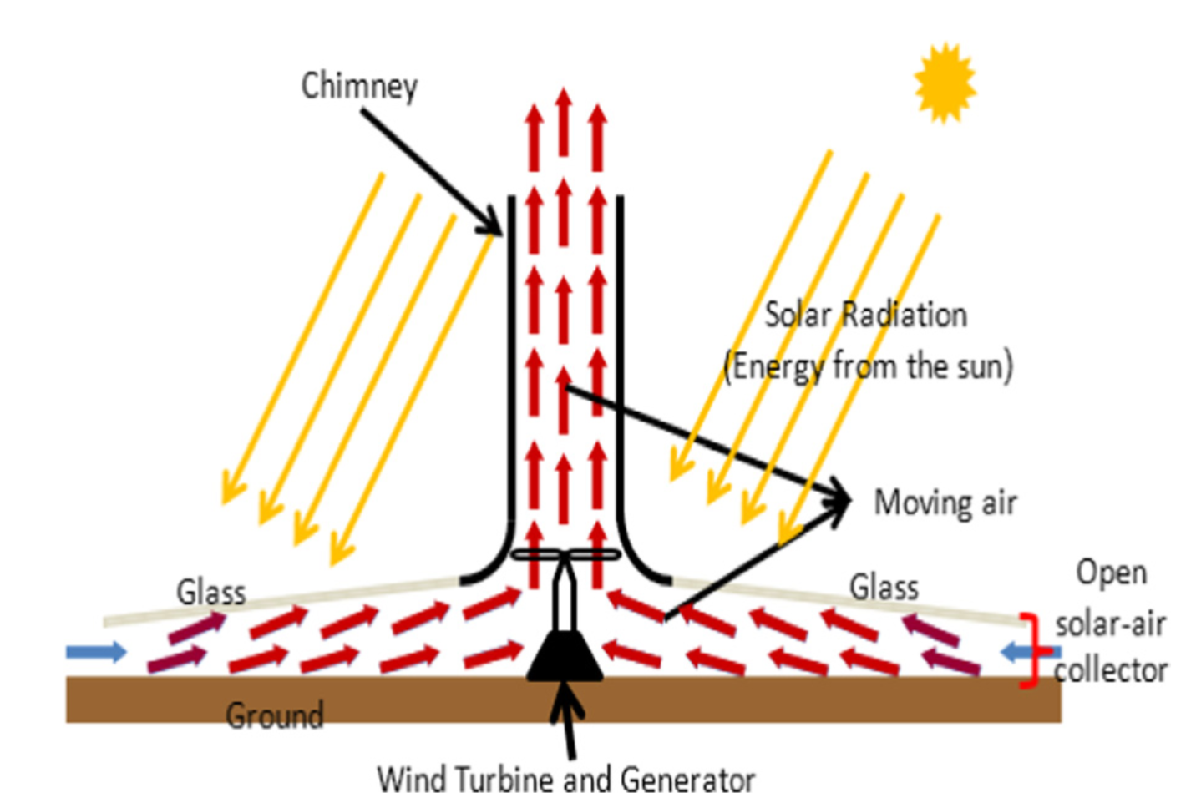
They heat air below a greenhouse-like transparent canopy
That heated air's lower density causes it to rise along the canopy's sloping roof
until it reaches, and rapidly accelerates up, the central chimney
which incorporates a large Wind Turbine Generator in its base
1) Historic and Recent Progress in Solar Chimney Power Plant Enhancing Technologies, Al-Kayiem et al., Renewable and Sustainable Energy Reviews 58, pp. 1269-92 (2016)
From 195 meter Manzanares chimney successfully produced up to 50 kW of power ^{1,2}
But cost-cutting on the prototype (e.g., thin 1.25 mm rust-susceptible iron walls)
weakened the tower, leading to its destruction in a 1989 wind storm
Other prototypes have been built or planned in China, Australia, Africa & Spain
But a full-scale commercial version has yet to be funded and built
2) A Review of Solar Chimney Power Generation Technology, A. Dhahri & A. Omri, Int. J .Eng. & Adv. Tech. 2(3), pp. 1-17 (2013)

Slide 13
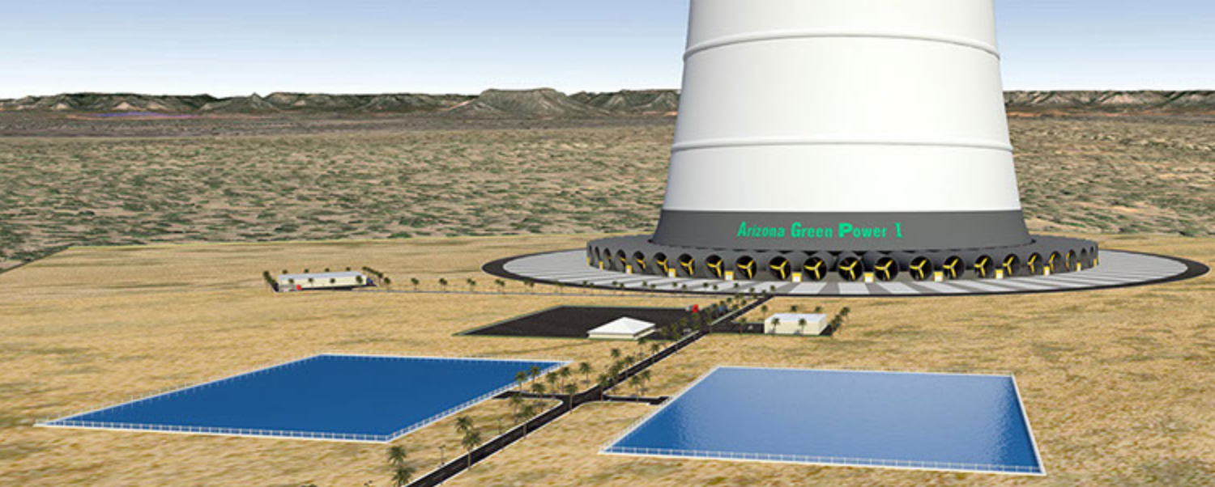
Concentration is eliminated & air flow reversed in a second scheme:
Proposed at Israel's Technion U. ^{1,2} & promoted by Solar Wind Energy Tower Inc, ³
this as-yet-untested scheme has no canopy or collector of any sort
Further, the only solar heating involved is that of naturally solar-heated desert air
But in that desert, a 1 km tall chimney would be built, and at its top opening
water would be sprayed inward (even salty nearby Mediterranean water)
to cool and densify that desert air causing it to fall DOWN the chimney
which would have many small wind turbine generators around its base
Artist's conception ³
1) Energy Tower (Downdraft) - Wikipedia (and references therein)
2) Solar Thermal Power Technologies - B.J. Groenendaal, VLEEM Project,2002
3) http://www.solarwindenergytower.com/the-tower.html

Slide 14
According to its proponents, such a Downdraft Chimney / Tower:
Would require so little surrounding desert that, for the same power output,
its installation would be much smaller than other forms of Solar Thermal Power
Indeed, the claimed footprint would rival that of fossil-fuel power plants
allowing for the possibility of closely spaced farms of such towers
Further (apparently in unpublished conference presentations) it was suggested that
seawater de-salinization could become an integral part of such farms
My best guess as to how: Saltwater spray at the tower's top would partially evaporate,
producing falling salt-enriched droplets + cooled downdraft air + water vapor
At the tower's base salt-enriched droplets would fall to the ground (into ponds?)
while air + water vapor passing through the turbines could continue outward
to where the water vapor could be condensed out of the air as pure water

Slide 15
Is this so called SNAP ¹ idea intriguing? Absolutely
But a huge number of questions have yet to be answered
Answers that will require construction and testing of a real-world prototype
Issues include:
Cost and survivability of 1 km tall chimneys in sandstorm-prone deserts?
Cost of continuously pumping seawater 1 km skyward?
Salt corrosion damage to inside of the chimney and turbines around its base?
Is power generation feasible only when it's combined with desalinization?
Or could power production alone justify construction of such plants?
1) SNeh Aero-electric Power ("Sneh" = Hebrew for ‘Burning Bush’ )

Slide 16
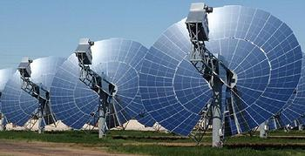
A final scheme is "novel" only in that it is not now used commercially
But ignoring certain bothersome practical & economic considerations, it is in fact the
gold standard against which other Solar Thermal technologies are compared
It is thus worth itemizing its scientific and technological strengths,
while identifying shortcomings that have thus far blocked its commercialization
The technology in question? Solar Thermal Power based on Paraboloid Dishes
Less pedantically called Parabolic Dishes
Or even more frequently, just Dishes
Photo used in article about the proposed (but since shelved) Calico California solar project
"Mirrored Solar Dishes to March Across California Desert"
http://www.ens-newswire.com/ens/oct2010/2010-10-20-091.html

Slide 17
As noted above, "paraboloid" mirrors have the ideal light-gathering shape
Lenses can also focus light, but they are subject to chromatic aberration
Which means that they bend different colors into slightly different directions
Instead, mirrors bounce all colors identically, yielding a sharper (more intense) focus
Further, while a large paraboloid mirror can be fully supported from behind,
lenses must be supported at only their edges, causing large and heavy
lenses to flex, distorting their shape, or even breaking those edges
Which explains why all large optical telescopes use mirrors
Solar Thermal Dishes focus sunlight so well that it is concentrated by ~ 1000 X
Which can heat fluids to 1200°C ^{1, 2}
1200°C is BRIGHT WHITE HOT
Way hotter than required to boil water!
1) Concentrating Solar Power, Weinstein et al., Chemical Reviews 115, pp. 12797-12838 (2015)
2) Concentrating Solar Power, Solar Energy Industries Association

Slide 18
That heat could be collected and pumped away - for use elsewhere
At the dish's focal point you'd install a Receiver filled with Heat Transfer Fluid ¹⁻³
The fluid would then transfer heat to remote steam-turbine generators
Those Heat Transfer Fluids would have to:
Carry a lot of heat energy per volume (have a "high heat capacity")
Pump easily (have "low viscosity")
Withstand the intense midday temperatures of Solar Thermal concentrators
But not solidify (or become un-pumpable) after things cool down overnight
MOST Solar Thermal Plants DO use Heat Transfer Fluids which include:
Synthetic oils, molten salts, highly compressed gases,
ceramic powders or sand suspended (or falling through) gases,
and perhaps in the future: specially engineered nanoparticles
1) Concentrating Solar Power, Weinstein et al., Chemical Reviews 115, pp. 12797-12838 (2015)
2) Heat Transfer Fluids for Concentrating Solar Power Systems – A review, Vignarooban et al., Applied Energy 146, pp. 383-96 (2015)
3) Advanced Heat Transfer Fluids for Direct Molten Salt Line-Focusing CSP Plants, Bonk et al., Progress in Energy & Combustion Science 67, pp. 69-87 (2018)

Slide 19
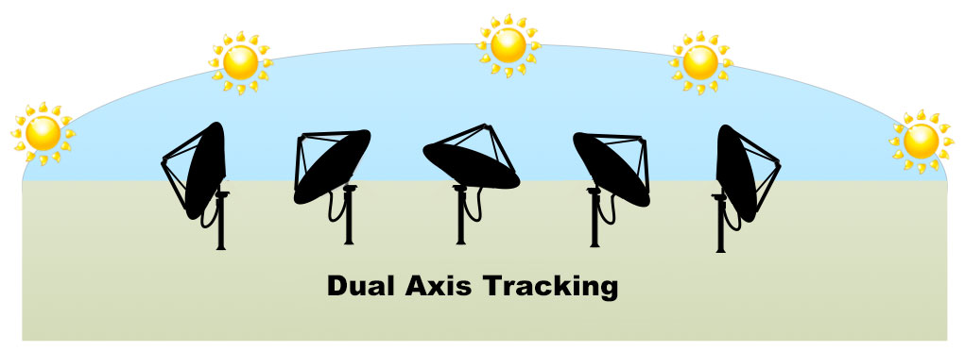
But heat transfer fluids don't work well for Dishes:
ALL Solar Thermal concentrators must track the sun across the sky
But the focus of a Dish is particularly sharp and precise (which is its strength!)
and a heat-absorbing Receiver must be to be locked into that focal point
That would require the Dish and Receiver to be built into a carefully aligned assembly
which would then pivot as a single unit as it tracked the sun
Figure: http://www.solartronenergy.com/solar-concentrator/how-does-a-solar-concentrator-work/
THE PROBLEM?
Getting 1200°C Heat Transfer Fluid out of that Receiver & down to the ground
so that it can be sent onward to boil water for a steam turbine generator

Slide 20
You can't just send 1200°C fluids through hoses!
Conventional rubber hoses would melt, and even silicone hoses would quickly fail
And while high-temperature metals pipes might survive, they would have to be
connected via swivel joints to allow for the mirror's two-axis sun tracking
(and deprived of rubber "O-rings" the joints would be very prone to leakage)
Dishes thus employ a COMPLETELY UNIQUE power generation scheme:
A weird thermal engine is placed in a Dish's focal point and coupled
to a small electrical generator, which sends electricity out a cable
This is all labeled Dish Engine (DE) Solar Thermal Power ^{1, 2}
For which the sun-tracking movement of the Dish + Engine + Generator Assembly
is accommodated by the Generator's flexible electrical output cable
1) Concentrating Solar Power, Weinstein et al., Chemical Reviews 115, pp. 12797-12838 (2015)
2) Solar Parabolic Dish Stirling Engine System Design, Simulation, and Thermal Analysis, Hafez et al., Energy Conversion & Management 126, pp. 60-75 (2016)

Slide 21
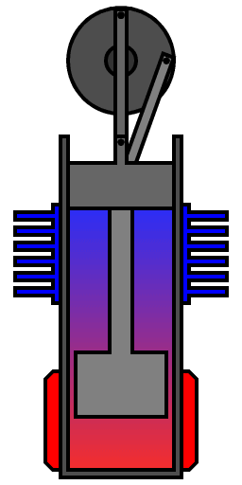
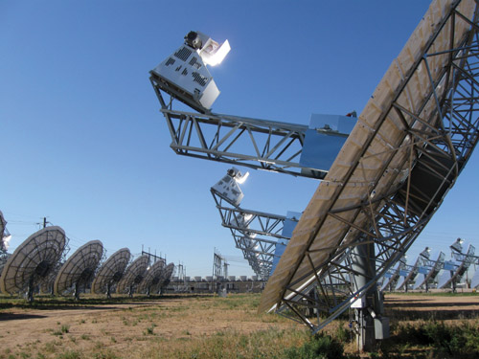
The weird engine? It's a "Beta-type Stirling Engine"
Coupling
Engine
Piston
Electrical
Generator
Displacer
The Stirling Engine is a sealed and self-contained unit that is filled with a gas
It has no incoming fuel lines nor outgoing exhaust ports
Its input energy comes ONLY from sunlight focused on the outside of its HOT end
Inside are a very loosely fitting displacer and tightly fitting piston
Pressure differences across the displacer try to push it up or down
But the displacer is also coupled to the upper tightly-fitting piston
The displacer is thus moved by BOTH pressure differences AND by the piston
Left / Center figure from : http://electricalacademia.com/renewable-energy/solar-concentrators-types-applications/

Slide 22
Setting this Stirling Engine in motion:
Heated gas below the displacer expands, driving the displacer upward
But now expanding, that gas in the lower chamber begins to cool
It also leaks around the loosely fitting displacer into the upper chamber
As the displacer rises, the coupling also lifts the piston
While gas continues to leak around the displacer
The displacer reaches the top of its travel but the coupling drives the piston higher
This expands the upper chamber, causing its gas to cool,
The engine's COOL walls also cool the gas, which then rapidly contracts
This sucks the piston sharply downward
which, through the coupling, also sends the displacer downward
Completing a cycle that will now repeat as long as heat is applied
PgDn starts the animation (now, hopefully, at least somewhat plausible)
HEAT
The animation is from Wikipedia's "Stirling Engine" webpage The animator is credited as: "YKTimes"
See also: Single Cylinder Stirling Engine, Animated Engines.com

Slide 23
Solar Thermal power plants are ALL examples of thermal engines
As discussed in my note set about Generic Power Plants (pptx / pdf / key),
thermal engines cycle a fluid through temperature to do some sort of work
The idealized "Carnot Cycle" predicts the maximum efficiency of a heat engine:
Work Energy Out / Heat Energy In = Δ Temperature / (Highest Temperature)
For a Dish Engine, the relevant temperatures are those of the engine's ends:
The Stirling Engine's hot end is at 1200°C (1473°K)
And I'll guess that the cold end might not rise above 200°C (473°K)
With those temperatures, the Carnot Cycle model predicts:
Max Dish-Engine Efficiency = 1000°K / 1473°K = 0.67 = 67%
Real-world D-E efficiencies are ~ 29-32% ¹ (demonstrating the Carnot Model's weakness)
By achieving the highest temperatures of ANY Solar Thermal Technology
Dish Engines achieve the field's highest power conversion efficiencies
1) For details see Review, Dish & Stirling Engine papers linked from this note set's Resources webpage (link)

Slide 24
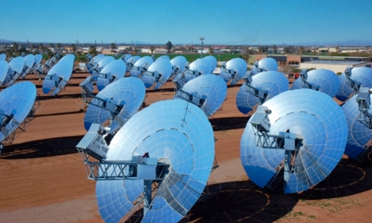
Disadvantages of Dish-Engine Solar Thermal Plants?
https://www.buildinggreen.com/news-article/stirling-suncatcher-heat-engine-technology
This photo hints at a few:
Erect Dish Engine assemblies are exceptionally susceptible to desert wind damage
The shape of DE units makes necessary cleaning of their mirrors particularly awkward
To avoid interference and facilitate cleaning scaffolds, Dishes must be very widely spaced
That, as evident in all the sunny ground above, wastes a lot of solar energy
The uniqueness of Solar Dishes & Stirling Engines eliminates economies of scale
This contrasts with most other Solar Thermal Schemes which make heavy use of
standard or semi-standard heat-exchangers, steam-turbines and generators
For these (and other) reasons, Dish Engines have fallen out of commercial favor

Slide 25
Solar Towers
Power Towers
Central Receivers
(three names for the same thing)
An Introduction to Sustainable Energy Systems: WeCanFigureThisOut.org/ENERGY/Energy_home.htm

Slide 26
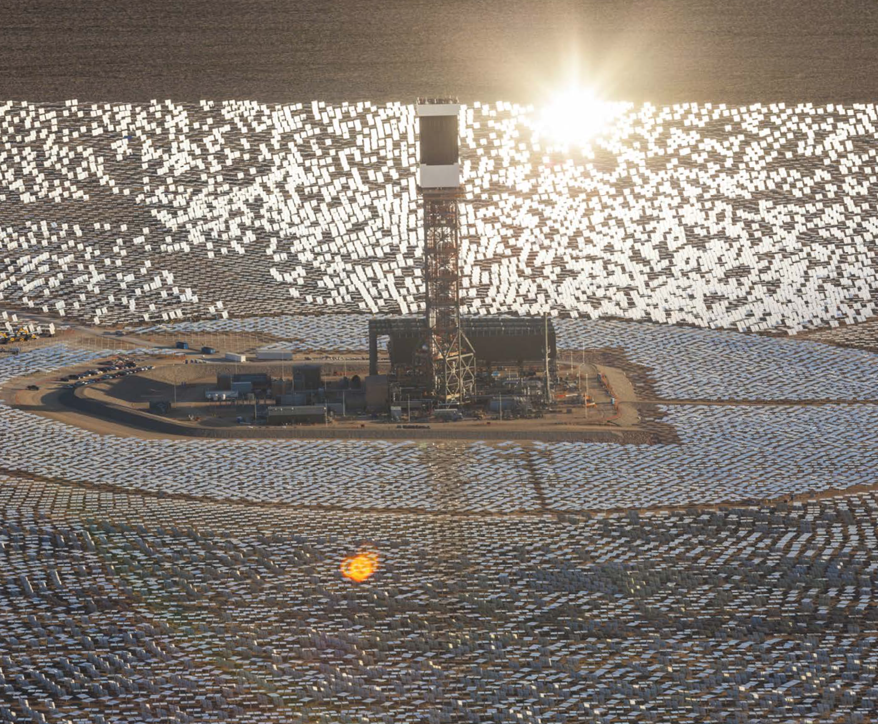
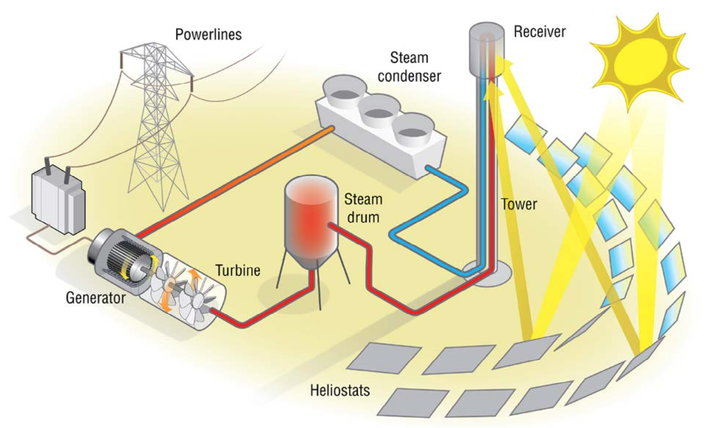
Only slightly less efficient than Dishes are Solar Towers
Which are also called Power Towers or Central Receiver Systems
Here as shown schematically & pictorially in the U.S. Department of Energy report:
2014 - Year of Concentrating Solar Power
An Introduction to Sustainable Energy Systems: WeCanFigureThisOut.org/ENERGY/Energy_home.htm

Slide 27
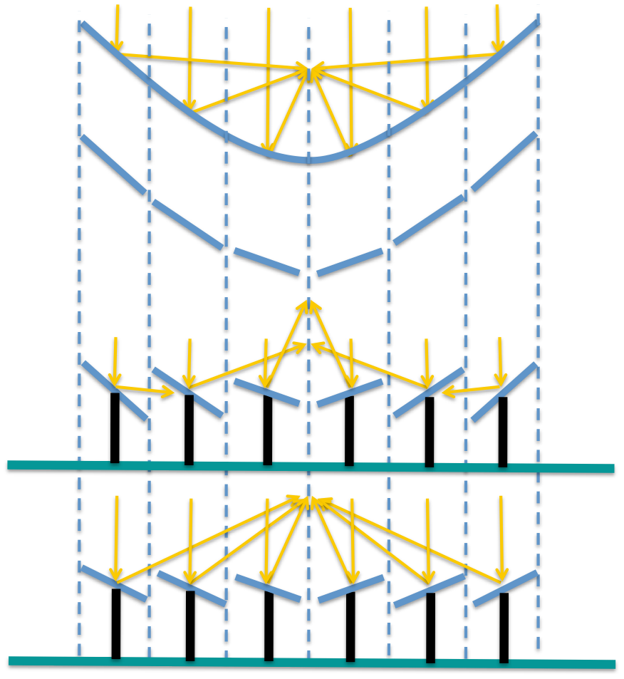
These concentrators are like cut-up and flattened Dishes:
Ideal continuous focusing parabolic mirror:
Approximation of it using flat mirror facets,
which are called Heliostats
Lower Heliostats to mount them atop poles
But they no longer focus the sunlight!
Tweaking their tilts to recover the focus:
An Introduction to Sustainable Energy Systems: WeCanFigureThisOut.org/ENERGY/Energy_home.htm

Slide 28
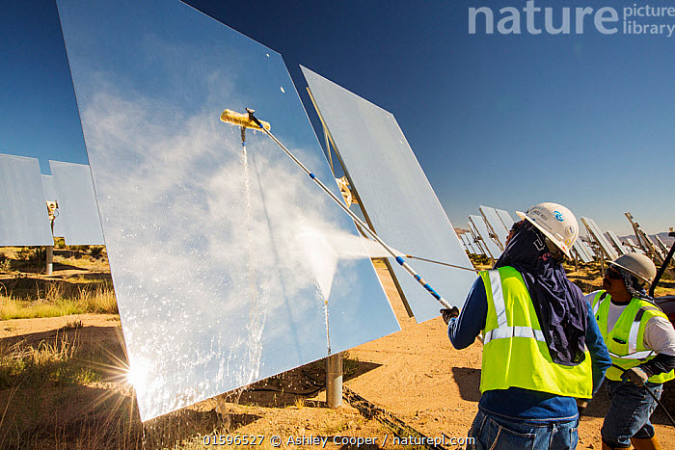
But this is done in 3D . . . using a WHOLE LOT of Heliostats
This concentrator, one of three at the Ivanpah California Solar Thermal plant,
uses almost 60,000 Heliostats (each actually consisting of a pair of mirrors) ¹
"2014 - Year of Concentrating Solar Power" - D.O.E.
www.naturepl.com/stock-photo-nature-image01596527.html
Not only must computers calculate the correct tilt for every single Heliostat,
but to adjust for the sun's motion tilts must be re-computed second-by-second,
with results used by two-axis tilting mechanisms at every single Heliostat:
[60,000] x [Celestial mechanics + Reflection geometry] x [Repeat every second]
Explaining why so many Heliostats seem to be MISALIGNED in DOE's photo on the left?
1) Ivanpah Solar Power Facility - Wikipedia

Slide 29
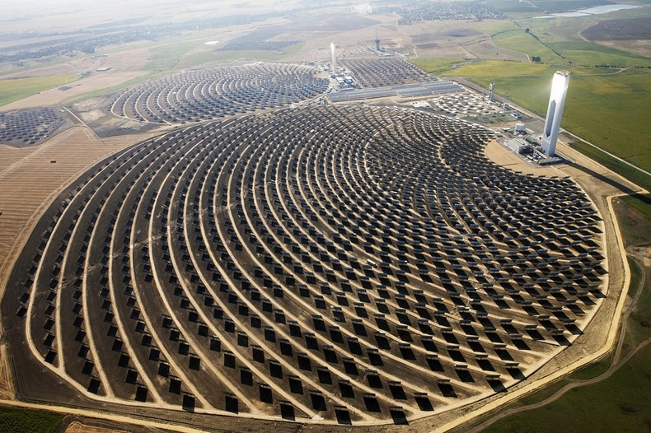
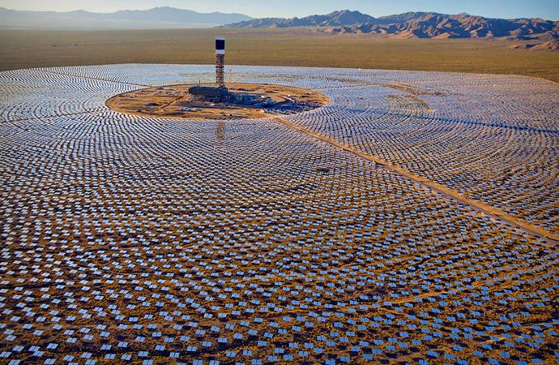
Which brings us to the Solar Tower itself
(also known as the Power Tower or Central Receiver)
These photos suggest that two very different strategies are being employed:
Spain's PS20 plant puts Solar Towers at the SIDE of its Heliostat fields
California's Ivanpah puts Solar Towers at the CENTER of its Heliostat fields
WHAT'S GOING ON?
Planta Solar 20 (PS20), near Seville Spain https://www.amusingplanet.com/2013/08/the-solar-power-towers-of-seville-spain.html
Ivanpah Solar Thermal Plant, Mojave Desert of California https://www.pinterest.com/pin/488992472012861561/

Slide 30
It's all about RETAINING power that Heliostats direct to the tower
Explanations require a bit of scientific review:
The hotter an object gets the more intensely it radiates away energy as light,
and that radiation also shifts towards higher energy colors
(i.e., towards shorter wavelengths such as blues & violets)
Scientist's call this black body behavior
For objects at different temperature they calculate curves such as those below
6000°K
Loss (area under a curve) increases as (object temperature)⁴
Curves peak at wavelength = 2896 μm / (object temperature)
these being "absolute temperatures" measured in °K
For details see my: Greenhouse Effect (pptx / pdf / key)
Light
Power
5000°K
4000°K
3000°K
100
500
1000
1500
2000
2500
Visible
Wavelength (nm)

Slide 31
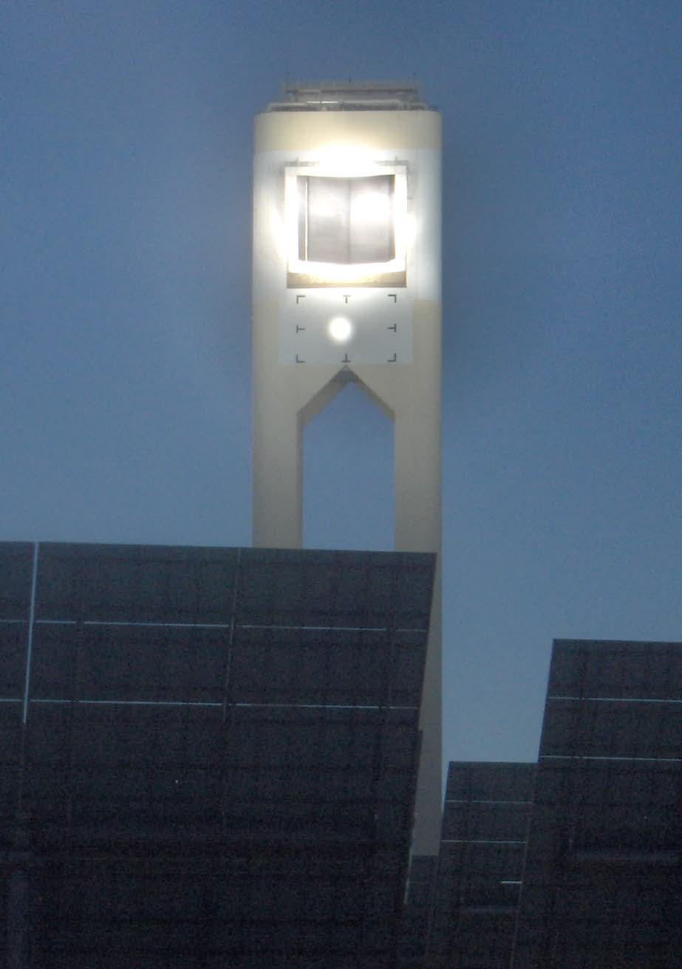
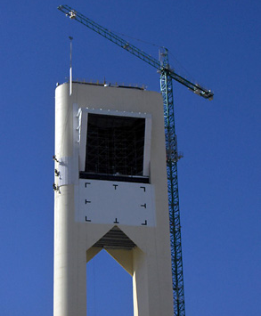
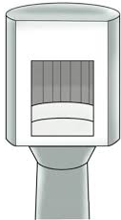
Side towers try to physically trap the sunlight's energy
Light beams pass through a single portal in the side tower, striking its inner surfaces
Those heat-absorbing surfaces make up what is then called a Cavity Receiver
Those heated surfaces DO still try to re-radiate energy outward in all directions,
but MOST of those directions don't lead back through the cavity's portal,
and energy missing the portal is just re-absorbed elsewhere in the Receiver
Left: http://sine.ni.com/cs/app/doc/p/id/cs-11550
Center: https://oijozi.wordpress.com/2010/02/22/solar-power-tower/
Right: Review of High-Temperature Central Receiver Designs for Concentrating Solar Power, Ho & Iverson, Renewable & Sustainable Energy Reviews (29), pp. 835-836 (2014)

Slide 32
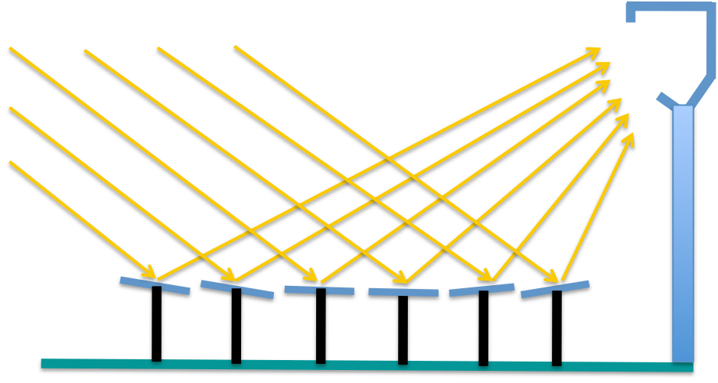
Side towers + cavities work best north or south of the equator
Where the sun naturally slants in from the south or north (respectively)
But a taller Tower is then desirable as it allows for flattened Heliostat tilts,
reducing the amount of sunlight slipping between Heliostats to the ground
However, increased Heliostat-Receiver separation also calls for an enlarged Receiver
which can suffer increased re-radiation of power out its enlarged cavity portal
An Introduction to Sustainable Energy Systems: WeCanFigureThisOut.org/ENERGY/Energy_home.htm

Slide 33
Open on all sides, Central Receivers must suppress re-radiation differently
So they dig even deeper into the science of how power is lost via light re-emission:
Black body laws are idealized, including the Stefan Boltzman Law
which states that total energy radiated = σ (Temperature)⁴
where σ = 5.670 x 10⁻⁸ W/m²/(°K)⁴
But we all KNOW how to CHANGE the amount of light coming from an object:
You only have to paint it a different color, or change its material or texture!
So why not change the Receiver's color or texture to REDUCE light emission?
Physicists then drag out Kirchhoff’s Law of Thermal Radiation which states that ¹
decreasing a surface's light emission, also decreases it light absorption
Suppressing a Reciever's heat emission would thus hurt its sunlight absorption!
1) Concentrating Solar Power, Weinstein et al., Chemical Reviews 115, pp. 12797-12838 (2015)

Slide 34
But like so many laws, this Kirchoff Law has a gaping loophole:
It applies only color by color, for example:
A paint or texture can cut an object's emission & absorption of RED light
But that doesn't have to affect its emission & absorption of BLUE light
The Sun's surface is at just over 6000 °K
But its light heats Central Receivers to no more than 1000 °C (1273 °K)
Recall that Black body emission/absorption peaks at 2896 μm / (object temperature)
6000°K
So while Sunlight peaks at ~ 0.48 μm = 480 nm
the heated Receiver's light peaks at ~ 2.3 μm = 2300 nm
Light
Power
5000°K
4000°K
3000°K
100
500
1000
1500
2000
2500
Visible
Wavelength (nm)

Slide 35
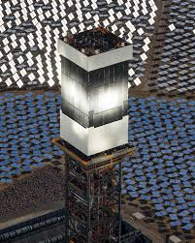
Putting this all together:
Via paint, texture or material, just alter the surface of a Central Receiver so that:
Light absorption / emission are MAXIMIZED for ~ 500 nm visible light
Light absorption / emission are MINIMIZED for ~ 2500 nm infrared light
Finding or preparing proper surface treatments is thus a hot research topic ¹
Various Central Receivers (Crescent Dunes NV, Ivanpah CA and Solar One CA):
1) Concentrating Solar Power, Weinstein et al., Chemical Reviews 115, pp. 12797-12838 (2015)Left Photo: http://www.basinandrangewatch.org/CrescentDune.html
Center Photo: 2014 - The Year of Concentrating Solar Power - US DOE
Right Photo: A Review of Thermal Collectors and Thermal Energy Storage in Solar Thermal Applications, Tian et al., Applied Energy 104, pp. 538-53 (2013)

Slide 36
Early Solar Tower Receivers used Direct-Steam-Generation (DSG)
One pioneering project was the Solar One plant built in Southeast CA (near Barstow)
(not to be confused with very different "Solar One" projects in Nevada & Spain)
In 1981 it was claimed to be the world's first "large-scale" Solar Thermal plant ¹
Meaning that its 1,818 mirrors produced 10 MW of output power ²
Its receiver was filled with water, which sunlight converted directly into steam
By NOT employing an intermediate Heat Transfer Fluid (HTF),
Solar One required no Heat Exchangers (HTF to water)
And its mirrors & black receiver alone replaced a steam boiler
Additional data on Solar One's performance was very hard to find
But I learned that soon after it, using similar Direct-Steam-Generation (DSG),
Spain's Planta Solar 10 & Planta Solar 20 installations generated
250-300 °C steam at 45 bar (~ 45 atmosphere) pressures ³
1) "The Solar Project" - Wikipedia - https://en.wikipedia.org/wiki/The_Solar_Project#Solar_One
2) http://www.solaripedia.com/13/31/solar_one_and_two_(now_defunct).html
3) Advances in Central Receivers for Concentrating Solar Applications, C.K. Ho, Solar Energy 152, pp. 38-56 (2017)

Slide 37
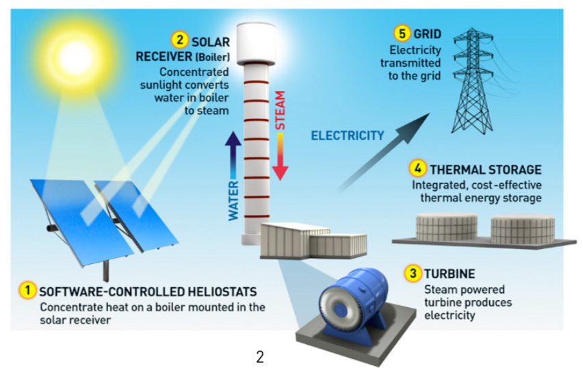
30 years later DSG was scaled upward at California's Ivanpah Plant
Which is today's largest Solar Thermal Plant, using three Solar Towers
to produce 392 MW, at a record 29% conversion efficiency (for Towers) ¹
Ivanpah's enhanced Direct-Steam-Generation yields superheated steam at ~ 540 °C ²
But given water's limited ability to capture and store heat energy,
this still means that power generation ceases around sunset
and next morning before dawn natural gas burners must be ignited
to re-heat the plant's water back up to where sunlight can boil it
1) From NREL's plant listings: https://solarpaces.nrel.gov/ivanpah-solar-electric-generating-system
2) Advances in Central Receivers for Concentrating Solar Applications, C.K. Ho, Solar Energy 152, pp. 38-56 (2017)
Figure from: http://www.brightsourceenergy.com/stuff/contentmgr/files/0/3eac1a9fed7f13fe4006aaab8c088277/attachment/ivanpah_white_paper_0414.pdf

Slide 38
Nevada's Crescent Dunes represents a potential breakthrough
Built near Tonopah in 2015 it produces 110 MW - Only about 1/4 of Ivanpah's power!
But instead of water, its Receiver uses molten salt ¹
That Heat Transfer Fluid is piped down from the tower and sent to EITHER:
Heat Exchangers in which salt boils water into steam for the generators OR
Two Storage Tanks, each having a 13.6 million liter molten salt capacity ²
After sunset, the stored salt can boil the generator's steam for 10 additional hours,
while leaving that salt still above its ~ 200°C solidification temperature, ³
keeping it pumpable and thus ready to re-enter service at sunrise
1) The FIRST commercial use of a molten salt central receiver was actually at Spain's 19 MW Gemasolar plant in 2011
2) From NREL's plant listing: https://solarpaces.nrel.gov/crescent-dunes-solar-energy-project
3) Advances in Central Receivers for Concentrating Solar Applications, C.K. Ho, Solar Energy 152, pp. 38-56 (2017)

Slide 39
Solar Thermal + Molten Salt = 24 / 7 Power (w/o carbon or nuclear)
However, as detailed in my note set: Power Plant Economics (pptx / pdf / key):
Even with storage, Solar Thermal is today's most expensive power technology
Not just more costly than notoriously expensive Nuclear and Offshore Wind
But also 3X more expensive than our currently least expensive technologies of
Combined Cycle Natural Gas, Solar Photovoltaics and Onshore Wind
And without storage, that disadvantage of 3X climbs to over 4X
So we need to examine possible FUTURE Central Receiver Solar Thermal technology:
As discussed earlier, a thermal engine's theoretical "Carnot" efficiency limit is:
Maximum Conversion Efficiency = Δ Temperature / (Highest Temperature)
But Ivanpah's steam AND Crescent Dune's molten salt top out at 540-565 °C ^{1, 2}
Heliostat fields concentrate sunlight almost as effectively as Dishes (i.e., by ~ 1000X) ³
So why CAN'T Power Tower fluids reach comparable ~ 1000 °C temperatures?
1) https://solarpaces.nrel.gov/ivanpah-solar-electric-generating-system
2) Advances in Central Receivers for Concentrating Solar Applications, C.K. Ho, Solar Energy 152, pp. 38-56 (2017)
3) Concentrating Solar Power, Weinstein et al., Chemical Reviews 115, pp. 12797-12838 (2015)

Slide 40
The first reason is that today's Tower fluids can't withstand the heat
In water, chloride salts (e.g. table salt, NaCl) are notoriously corrosive
It's thus unsurprising that molten chloride salts are HUGELY corrosive
Crescent Dunes, and other Solar Thermal plants therefore employ nitrate salts
But nitrate salts break down above ~ 600 °C, limiting Receiver temperatures
What are possible alternatives? Sandia National Labs ^{1, 2} identifies these candidates
along with their limits on incident solar intensity (flux) & operating temperature:
1) Advances in Central Receivers for Concentrating Solar Applications, C.K. Ho, Solar Energy 152, pp. 38-56 (2017)
2) Review of High-Temperature Central Receiver Designs for Concentrating Solar Power, Ho & Iverson, Renewable & Sustainable Energy Reviews (29), pp. 835-836 (2014)

Slide 41
From that list - moving past today's water & nitrate salts:
The next hotter would-be Heat Transfer Fluid is liquid sodium
As a molten liquid, sodium can be pumped through piping inside Receivers
that are not much different from today's water and nitrate salt Receivers
Molten liquid sodium has thus long been tested as a Heat Transfer Fluid
in both experimental Nuclear Reactors and Solar Thermal Receivers
It can work well - But if it ever leaks, it spontaneously ignites in moist air
And it is thus associated with a number of Nuclear & Solar Thermal plant fires
Next on Sandia's list is air or (discussed in their papers) other gases such as CO2
With so few atoms, normal gases carry very little thermal energy
Solar Receivers would thus use gases pressurized to 15-25 bar
And because even pressurized gases tend to be transparent, sunlight would first be
absorbed by porous solid structures through which the gas would be pumped

Slide 42
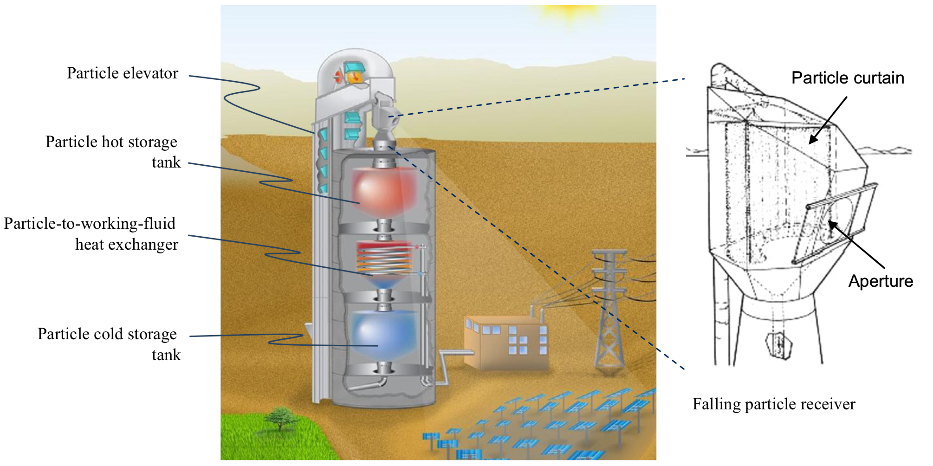
The second reason is that today's fluids can't transport away enough heat
For which the solution may be solid Heat Transfer Fluids
Solids, of course, have the highest possible density of heat-carrying atoms
Further, many "ceramic" solids can withstand tremendous temperatures
Typical ceramics include many metal oxides and carbides
But "pumping" solid Heat Transfer Fluid through a Receiver has got to be tricky
In this scheme, solid particles (even sand!) could shower down thru the sunlight
1) Advances in Central Receivers for Concentrating Solar Applications, C.K. Ho, Solar Energy 152, pp. 38-56 (2017)

Slide 43
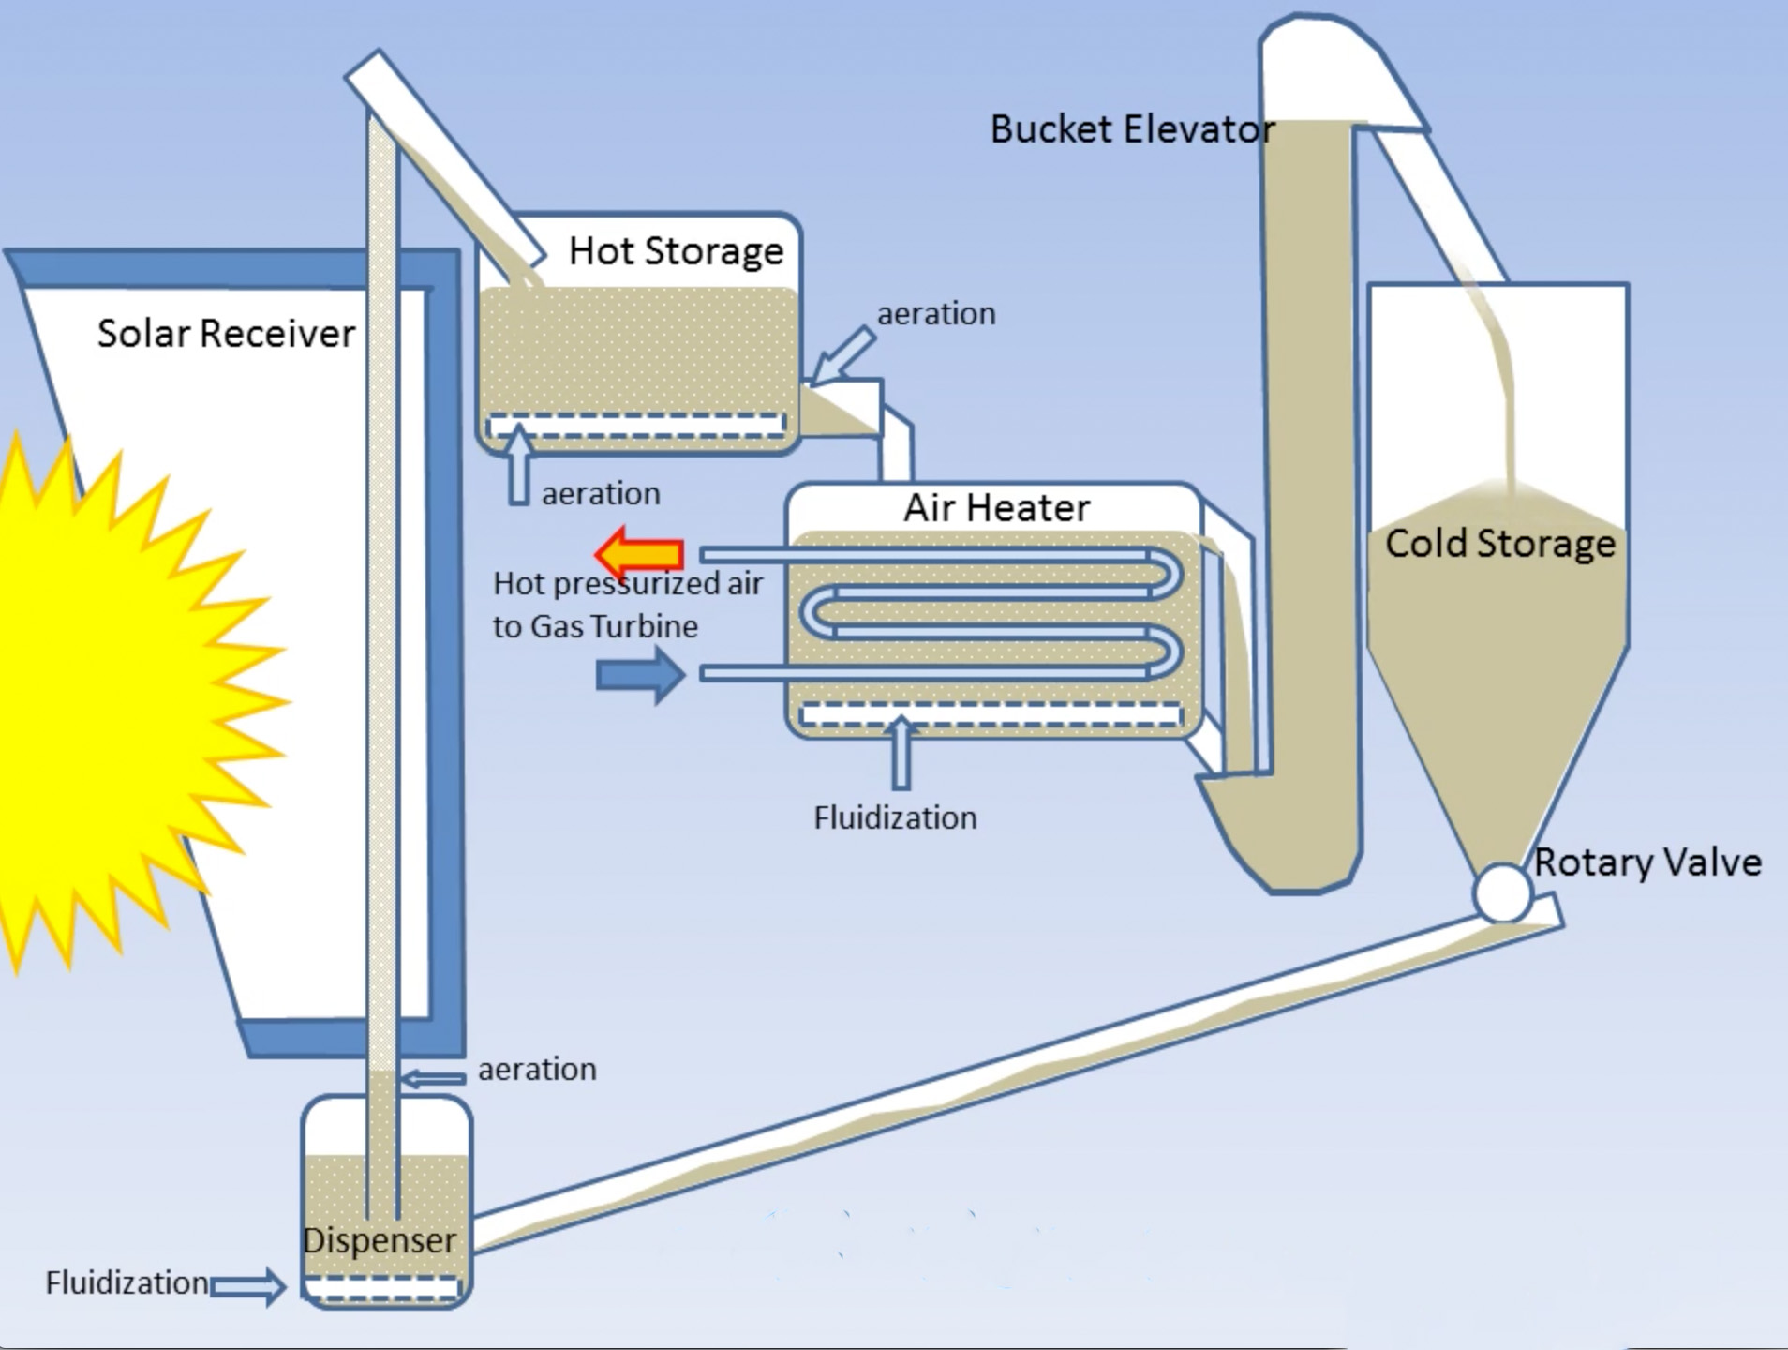
In other schemes, solids would be "fluidized"
"Liquid" Quick Sand is produced by flowing water driving solid sand particles apart
Solid powders can be similarly "fluidized" by pumping gas up through them
The EU's "Next-CSP" project animated their Fluidized Powder Receiver proposal ¹
From which I have extracted and labeled this single frame:
1) Dispenser from which fluidized powder ascends (!!)
2) Passing though the Solar Receiver portal
3) Then descending into a Hot Storage container
where it can be re-fuildized to pass into the
4) Air Heater where air is a secondary heat transfer fluid
which is sent out to drive the generator's turbine
5) Powder is finally re-fluidized & sent to Cold Storage
before being released to begin another cycle
(3)
(4)
(5)
(2)
(1)
Full Animation at: http://next-csp.eu/2017/06/20/animated-video-principles-next-csp-solar-thermal-power-plant/

Slide 44
How much might new HTF's & Receivers improve Tower performance?
Max Carnot Conversion Efficiency ~ Δ Temperature / (Highest Temperature)
~ [T high - T low ] / T high for "absolute" temperatures measured in °K
T low would probably not change much, remaining near 473 °K (200 °C)
Thigh in present day water & molten nitrate salt receivers is just under 873 °K (600 °C)
The Carnot theoretical efficiency limit is then ~ (400/873) ~ 46%
Versus Ivanpah's record measured Tower efficiency of ~ 29%
The new Heat Transfer Schemes & Receiver designs discussed above
mostly elevate Thigh to somewhere in the range of 973-1023 °K (700-750 °C)
Giving a new Carnot theoretical efficiency limit of ~ (550/1023) ~ 54%
Ignoring the questionable absolute numbers and instead just comparing their ratio:
New efficiency limit / Present efficiency limit ~ 54% / 46% ~ 1.2 times larger
An Introduction to Sustainable Energy Systems: WeCanFigureThisOut.org/ENERGY/Energy_home.htm

Slide 45
Parabolic Troughs / Concentrators
An Introduction to Sustainable Energy Systems: WeCanFigureThisOut.org/ENERGY/Energy_home.htm

Slide 46
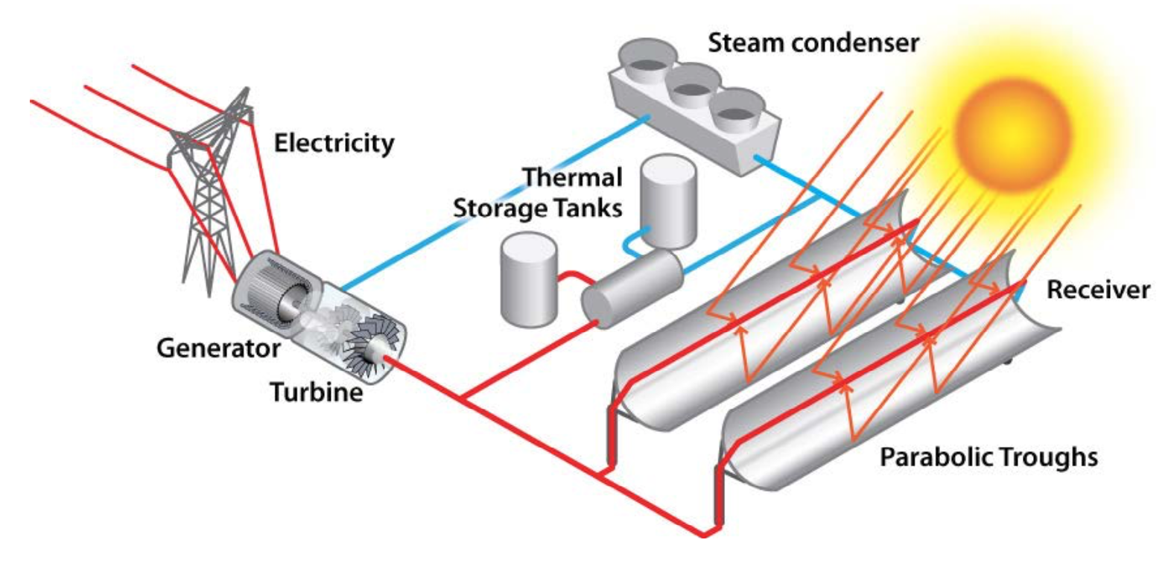
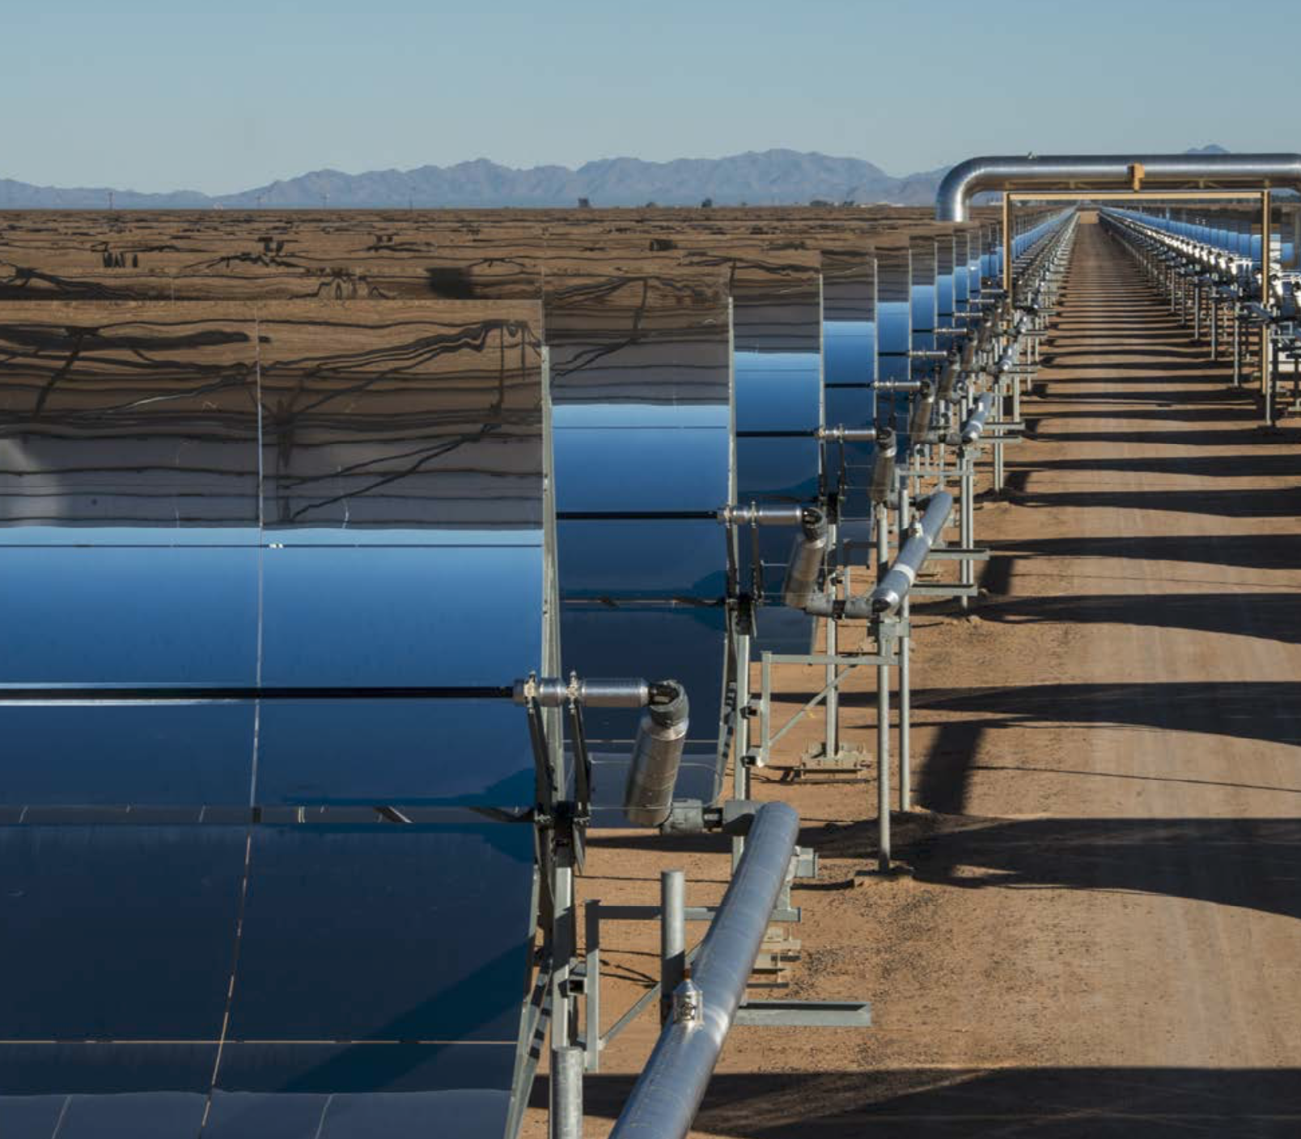
Next lower in efficiency are Parabolic Trough Solar Thermal Plants
Which the US DOE depicts schematically and photographically as: ¹
1) 2014 - The Year of Concentrating Solar Power - US DOE
Unlike continuous Dish paraboloids OR fragmented Tower paraboloids
Parabolic Troughs are just stretched out (extruded) versions of 2D parabolas

Slide 47
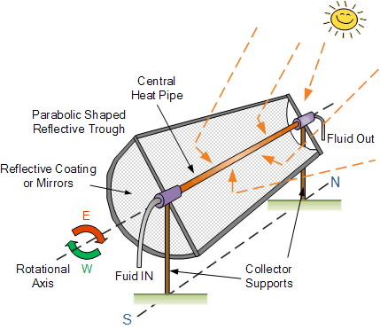
Parabolic Troughs have a pipe-like Receiver running along their focal line
In most installations a Heat Transfer Fluid is pumped along that Receiver
Synthetic oils are typical because they can withstand heating to ~ 390 °C
But experimental plants are exploring molten nitrate salt HTF's (stable to ~ 560 °C),
OR replacement of HTF's by water for high-pressure Direct-Steam-Generation ¹
1) Concentrating Solar Power - Technology Brief, International Renewable Energy Agency - IRENA, 2013
Figure: http://www.alternative-energy-tutorials.com/solar-hot-water/parabolic-trough-reflector.html

Slide 48
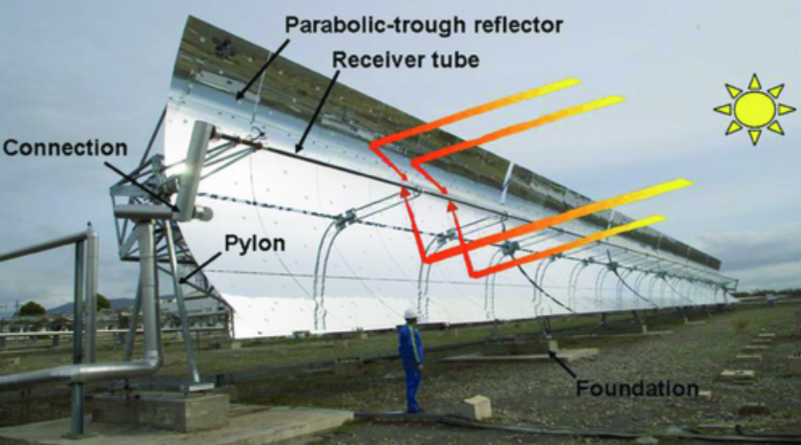
But high temperature and/or pressure again creates plumbing problems:
Tower Central Receivers (above), with all of their necessary plumbing, STAY PUT
Leaving their multitude of tilting Heliostats to do the job of tracking the sun
But as with Dishes, Troughs themselves must do the tracking
And to maintain focus upon their Receiver, both must move together as a unit
Which resurrects the challenge of getting Heat Transfer Fluid OUT to do its transferring
Or the alternate challenge of getting extremely high pressure steam out
Use of high-temperature metal piping with rotating joints is again the only possibility,
but for Troughs (unlike Dishes) SINGLE tracking axis / rotation make that practical
Solar Thermal CSP Technology, M. Romero & J. Gonzalez-Aguilar, Wires - Energy and Environment 3(1), pp. 42-59 (2013)
Rotating pipe joints at Parabolic Trough's ends

Slide 49
The length of Parabolic Troughs ALSO demands single axis tracking
These trough assemblies are typically at least 100 meters long ¹
So while rotating pipe joints can accommodate their side to side tilting
it is completely impractical to ALSO tilt them along their 100 meter length
But while the Sun moves East to West daily, it also shifts North to South seasonally
Should troughs run North-South to allow daily East to West sun tracking?
Or should they run East-West to allow seasonal North to South sun tracking?
That sounds like an almost dumb question because
the Sun's East-West motion is so MUCH MORE frequent and pronounced
1) Concentrating Solar Power, Solar Energy Industries Association - SEIA

Slide 50
Which seemingly calls for North-South troughs tilting daily East to West
But look again at my illustration of an East-West running trough (on the right)
Morning & evening sunlight would slant in from the ends of that East-West trough
But while parabolas focus perfectly only for light coming from directly above them,
slanting sunlight would still bounce off a basically parabolic shape
which should still try to focus that light (albeit to points farther down that trough)
I concede that focus would be degraded and it would likely shift lower in the trough:
Vertical incidence, Perfect focusing
Slanting incidence, Imperfect focusing

Slide 51
So why accept degraded focus, slightly below the Receiver?
Because such an East-West trough would NOT have to track the Sun second-by-second:
In the Northern Hemisphere, it would only have to be tilted mildly
Northward in the Summer, and Southward in the Winter
Which might only require shifting it (manually?) once in the Spring and once in the Fall
Not only would computerized second-by-second tracking become unnecessary,
but motors and potentially leaky rotating pipe joints might also be eliminated
by simply swapping in/out alternate fixed-angle pipe joints (a.k.a. "unions")
I dug into government, industry and academic analyses of parabolic trough focusing ¹
And could not find ANY study raising (much less analyzing) this long-shot possibility ²
1) For details see the Parabolic Trough papers papers cited on this note set's Resources webpage (link)
2) This website is named WeCanFigureThisOut because WE CITIZENS NEED TO UNDERSTAND OUR ENERGY CHOICES!

Slide 52
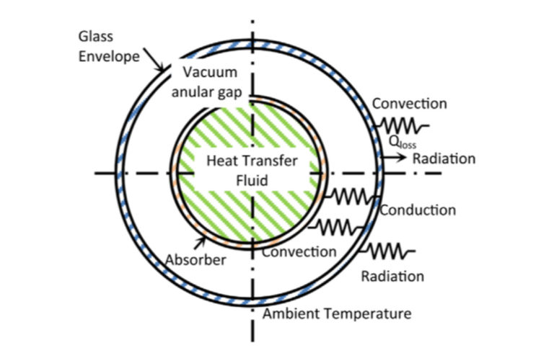
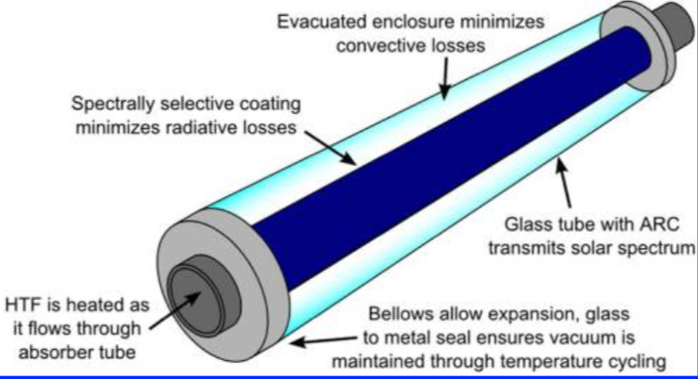
Returning to the dominant N-S running Parabolic Trough technology:
For the now common choice of synthetic oil heat transfer fluids,
temperatures within the Receiver pipe cannot exceed 400 °C
These temperatures, which are at least ~ 200 °C cooler than in Tower Receivers,
slashing black body radiative heat loss (varying as temperature to the 4th power)
What is left are conductive & convective heat loss (e.g., by movement of gas atoms)
Parabolic Trough Receivers thus center HTF pipes within evacuated glass tubes
Left Figure: Review of Solar Parabolic Trough Collector Geometrical and Thermal Analyses, Performance, and Applications, Abdulhamed et al., Renewable and Sustainable Energy Reviews 91, pp. 822-31 (2018)
Right Figure: Concentrating Solar Power, Weinstein et al., Chemical Reviews 115, pp. 12797-12838 (2015)

Slide 53
Summarizing Today's Parabolic Trough Solar Thermal Power:
Common Parabolic Trough configuration: N-S running, daily E-W tilting, oil HTF pumping
With single axis tracking, Parabolic Troughs concentrate sunlight by only ~ 100X ¹
Versus Solar Tower / Heliostat field or Dish-Engine concentration ratios of ~ 1000X
That produces Parabolic Trough Receiver temperatures of ~ 390 °C
Versus Solar Towers' (fluid limited) 600 °C or Dish-Engines' over 1000 °C
Yielding Parabolic Trough solar to electrical power Conversion Efficiencies of 14-16% ²
Versus Solar Towers' 29% or Dish-Engines' 29-32%
Only molten salt Solar Towers now offer effective / extended heat energy storage
But for Parabolic Troughs, the Spanish Andasol & Valle I/II plants
ARE testing schemes for transferring oil HTF heat into molten salt reservoirs ¹
ALL of the above technologies now employ widely spaced mirrors / mirror assemblies
to accommodate regular servicing & manual (non-automated) mirror washing
1) Concentrating Solar Power, Weinstein et al., Chemical Reviews 115, pp. 12797-12838 (2015)
2) Concentrating Solar Power - Technology Brief, International Renewable Energy Agency - IRENA, 2013

Slide 54
Linear Fresnel Reflectors / Concentrators
An Introduction to Sustainable Energy Systems: WeCanFigureThisOut.org/ENERGY/Energy_home.htm

Slide 55
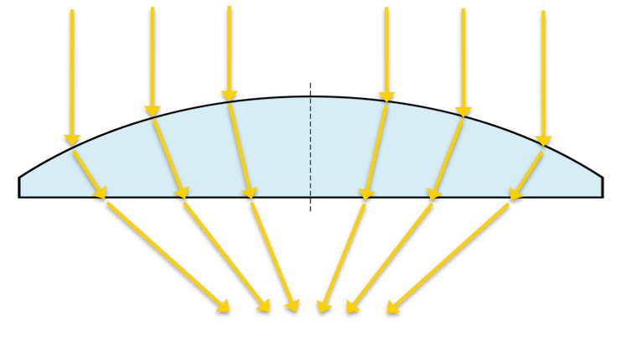
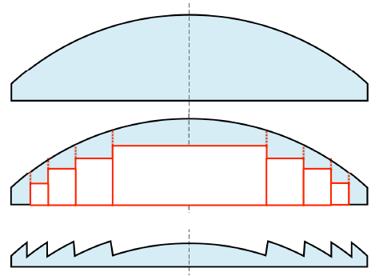
Fresnel Linear Reflectors / Concentrators
In 1823 the French scientist August Fresnel ("fray-NEL") demonstrated
an immensely thinner, lighter and thus more practical lighthouse lens ¹
As embodied in Snell's Law of light refraction, he knew that light changes direction
ONLY as it passes in or out of a material (and not while traveling through it):
So he just did away with the useless inner volumes of a conventional focusing lens:
1) See, for example: Wikipedia's Fresnel Lens webpage

Slide 56
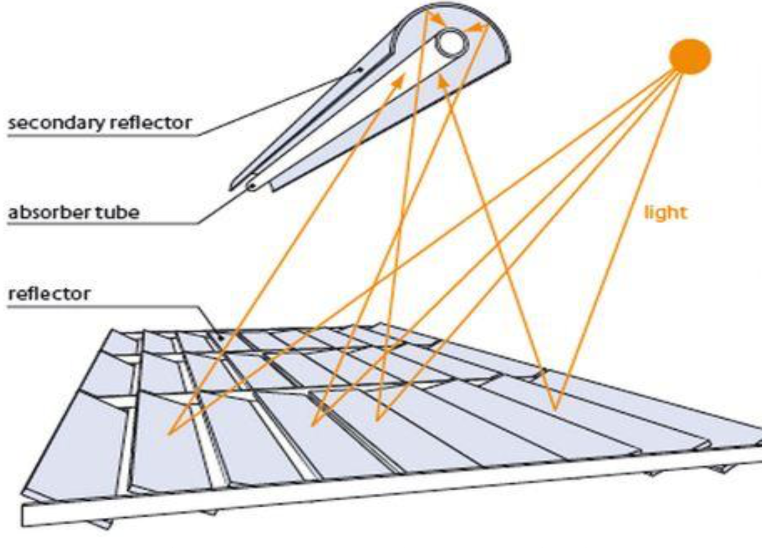
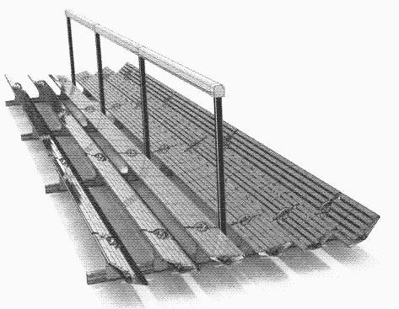
Modern Linear Fresnel Reflectors do the same thing for parabolic mirrors:
Which is equivalent to a Parabolic Trough cut into slivers and then flattened out:
Design and Analysis of Rooftop Linear Fresnel Reflector Solar Concentrator - Gouthamrai et al., Int J Eng. & Innovative Tech 2(11) pp. 66-69 (2013)
https://solar.lowtechmagazine.com/2011/07/solar-powered-factories.html
Or to a single stripe of of Solar Tower Heliostat mirrors that have been stretched out

Slide 57
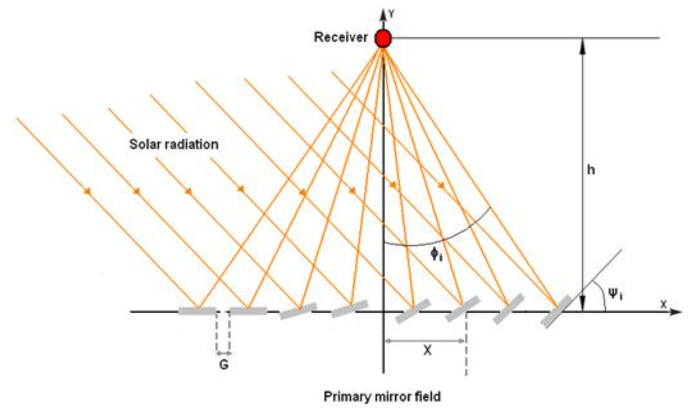
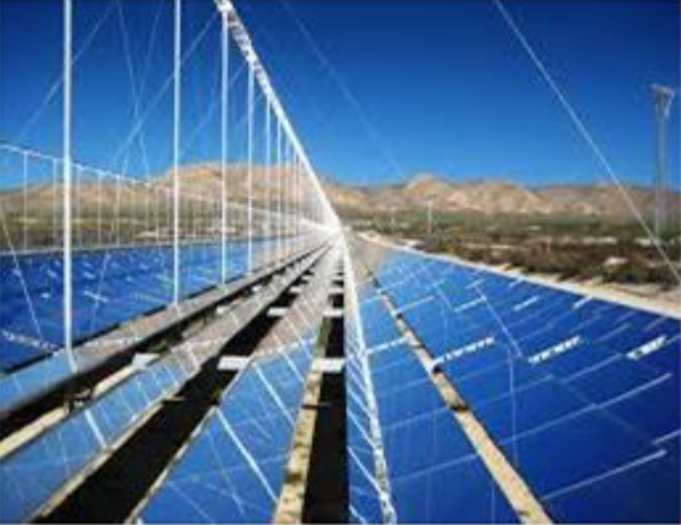
The mirrors then tilt almost like common venetian window blinds
But to direct sunlight up to a parallel Receiver, each mirror must tilt differently
Despite appearances, this is more like a Solar Tower than a Parabolic Trough
Why? Because the Receiver, with its high-temperature and/or high-pressure plumbing,
is once again completely STATIONARY (vastly simplifying all of that plumbing),
with only the immensely simpler mirrors moving to track the sun
Left Figure: Analytic Optical Design of a Linear Fresnel Solar Collector with Variable Parameters, Eddhibi et al., J Mat Env Sci 8 (10), pp. 4068-84 (2017)
Right Figure: Analytic Optical Design of a Linear Fresnel Solar Collector with Variable Parameters, Eddhibi et al., J Mat Env Sci 8 (10), pp. 4068-84 (2017)

Slide 58
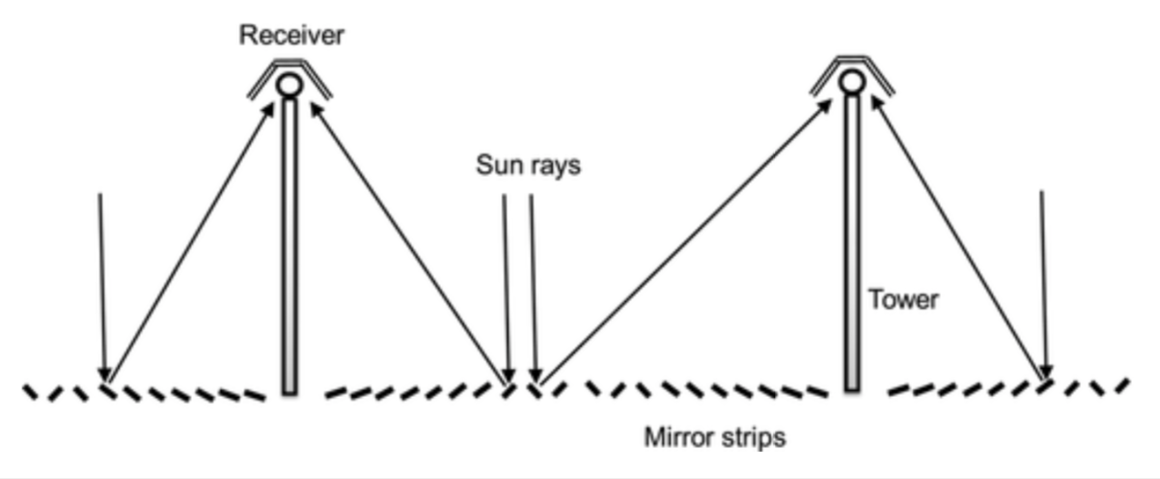
And this arrangement comes with further advantages:
First, as illustrated below, the mirrors can be laid out in densely packed stripes
occupying 60-70% of the ground area (vs. 33% for Parabolic Troughs) ¹
Computers might then even dynamically select the optimum grouping of mirrors
used to direct the moving sun's light to a particular parallel Receiver
1) Solar Thermal CSP Technology, M. Romero & J. Gonzalez-Aguilar, Wires - Energy and Environment 3(1), pp. 42-59 (2013)
Second, with the mirrors in an almost flat single plane that is very close to the ground,
those mirrors are much less susceptible to desert windstorms that can damage
far taller / wind-catching Dishes, Heliostats & Parabolic Troughs
Finally, because mirrors ARE nicely parallel & close to the ground, this is the ONLY
Solar Thermal technology using simple robotic machines to clean its mirrors

Slide 59
But there are certain disadvantages:
Discontinuous parabolic Linear Fresnel mirrors do not focus light
quite as effectively as the continuous parabolic mirrors of Parabolic Troughs
They thus employ wider receivers to collect that less well focused light
Those Receivers contain multiple side-by-side Heat Transfer Fluid pipes
plus trapezoidal backside reflectors to trap any light missing those tubes
Those Receivers still reach lower temperatures then those of Parabolic Troughs
But their convective heat-loss IS then reduced to the point that their collection tubes
don't have to be enclosed within costly & delicate evacuated glass enclosures
Figures from: Concentrating Solar Power, Weinstein et al., Chemical Reviews 115, pp. 12797-12838 (2015)

Slide 60
A comparison of all four mainstream Solar Thermal technologies: ^{1, 2}
Typical Configuration:
Receiver:
Concentration Ratio:
Receiver Temp:
Receiver Fluid(s):
Conversion Efficiency:
Heat Storage:
Plusses & Minuses:
Dishes
Dish arrays
Stirling Engine
with Generator
~ 1000 X
Up to 1200 °C
Pressurized Gas
29-32%
None
Exotic components
Poor land use
Wind susceptibility
Manual cleaning
Solar Towers
Center or Side
Cavity or non-cavity
~ 1000 X
Up to 575 °C
Water or Salt
Up to 29%
10 (or more?) hours
Wind susceptibility
Manual cleaning
Water use
Bird kills
Parabolic Troughs
N-S Trough Arrays
Linear / Evacuated
~ 100 X
400 °C
Oil (eventually Salt?)
~14-16%
Not yet (eventually?)
Mature technology
Wind susceptibility
Manual cleaning
Water Use
Linear Fresnel
Dense N-S arrays
Linear
Direct-to-Steam
~ 80 X
300-400 °C
Water
~13%
None
Effective land use
Lower costs
Robotic cleaning
Water use
1) Table data are from sources cited earlier, or publications identified in this note set's Resources webpage (link)
2) Trends exhibited in this table are consistent within those sources, but numerical values often differ significantly. Industry associated sources tend to cite more positive data. While their bias may of course be a factor, I've found that industry sources are often much better informed about forefront technology than governmental and academic sources.

Slide 61
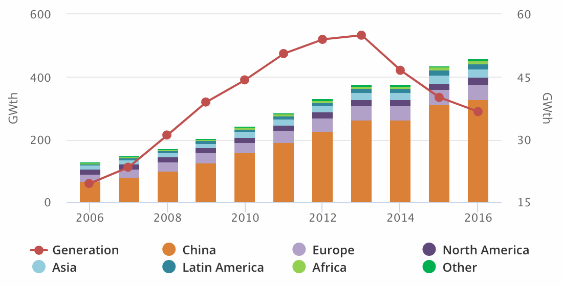
Yielding these patterns of current Solar Thermal deployment:
Number of U.S. Solar Thermal plants by type (not accounting for power outputs): ¹
Dish-Engine: 2 Solar Tower: 36 Parabolic Trough: 99 Linear Fresnel: 14
Versus International Renewable Energy Agency (IRENA) statement that (in 2013) ²
90% of worldwide Solar Thermal power was produced by Parabolic Troughs
(a breakdown of the other 10% of Solar Thermal power was not provided)
And this International Energy Agency (IEA) figure about worldwide Solar Thermal: ³
Line = Total worldwide Solar Thermal Power
(left axis)
Colored bars = Solar Thermal Power ADDED
within that region within that year
(right axis)
Line's fall also implies recent plant CLOSURES
1) https://solarpaces.nrel.gov/
2) https://www.irena.org/publications/2015/Oct/Concentrated-Solar-Power
3) https://www.iea.org/topics/renewables/solar/

Slide 62
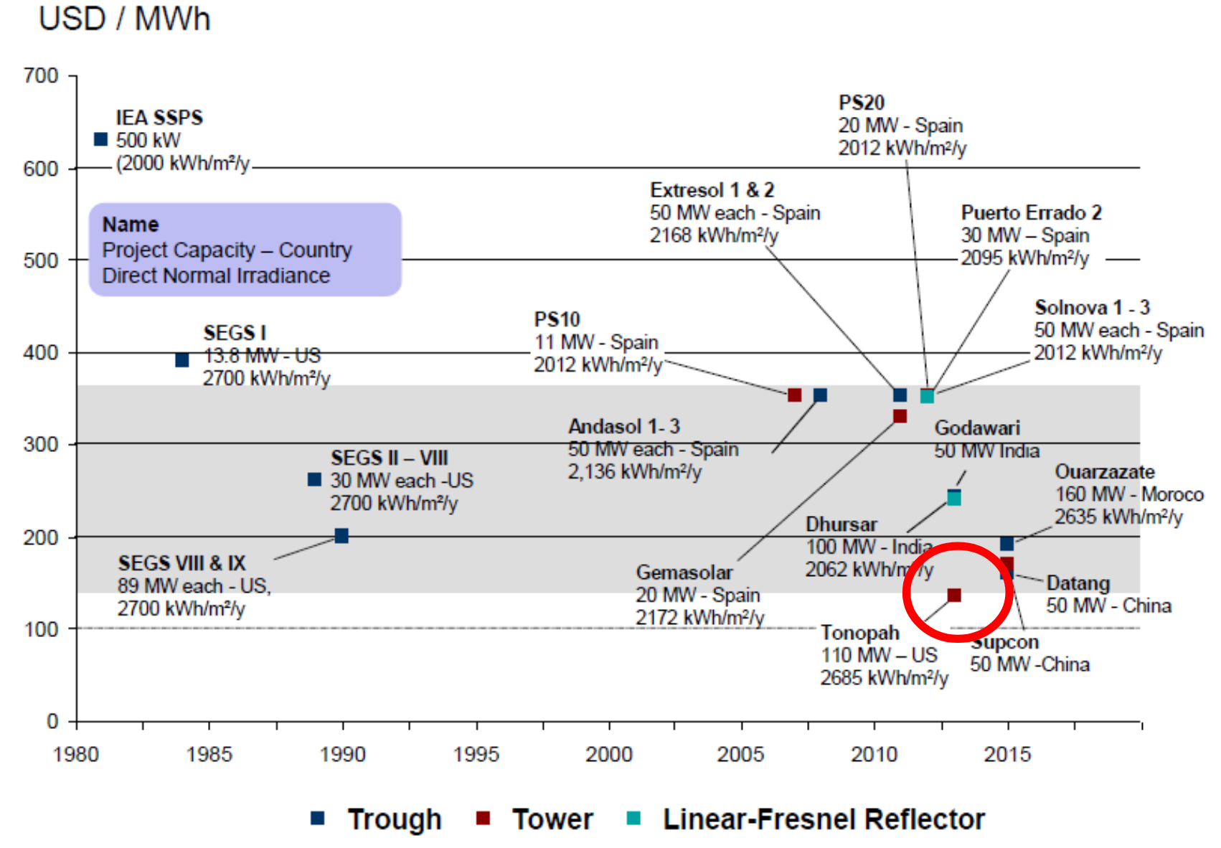
And this comparison of Solar Thermal Power cost by technology:
As reported in a talk by Prof. Nick Jelley (Physics Department, University of Oxford) ¹
with his source cited as "SBC Energy Institute Solar Factbook 2013"
1) Concentrated Solar Power and Thermal Storage, Prof. Nick Jelley, Physics Dept., University of Oxford
(Link & cached copy of his talk are provided on this note set's Resources webpage (link)

Slide 63
Heat Storage
An Introduction to Sustainable Energy Systems: WeCanFigureThisOut.org/ENERGY/Energy_home.htm

Slide 64
Heat Storage
I have identified Crescent Dune's molten salt storage as a "Potential Breakthrough"
One that might :
Provide the first true 24/7 Green Energy Source
End Solar Thermal's "Non-green marriage-of-convenience with Natural Gas"
Eliminate "One of the two biggest hurdles to building a Green Grid"
A full explanation is complicated and, at a minimum, calls strongly upon my note sets:
U.S. Energy Production and Consumption (pptx / pdf / key)
A Generic Power Plant and Grid (pptx / pdf / key)
Fossil Fuels Power Plants (pptx / pdf / key)
As well as technology-specific note sets about Hydro, Wind, Photovoltaic & Nuclear Power
AND note sets about the Smart Grid and existing forms of Energy Storage

Slide 65
But let me here try for a (radically) abbreviated explanation:
You might guess that our consumption of power peaks during the day
It doesn't - A very pronounced peak instead occurs in the evening:
Peak Power
80%
"DISPATCHABLE POWER"
60%
"BASE POWER"
Midnight
Noon
Midnight
Power companies divide this Power Demand into two segments,
which are referred to as "Base Power" and "Dispatchable Power"
They do this because each requires different types of power plants

Slide 66
Water-boiling steam turbine power plants provide Base power
This includes coal, oil and some natural gas plants, as well as nuclear power plants
These generally massive plants use a massive amount of heat to boil that water
Indeed, from a cold start they need many hours to get up to full operating temperature
Which, to improve the plant's efficiency, is generally well above 100 °C
Being as massive as they are, requiring so much energy to even start operating:
You do NOT want to turn such plants on and off
You do NOT even want to turn their power levels up or down very much
Which is why they are used as BASE (i.e., essentially constant) power sources
DISPATCHABLE (i.e., adjustable) power plants then power up in the evenings
But used for as little as a half dozen hours a day,
power companies benefit far less from the money invested in such plants
If allowed, power companies will thus charge far more for evening power
And they will certainly try to use plants that are cheaper to build or buy

Slide 67
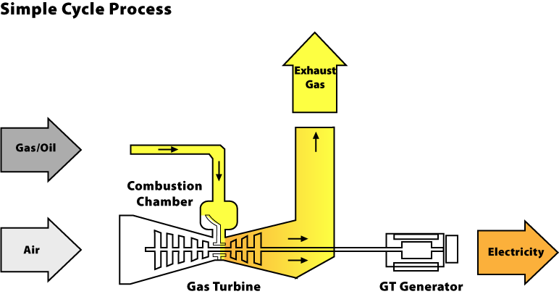
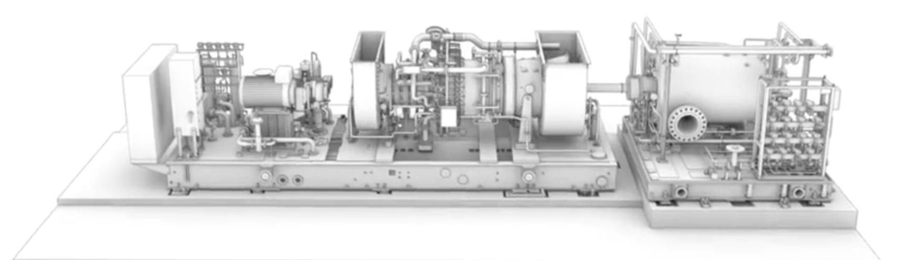
The U.S. Dispatchable favorite is one type of Gas Turbine Plant:
It is basically a jet engine burning Natural Gas (rather than kerosene),
which is connected directly (and simply) to an electrical generator,
but which wastes heat in its very hot exhaust by sending it up a chimney
Giving it the name: Open Cycle Gas Turbine (OCGT)
As shown here schematically:
Or here pictorially (this is essentially the entire "power plant," all ~ 25 meters of it!)
Top: https://www.consumersenergy.com/content.aspx?id=1345
Bottom: https://www.youtube.com/watch?v=OkfqUSBdN8M

Slide 68
To these established power sources we now want to add Sun and Wind:
Solar power of course peaks midday
While in most onshore locations Wind velocity peaks late afternoon, and because
wind power scales as velocity cubed, its power peak is even sharper:
Sun
Wind
Peak Power
Midnight
Noon
Midnight
Comparing this to the earlier (status quo) BASE / DISPATCHABLE figure,
it is clear that this is not WHEN we need more power
It might be used to reduce the Base Power level
But evening & night, you'd just end up needing more Dispatchable power

Slide 69
That makes little economic (or environmental) sense
Further, as a Grid struggles to absorb more than about 20% daylight green power
it can actually become unstable and more prone to blackouts
The obvious solution is to store daylight wind & solar power for later evening use
But existing Grid power storage technologies are so expensive that
their use would effectively double the cost of wind & solar power ¹
That's why Solar Thermal + Heat Storage represents a breakthrough
That heat storage is not a separate expensive technology
Piping around heat, ALL Solar Thermal Plants use at least brief heat storage
With the right Heat Transfer Fluids paired with the right Concentrators,
all you need is MORE of that Heat Transfer Fluid
and a well-insulated place to store it for a fraction of the day
1) See data near the end of my note set: Power Plant Economics (pptx / pdf / key)

Slide 70
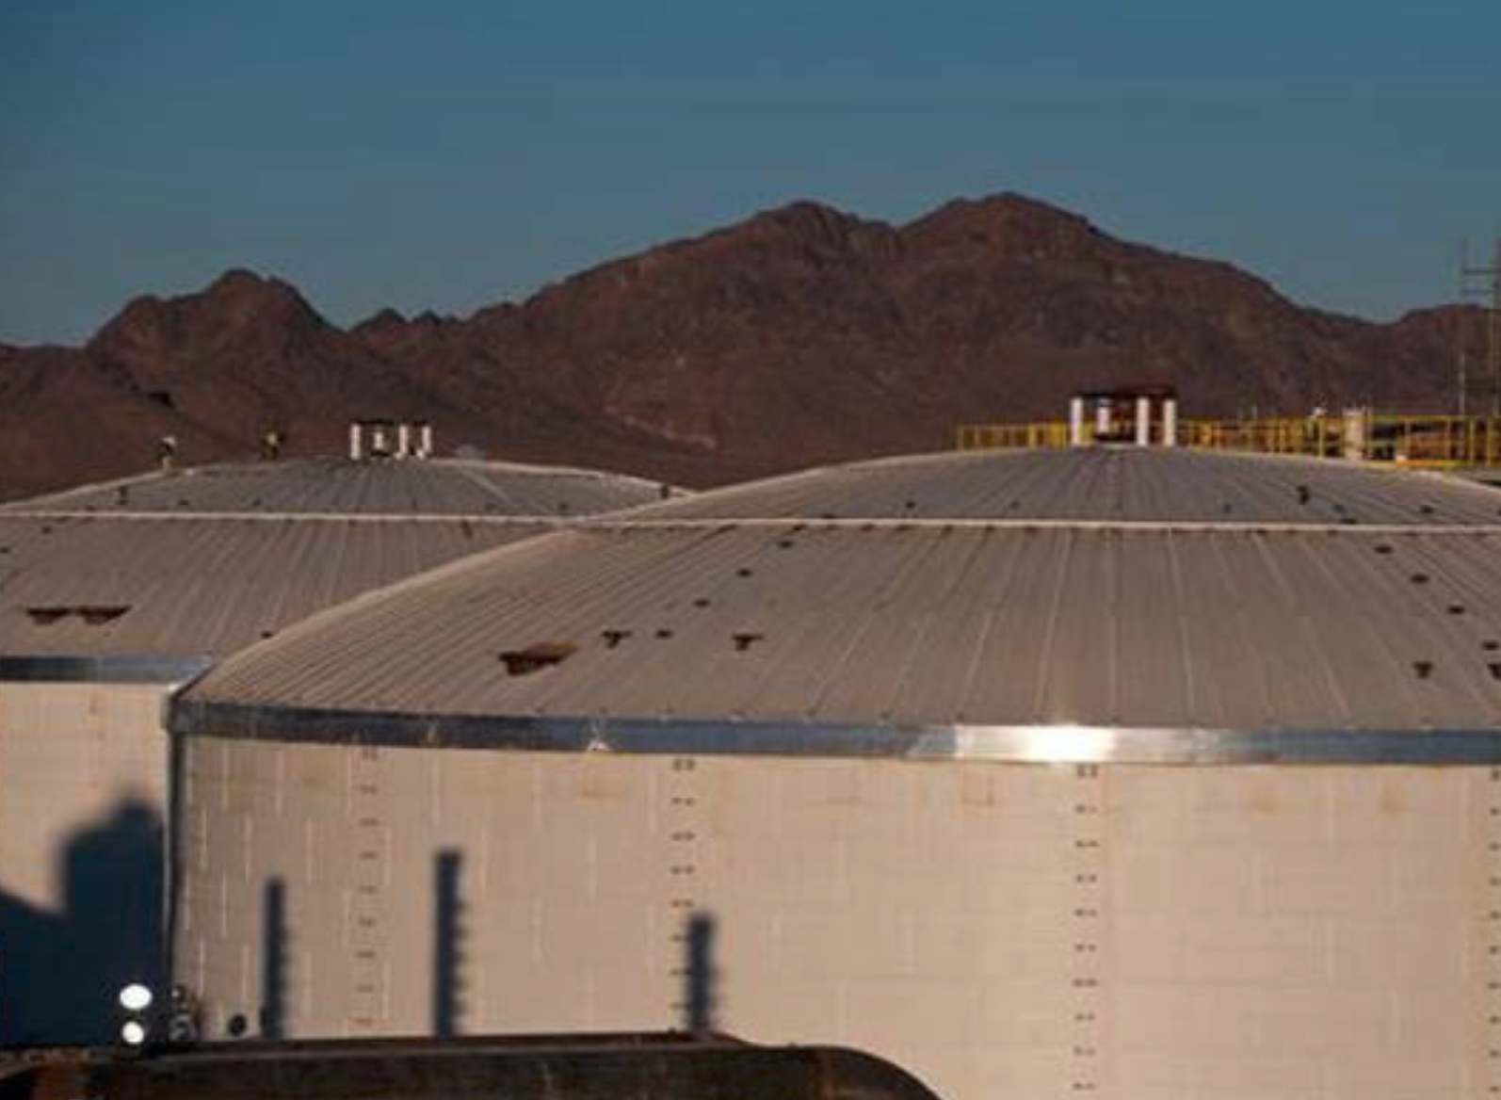
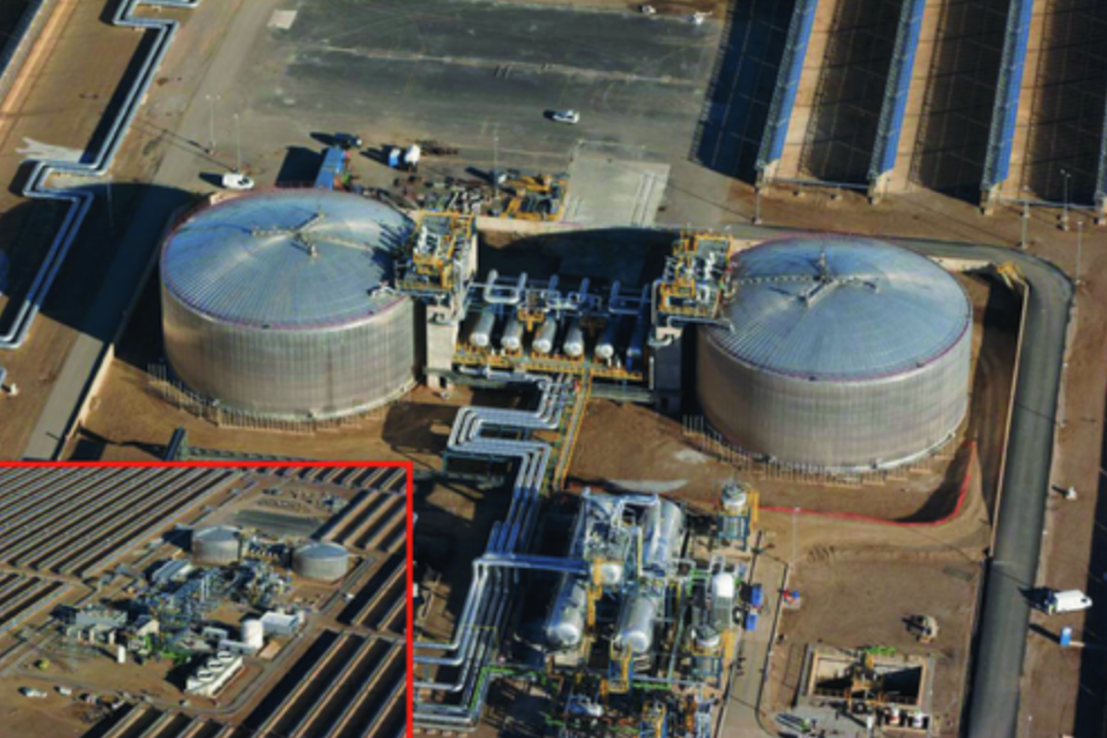
"Places" that look like this:
Molten salt storage tanks incorporated into
Arizona's Solana Plant (left) and Spain's Andasol Plants (right):
Left: DOE's "2014 - The Year of Concentrating Solar Power"
Right: Solar Thermal CSP Technology, M. Romero & J. Gonzalez-Aguilar, Wires - Energy and Environment 3(1), pp. 42-59 (2013)

Slide 71
What about the "Non-green marriage-of-convenience with Natural Gas?"
There I was referring to today's Solar Thermal in the absence of Heat Storage
As I noted above, the world's biggest Solar Thermal Plant (Ivanpah),
along with other plants, must now burn natural gas every morning
to re-heat their water to the point that sunlight can begin to boil it
Which obviously adds to Solar Thermal's already very high cost
AND disqualifies it as a green (non-greenhouse gas producing) technology
Power companies recognized (at least one) of these shortcomings and came up
with something making economic (and perhaps limited environmental) sense
Their solution goes back to those Open Cycle Gas Turbines
And the heat they now wastefully send right up their exhaust chimneys
An Introduction to Sustainable Energy Systems: WeCanFigureThisOut.org/ENERGY/Energy_home.htm

Slide 72
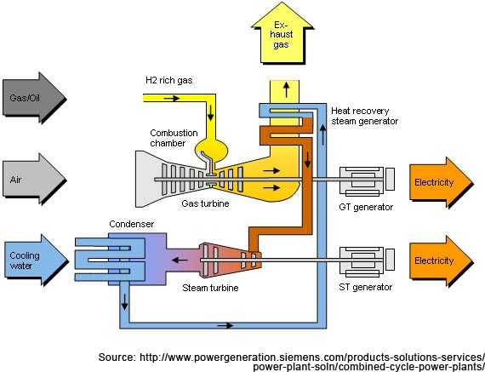
Burning Natural Gas gets hotter AND expands:
Open Cycle Gas Turbines are driven by that expansion but send heat up a chimney
Another type of Natural Gas power plant ALSO exploits that heat - It's thus called a
Combined Cycle Gas Turbine (CCGT) which uses two turbine-generators:
Water pipes run in/around the hot exhaust of the gas turbine-generator (top / yellow)
The exhaust's heat boils that water, expanding it by about 1700 times,
and that steam then drives a steam turbine-generator (lower / blue)

Slide 73
But Solar Thermal Plants ALREADY have a steam turbine-generator
Which, by morning, is desperately seeking heat to boil its water
So rather than just burning natural gas (exploiting only the heat produced) :
Feed that natural gas into a gas turbine-generator
Then use its exhaust to heat the Solar Thermal plant's water
This sends out gas-turbine power, while kick-starting the Solar Thermal plant
Which, in fading afternoon sunlight, or under drifting clouds
might again benefit from supplemental gas-turbine generator heat
This sort of symbiotic arrangement is now being exploited in what is effectively a
Combined Cycle Gas + Solar Turbine power plant (CCG&ST or CCG/ST?)
IT is the "marriage-of-convenience" to which I was alluding
An Introduction to Sustainable Energy Systems: WeCanFigureThisOut.org/ENERGY/Energy_home.htm

Slide 74
Heat Storage could eliminate the attraction of such a marriage
Transforming Solar Thermal into arguably our first "24/7 Green Energy Source"
Although that is a claim that Hydroelectric Power could legitimately dispute
Such a 24/7 Green Energy Source (in concert with Hydro) could remove
one of two key hurdles to creating a green and hopefully sustainable Grid
The other key hurdle?
Getting that green power to WHERE we most want to use it
Which, at least for now, is in our urban and/or coastal regions
Solar Thermal's high desert locations will certainly NOT help with that hurdle
Which instead calls for much more effective long distance power transmission
for which today's best option is Very High Voltage DC Power lines ¹
(from which Wind, Solar and Hydro power would also benefit)
1)See my note set: A Generic Power Plant and Grid (pptx / pdf / key)

Slide 75
Water Usage
An Introduction to Sustainable Energy Systems: WeCanFigureThisOut.org/ENERGY/Energy_home.htm

Slide 76
What is the shortcoming seen in all of these DOE illustrations?
Solar Tower Plant
Parabolic Trough Plant
Linear Fresnel Reflector Plant
The answer: Water-driven Steam Condensers
Top & Bottom Left: 2014 - The Year of Concentrating Solar Power - US DOE
http://www.energy.gov/eere/sunshot/downloads/2014-concentrating-solar-power-report
Bottom Right: https://www.energy.gov/eere/solar/articles/linear-concentrator-system-basics-concentrating-solar-power

Slide 77
After heat expands water into the steam turning turbine-generators . . .
That steam needs to be cooled back into liquid so that it can repeat the cycle
This occurs within Heat-Exchangers fed by water from Cooling Towers
Within Evaporative cooling towers, sprays of hot water fall through a honeycomb
Some cooling comes from air pulled upward through the honeycomb by a fan
Some cooling comes from evaporation of part of that water
But evaporating water is "lost" and must be continuously "madeup"
http://www.matrixcooling.com/cooling-towers/counterflow-cooling-towers/
http://poongcheon-group.com/web/en/frame/news/id/80/induced-draft-open-circuit-counter-flow-cooling-tower.html
A now little-used alternative (because of its lower effectiveness / increased cost):
PIPE water past the air flow, eliminating its evaporation = "Dry-Cooling"

Slide 78
Additional water is used for regular cleaning of the mirrors
Of which there are 347,000 within Ivanpah's three heliostat fields (!) ¹
How much total water is used, and how is it used?
At an industry workshop, Dr. Raymond Branke of Germany's Fraunhofer Institute
analyzed water use for a possible Parabolic Trough plant near Las Vegas,
based on cooling tower type, with & without thermal energy storage (TES) ²
1) Ivanpah Solar Power Facility - Wikipedia
2) Figure from Dr. Branke's talk (yellow box added): http://helioscsp.com/water-use-in-concentrated-solar-power-plants/

Slide 79
He then compared that plant's water consumption
to the water used by all sorts of other power plants
http://helioscsp.com/water-use-in-concentrated-solar-power-plants/

Slide 80
On the left are his estimates for various Solar Thermal technologies
Squinting to read off gallons of water use
per MW-hr of electrical energy generated:
Troughs / evaporative cooling: 900 gal / MW-hr
Towers / evaporative cooling: 840 gal / MW-hr
Troughs / hybrid cooling: 300 gal / MW-hr
Towers / hybrid cooling: 200 gal / MW-hr
Troughs / dry cooling: 40 gal / MW-hr
Towers / dry cooling: 20 gal / MW-hr
Dish-Stirling: ~ 0 gal / MW-hr
Fresnel Reflector: 1000 gal / MW-hr
WHY are Fresnel Reflectors right off the map?
It must involve their now increasingly unique use of Direct-Steam-Generation

Slide 81
What is the "hybrid" cooling to which Branke's figure refers?
Its cooling is still provided by a combination of passing air AND partial water evaporation
But each is separately engineered & optimized
within a different section of the cooling tower (as seen in the figure below) ¹
How much cost would FULLY Dry Cooling add?
Branke predicted a 2.5-9% rise in present day
Solar Thermal Power cost (depending on plant's climate)
But what cooling do such "present day" plants use?
67% of the world's plants now use Wet Cooling
Only one (Crescent Dunes) uses Hybrid Cooling
And he cited NO plant using Dry Cooling
(as of the February 2018 date of his talk)
1) https://www.fansct.com/en/hybrid-cooling-towers/

Slide 82
But might fully deployed Solar Thermal consume only a "drop" from the
Southwest's shrinking water bucket?
I found two in-depth studies addressing that question
From a U.S. Congressional Research Service study (summary): ¹
"The quantity of electricity produced at these facilities, the water intensity per unit of electricity generated, and the local and regional constraints on freshwater will shape the cumulative effect of CSP deployment on southwestern water resources and the long-term sustainability of CSP as a renewable energy technology."
As echoed in a later U.S. National Renewable Energy Lab financed study (page 44): ²
"CSP plants require significant amounts of space and ample sunshine, which often means that the most suitable locations are in remote, desert areas far from large population centers. The siting of these projects in such areas typically makes connecting to municipal, industrial, or wastewater supplies prohibitively expensive, which typically leaves groundwater as the only feasible water supply for such projects. However, given increasing demands for freshwater supplies in the Southwest, acquiring the right to use groundwater or other water sources for CSP plants, especially for cooling purposes, can be an expensive, time-consuming, and sometimes contentious process that has the potential to significantly delay or even scuttle projects."
Links and cached copies of the following are provided on this note set's Resources webpage (link):
2) Water Issues of Concentrating Solar Power (CSP) Electricity in the U.S. Southwest, N.T. Carter & R.J. Campbell, Congressional Research Service 2009
1) Concentrating Solar Power and Water Issues in the US Southwest, Bracken et al., Joint Inst. for Strategic Energy Analysis & NREL, 2015

Slide 83
Given the strength of those statements . . .
And given Solar Thermal's present huge dependence upon government subsidies
With the public goodwill / lack of moneyed opposition such subsidies require
I was VERY surprised at the Solar Thermal industry's apparent tone deafness,
as suggested by Branke's claims that (in 2018):
Only ONE Solar Thermal plant was using water-conserving hybrid cooling
And his inability to identify ANY plant using dry cooling
But the NREL commissioned report cited above DOES suggest that
water conservation is finally on the Solar Thermal industry's radar (page vii):
"Of the 24 CSP plants that are operational in the Southwest, 17 are wet-cooled.
In contrast, of the 15 CSP projects that are under construction or development in the region, at least 9 will be dry-cooled, hybrid-cooled, or use reclaimed water. "
An Introduction to Sustainable Energy Systems: WeCanFigureThisOut.org/ENERGY/Energy_home.htm

Slide 84
Bird Kills
An Introduction to Sustainable Energy Systems: WeCanFigureThisOut.org/ENERGY/Energy_home.htm

Slide 85
Bird kills due to Solar Thermal Power plants:
"No-fly zone: California solar thermal farm proves fatal to birds" ¹
"Why solar-thermal farms are accurately called wing-toasters" ²
"New solar power plant is actually a death ray that’s
incinerating birds mid-flight" ³
Those headlines all concerned the opening of the Ivanpah Solar Tower Plant in 2013:
Photo:
https://www.marketwatch.com/story/could-californias-massive-ivanpah-solar-power-plant-be-forced-to-go-dark-2016-03-16
1) No-fly zone: California solar thermal farm proves fatal to birds: pv-magazine
2) http://outrunchange.com/2015/06/16/why-solar-thermal-farms-are-acc...-called-wing-toasters-ivahpah-offs-an-estimated-3500-birds-a-year/
3) http://www.extremetech.com/extreme/188328-californias-new-solar-power-plant-is-actually-a-death-ray-thats-incinerating-birds-mid-flight

Slide 86
But it took quite a bit of Googling to actually dig up hard numbers:
The "toaster" article claimed that Ivanpah toasts about 3500 birds/year
A number it attributed to the blog site "Outrun Change" ¹
Which cited the Los Angeles Public Broadcasting TV station (KCET) ²
Which quoted a number of 2500-6700 kills
A number it attributed to a study by "H.T. Harvey & Associates"
Which I was finally able to fully identify
WHY are so many energy reporters & bloggers content with hearsay (a.k.a. gossip)?
That source (which ONLY the reporters at KCET probably ever read) turned out to be:
The Ivanpah Solar Electric Generating System Avian & Bat Monitoring Plan ³
Which (commissioned by Ivanpah) was submitted to the California Energy Commission
1) http://outrunchange.com/2015/06/16/why-solar-thermal-farms-are-accurately-called-wing-toasters-ivahpah-offs-an-estimated-3500-birds-a-year/
2) http://www.kcet.org/news/redefine/rewire/solar/solar-plant-likely-killed-3500-birds-in-first-year.html
3) http://docketpublic.energy.ca.gov/PublicDocuments/07-AFC-05C/TN204258_20150420T145549_Ivanpah_Solar_Electric_Generating_System_Avian__Bat_Monitoring.pdf

Slide 87
That Ivanpah monitoring plan reported:
Data for one year (four seasons), October 2013 – October 2014, including:
"Avian point counts, raptor/large bird surveys
and facility monitoring for avian and bat fatalities"
Deaths of 54 bird species were noted, with diversity increasing in the spring & fall
Along with deaths of 9 raptor species and 6 other larger bird species
The surveys covered 100% of the 154 acres closest to the central tower
Plus 24% of the 720 acres occupied by more remote mirrors
Overall, 29.2% of the complete facility area was monitored
The result of this monitoring:
"A total of 32 bat detections, 695 avian detections (including 25 injured birds that died), and eight injured bird detections were found over the first four seasons"
An Introduction to Sustainable Energy Systems: WeCanFigureThisOut.org/ENERGY/Energy_home.htm

Slide 88
Centrally concentrated sunlight produced Centrally concentrated bird kills:
From: The Ivanpah Solar Electric Generating System Avian & Bat Monitoring Plan
Fatalities were 25.4 / acre near the central power block,
falling to 2.0 / acre in the inner rings of mirrors (i.e., heliostats),
falling to 0.3 / acre in the outer rings of mirrors
Causes of death were identified in 42.6% of cases
Of the identified causes, 47.4% were burns vs. 51.9% were collisions
At a 90% statistical confidence level, the full site bird kill extrapolations were:
1492 due to identified causes + 2012 due to unidentified causes

Slide 89
Those final numbers do indeed match the earlier 3500 kill claim
But how does this compare with, for instance, wind energy?
Kill numbers should first be adjusted for the corresponding powers produced:
An earlier wind power bird kill study extrapolated 573,000 total U.S. bird kills ¹
That extrapolation was for 2012 total U.S. wind power capacity of 51,630 MW
Wind power bird kill rate = (573 K) / (51,630 MW) = 11.1 / MW / yr
Ivanpah's design capacity is given as 377 MW, but its study notes that:
"The three solar units became operational at different times during the winter 2013-2014"
And elsewhere Ivanpah's 1st year power level is reported as 40%, I thus estimate:
Ivanpah's bird kill rate ~ 3504 / (0.4)(377 MW) ~ 23.2 / MW / yr
Thus yielding roughly comparable bird kill rates
With, possibly, lower kill rates for raptors/bats less common out in flat dessert?
1) That wind turbine bird kill study is discussed (and analyzed) in my note set: Wind Power - Part II (pptx / pdf / key)

Slide 90
Finally: Data on ALL human-caused U.S. bird kills
This from the "State of the Birds" organization's 2014 annual report:
Cause:
Domestic Cats
Building Collisions
Auto Collisions
Power Line Collisions
Telecom Tower Collisions
Power Line Electrocutions
Agricultural Chemicals
Wind Turbines
Solar Thermal Plants
Annual U.S. Bird Kills:
2400 million
599 million
200 million
25 million
6.6 million
5.6 million
(No data given)
0.234 million
(No data given)
Figure from: http://www.stateofthebirds.org/2014%20SotB_FINAL_low-res.pdf
It incorporates data (some then unpublished) these studies of Loss et al.:
2012: http://www.nature.com/ncomms/journal/v4/n1/full/ncomms2380.html
2015: http://www.annualreviews.org/doi/abs/10.1146/annurev-ecolsys-112414-054133?journalCode=ecolsys

Slide 91
From the preceding two slides:
Plus the fact that time-averaged power consumption per U.S. household = 1.25 KW ¹
IF 100% of my household's power were provided by Wind Power,
my household's share of wind turbine bird kills would be
(11.1 / MW / yr) x 1.25 KW = 0.014 bird kills / yr
IF 100% of my household's power were provided by Tower Solar Thermal Power,
my household's share of Tower Solar Thermal bird kills would be
(23.2 / MW / yr) x 1.25 KW = 0.029 bird kills / yr
IF there are ~100 million U.S. households, half including cats,
then my household is one of 50 million households including cats making
my share of cat bird kills 2400 million / 50 million = 48 bird kills / yr
My cats are not "free-range" so I'll claim a lesser responsibility - but you get the point
1) As discussed in my note set: U.S. Energy Production and Consumption (pptx / pdf / key),
Original source: U.S. Energy Information Agency FAQs 2017: https://www.eia.gov/tools/faqs/faq.php?id=97&t=3

Slide 92
Credits / Acknowledgements
Some materials used in this class were developed under a National Science Foundation "Research Initiation Grant in Engineering Education" (RIGEE).
Other materials, including the WeCanFigureThisOut.org "Virtual Lab" science education website, were developed under even earlier NSF "Course, Curriculum and Laboratory Improvement" (CCLI) and "Nanoscience Undergraduate Education" (NUE) awards.
This set of notes was authored by John C. Bean who also created all figures not explicitly credited above.
Copyright John C. Bean
(However, permission is granted for use by individual instructors in non-profit academic institutions)
An Introduction to Sustainable Energy Systems: WeCanFigureThisOut.org/ENERGY/Energy_home.htm

