Slide 1
Wind Power – Part II
John C. Bean
Outline
Offshore Wind Power: The potential rewards / The unique challenges
Wind Power economics: LCOE
Wind Power Return on Energy Invested: EROI
Integrating wind power into the Grid:
Power conversion, transmission and storage
The looming threat of Grid instability
Wind's role in crashing Southern Australia's Grid?
The broader impacts of Wind Power:
Onshore Wind Power's bird & bat Kills
Offshore Wind Power's effect upon sea life
Noise
NIMBY
(Written / Revised: August 2022)

Slide 2
Wind Power – Part II
Wind Power - Part I (pptx / pdf / key) I focused narrowly upon wind and wind turbines
In this note set I'll explore Wind Power more broadly, including:
Its impact upon our Grid, our economy, our society, and our biosphere
This will include consideration of Wind Power's:
Monetary cost (LCOE), its energy return on energy invested (EROI),
its connection to the Grid (including possible de-stabilizing effects),
its impact on neighboring humans and animals . . .
But I will open this note set by discussing Offshore Wind Power,
which could have been covered in Part I, but actually fits well in Part II
because its impacts are very different, and often more favorable
An Introduction to Sustainable Energy Systems: WeCanFigureThisOut.org/ENERGY/Energy_home.htm

Slide 3
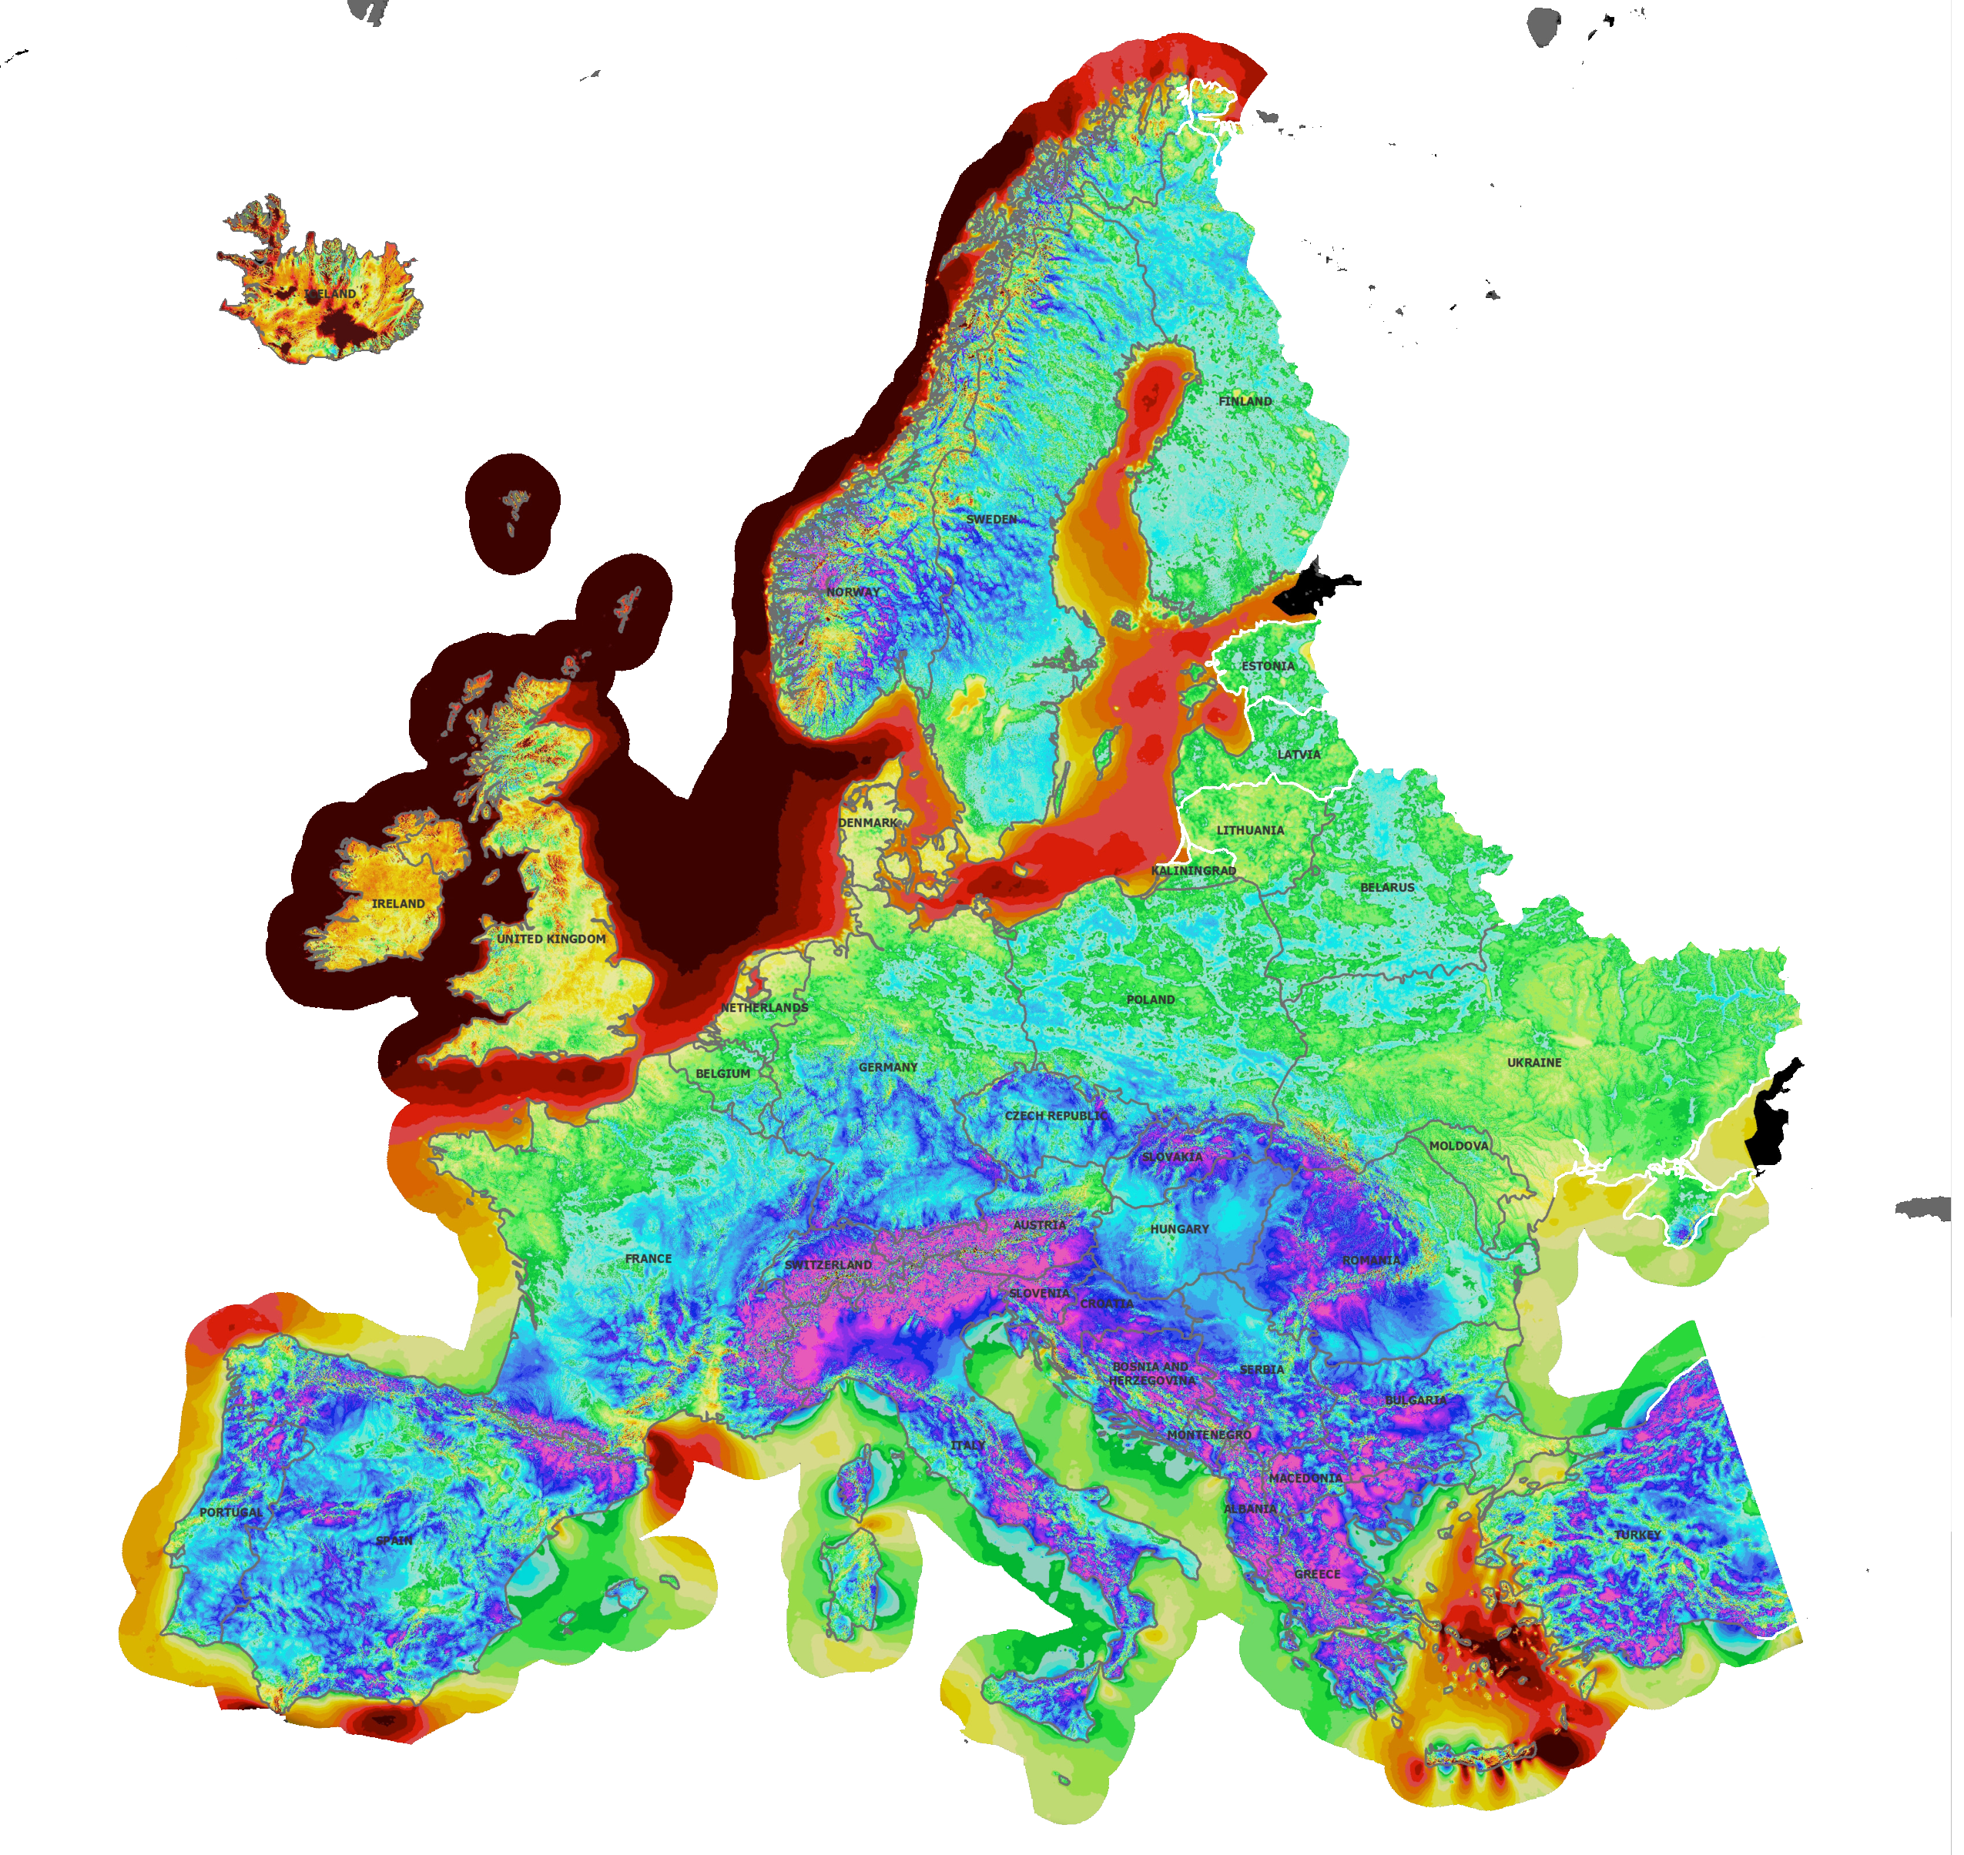
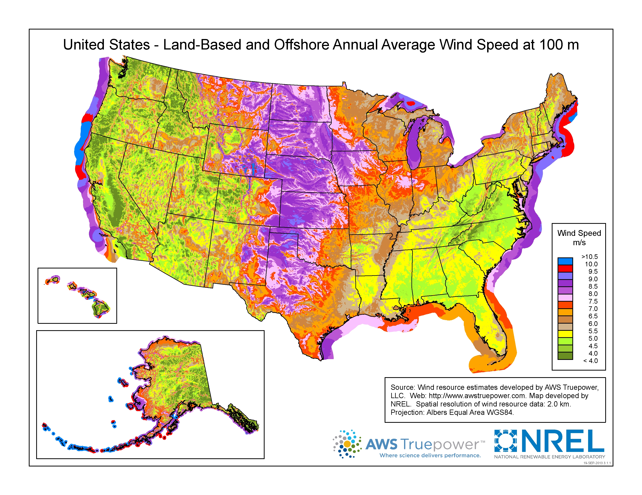
Concerning wind, the big takeaways from Part I were:
Wind's power increases as its velocity cubed:
SLIGHTLY faster winds => VASTLY greater wind power
And where are the surest places to find faster winds?
Higher off the ground AND Off our northern coasts:
Fastest = Brown/Red Fastest = Blue / Red:
Wind Power - Part I (pptx / pdf / key):
Left: https://aws-dewi.ul.com/assets/Wind-Resource-Map-EUROPE-11x17.pdf Right: www.nrel.gov/gis/wind.html

Slide 4
Offshore Wind Power
An Introduction to Sustainable Energy Systems: WeCanFigureThisOut.org/ENERGY/Energy_home.htm

Slide 5
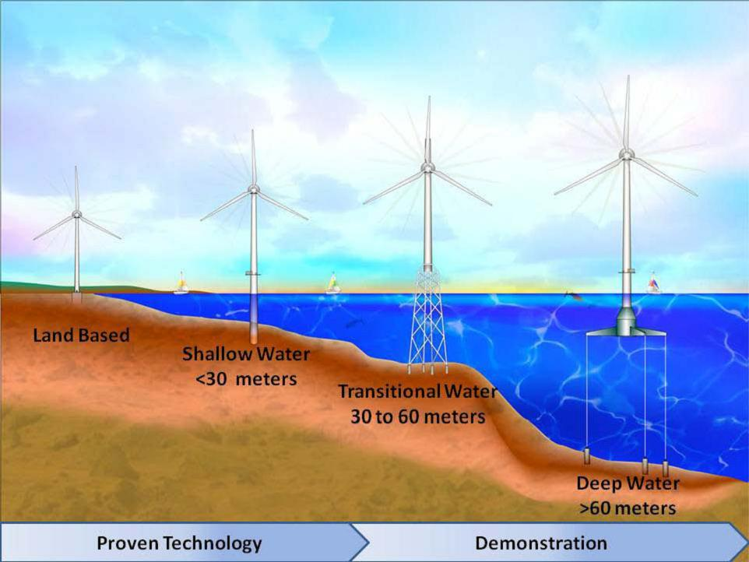
Construction of offshore wind turbines is a lot more difficult:
This U.S. government graphic predicted that for turbines in water of depths:
≤ 30 meters: Fixed tubular bases could be still driven into the seabed
30-60 meters: Complex underwater towers would instead be required
> 60 meters: Floating semi-submerged platforms would become necessary
http://www.boem.gov/renewable-energy-program/renewable-energy-guide/offshore-wind-energy.aspx

Slide 6
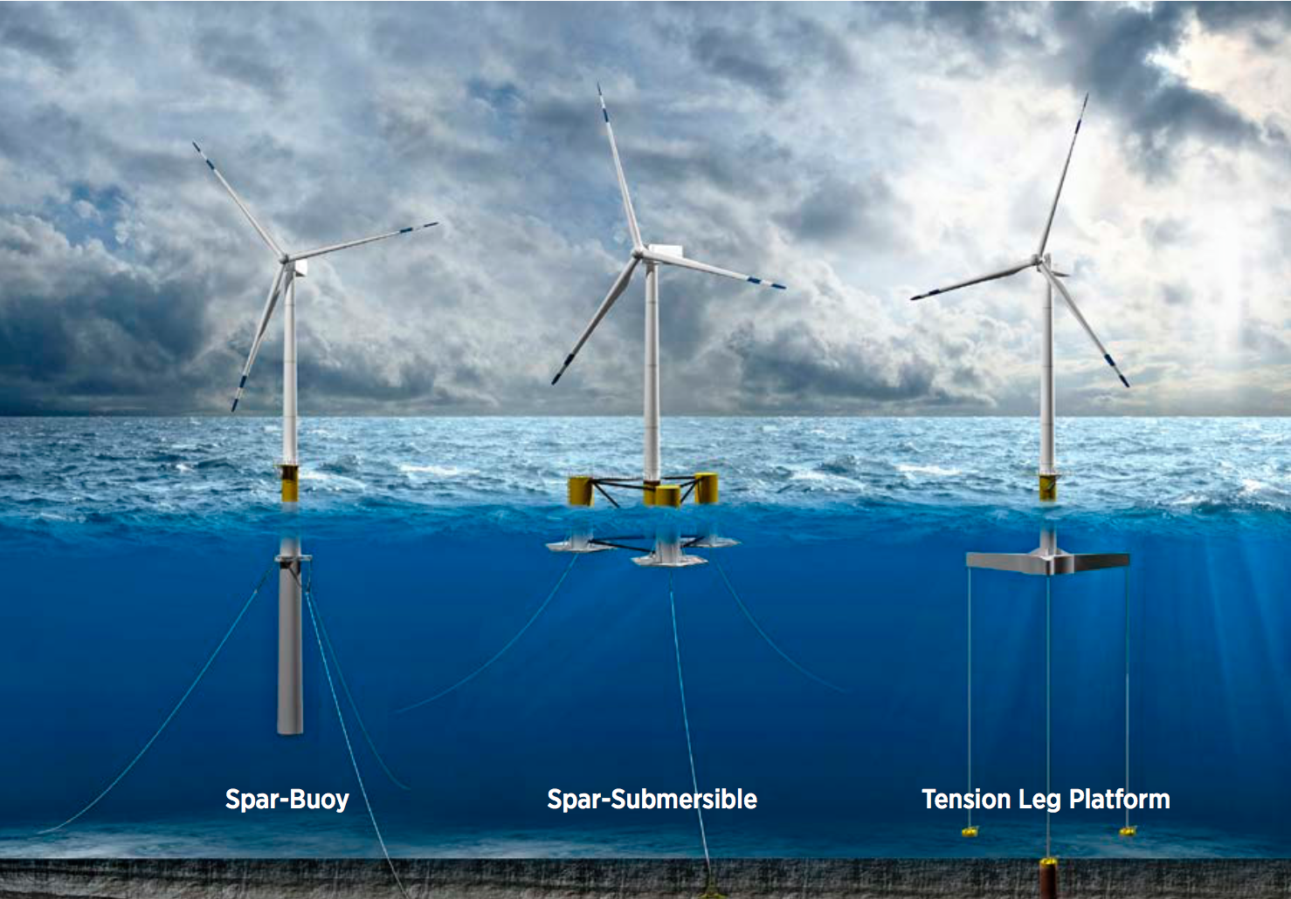
The DOE's "Wind Vision" then identified three classes of floating turbines: ¹
1) p 45. Wind Vision Report – US DOE: https://www.energy.gov/eere/wind/wind-vision

Slide 7
But even shallow technologies were thought to be hopelessly expensive:
Early in this decade the U.S. Energy Information Administration (EIA)
estimated the cost of wind power above even < 30 meter deep seas
as almost three times more expensive than onshore wind ¹
Further, residents of U.S. resort islands off the shores of New England
objected strenuously (and effectively) about offshore turbines' visual impact
Finally, even if the cost of shallow fixed based turbines could be reduced,
30 meters (98 feet) doesn't sound very deep, suggesting that offshore turbines
could only be built in a very narrow band very close to U.S. shores
Off our eastern shores, at least, that last objection turns out to be wrong:
See my web note set Power Plant Economics – Analysis Techniques & Data (pptx / pdf / key) for details

Slide 8
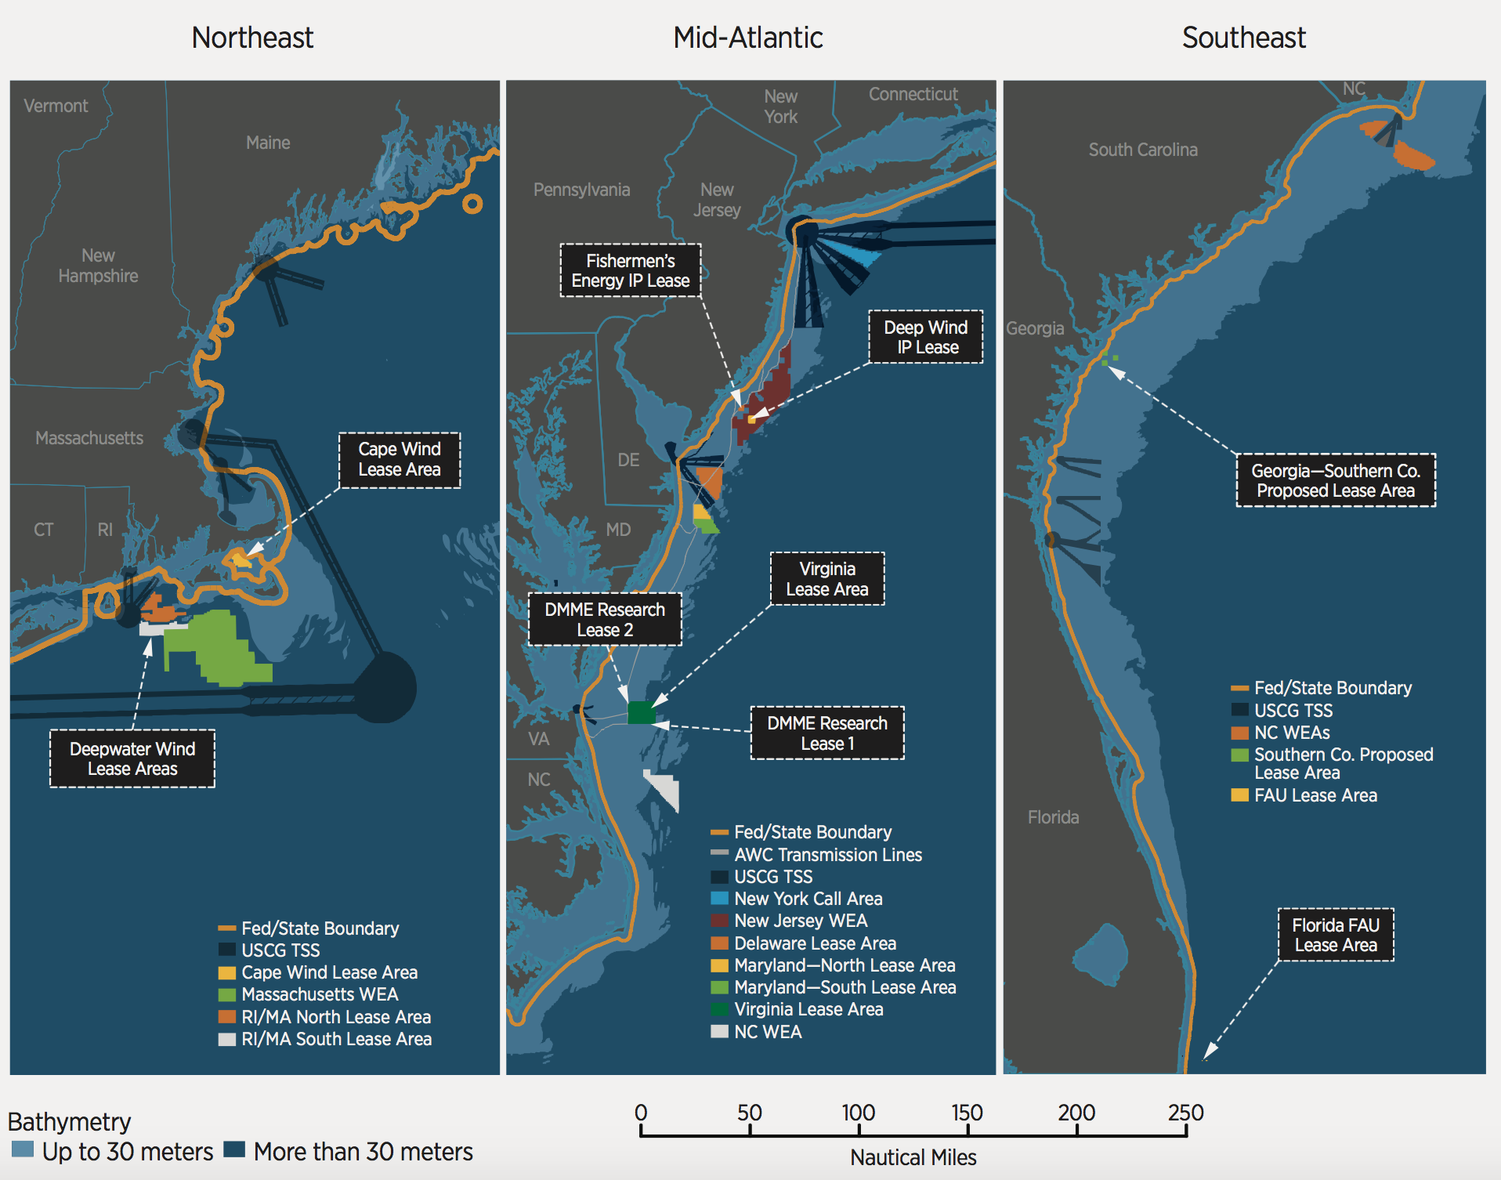
30 meters depth takes you a surprisingly long way off some U.S. shores:
The lighter blue band in these figures is for depths up to 30 meters
Along much of the U.S. east coast, that band is nearly 50 miles wide ¹
1) p 75. Wind Vision Report – US DOE: https://www.energy.gov/eere/wind/wind-vision

Slide 9
But what about the 3X higher cost of even 30 meter deep turbines?
That EIA cost analysis, compounded by concerns about ruining resort island views,
led the U.S. to essentially ignore development of offshore wind power
In contrast, Northern Europeans (including British, Danes and Germans)
lack many of our more affordable energy alternatives,
but their adjacent North & Irish Seas are unusually shallow
And as a result, they aggressively pursued development of offshore wind power
Which has produced some very interesting,
and possibly game-changing, developments:
An Introduction to Sustainable Energy Systems: WeCanFigureThisOut.org/ENERGY/Energy_home.htm

Slide 10
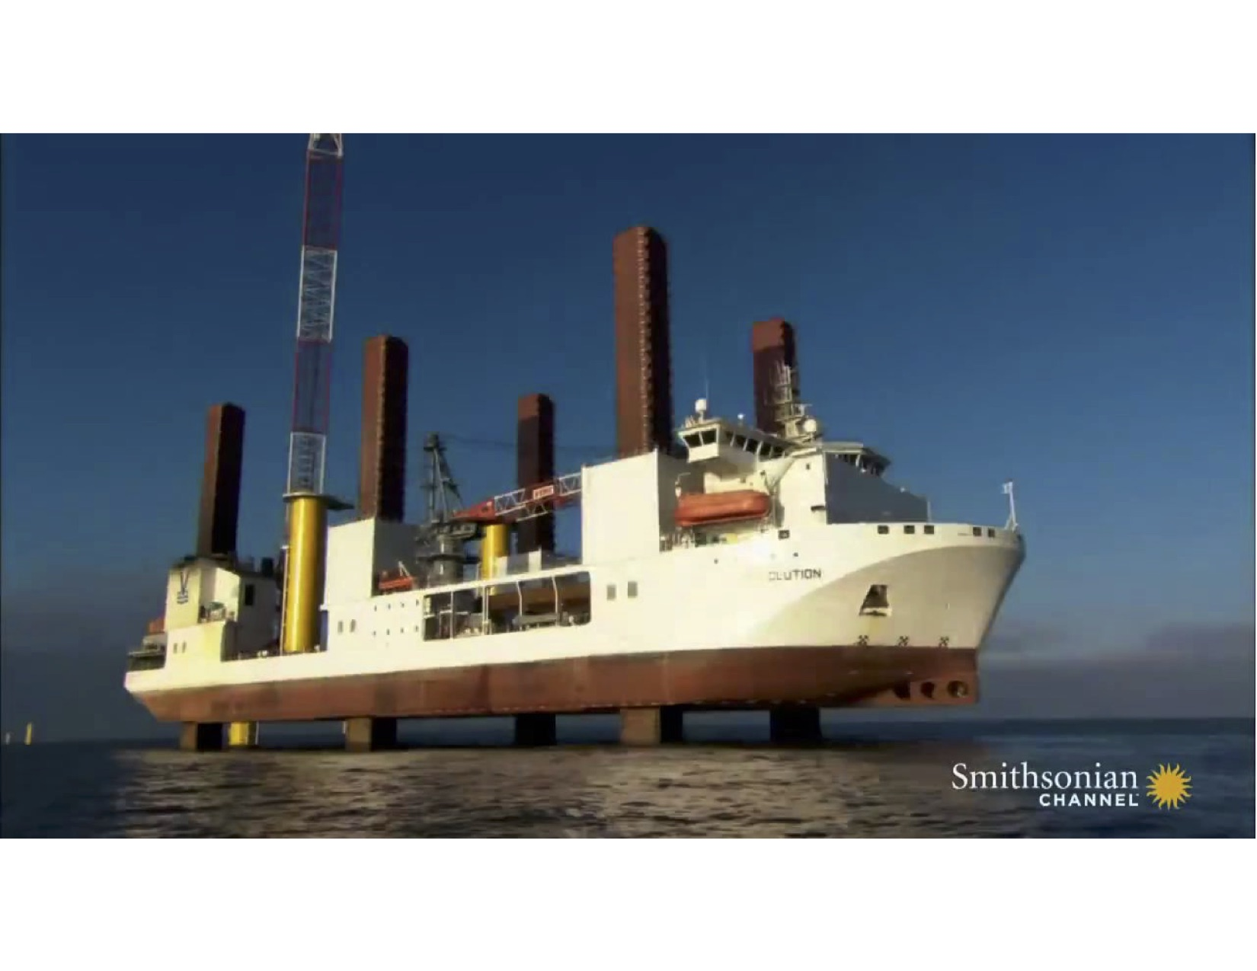
One development challenges the limits of fixed base shallow water turbines:
Ships are now built for the sole purpose of installing offshore wind turbines
This one has six legs that actually lift it above the ocean surface
Turbine bases are then pile-driven into ocean bottom in as little as one day
Which should sharply reduce offshore wind farm construction costs
Further, this ship can drive in foundations beneath water up to 50 meters deep
Versus the earlier U.S. government figure's claimed limit of "< 30 meters"
An Introduction to Sustainable Energy Systems: www.virlab.virginia.edu/Energy_class/Energy_class.htm

Slide 11
This ship was the subject of a Smithsonian Channel documentary:
From which a two minute clip was posted on the web:
YouTube link: https://www.youtube.com/watch?v=QltAyg_R2go
(I have also cached a copy of that clip on this note set's Resources Webpage)
An Introduction to Sustainable Energy Systems: www.virlab.virginia.edu/Energy_class/Energy_class.htm

Slide 12
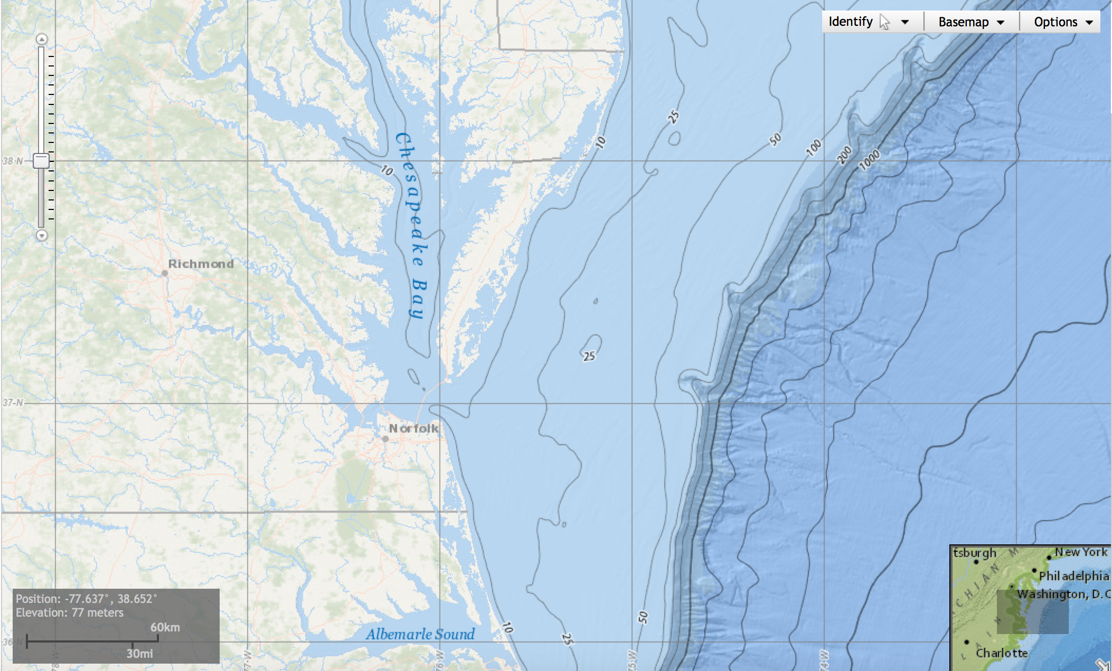
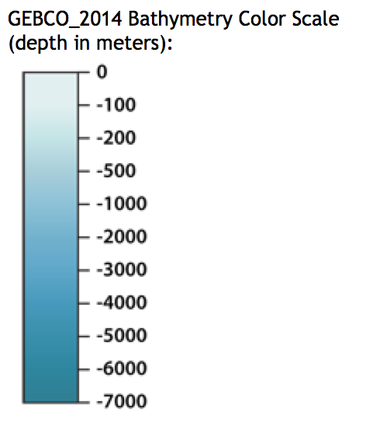
How far out would this ship's 50 meter depth range take us?
Here I've sketched in lines 30 and 60 miles off the Virginia coast
The faint black line between them calls out 50 meter depth (blue label)
50 meter depth takes us almost to the edge of the continental shelf
50 meters
30 mi
60 mi
Background NOAA map: http://maps.ngdc.noaa.gov/viewers/bathymetry/

Slide 13
Anticipating my later discussion of NIMBY ("Not in MY Backyard!"):
To disappear below the horizon, how far offshore would a wind turbine have to be?
A modern 6 MW wind turbine rises to about 175 meters ¹ = H
The earth's radius is 6371 km (3959 miles) = R, calling on Pythagoras:
X² + R² = (R + H)² = R² + H² + 2RH
Or X² = H² + 2RH
But R >> H, making 2RH >> H², so the equation becomes:
X² ~ 2RH Or X ~ √(2RH)
Thus, for H = 175 m and R = 6.4 x 10⁶ m, we get:
X = 47 kilometers = 28 miles
From shore the entire turbine is below the horizon if it's > 30 miles out
MUCH of it is below horizon 15 miles out => ¾ of VA continental shelf
X=?
H
R
R
Earth
1) Per the data on Siemens 6MW turbines given on the immediately following slides

Slide 14
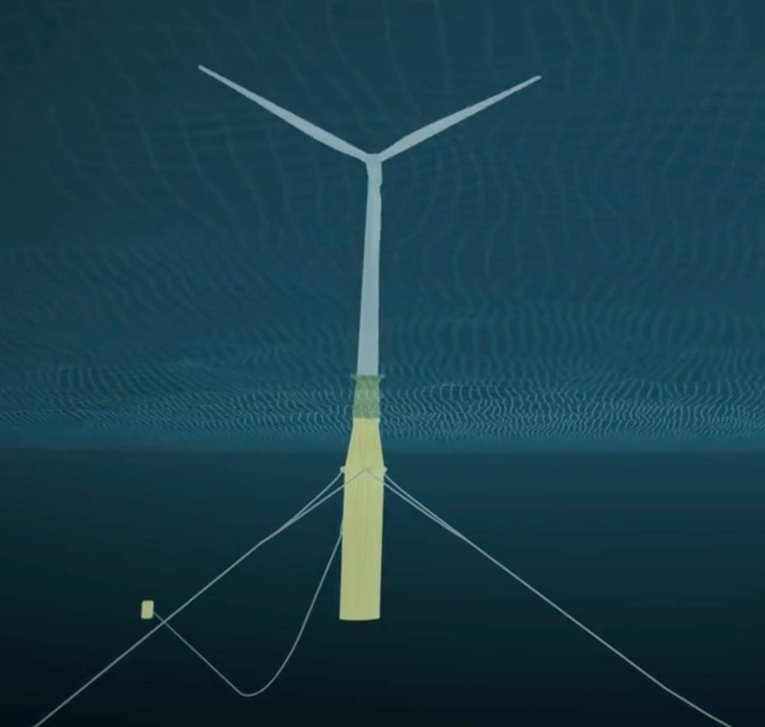
And the 1st ever Floating Wind Farm may render depth limits obsolete:
Developed by a company that's built & maintained offshore oil platforms for 40 years
Completed in the fall of 2017, twenty-five kilometers off Scotland's eastern coast:
Five 6 MW, 154 meter diameter turbines,
towering 175 meters above sea level,
with an additional 78 meters of buoyant "spar buoy" below sea level,
attached to three seabed "suction anchors" (and electrical cables) ¹
1) From "Hywind Scotland" brochure:
https://www.equinor.com/content/dam/statoil/documents/newsroom-additional-documents/news-attachments/brochure-hywind-a4.pdf

Slide 15
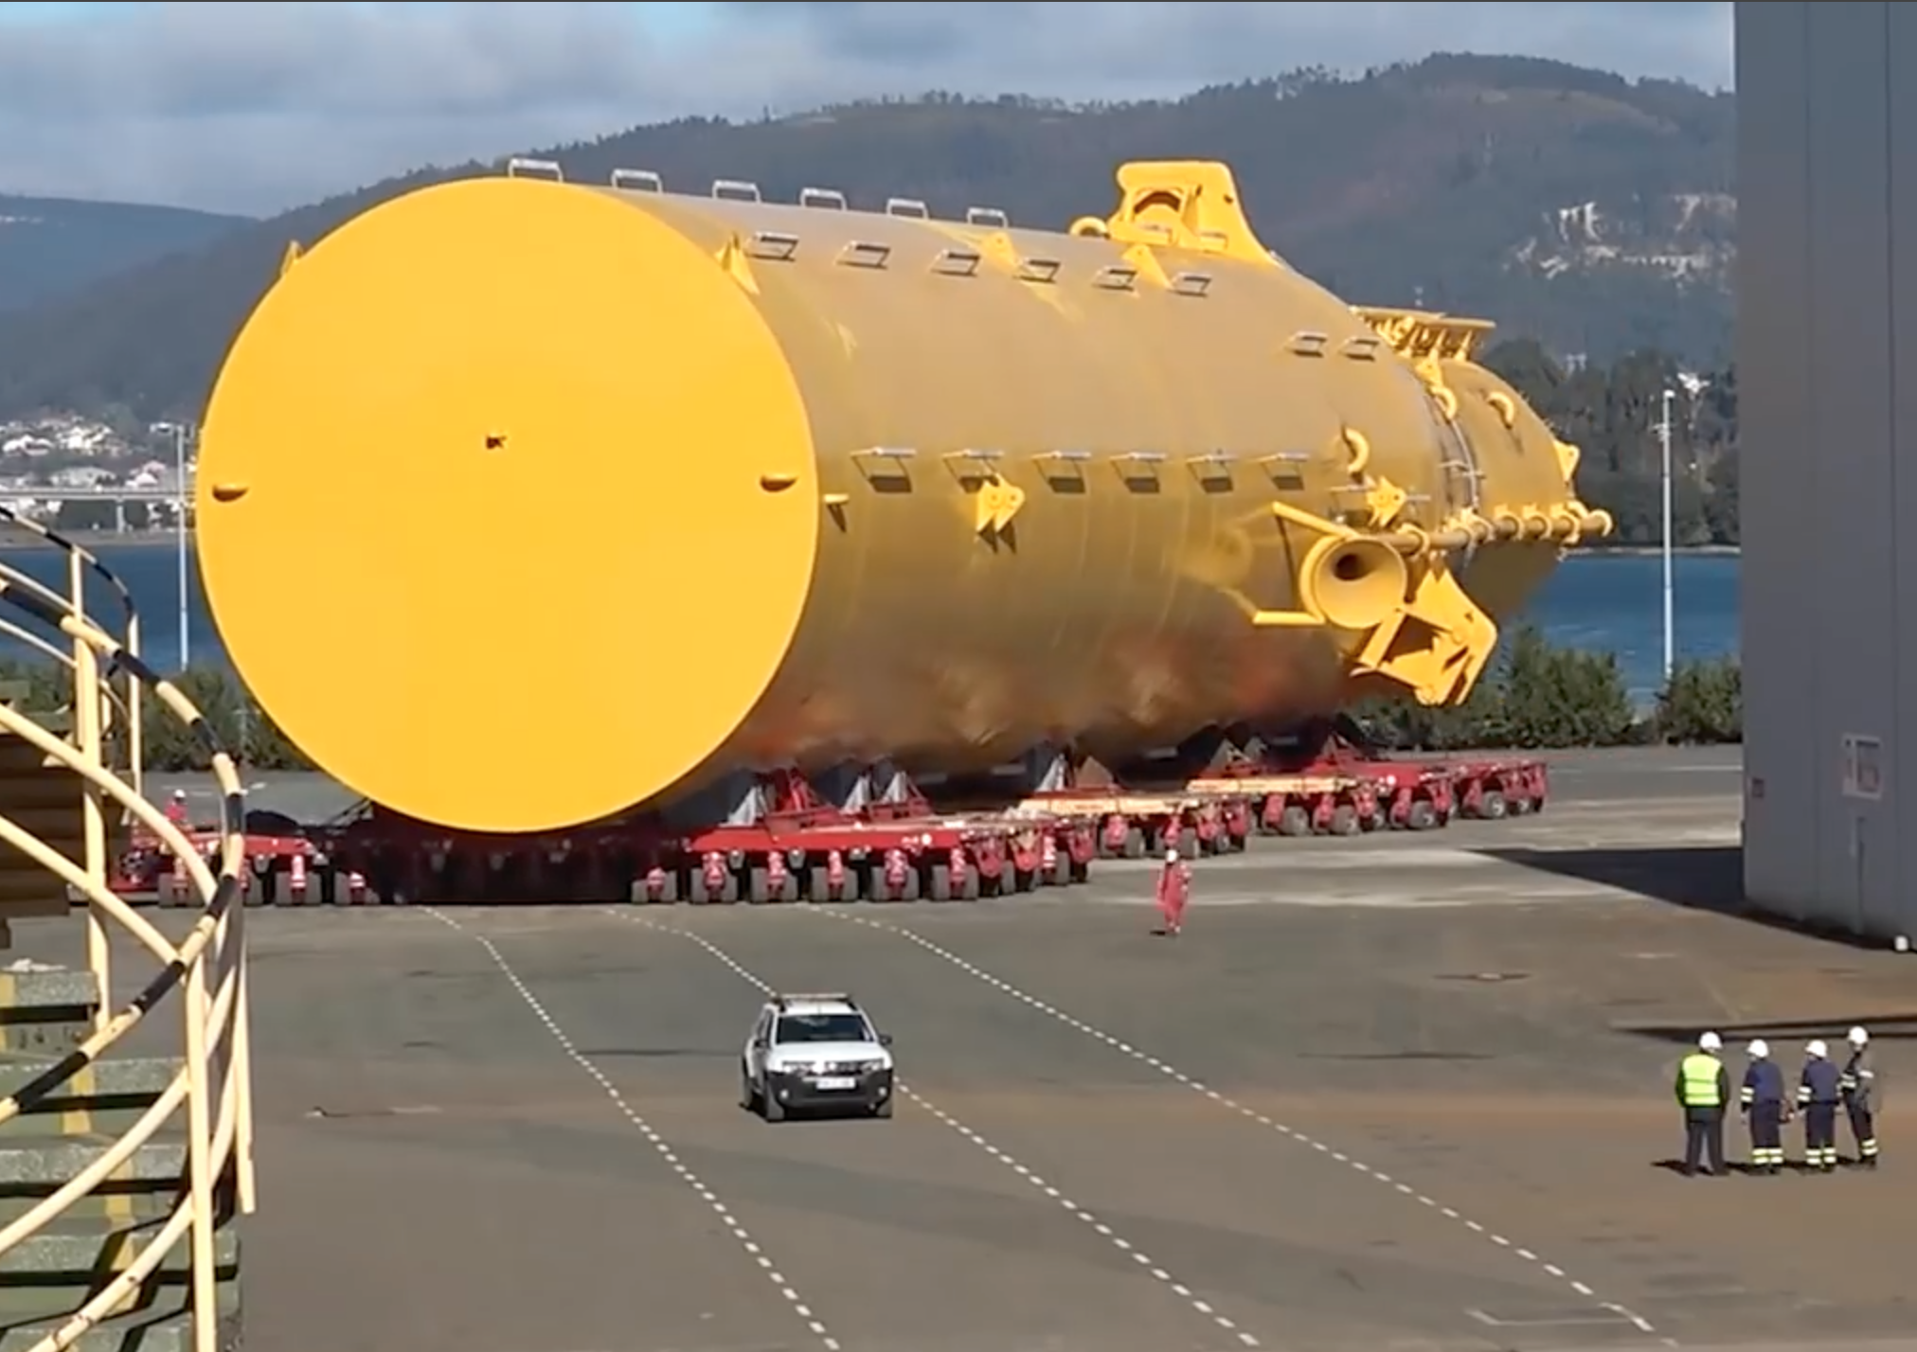
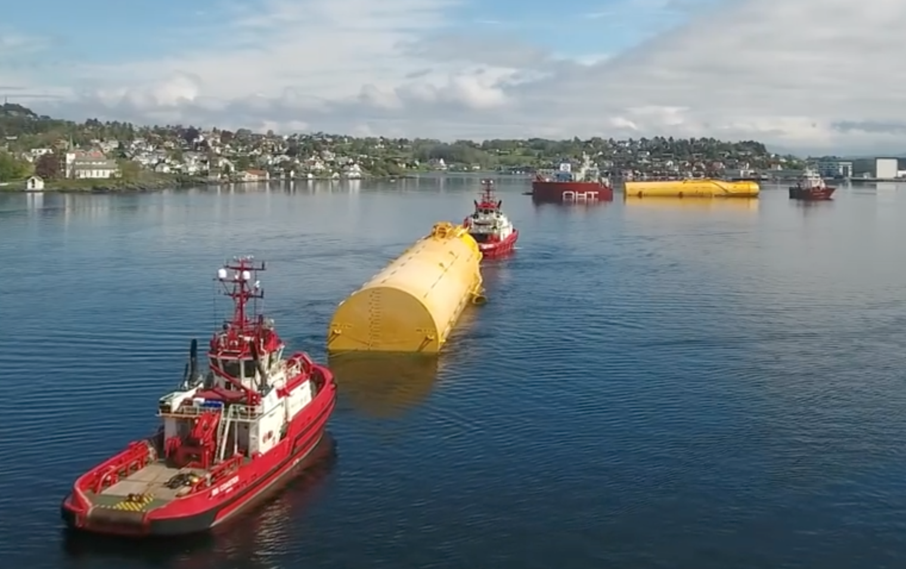
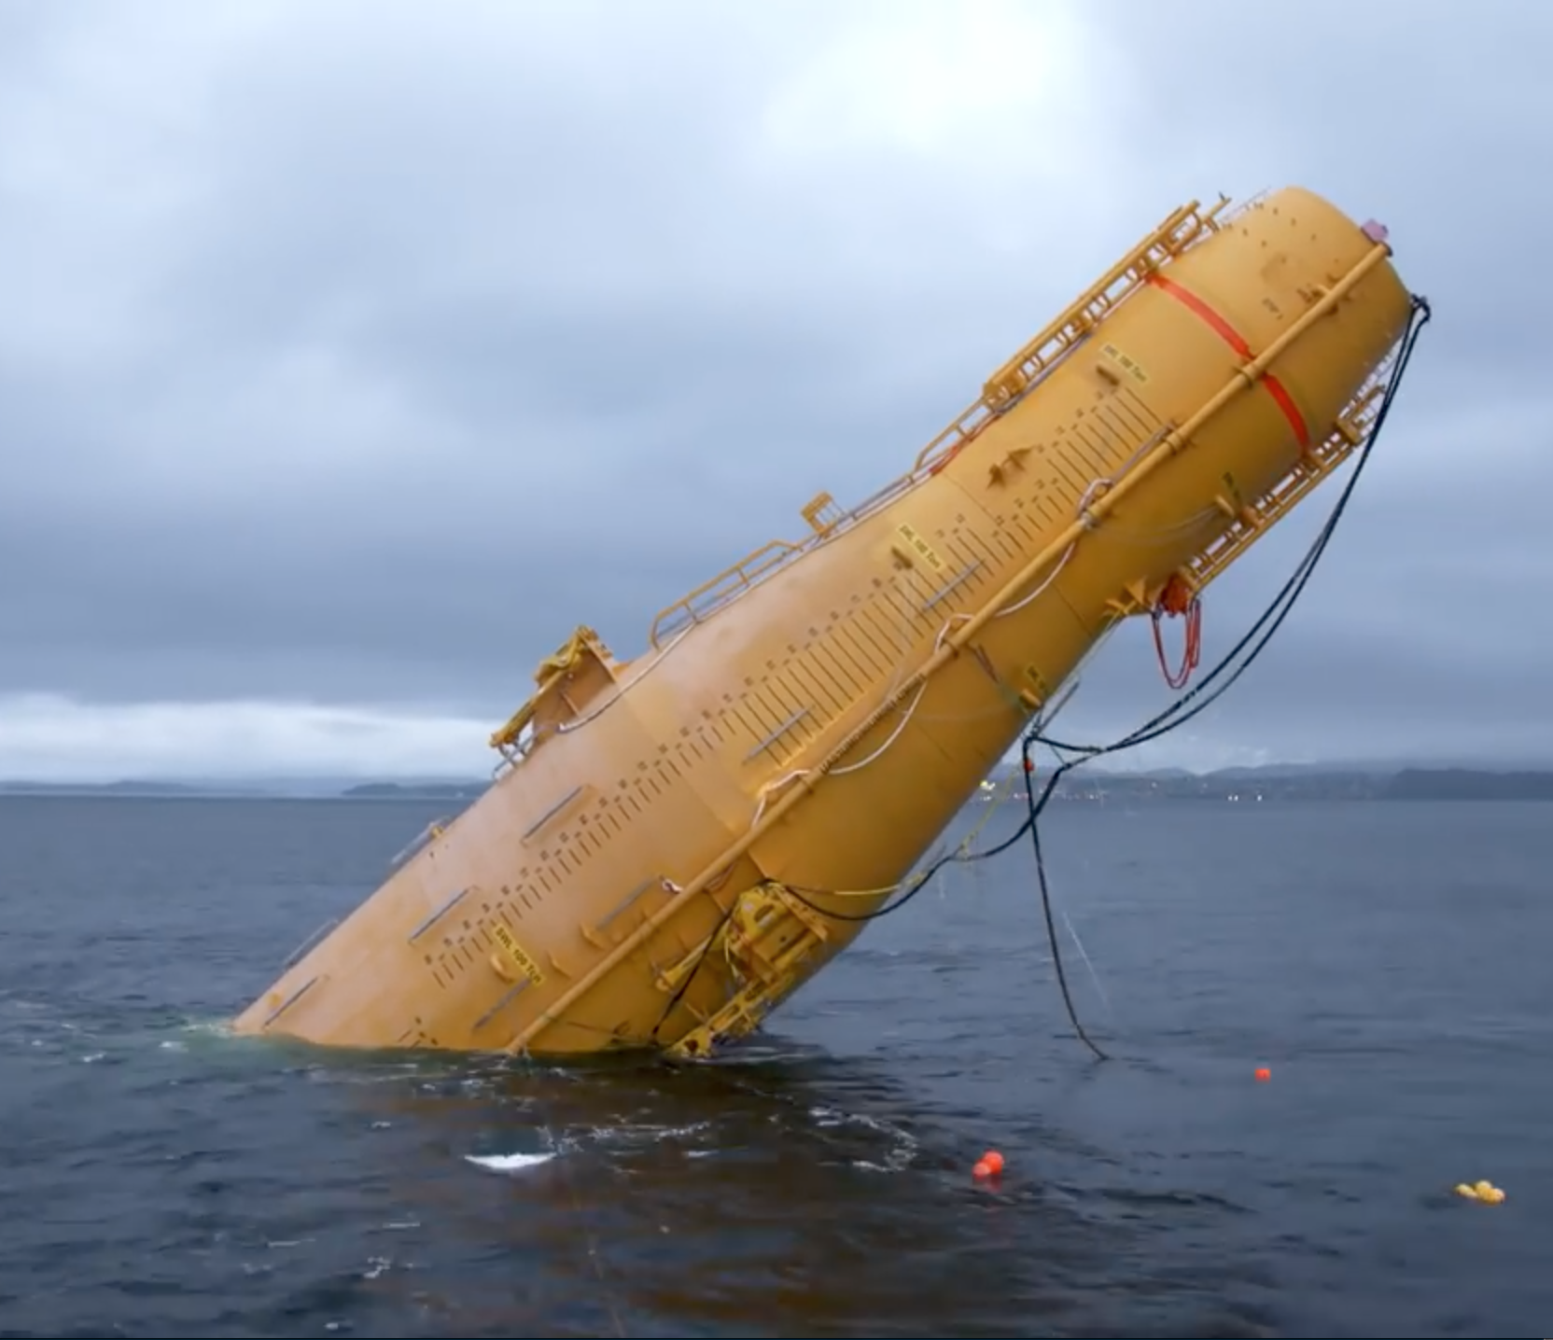
Construction of the floating bases:
Bases were fabricated in Spain, then floated into a Norwegian assembly harbor:
In that harbor, 5000 tonnes of iron ore was poured into each base, tilting it upright:
Pictures and information from:
https://www.youtube.com/watch?v=PUlfvXaISvc&vl=en

Slide 16
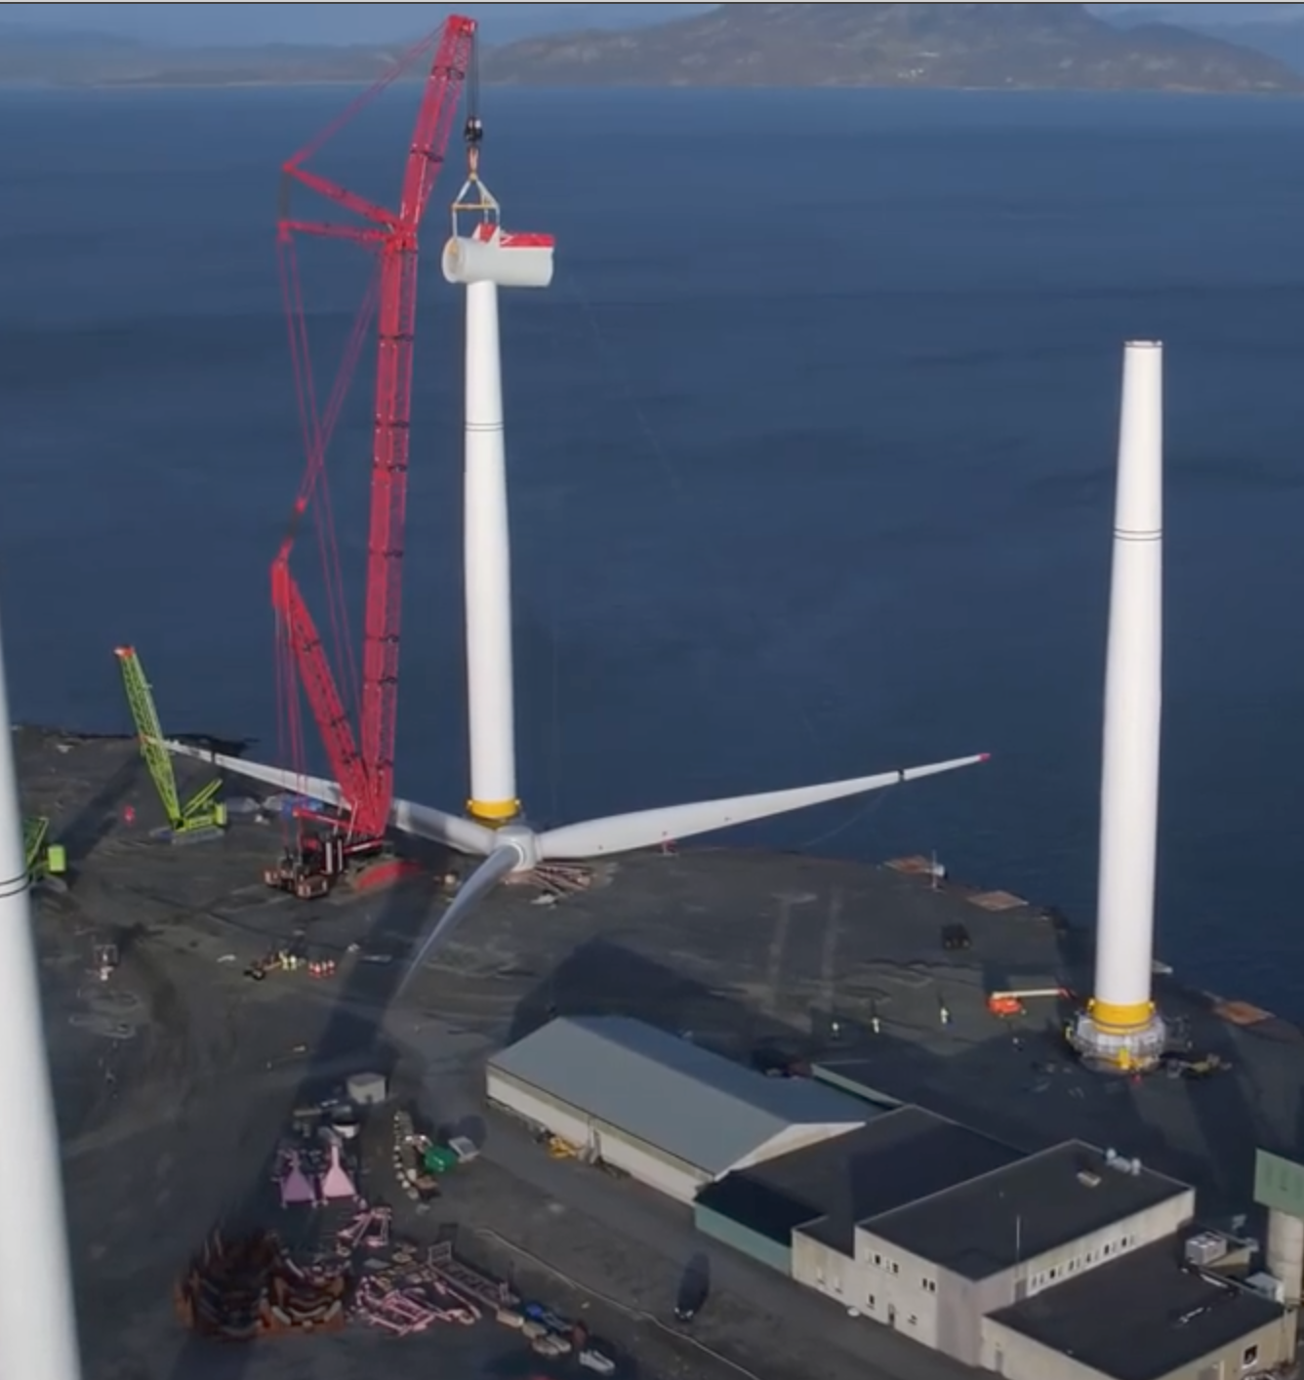
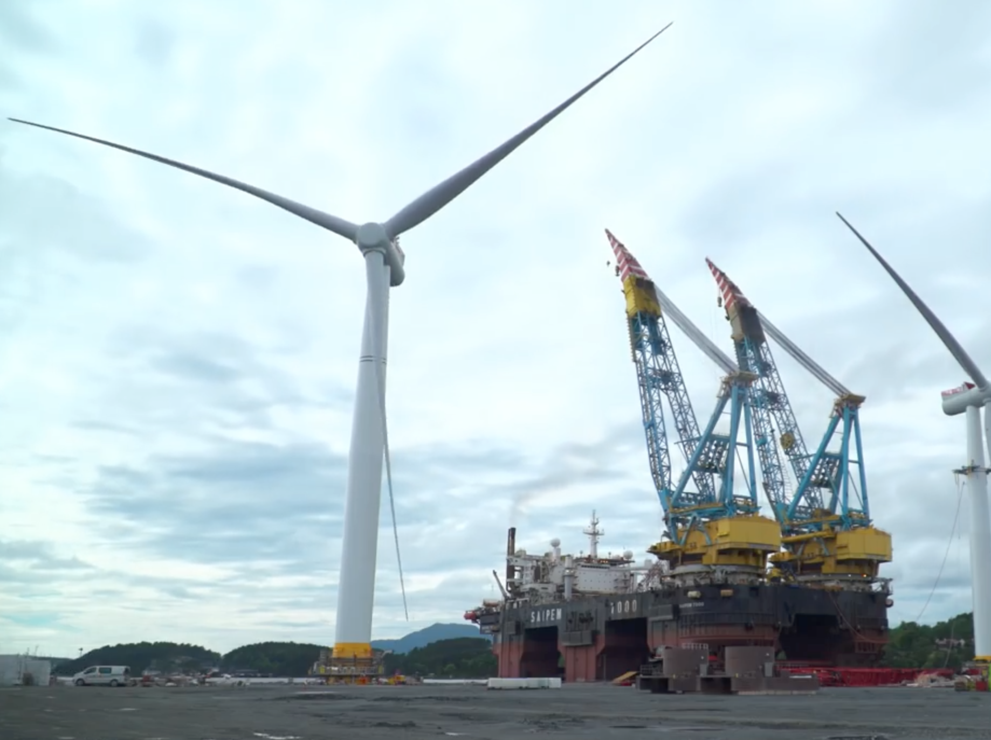
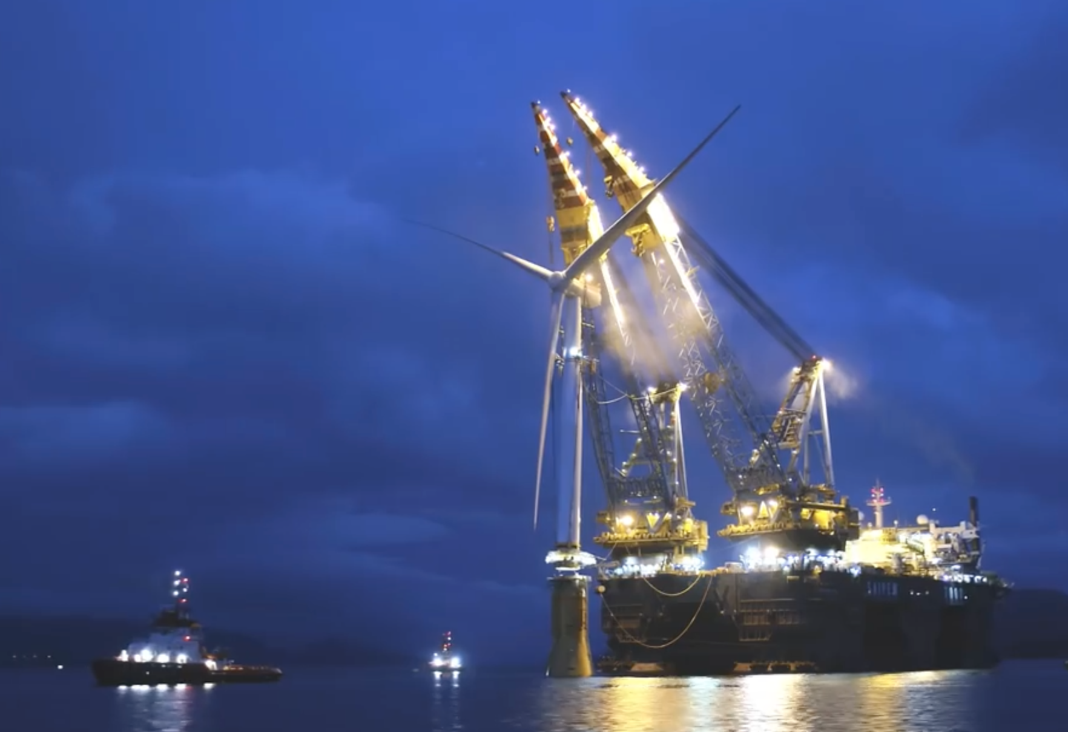
Assembly of the floating turbines:
Siemens SWT-6.0-154 turbines ¹ were assembled onshore at water's edge,
with a floating crane barge standing by:
Moving out into the assembly harbor, that barge mated turbines with floating bases:
Pictures and information from:
https://www.youtube.com/watch?v=PUlfvXaISvc&vl=en
1) https://www.4coffshore.com/windfarms/contracts-on-hywind-scotland-pilot-park-uk76.html

Slide 17
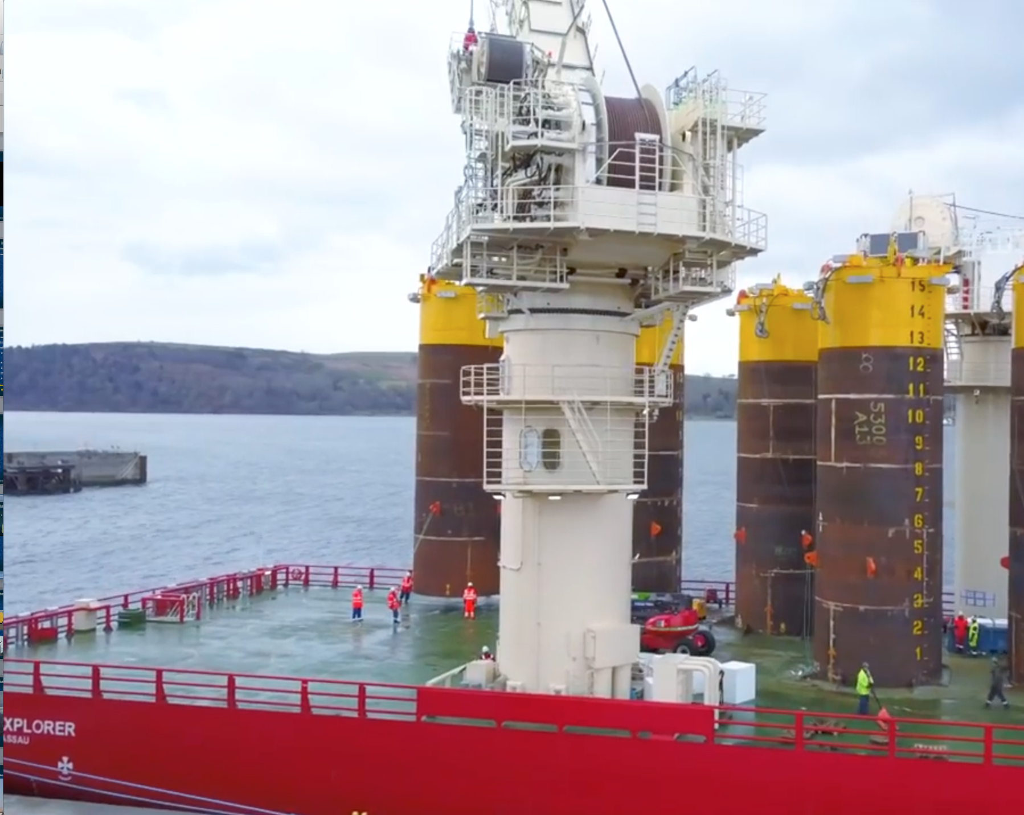
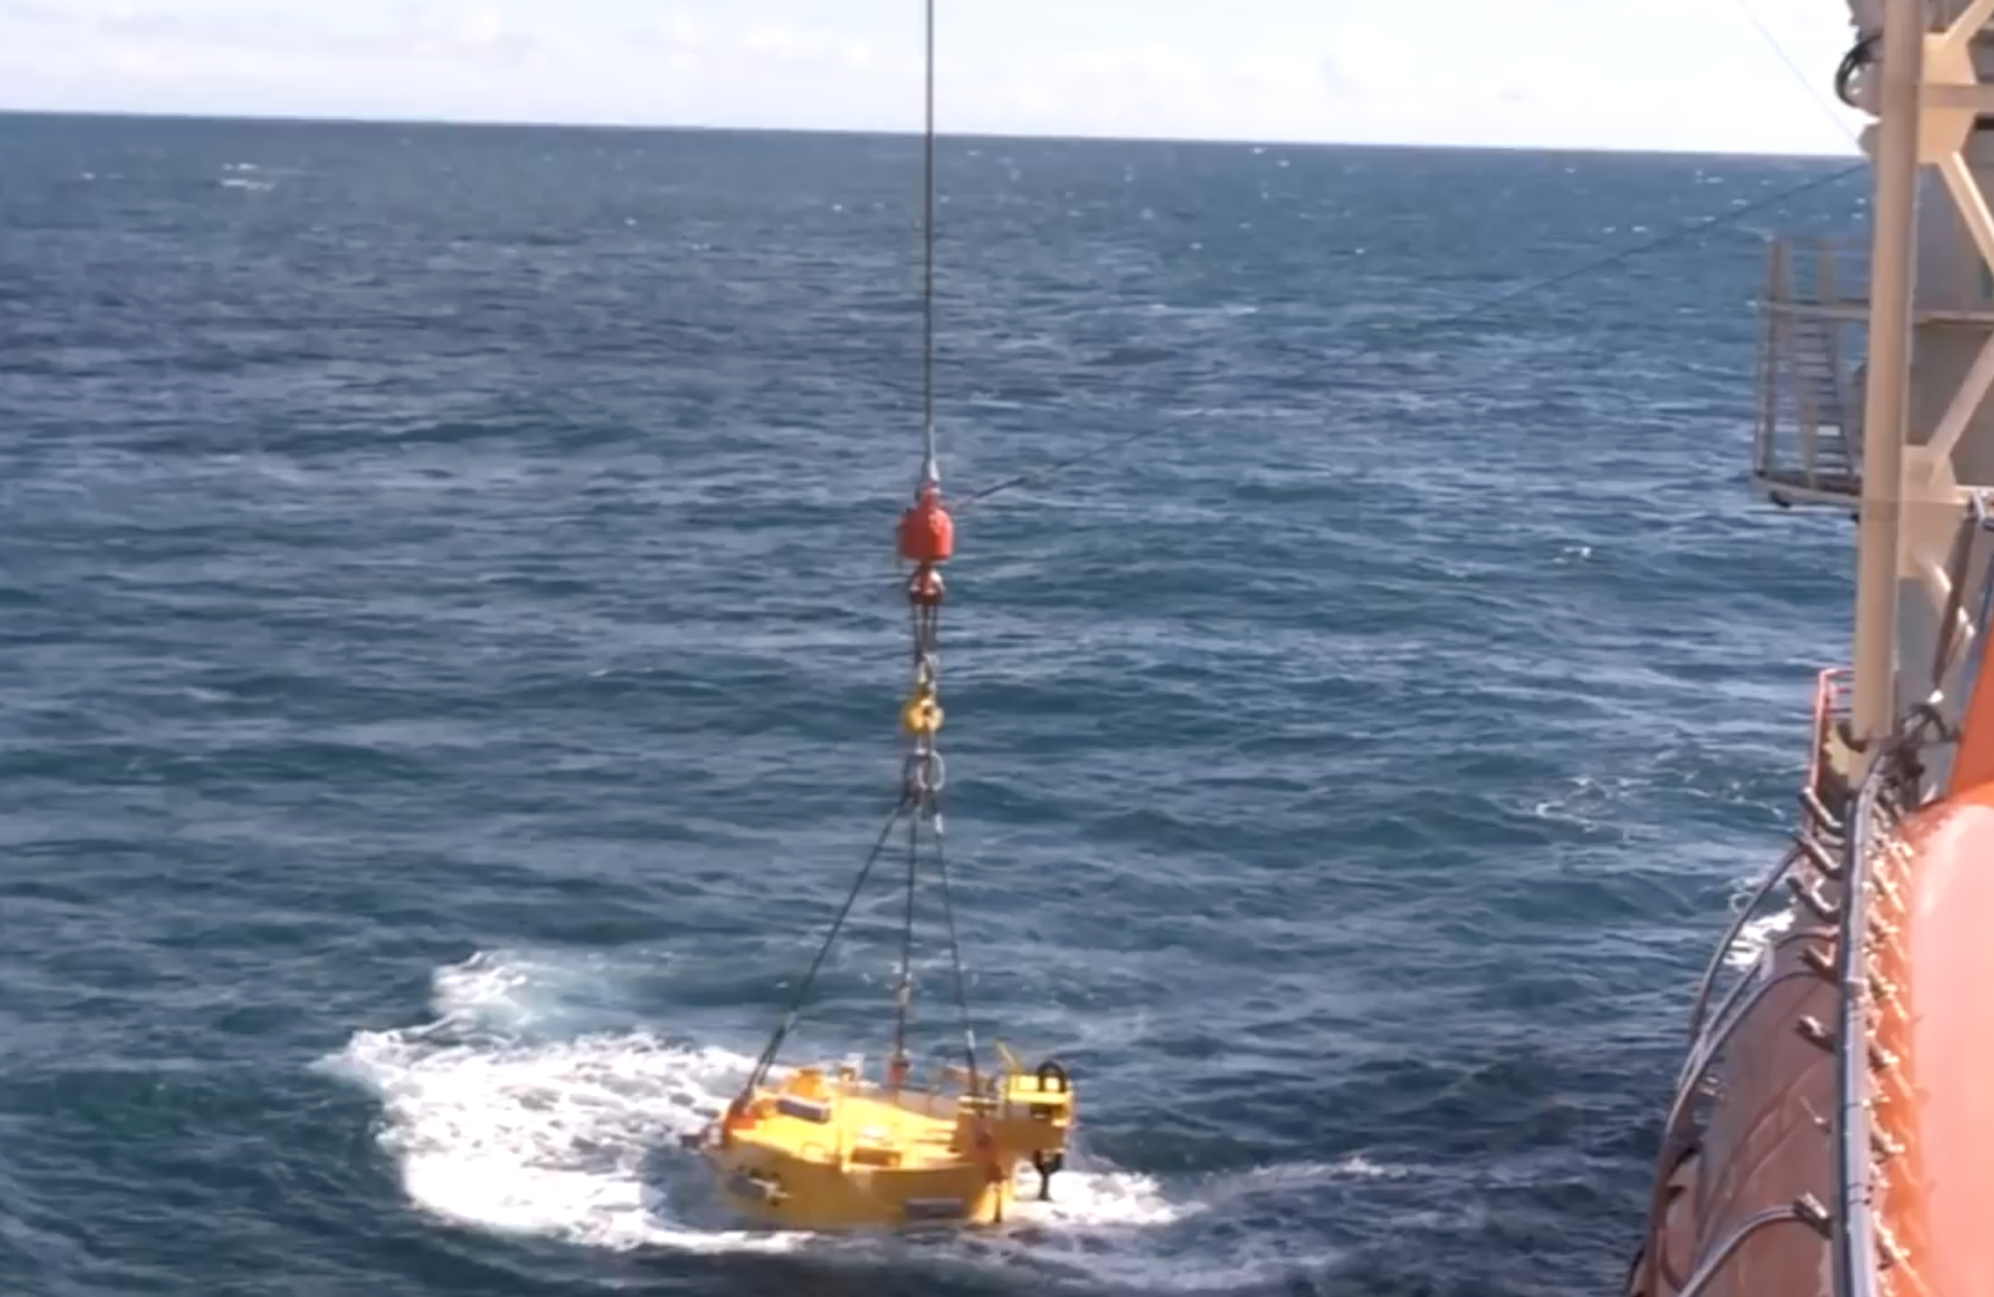
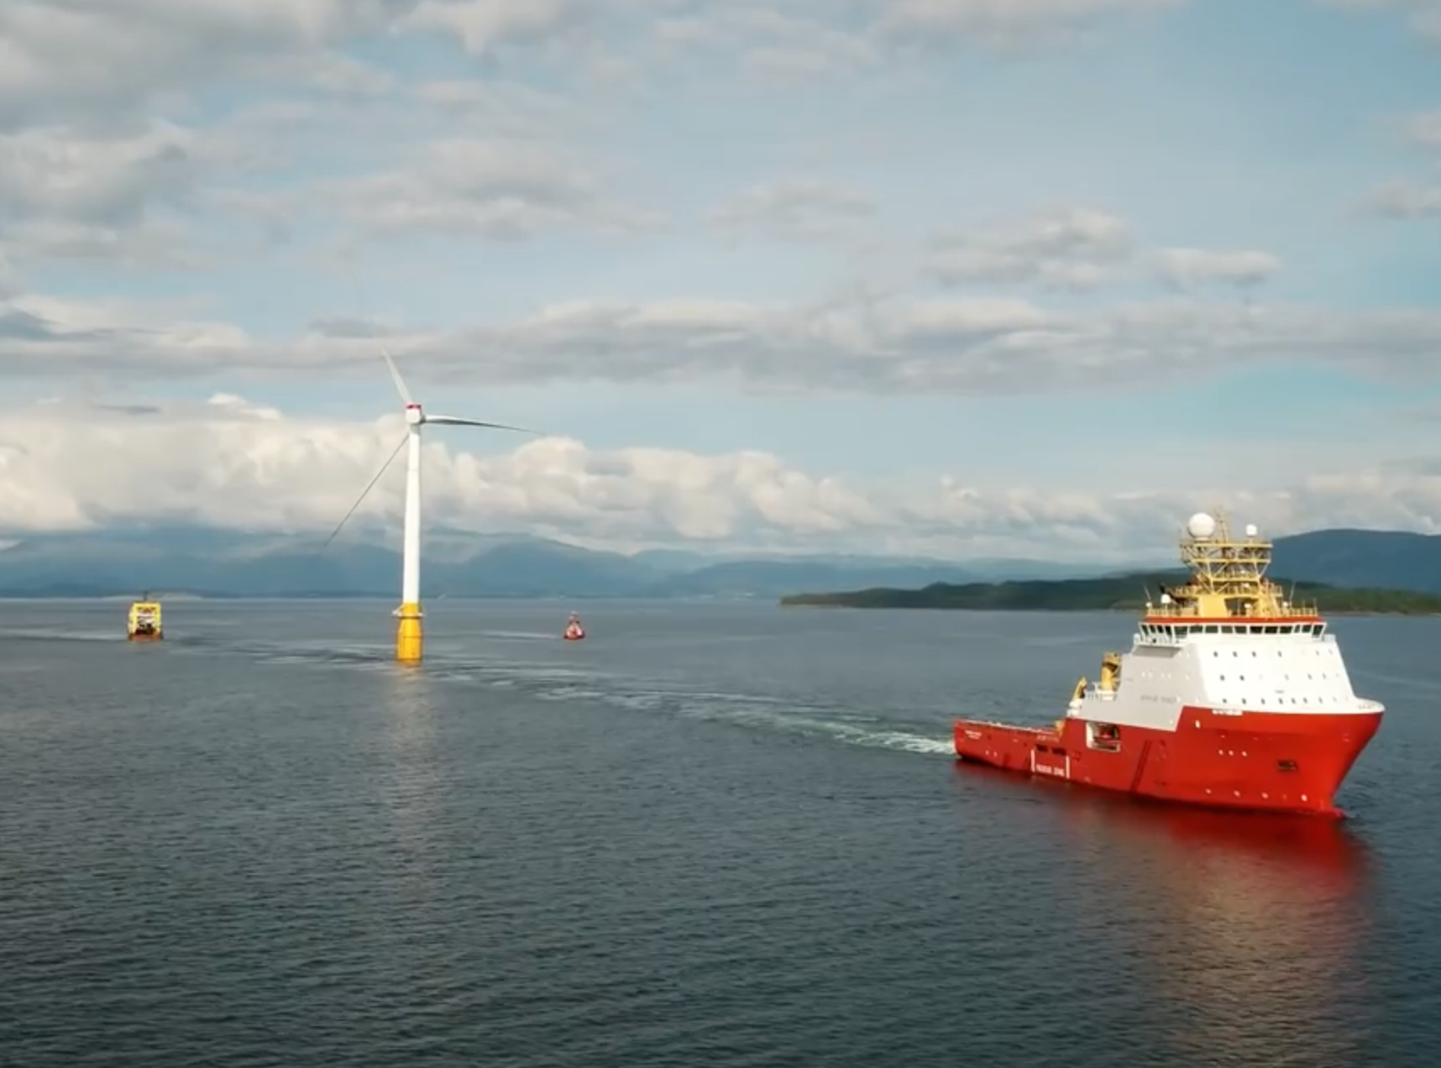
Transport to wind farm site off Scotland:
111 tonne Scottish made "suction anchors" were loaded onto a transport vessel,
then lowered to sea bottom 25 km offshore at wind farm site:
Floating turbines were towed from Norway to that farm & connected to those anchors:
Pictures and information from:
https://www.youtube.com/watch?v=PUlfvXaISvc&vl=en

Slide 18
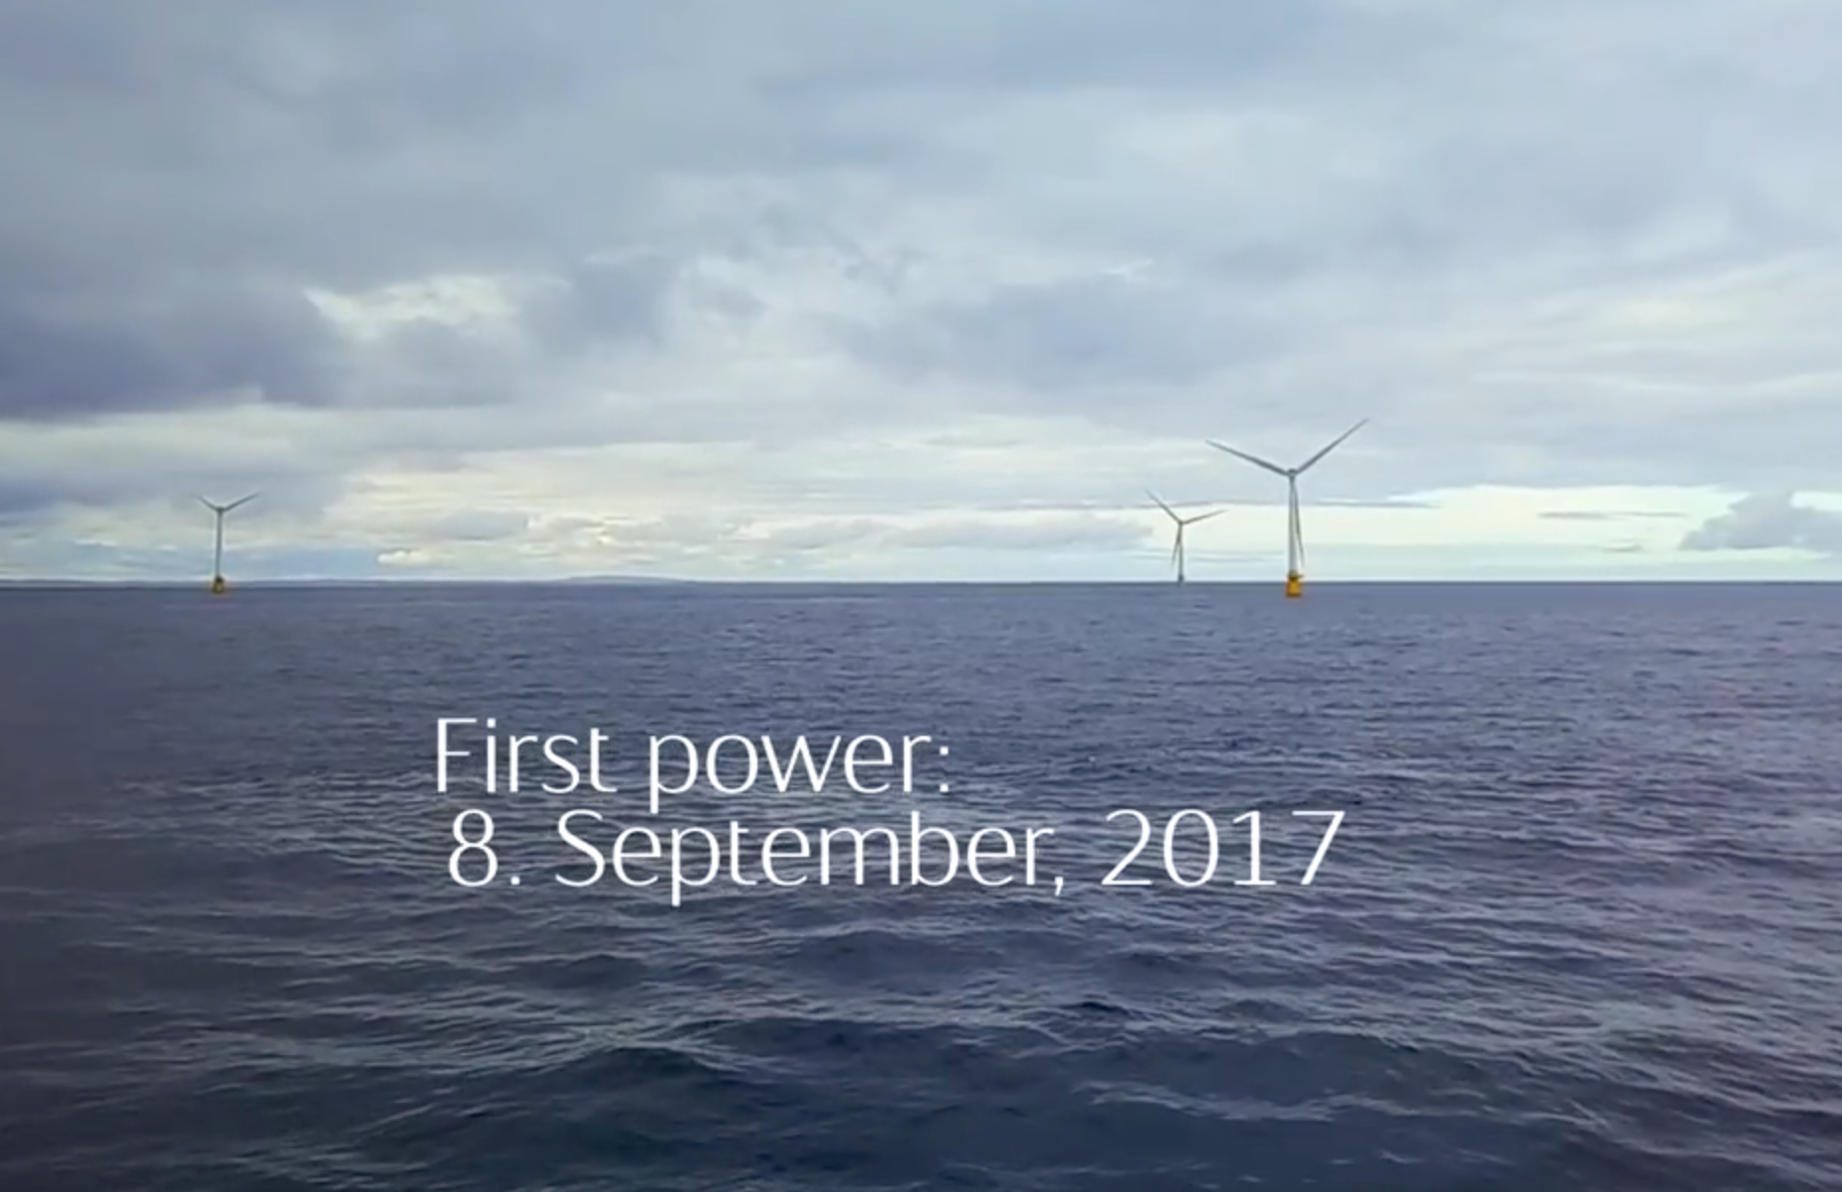
Statoil's video about their "Hywind-Scotland" - 1st ever floating Wind Farm:
= The source of most of the preceding images and information
YouTube link: https://www.youtube.com/watch?v=PUlfvXaISvc&vl=en
(I have also cached a copy of that video on this note set's Resources Webpage)
An Introduction to Sustainable Energy Systems: WeCanFigureThisOut.org/ENERGY/Energy_home.htm

Slide 19
Hywind-Scotland has operated exceptionally well in its first year:
The wind industry press reports that over its first three months of operation: ¹
It produced average power output at 65% of its capacity
(which should mean average power of 5 x 6 MW x 0.65 = 19.5 MW)
Further, that 65% level included brushes with two major storms:
October's hurricane Ophelia, which produced 125 km/hr winds at the wind farm
(which would then/there make it a Category 1 hurricane) ²
And December's Caroline, which produced gusts to 160 km
(which, had they been sustained, would qualify as Category 2) ²
Hywind's 65% of capacity output was compared to fixed (shallow water) wind farms
which the article claimed typically produce average power at 45-60% capacity
(consistent with 2018 EIA number of 45% for offshore wind farms) ³
1) https://www.offshorewind.biz/2018/02/15/worlds-first-floating-wind-farm-outdelivers/
2) https://en.wikipedia.org/wiki/Saffir%E2%80%93Simpson_scale
3) See my web note set on: Power Plant Economics – Analysis Techniques & Data (pptx / pdf / key)

Slide 20
But what about NIMBY? Per my earlier calculation of view horizons:
That Floating Wind Farm would be completely below the horizon (thus invisible)
if it were situated more than 47 km (28 miles) offshore
But what if it weren't that far offshore (as the Hywind Scottish wind farm is not!):
How objectionable would its appearance still be?
I decided to simulate an offshore turbine's appearance from onshore:
I found a photo with a beach view off the "Jersey Shore" of the U.S.
It appears to have ~30° field of view (a slightly magnified telephoto image)
(But similar to what you'd notice if you stared directly offshore)
I calculated how big a 175 m tall wind turbine (+ 330 m cruise ship)
would appear in such a beach view - for different distances off shore: ¹
1) My spreadsheet calculations are downloadable from this note set's Resources Webpage

Slide 21

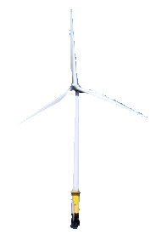
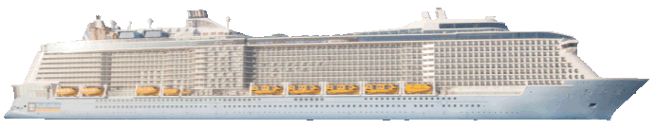
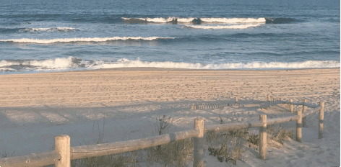
Simulated views of offshore wind turbine + cruise ship:
Wind turbine: 175 m (574') tall (Hywind-Scotland / Siemens 6 MW turbine)
Cruise ship: 335 m (1100') long x 63 m (227') tall (large modern cruise ship)
Use PgDn Key
3 km offshore
5 km offshore
10 km offshore
15 km offshore
(Still well above the horizon, wind turbine is already almost invisible)
Based on my estimate that this photo had ~ 30° wide field of view, and was shot at ~ 5 m above sea level

Slide 22
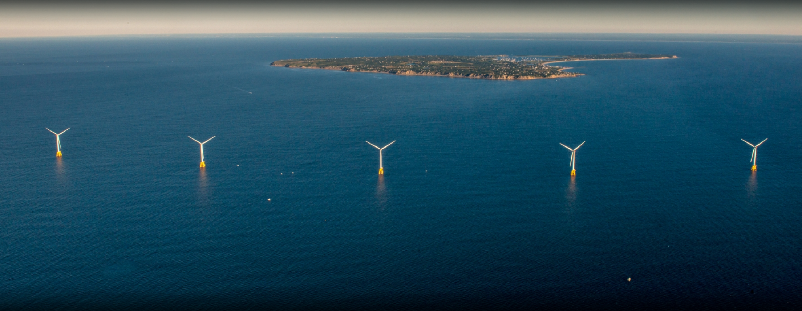
All of which has led the U.S. to reconsider offshore wind power:
In late 2016 the 1st U.S. offshore wind farm became operational off Block Island ¹
Five 6MW fixed base turbines
180 meters tall
Located 6.1 km offshore
Claimed to be able to survive a Category 3 hurricane
Other farms are proposed (some with partial funding) off the shores of: ^{2, 3}
Massachusetts, Rhode Island, New York, New Jersey,
Maryland, Virginia & North Carolina
With the more ambitious projects targeting wind farm capacities of 400-1500 MW
Photo: http://www.blockislandreservations.com/activities/tour-block-islands-wind-farm
1) https://en.wikipedia.org/wiki/Block_Island_Wind_Farm
2) https://en.wikipedia.org/wiki/List_of_offshore_wind_farms_in_the_United_States
3) https://e360.yale.edu/features/after-an-uncertain-start-u-s-offshore-wind-is-powering-up

Slide 23
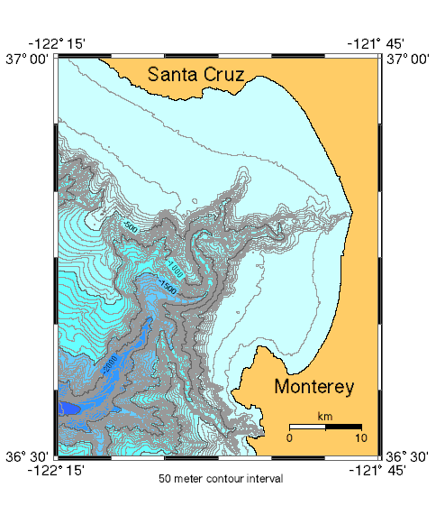
And offshore wind is finally plausible off our western coasts:
There, ocean depths plunge due to plate tectonics
For instance, in Monterey Bay
the 50 meter depth contour
is typically only 3-7 km offshore
vs. 75 to 100 km offshore on our east coast!
Fixed-base wind turbines would thus
have to be extremely close to shore
But the Hywind-Scotland type floating wind farms remove that restriction
And floating wind farms are thus being proposed well off western shores, including: ¹
A 60-100 turbine, up to 1000 MW total capacity, floating wind farm
53 kilometers (33 miles) off Morro Bay in central California ^{1, 2}
And a smaller up to 100-150 MW floating farm off Eureka in northern California ³
https://walrus.wr.usgs.gov/monterey/mbms/indexmap.html
1) https://www.technologyreview.com/s/608128/floating-wind-plan-could-finally-crack-californias-offshore-market/
2) https://www.marinelog.com/index.php?option=com_k2&view=item&id=28822:northern-california-could-be-home-to-first-us-floating-wind-farm&Itemid=257
3) https://www.maritime-executive.com/article/new-offshore-wind-project-planned-for-california#gs.JcOLM6U

Slide 24

(Relevant news articles I've not yet fully researched and/or verified)
"Dominion Energy Plans Major Offshore Wind Farm off Virginia Beach"
Washington Post - 9 September 2019
  "Would be the largest of its kind in the country"
  "220 giant wind turbines on a patch of ocean 27 miles off the coast"
  "Would generate 2,600 megawatts of electricity by 2026"
  "Estimated to cost $7.8 billion"
That WOULD be a BIG deal
It would in be the world's LARGEST offshore wind farm (by some margin): ¹
  Biggest existing: "Walney Extension" UK - 659 Megawatts
  Biggest planned: "Homsea Project 1" UK (completion 2020) - 1218 Megawatts
Might be 1st "green" (wind/solar) plant EVER equaling size of carbon & nuclear plants
1) Wikpedia's "List of Offshore Wind Farms" (and other sources)

Slide 25
Wind Power Economics
&
Energy Return on Energy Invested
An Introduction to Sustainable Energy Systems: WeCanFigureThisOut.org/ENERGY/Energy_home.htm

Slide 26
But can we afford Wind Power?
That can be a complex question. It requires comparisons with other technologies
It may also be that power plant cost is not the major concern, as when the cost
of power is instead dominated by fuel or operational & maintenance expenses
Or the cost of power may be inflated by financing expenses (interest/bond payments)
as can be the case for technologies with shorter operational lifetimes:
e.g., solar & wind (20 years) vs. nuclear (40 years) vs. hydro (100 years)
And those financing costs may escalate for technologies considered high risk,
including nuclear (more because of construction defaults than rare accidents)
or for very young & unproven technologies (e.g., floating wind power)
Hence my whole note set on: Power Plant Economics (pptx / pdf / key)
explaining the Levelized Cost of Energy (LCOE) for alternate technologies
An Introduction to Sustainable Energy Systems: WeCanFigureThisOut.org/ENERGY/Energy_home.htm

Slide 27
Nevertheless, here is a quick overview of Wind Power economics:
(Which really should be followed by study of my full Power Plant Economics (pptx / pdf / key) note set!)
In principle, Levelized Cost of Energy (LCOE) takes into account ALL costs:
Capital, Construction, Fuel, Operation & Maintenance, and Decomissioning . . .
as well as the full financing of all of the above, over the full plant life cycle
It should thus be equal to the power company's breakeven charge for power
LCOEs are stated in terms of $/MW-h, now typically $50 - $200 / MW-h
But we are charged for power in cents/kW-h, typically 10 - 20 cents / kW-h
1 $/MW-h = 100 cents / (1000 kW)-h = 0.1 cents / kW-h
Thus: $50 - $200 / MW-h = 5 – 20 cents/kW-h
Thus, to make a profit selling power to us at 10 - 20 cents/kW-h,
power companies need production LCOE's of $50 - $100 / MW-h
An Introduction to Sustainable Energy Systems: WeCanFigureThisOut.org/ENERGY/Energy_home.htm

Slide 28
We tend to use LCOEs from the U.S. Energy Information Administration
Each year the EIA estimates LCOEs for a dozen or so types of U.S. power
But that estimation is done by economists who, like social scientists,
may not follow (or fully appreciate) ongoing technical development
I (and many others) have come to believe that this can lead to significant errors
Indeed, in the remainder of this note set I'll provide multiple examples of how
re-analysis of some study data has led me to very different conclusions
For the EIA, problems often stem from an over-reliance on U.S. experience:
If we don't now use a technology (e.g., floating wind power) it may be omitted
If we've only one, possibly non state-of-the-art example (e.g., Block Island)
it may become the sole basis for estimating cost of any plant of this type
If we now employ many generations of a technology (e.g., onshore wind),
these are just averaged together ignoring their often major cost differences

Slide 29
Is there an alternative (more expert) source of U.S. LCOE data?
Yes
Lazard.com analyzes the U.S. energy market for U.S. energy companies
This it does (presumably for a substantial fee) about once every two years
They do not release their full reports
But they do release public summaries (typically of 22 pages)
Both recent EIA & Lazard data are in Power Plant Economics (pptx / pdf / key)
This is its summary slide of 2018 EIA and 2017 Lazard data:
An Introduction to Sustainable Energy Systems: WeCanFigureThisOut.org/ENERGY/Energy_home.htm

Slide 30
LCOE's: EIA 2018 vs. Lazard 2017
EIA Lazard
Sequestered IGCC Coal 119.1 143
Natural Gas CC (CCGT) 50.1 42-78
Natural Gas Peaking (OCGT) 85.1 156-210
Hydroelectric 61.7
Nuclear 92.6 112-183
Biomass - no subsidy (subsidized) 95.3 55-114 (40-112)
Geothermal - no subsidy (subsidized) 44.6 (41.6) 77-117 (64-116)
Wind Onshore - no subsidy (subsidized) 59.1 (48) 30-60 (14-52)
Wind Offshore - no subsidy (subsidized) 138.0 (117.1) 113
Solar PV 63.2 (49.9)
Si crystalline PV – utility - no subsidy (subsidized) 46-53 (37-42)
Thin Film PV – utility - no subsidy (subsidized) 43-48 (35-48)
Solar Thermal w/o Storage - no subsidy (subsidized) 237
Solar Thermal w/ Storage - no subsidy (subsidized) 165.1? (126.6)? 98-181 (79-140)

Slide 31
Things to note on that slide:
Onshore Wind Power's LCOE is 30-60 $/MW-h
Even acknowledging the above range in LCOE estimates, it is clear that:
Onshore Wind Power is now decidedly cheaper than:
Sequestered coal, Natural gas (peaking / OCGT), Nuclear and Biomass
Its present cost is roughly comparable to:
Natural gas (CCGT), Geothermal, Hydroelectric and utility-scale Solar
But it remains significantly more expensive than:
No other U.S. power source
Which is why more than half of new U.S. power comes from onshore wind!
An Introduction to Sustainable Energy Systems: WeCanFigureThisOut.org/ENERGY/Energy_home.htm

Slide 32
Things to note on that slide (cont'd):
Offshore Wind Power's LCOE is 113-138 $/MW-h
Given that we have ONLY one offshore wind farm (Block Island)
that LOCE likely ¹ represents fixed base / shallow water 6 MW turbines
It's likely not for fixed base offshore 12 MW turbines GE plans to install by 2020,
despite EIA reports being for power sources "coming online five years from now"
It almost certainly does not represent floating wind turbines (of any size)
After all, there is only one barely-year-old floating wind farm in the whole world!
And while the Statoil / Hywind-Scotland video claims that costs have already
fallen significantly from those of their earlier, smaller, single prototype
They concede that Hywind-Scotland will need subsidization for the time being
Elsewhere, they state a 2030 goal of LCOE = 40-60 Euro / MW-h (~ 50-75$) ²
1) The EIA makes it surprisingly difficult to identify exactly which technologies their LCOE estimates are based upon!
2) https://www.equinor.com/en/what-we-do/hywind-where-the-wind-takes-us/our-ambitions-for-hywind.html

Slide 33
But LCOE's evaluate only today's monetary costs
What about longer-term, bigger-picture environmental costs?
One way of evaluating this is to evaluate an energy technology's:
Energy Return on Invested energy (EROI)
= Total lifetime energy produced by a power plant or power source
divided by all of energy EVER put into that power plant/source
for its materials, construction, operation and ultimate decomissioning
Which implicitly assumes that for two technologies producing an amount of energy X,
the one requiring a lower net energy input to do so
stands an excellent chance of having a lower environmental impact
Like LCOEs, EROIs require a lot of input and are thus very difficult to calculate
And those calculations are once again done by economists & social scientists
who may not fully appreciate ongoing technological development

Slide 34
My full exploration of EROI thus again required a full note set: ¹
(Which, again, you really should eventually read in its entirety!)
But here are the highlights of that note set's discussion of Wind Power:
The seminal technology-spanning study of EROI was by Murphy & Hall in 2010
For Wind Power they drew on data from a then new paper by Kubiszewski et al.
They estimated a single EROI that did not differentiate between wind technologies
Murphy & Hall (2010): Wind EROI = 18
Which, rounded up to 20 is still the most commonly cited value
But there was an earlier paper by White & Kulcinski in 1998, instead suggesting:
Onshore wind EROI = 34 vs. Offshore wind EROI = 18
But those data were even then so old as to be considered suspect
Which was perhaps why they were seemingly ignored by Murphy & Hall
1) My note set: Lifetime Energy Output vs. Lifetime Energy Investment (pptx / pdf / key)

Slide 35
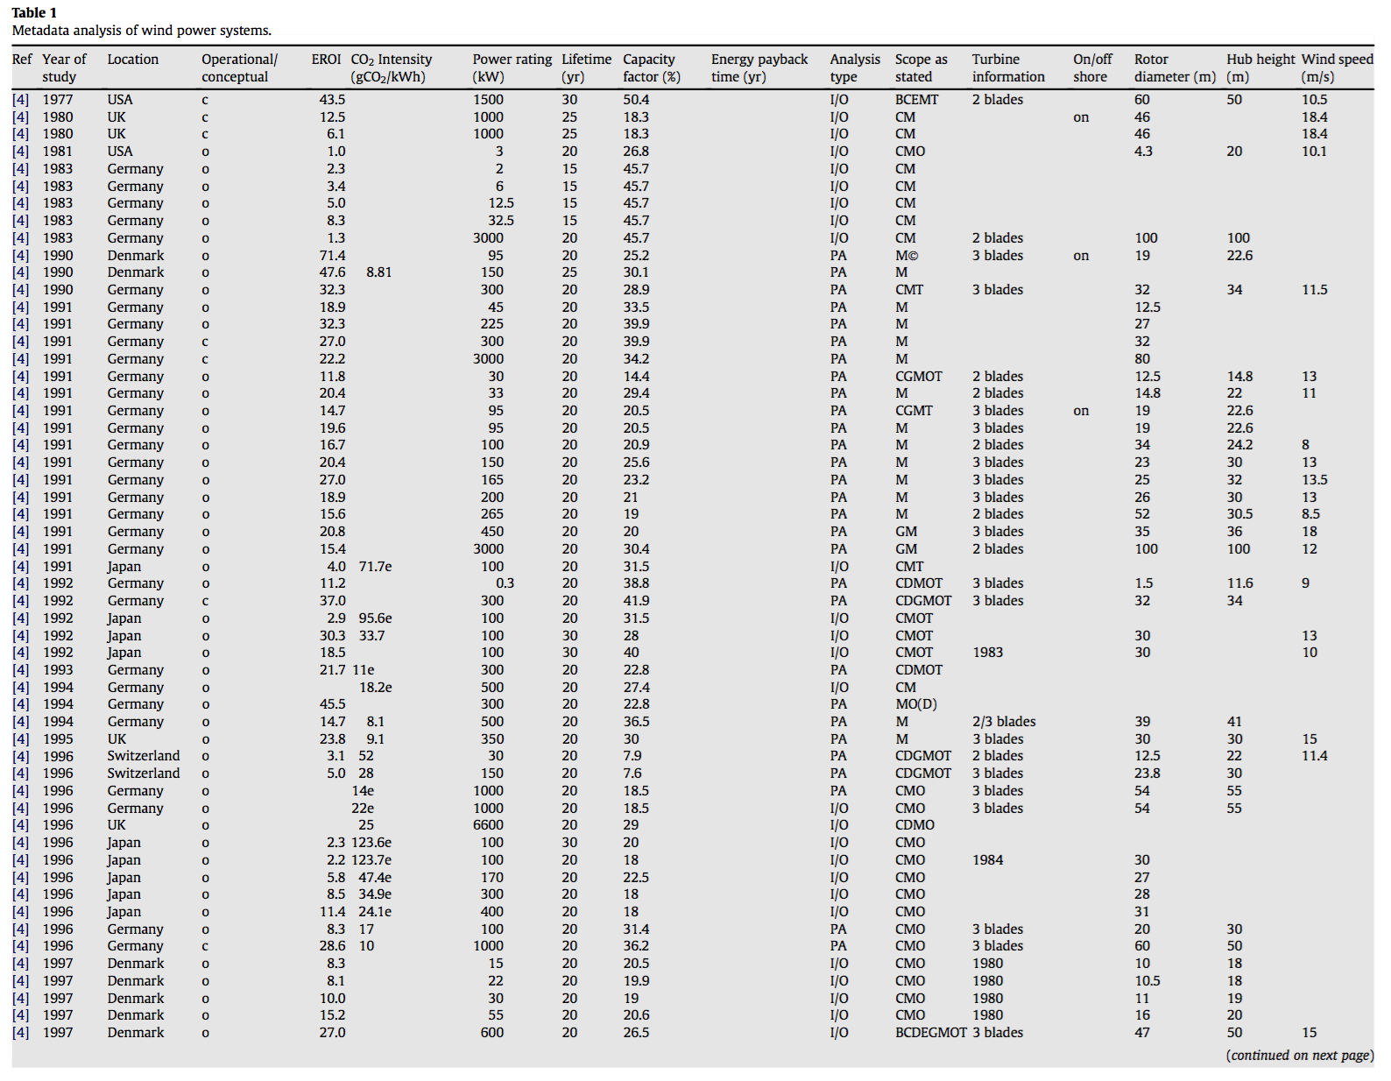
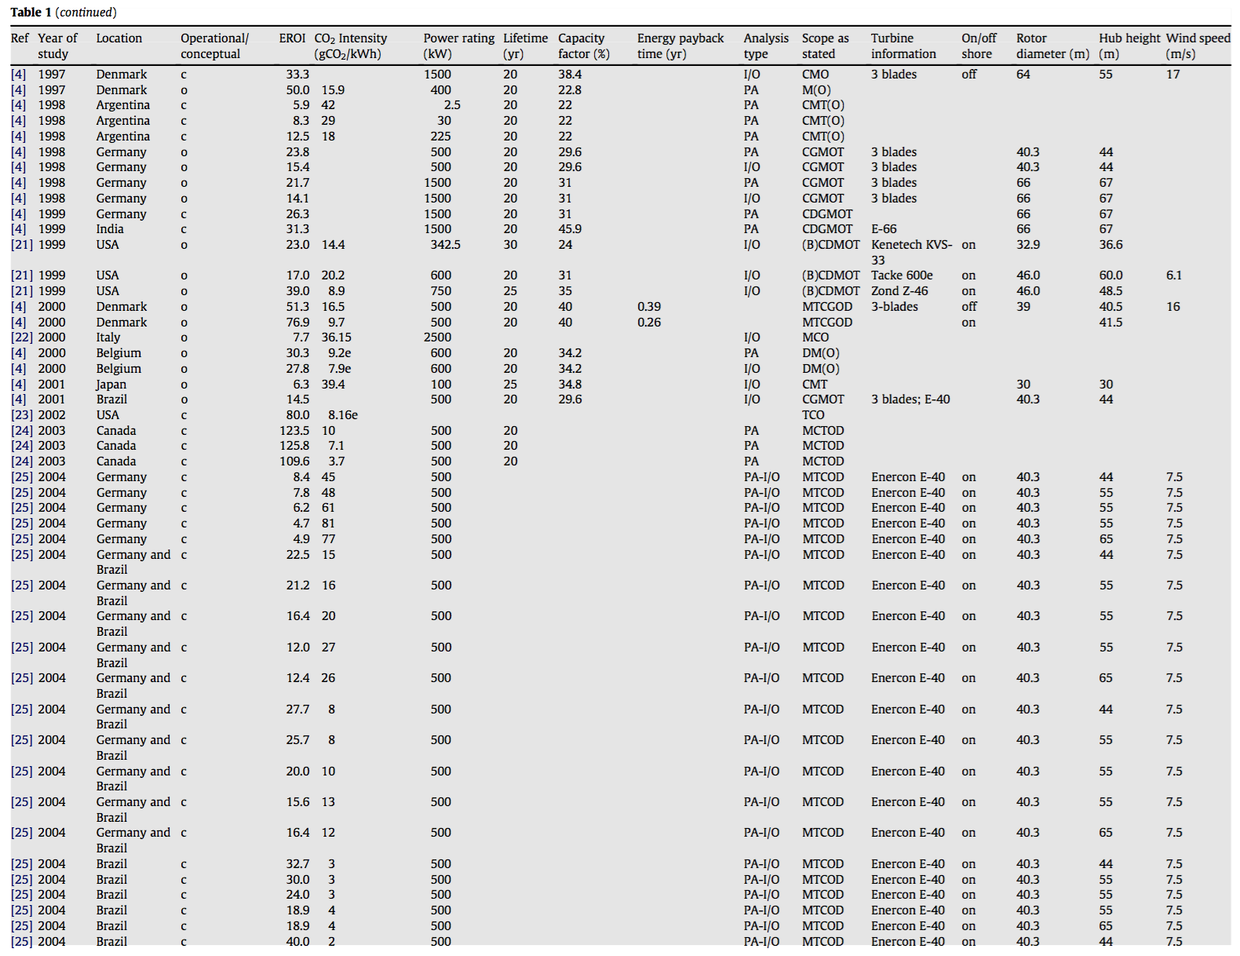
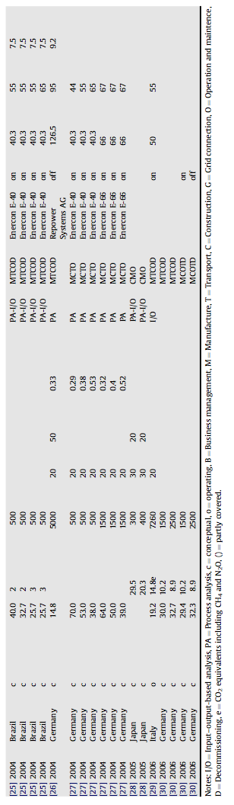
But I decided to dig more deeply into the 2010 Kubiszewski paper:
Which, it turns out, included data on a whole lot of wind power installations:
1) For details & sources see my note set: Lifetime Energy Output vs. Lifetime Energy Investment (pptx / pdf / key)

Slide 36
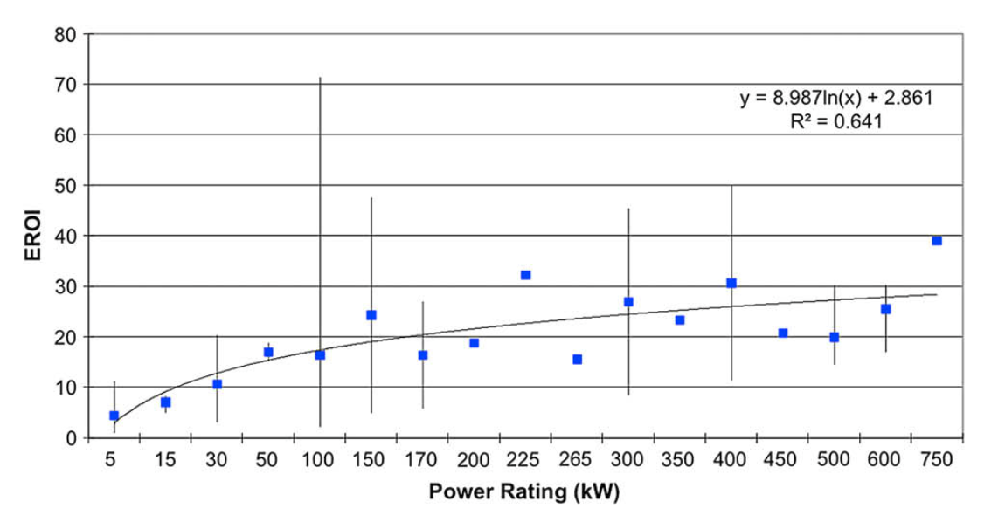
It also included a correlation of EROI with wind turbine power rating:
Small turbines at left => Wind EROI's of 5-20
Almost 1 MW turbines at right => Wind EROI's of 30-40
But these economists & social scientists failed to appreciate the significance
This correlation with turbine power was far more than a curiosity
Given the ongoing technological evolution of wind turbines,
It was effectively a correlation of EROI with the wind turbine's age:
Kubiszewski 2010: Meta analysis of EROI for Wind - Renewable Energy

Slide 37
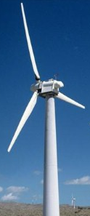
WE know why and how wind turbine power has been increasing:
Wind speed increases with the altitude above the ground
Wind power grows even more quickly (as wind speed cubed)
Making taller turbines much more powerful
But taller turbines also accommodate larger blades
Which, putting this all together, makes taller turbines vastly more powerful
For at least twenty years, this has driven the evolution of Wind Power technology:
Missing this, EROI researchers just averaged wind turbine results together
Which gave the newest turbines (then being installed at wind farms)
far less weight than that of much smaller turbines installed 5-20 years earlier

Slide 38
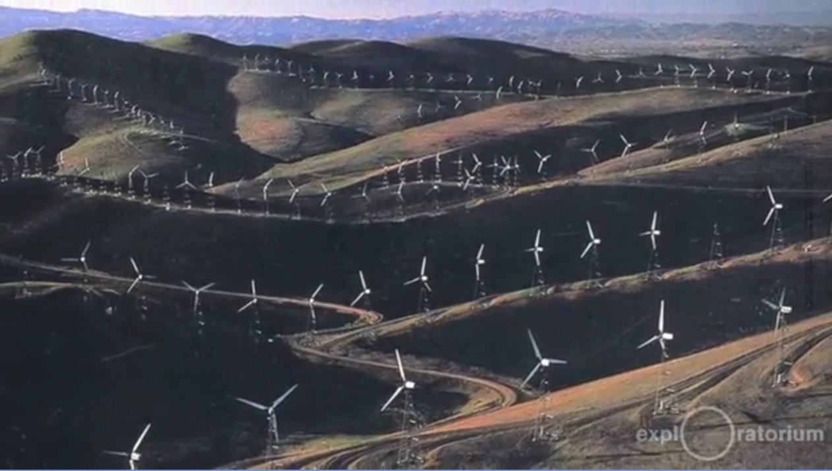
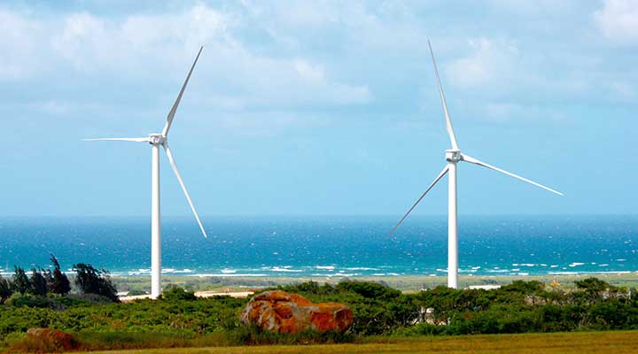
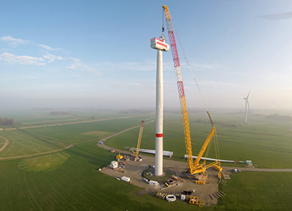
In other words, these EROI studies mixed apples & oranges:
Vintage 1985-1995 ≤ 0.2 MW
wind turbines: EROI = 5-20
Vintage 1995-2005 ≤ 1 MW
wind turbines: EROI = 30-40
Naive averaging thereby yielded the studies' stated Wind Power EROI = 18-20
Despite then current 2010 technology having EROI of ~ 40
Further, the 18-20 figure is still widely accepted & cited because there have yet to be
any widely acknowledged follow-on studies (!!!)
Despite modern turbines now growing to 6 MW
Leading me (and others) to suspect that those
modern turbines likely have EROI >> 40
Left: https://www.youtube.com/watch?v=NfOZjsOaqSQ Right: https://www.nrel.gov/wind/facilities-research.html
Bottom: https://www.siemens.com/press/en/presspicture/?press=/en/presspicture/2014/windpower-renewables/pn201403.php

Slide 39
My bottom line reevaluation of ALL energy EROI's (from my EROI note set): ¹
Technology EROI
Heat from:
Conventional oil 16
Ethanol from sugarcane 9
Biodiesel from soy 5.5
Tar Sands 5
Heavy oil from California 4
Ethanol from corn 1.4
Electricity from:
Hydroelectric Dams 40+
Wind ~ 40
Coal (CC) 2.5-5
Natural Gas (CCGT) 3.5-5
  Solar PV 9, 12, 15, 35
Nuclear 35-40
1) Lifetime Energy Output vs. Lifetime Energy Investment (pptx / pdf / key)
Likely now lower for fossil fuels
and/or overstated for biofuels.
But insufficient new data
to support strong revisions
poly-Si
xtal-Si
α-Si
CdTe

Slide 40
Integration of Wind Power into the Grid
An Introduction to Sustainable Energy Systems: WeCanFigureThisOut.org/ENERGY/Energy_home.htm

Slide 41
Integration of Wind Power into the Grid:
My Magnetic Induction (pptx / pdf / key) note set explains why varying magnetic fields
are essential for the operation of motors, generators and transformers
Power systems were thus designed to deliver oscillating (AC) electrical power,
which almost always originates from something turning the shaft of a generator
That "something" can be a combustion turbine, or a steam, water or wind turbine
The speed of which determines HOW FAST the electrical power oscillates
In the U.S. that oscillation is held at 60 ± 0.067 Hz (cycles per second) ¹
To control a turbine's speed, we control its input flow of fuel, steam or water
But WE CANNOT CONTROL the flow of wind into wind turbines
A simple wind turbine thus tends to produce AC power out of step with the GRID
Yielding, when connected to the Grid: Sparks, heat, fire, smoke (explosions) . . .
1) See my Generic Power Plant & Grid (pptx / pdf / key) note set

Slide 42
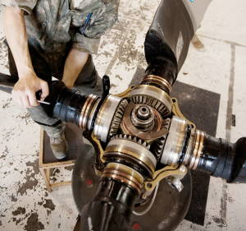
Grid integration thus requires not-so-simple wind turbines
While wind speeds cannot be controlled, we can control turbine blade pitch:
By using the simple gear-driven "pitch control" mechanism
shown here in the hub of a smaller aircraft propeller:
Larger versions of this mechanism were built into the hubs of early wind turbines
The blade pitch was then continuously adjusted such that, in variable winds,
turbines would still rotate at the speed required to produce 60 Hz power
This allowed connection of early turbines to the Grid (w/o sparks, heat, fires . . .)
But speed control required near-continuous adjustment of blade pitch,
which tended to wear out the geared mechanism above,
thereby shortening the wind turbine's operational lifetime
http://www.explainthatstuff.com/how-propellers-work.html
An Introduction to Sustainable Energy Systems: WeCanFigureThisOut.org/ENERGY/Energy_home.htm

Slide 43
Modern wind turbines thus use an even more complex scheme:
Blade pitch is changed only to help start and stop the turbine's rotation
But during normal rotation, the pitch is fixed (at some optimized value)
This minimizes wear and tear on the blade pitch control mechanism,
significantly extending the lifetime of that turbine
But with fixed pitch, the turbine's rotation speed changes with wind speed
That variable rotation is sent (via a geared transmission) to an AC generator
Driven at variable speed, that AC generator produces AC power
with variable frequency, phase & voltage which is NOT Grid compatible
But via new semiconductor device technology, that variable/unregulated AC power
is then converted to DC (non-oscillating) electrical power
Which then, using other new semiconductor devices,
is converted back into AC, but synchronized AC which IS Grid compatible

Slide 44
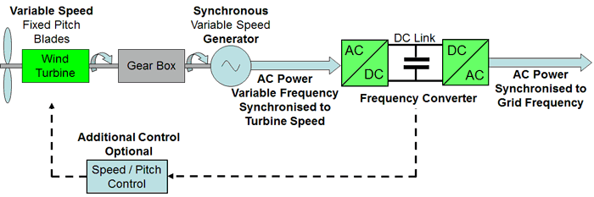
The resulting circuit diagram/circuit looks something like this:
Where the green AC/DC and DC/AC boxes are the semiconductor-based converters ¹
Not shone here is a critical connection from the Grid into the frequency converter
  That connection tells the converter the Grid's precise frequency and phase
    Allowing the converter to synchronize its wind-driven AC output to the Grid
      Note: Grid synchronization circuits similar to this played a role the
      2016 South Australian Grid blackout (as will be described shortly)
Semiconductor circuits also convert solar cell's DC output into Grid compatible AC
  As detailed in (for wind and solar): Renewable Distributed Grid (pptx / pdf / key)
1) Figure & details are from an excellent wind power tutorial in MPOWERUK.COM's "Electopaedia"
https://www.mpoweruk.com/wind_power.htm

Slide 45
But synchronization is not the only Wind Power integration issue:
Because wind's power increases as its velocity cubed,
we really want to generate wind power where wind speeds are fastest,
which is off our northern coasts, or (for the U.S.) on our Midwestern plains:
We would then need to transmit that power to our population centers
which are hundreds, if not thousands, of kilometers distant
But, from Magnetic Induction (pptx / pdf / key) & Generic Grid (pptx / pdf / key) notes:
AC power cannot be efficiently transmitted over such distances!

Slide 46
Large scale use of Wind Power will thus additionally require:
An almost entirely new, ultra-high-voltage DC power transmission system
And if this were not enough, if/when we come to rely upon wind (or solar) power,
we will also have to confront their natural daily cycles,
and the fact that they do not produce power when we most want it
Which will inevitably require the development & massive deployment of new
Energy storage systems (see Power Cycles & Energy Storage (pptx / pdf / key))
Typical wind power
Typical summer/winter solar power
100%
100%
Midnight
Noon
Midnight
Midnight
Noon
Midnight

Slide 47
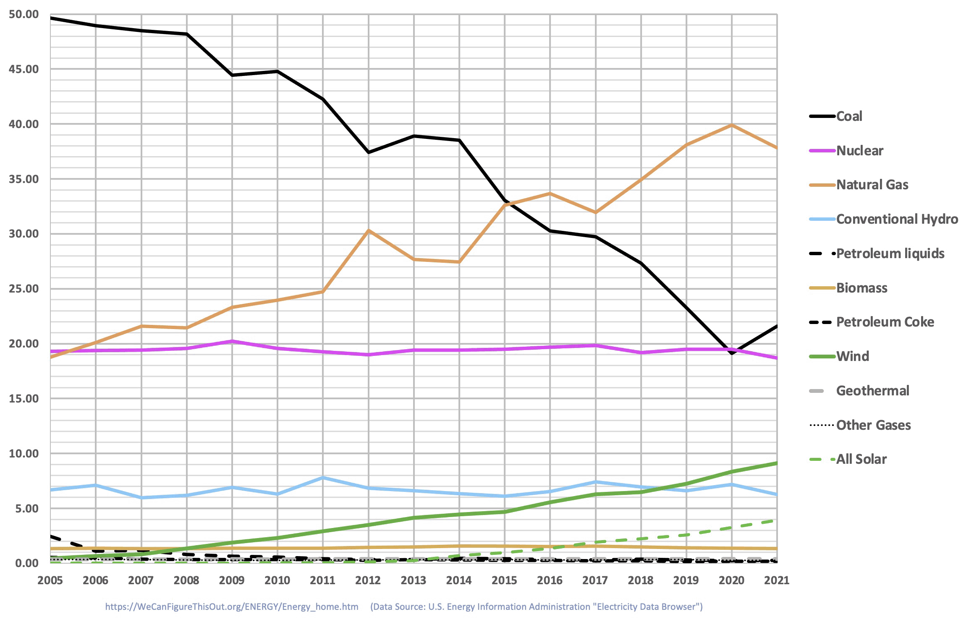
In the U.S. we've avoided those integration challenges . . . thus far
Why? Because wind + solar power still account for < 10% of our total power,
allowing us to use other power technologies (often older, dirtier . . .)
to fill in for wind & solar's shortcomings and/or special requirements
How long can we continue to get away with this? Experts say the crunch will come
when wind + solar power grow to contribute ~ 15-20% of our Grid's total power
From U.S. Power Production (pptx / pdf / key):
and with wind's accelerating growth,
our crunch likely comes by 2030
An Introduction to Sustainable Energy Systems: WeCanFigureThisOut.org/ENERGY/Energy_home.htm

Slide 48
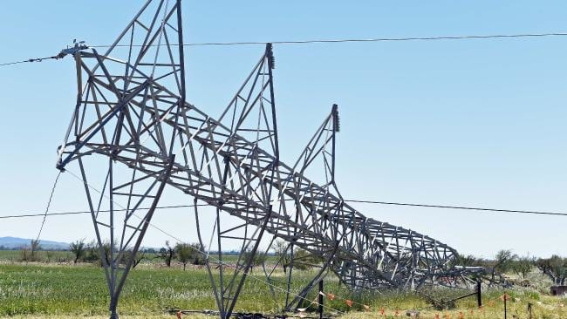
Bringing us to news headlines such as this:
"Australia Has Serious Problems with Green Energy Triggering Blackouts" ¹
Which referred to the Southern Australia (SA) Grid blackout of 28 September 2016
That day a "once in 50 year" storm produced 190-260 kph winds, including two
"almost simultaneous tornados" 175 km apart which knocked out (and down)
three different high-voltage long-distance power transmission lines ²
Within two minutes, their loss caused the SA Grid voltage to dip a half dozen times
Those dips caused power stations to disconnect themselves from the grid,
a standard fully-automatic means of protecting them from damage
Those power stations included a large number of new wind farms
1) http://dailycaller.com/2016/11/23/australia-has-serious-problems-with-green-energy-triggering-blackouts/
2) https://www.aemo.com.au/-/media/Files/Electricity/NEM/Market_Notices_and_Events/Power_System_Incident_Reports/2017/Integrated-Final-Report-SA-Black-System-28-September-2016.pdf
Picture: https://www.news.com.au/technology/environment/final-report-reveals-the-causes-of-south-australias-statewide-blackout/news-story/d5499231749c6a858cdc3b4a78f5c7e1

Slide 49
But while those power plants were protecting themselves:
Other fully automatic Grid switches began attempts at "load shedding"
That is, to cut off progressively more of the Grid's customers until
power demand fell to a level that the remaining power plants could supply
"Which power plants, I thought they'd all cut themselves off from the Grid?"
But power plants try (very briefly) to re-connect themselves to the Grid
If load shedding has succeeded in cutting demand to a level they can then supply
normal voltages are sustained and the power plants remain connected
But if voltages do not stabilize, the power plants disconnect themselves again
And after a specified number of failed attempts, they remain disconnected
All of this occurs, fully automatically, within tens of seconds
If successful, at least some customers then get power from some power plants
Allowing human beings to begin work on restoring the rest of the Grid

Slide 50
Wind (tornados) started the problem - But why was Wind Power blamed?
Because of something that happened at some of those new wind farms
Eight of them were programmed to attempt reconnection 9 times
Before the 9th attempt, Grid voltage stabilized and they remained connected
But a larger number of wind farms were programmed for fewer attempts
Those wind farms reached their limits before Grid voltage could stabilize
And those wind farms thus ceased further reconnection attempts
The sustained loss of their power was the "last straw" that finally caused a
connector siphoning power from the neighboring Victoria Grid to exceed its limits,
causing it to shut off that emergency power supply, crashing the SA Grid
An Introduction to Sustainable Energy Systems: WeCanFigureThisOut.org/ENERGY/Energy_home.htm

Slide 51
Cue the blame game / Enter the opportunists:
Both AEMO (the responsible power authority) and independent authorities
soon initiated in-depth investigations of the event ^{1, 2}
But long before their studies could be completed, politicians rushed in: ³
Australia's Deputy Prime Minister Barnaby blamed wind power for the blackout
Prime Minister Turnbull faulted state governments for neglecting energy security
An SA senator supportive of renewable energy faulted an overreliance on wind
A Queensland senator demanded an end to all climate change reduction policies
The blogosphere went crazy, including misrepresenting loss of embryos at a
fertility clinic (whose back-up generator failed) as the deaths of newborn infants
And Elon Musk rushed in to claim that his new batteries could have saved the day!
1) https://www.aemo.com.au/-/media/Files/Electricity/NEM/Market_Notices_and_Events/Power_System_Incident_Reports/2017/Integrated-Final-Report-SA-Black-System-28-September-2016.pdf
2) https://www.energynetworks.com.au/sites/default/files/ena_response_to_salc_state-wide_blackout_and_subsequent_power_outages_inquiry_april_2017.pdf
3) https://en.wikipedia.org/wiki/2016_South_Australian_blackout

Slide 52
Eventually, the completed studies painted a more nuanced picture: ^{1, 2}
Blame was assigned to the software at some (but not all) wind farms, which led
power/frequency converters to prematurely abandon reconnection attempts
DEEPER FAULT was attributed to under-appreciated changes in the SA Grid
For over a century worldwide grids have been built around
huge steam or water-powered turbine generators
Those huge turbines literally have huge momentum (angular momentum)
meaning that even when disconnected from their grid, they will only
very slowly drift off the rotational speed required for 50 or 60 Hz power
That means that when a grid has been damaged and is attempting to repair itself,
power plants can still be disconnected and reconnected as needed,
for seconds or even minutes, without worrying about re-synchronization
1, 2) See first two references on preceding page

Slide 53
But the SA Grid had retired virtually all of its huge turbine power plants
They were replaced largely by wind farms and gas turbine plants
Wind turbines DO have momentum, but their modern use of power converters
de-couples the blade momentum from the frequency of their power output
Small gas turbines (a.k.a. jet engines) lack the momentum of huge steam turbines
Thus:
Neither technology (green or non-green) clings to synchronization
This lack of essentially built-in power plant to power plant coordination inhibited
the damaged SA Grid's ability to disconnect and then reconnect power plants
It was also found that it critically slowed that Grid's automated process
of load shedding, which might otherwise have limited the blackout's extent
An Introduction to Sustainable Energy Systems: WeCanFigureThisOut.org/ENERGY/Energy_home.htm

Slide 54
Finally, reports faulted the "skinnyness" of the SA Grid: ¹
An old-school grid is fat in the sense that it consists largely of a
few big central power plants sending power to local/near-local customers
If one radiating line is damaged, only customers down that line loose power
But a skinny grid (a.k.a. a distributed grid) is a much more complex web
linking together a much larger number of much smaller power plants
In such a grid, the local power plant may not be able to supply 100% of local power
Which is acceptable if supplemental power is reliably available from distant plants
Connectivity is essential in renewable/skinny grids, allowing them to deal with
a wind farm's temporary loss of wind, or solar farm's temporary loss of sun
(Longer daily cycles require non-renewable energy or massive energy storage)
1) https://thediplomat.com/2016/10/south-australias-blackout-blame-game/

Slide 55
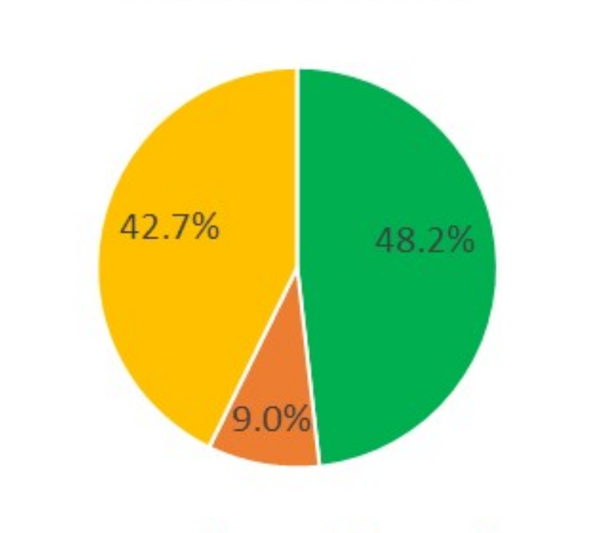
The Southern Australia Grid was exceptionally renewable & skinny:
Serving a population of ~ 1.7 million residents ¹ (~ same as the city of Philadelphia) ²
Its grid was then ~ 52% renewable: ³
With overall power then being provided by: ⁴
Solar = Then only via private rooftop installations
Wind = 36 wind farms averaging 98 MW
Gas = 1 large 1.3 GW gas-fired steam plant
+ 1 small 58 MW gas-fired steam plant
+ 12 gas turbines averaging only 140 MW
Which, if I've done the math correctly, is 1 power plant or farm per 34,000 residents
Wind
Gas
Solar
1) https://en.wikipedia.org/wiki/South_Australia
2) http://www.citymayors.com/gratis/uscities_100.html
3) https://www.energycouncil.com.au/analysis/south-australias-blackouts-not-as-simple-as-it-looks/
4) https://en.wikipedia.org/wiki/List_of_power_stations_in_South_Australia

Slide 56
Bottom line Wind Power integration questions:
Did Wind Power CAUSE the SA Grid blackout? No
Did Wind Power CONTRIBUTE to the SA Grid blackout?
The SA Grid got skinnier (and thus more connection dependent / weather vulnerable)
by closing a few huge central coal power plants and replacing them
with a much larger number of much smaller
non-green gas turbine plants AND green wind farms
Further, dumb software errors are much more likely in any new technology
which, in this case, was Wind Power technology
Considering all of this, it would seem disingenuous to say Wind Power played no role
Renewable / Distributed Grids WILL present substantial challenges!

Slide 57
Broader Impacts of Wind Power
An Introduction to Sustainable Energy Systems: WeCanFigureThisOut.org/ENERGY/Energy_home.htm

Slide 58
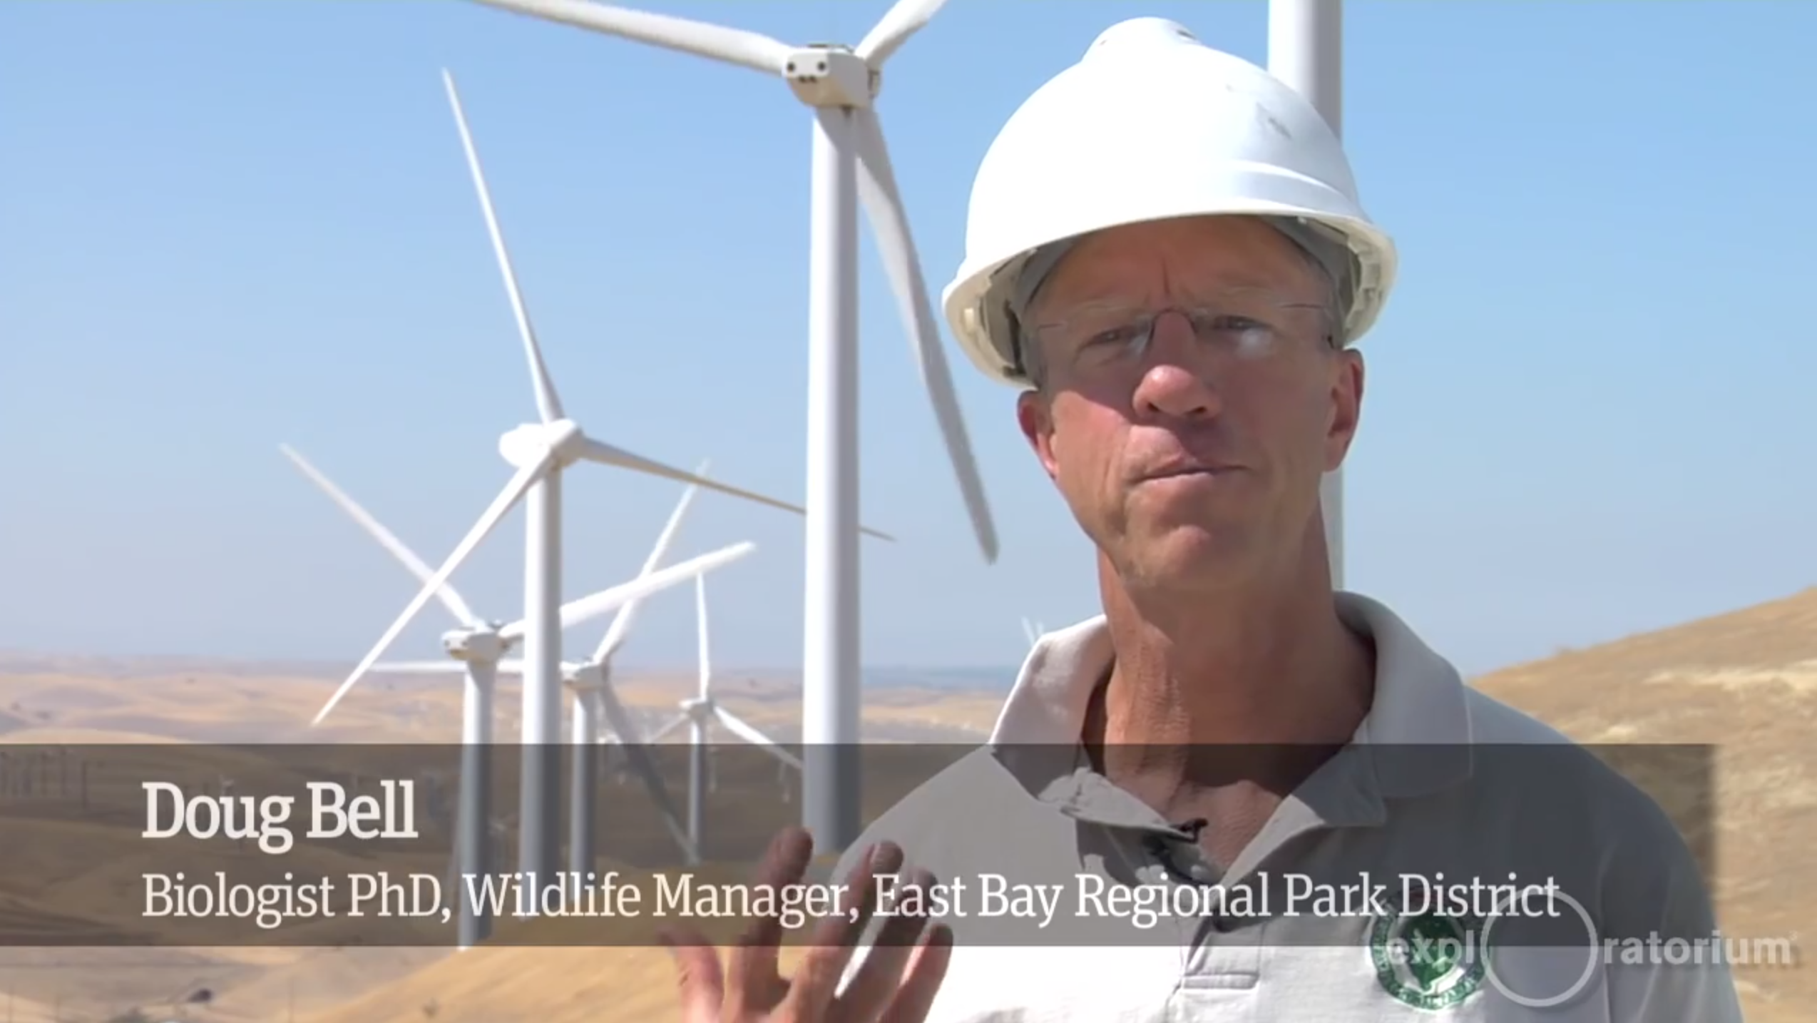
Onshore Wind Power's Bird & Bat Kills
Here's a good introduction from San Francisco's "Exploratorium" Science Museum:
YouTube link to the full video: https://www.youtube.com/watch?v=NfOZjsOaqSQ
(I have also cached an edited version of that video on this note set's Resources Webpage)

Slide 59
Do the numbers support Dr. Bell's cautious optimism?
The first impression is NO: Reported wind turbine bird kills appear to be huge!
Particularly widely reported ¹⁻³ U.S. numbers include:
888,000 bat kills per year
573,000 bird kills per year
83,000 raptor kills per year
Which leads to online news and blog headlines such as these:
"License to Kill: Wind and Solar Decimate Birds and Bats" ¹
"U.S. Windfarms Kill 10-20 Times More than Previously Thought" ³
"How Much Wildlife Can USA Afford to Kill?" ³
1) http://dailycaller.com/2015/04/20/wind-turbines-kill-more-birds-than-bp-oil-spill/
2) http://instituteforenergyresearch.org/analysis/license-to-kill-wind-and-solar-decimate-birds-and-bats/
3) http://savetheeaglesinternational.org/new/us-windfarms-kill-10-20-times-more-than-previously-thought.html

Slide 60
Those numbers come from the abstract of a single research paper:
As published in the 2013 Wildlife Society Bulletin. Its abstract cites: ¹
"888,000 bat and 573,000 bird fatalities/year (including 83,000 raptor fatalities)"
This is a serious in-depth study, but its purpose was not to generate new data
It instead focused on the fact that data exist for only a fraction of all sites
And at these sites it's likely only a fraction of all corpses were found
For a few better documented wind sites the author thus studied factors such as:
Dispersion of corpses by the turbines, prior removal by scavaging animals,
radius from turbine typically searched, effect of terrain upon discovery . . .
Based on those factors he then proposed algorithms for extrapolating counts
to likely full kill numbers (as a function of turbine and terrain parameters)
Comparing Bird and Bat Fatality-Rate Estimates Among North American Wind-Energy Projects – K. Shawn Smallwood - Wildlife Society Bulletin 37(1):19–33; 2013; DOI: 10.1002/wsb.260
http://onlinelibrary.wiley.com/doi/10.1002/wsb.260/abstract

Slide 61
But then, using those derived algorithms, he DID:
Count up the total number of 2013 U.S. wind farms,
noting the turbine types, terrain, etc. at each farm
And he then applied his new algorithms to extrapolate kill numbers,
thus estimating a probable overall kill rate total for combined U.S. wind farms
I carefully studied his full paper AND both of its two web-posted data appendices
(Something I strongly doubt most reporters and bloggers bothered to do!)
Assuming its detailed execution was sound, I found nothing to criticize
However, TWO OMISSIONS can cast a different light upon its conclusions:
First, its wind turbine bird kill data need to be put into context
How? By comparing them with TOTAL U.S. human-caused bat, bird & raptor kills
Data such as this:

Slide 62
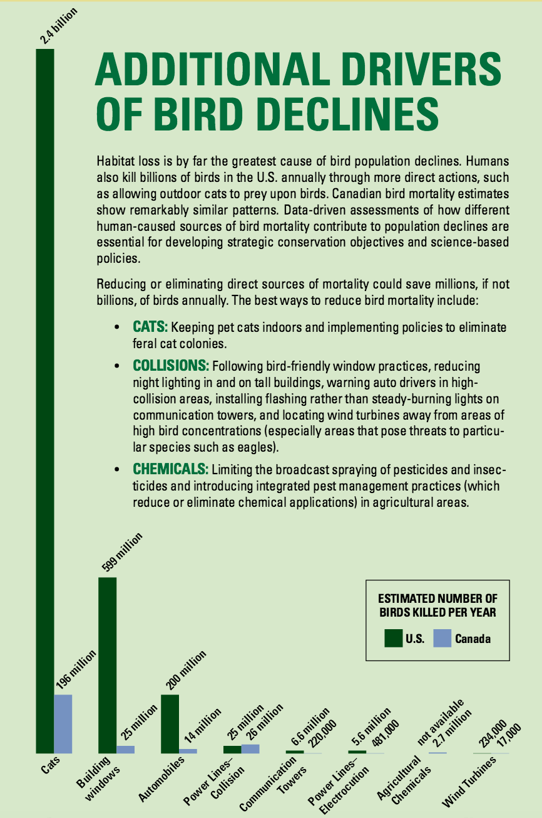
One of the most complete listings of overall human-caused bird kills:
From the "State of the Birds" organization's 2014 annual report:
Cause: Annual U.S. Bird Kills:
Cats 2400 million
Building Collisions 599 million
Auto Collisions 200 million
Power Line Collisions 25 million
Telecom Tower Collisions 6.6 million
Power Line Electrocutions 5.6 million
Agricultural Chemicals N/A
Wind Turbines 0.234 million
Figure from: http://www.stateofthebirds.org/2014%20SotB_FINAL_low-res.pdf
Which incorporates both prior and later published data from Loss et al.:
2012: http://www.nature.com/ncomms/journal/v4/n1/full/ncomms2380.html
2015: http://www.annualreviews.org/doi/abs/10.1146/annurev-ecolsys-112414-054133?journalCode=ecolsys

Slide 63
Thus, while wind turbine bird kills are anything but trivial:
Our CATS kill 10,000 times more birds than turbines
Turbines account for only one in 14,000 U.S. bird kills
Or double that if you instead substitute the research study's
extrapolation of 0.573 (vs. 0.234) million turbine-caused bird kills
The study's 2nd omission is seen in a single phrase within its abstract:
"Adjusted fatality rates correlated inversely with wind-turbine size
for all raptors . . . and for all birds"
But what exactly does the author mean by "wind-turbine size"?
He briefly discusses an inverse correlation with turbine POWER
But he never makes a correlation with turbine HEIGHT
However, his raw data ARE posted in a separate online "Appendix II" ¹
Links to that appendix & my re-analysis of it are given in this note set's Resources Webpage

Slide 64
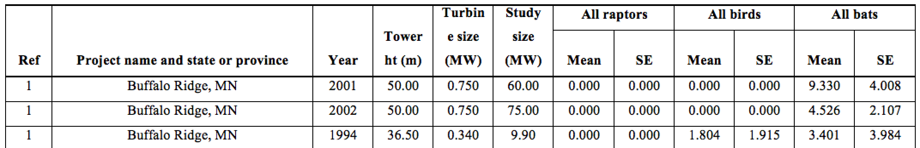
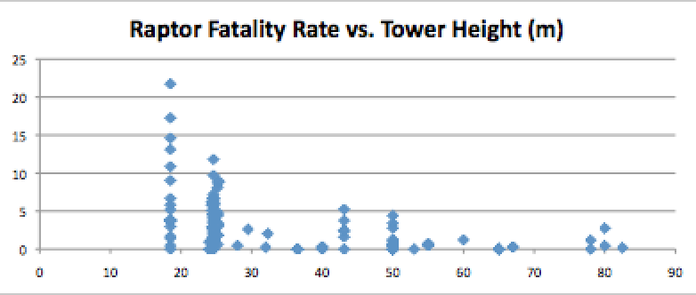
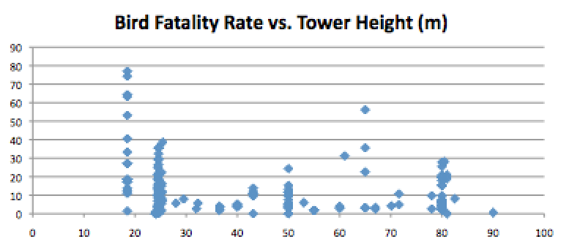
Using those data, I made that correlation with turbine height:
That Appendix II raw data table begins like this:
Throughout this table, raptor and bird rates appear lower for taller wind turbines
Which was suggested by Dr. Bell in the earlier Exploratorium video!
After downloading the paper's Appendix II, I copied it data into Excel,
producing these plots of raptor & bird fatalities versus tower height:

Slide 65
(Again!) WE know why & how wind turbine height has been increasing:
Wind speed increases (and power vastly increases) with height above the ground,
driving strong year-by-year increases in new wind turbine height and power
Most of this study was for old wind farms with turbine towers of < 40 meters
versus modern wind farms with towers ≥ 100 meters (now climbing to 150 m)
By simply correlating this study's raw data with turbine tower height
I find that fatality rates for taller towers are as much as 5X lower!
Further, because large turbines produce more power (again by perhaps 5X)
Kill rates PER MW POWER PRODUCED might be AT LEAST 10X LOWER!

Slide 66
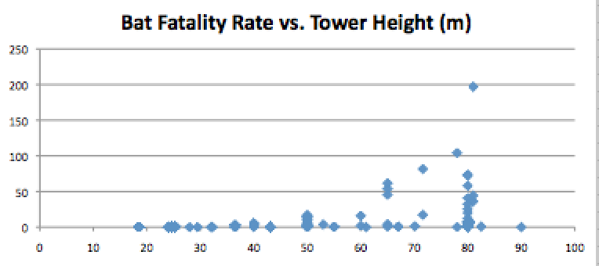

But for bats my correlation suggests that taller towers might be worse:
Then, bizarrely, it was reported ¹ that bats might avoid colored turbines
Why? Because bats (and some birds) are attracted by flying insects,
and insect attraction to color goes as: Yellow > White or Gray > Purple
Which came from the U. Loughborough Ph.D. thesis of Ms. (now Dr.) Chloe Long ²
The Brave New Purple World of wind power?
Or might we just alter turbines' invisible (to us) UV color?
1) http://www.treehugger.com/renewable-energy/wind-turbine-color-makes-difference-in-bird-bat-deaths.html
2) https://dspace.lboro.ac.uk/2134/8041 Figure from: http://www.iconsdb.com/violet-icons/wind-turbine-icon.html

Slide 67
The conclusion of leading avian advocates:
The Audubon Society is probably the oldest and largest U.S. bird advocacy group
They are thus very aware of, and very concerned about, the above bird kills
But they are also very worried about the impact on birds due to
habitat loss (e.g., by corn methanol farming) and climate change
Which led to the "Audubon's Position on Wind Power" which states: ¹
"Audubon strongly supports properly sited wind power as a renewable energy source that helps reduce the threat posed to birds and people by climate change.
However, we also advocate that wind power facilities should be planned, sited, and operated in ways that minimize harm to birds and other wildlife, and we advocate that wildlife agencies should ensure strong enforcement of the laws that protect birds and other wildlife."
Proper siting is essential because raptor deaths can be sharply reduced by
avoiding their often specific, narrow, mountain migration flight paths
1) https://www.audubon.org/content/audubons-position-wind-power

Slide 68
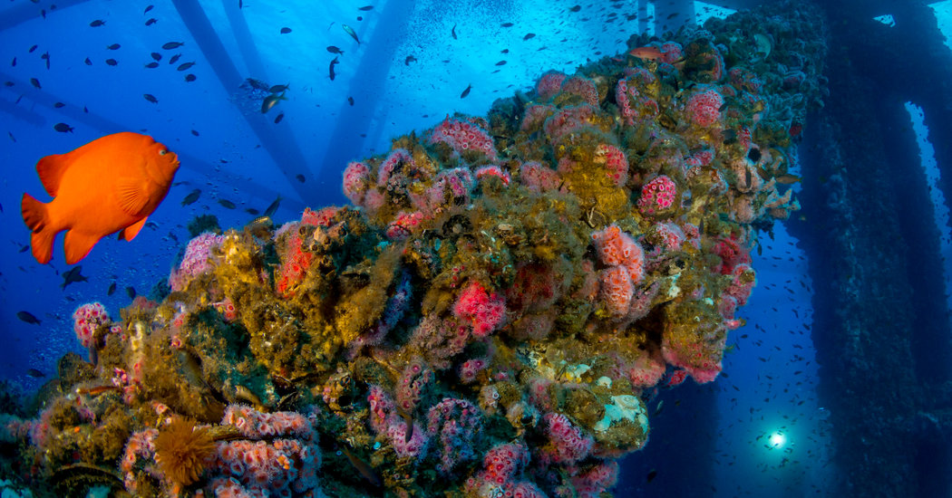
Offshore Wind Power's effect upon sea life
Life IN the seas:
Man has been building ocean oil & radar platforms for at least 75 years
And, of course, our ships have been sinking in those seas for millennia
In the absence of chemical leakage, their impact has been surprisingly favorable:
Mollusks & corals rapidly colonize those hulks, attracting fish and other sea life
See for instance the NY Time's 2016 article & video:
"Marine Life Thrives in Unlikely Place: Offshore Oil Rigs"
NY Times Link
(I have also cached a copy of that article & video on this note set's Resources Webpage)
https://www.nytimes.com/2016/03/08/science/marine-life-thrives-in-unlikely-place-offshore-oil-rigs.html

Slide 69
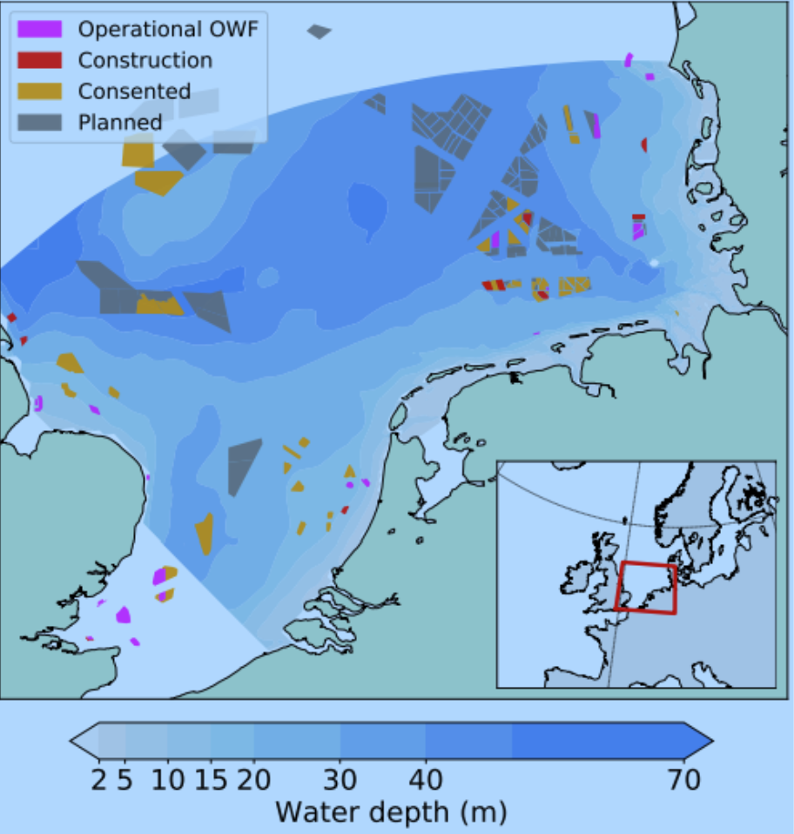
Do offshore wind farms have a similar effect?
A recent study simulated the likely effect of multiple North Sea offshore wind farms ^{1, 2}
It concluded that wind farms could increase the North Sea's
overall blue mussel population by as much as 40%
Filter-feeding mussels makes the water clearer,
increasing "the degree of habitat complexity,
encouraging a higher level of species richness"
But it was noted that rich, new, and isolated environments such as these
might also provide locations for new invasive species to gain a foothold
But that concern should apply equally to offshore oil platforms & wrecks
Suggesting that, while further study is necessary, offshore wind farms
could well reproduce the positive impacts of both oil platforms & shipwrecks
1) 2017 MIT Technology Review news article about the study:
https://www.technologyreview.com/s/608930/first-evidence-that-offshore-wind-farms-are-changing-the-oceans/
2) The 2018 study itself: https://arxiv.org/pdf/1709.02386.pdf

Slide 70
What about life ABOVE the seas (e.g., birds)?
I do not know of studies yet done on possible bird kills due to offshore wind farms
The seminal wind power bird kill study (discussed at length above)
highlighted how difficult it is to assess mortality rates onshore
(e.g., corpses going missing due to scavenging or being hidden in vegetation)
I'd thus assume recovering & counting bird corpses offshore would be ~ impossible
Leaving alternatives such as collecting data on bird migration routes & altitudes
And then constructing probabilistic models of bird / offshore turbine collisions
(But I'd personally doubt the accuracy of such models until they were
also able to account for corpse-verified onshore bird kill rates)
OR one might very, very carefully monitor post-migration bird populations
looking for changes after construction of offshore wind farms in migration paths
(Which would still leave uncertainty as to if wind farms were responsible)

Slide 71
Wind Turbine Noise:
Many research studies have recorded wind turbine noise
and reported on their detailed (and often obscure) sound spectra analyses
Some of these studies have searched for adverse physiological effects
including those which might be produced by ultralow frequency sound
None of the studies that I found claimed to have documented any such effects
But what about the possibly very real psychological impact of wind turbine noise?
I searched for videos that would allow me to judge that for myself
The sound levels in MOST videos SEEMED very, very loud
But those levels were not quantitatively measured,
nor did the videos include other sounds that could have provided a reference,
and electronic noise led me to suspect that audio levels had been jacked up
An Introduction to Sustainable Energy Systems: WeCanFigureThisOut.org/ENERGY/Energy_home.htm

Slide 72
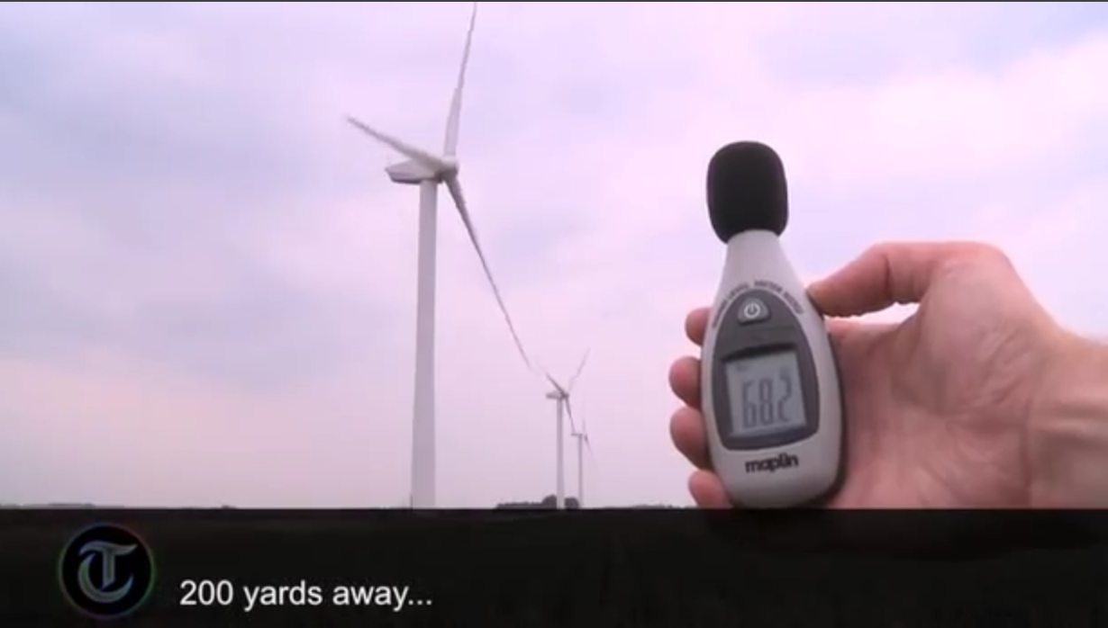
I then found this video recorded by one of Britain's major newspapers
With a Decibel Noise Meter in hand, The Telegraph newspaper visited:
A nature preserve, rural town, London, highway, airport approach & wind farm
This video's loudest message may be about always questioning web-postings!
YouTube link: https://www.youtube.com/watch?v=zKgN2G9d0dc
(I have also cached a copy of that video on this note set's Resources Webpage

Slide 73
NIMBY – Not in My Backyard!
The biggest NIMBY objections to wind power are its noise and visual impact
Neither is a clear cut technical issue, they both invoke personal judgments
Thus (for better or worse) let me now take a very personal approach to NIMBY:
Regarding noise:
Wind Power - Part I (pptx / pdf / key) notes described how the common Danish turbines
operate at blade tip speed ratios (TSRs) of ~ 5, meaning the fastest parts of
their blades move at 5X the ambient wind speed
That note set's maps also showed that faster wind farm winds might move at 8 m/s
which is equivalent to ~ 18 mph (or 29 kph)
Combining those two pieces of information:
Wind farm turbine blade tips typically move at ~ 90 mph (150 kph)
With inner parts of the blades moving at progressively lower speeds

Slide 74
Those speeds & sizes are roughly comparable to freeway traffic
Which is indeed what I believe I heard confirmed in
The Telegraph's exceptionally careful (and honest) video of two slides ago
I live a bit over a kilometer from a freeway (and I am happy for that distance)
but my neighbors living much closer to the freeway do not complain of noise
The above experience + the video's information thus lead to
My personal (subject to possible revision) conclusion about wind turbine noise:
For other than a small number of rural residents who are actually living
within the bounds of an active wind farm (as might occur in the Midwest),
wind farm noise does not appear to be a valid NIMBY objection
An Introduction to Sustainable Energy Systems: WeCanFigureThisOut.org/ENERGY/Energy_home.htm

Slide 75
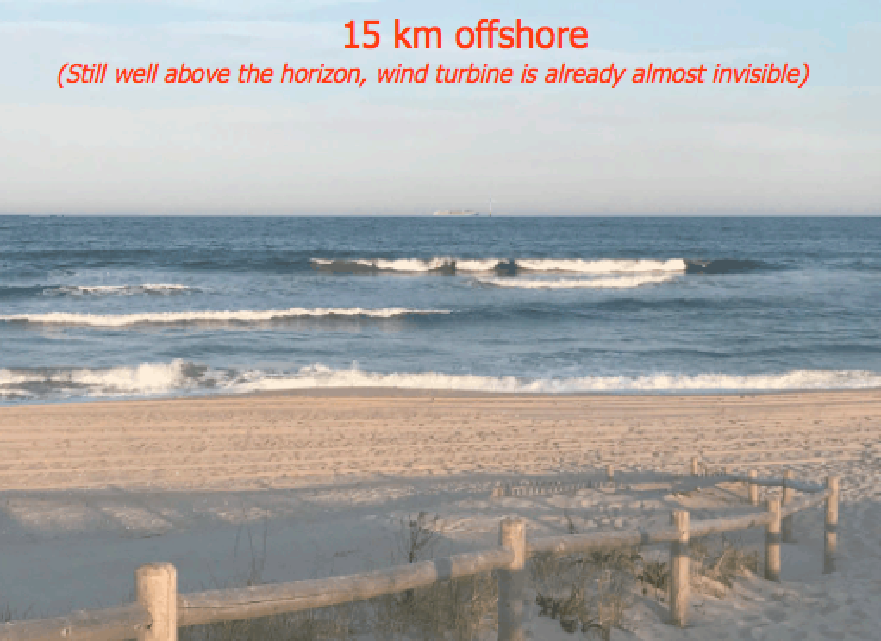
Regarding visual impact:
While I have never lived ON the coast, I grew up within easy driving distance
of some of the west coast's most beautiful ocean vistas
and I thus cherish ocean views, including their clear open expanses
I can thus empathize coastal residents, such as even those on Martha's Vineyard
(even if I never stood a chance of ever living there myself!)
But my horizon calculations & view simulations now convince me that:
Wind farms ≥ 15 km offshore would not significantly compromise such vistas

Slide 76
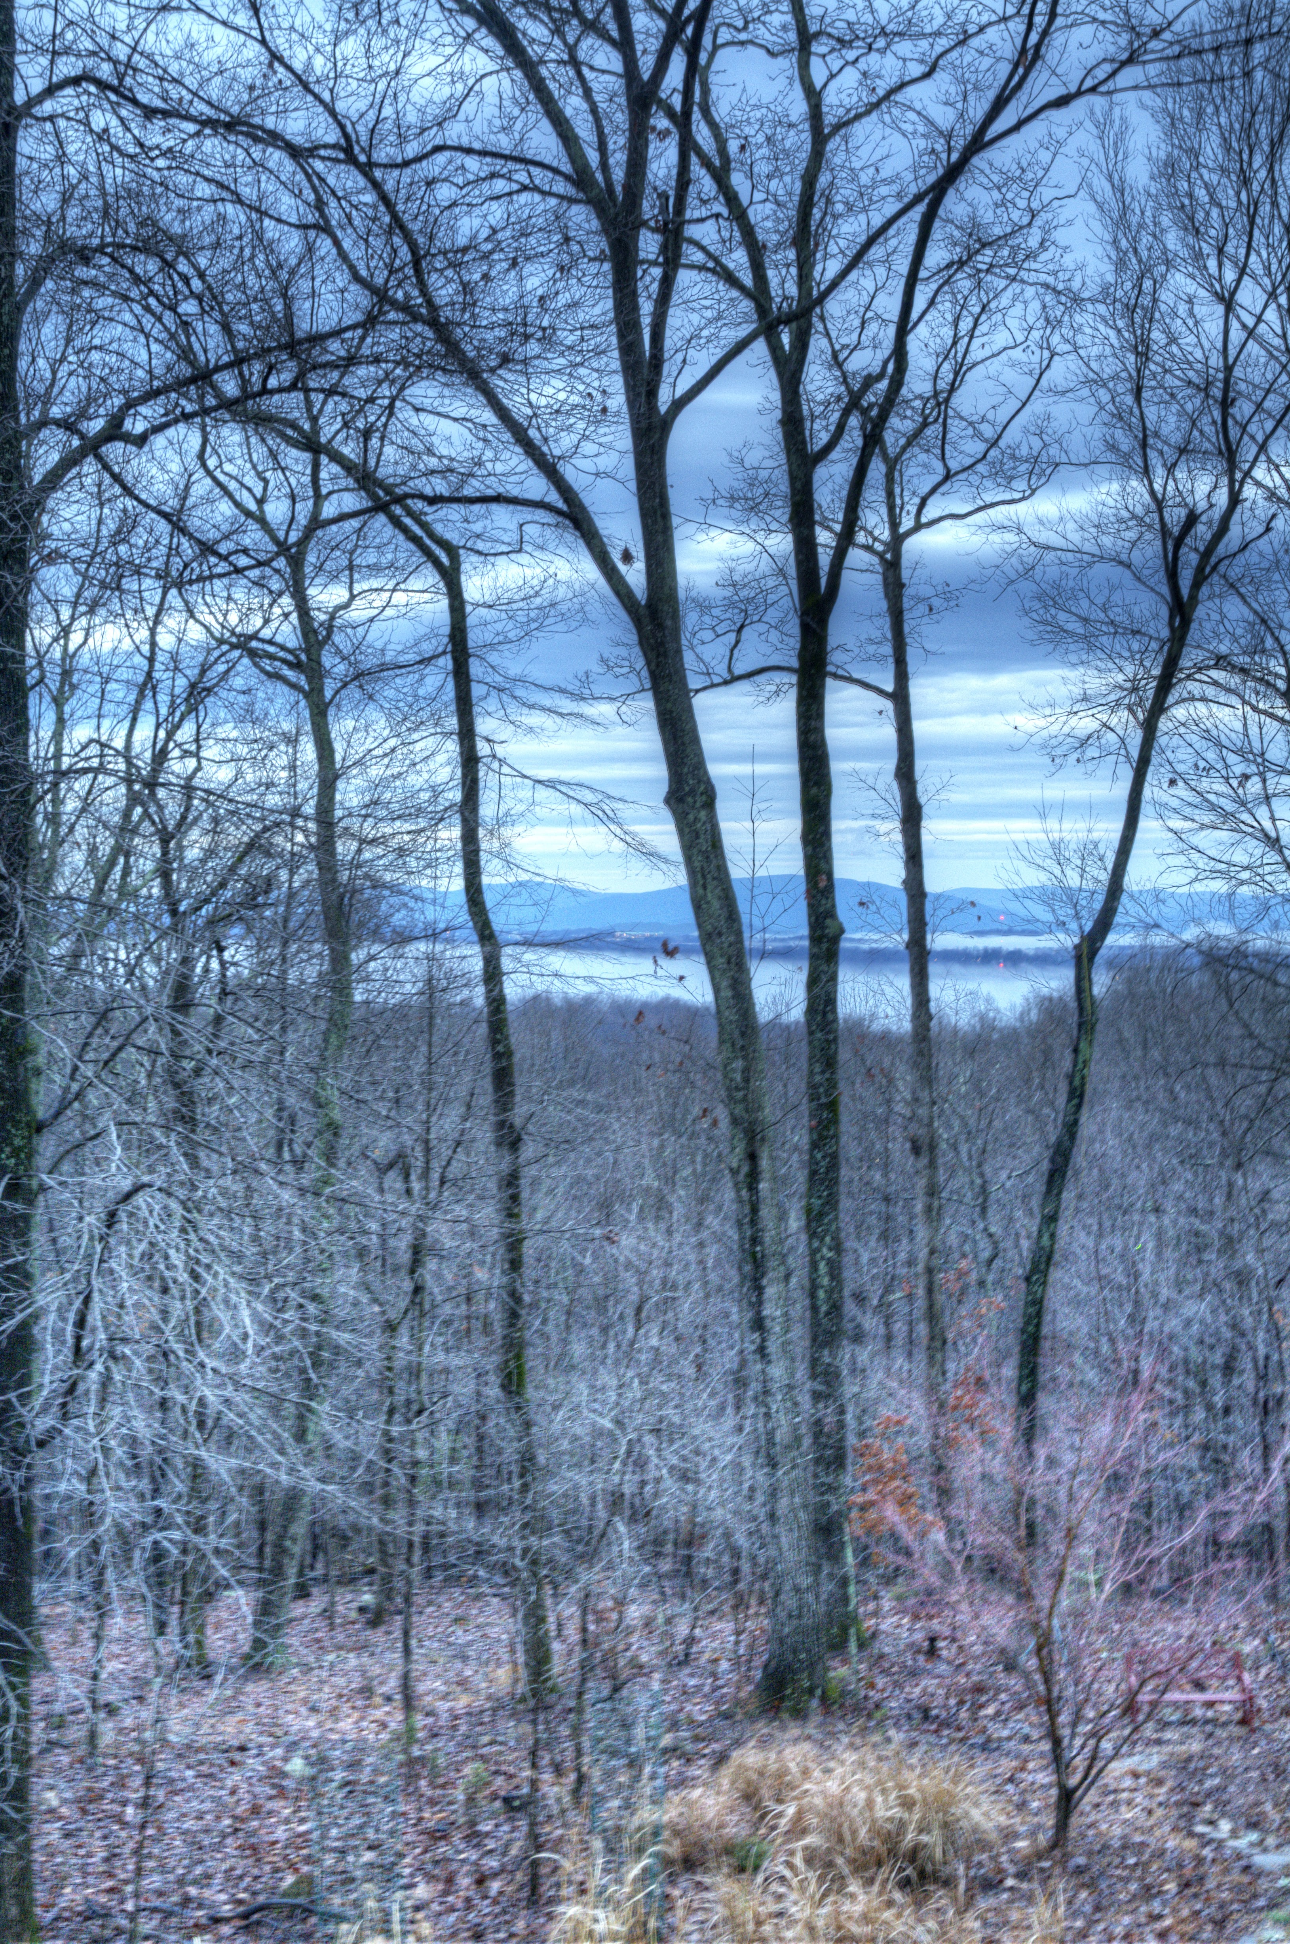

But what about my actual backyard?
My Backyard's Status Quo:
Up Wind: Immediately behind those mountains
is West Virginia, powered ~100% by coal, with
coal's air pollution restrictions now being slashed!
Down Wind (hopefully): Two 40 year old
nuclear reactors, now passing their design
lifetime, but continuing to operate because their
modern safer replacements are in political limbo!
My Backyard's Possible Future (swap the images):
Wind turbines intruding upon my view?
Given the alternatives, I could live with that
(Power can't ALL come from "elsewhere!")
PgUp
PgDn
Turbine pair (4 km distant)
Without wind turbines
But here in Virginia, offshore wind power WOULD be immensely more productive!

Slide 77
Credits / Acknowledgements
Some materials used in this class were developed under a National Science Foundation "Research Initiation Grant in Engineering Education" (RIGEE).
Other materials, including the WeCanFigureThisOut.org "Virtual Lab" science education website, were developed under even earlier NSF "Course, Curriculum and Laboratory Improvement" (CCLI) and "Nanoscience Undergraduate Education" (NUE) awards.
This set of notes was authored by John C. Bean who also created all figures not explicitly credited above.
Copyright John C. Bean
(However, permission is granted for use by individual instructors in non-profit academic institutions)
An Introduction to Sustainable Energy Systems: WeCanFigureThisOut.org/ENERGY/Energy_home.htm

